Slide 1
2024 November IEEE 802 Plenary Session - Vancouver
Event Summary and Important Information
Prepared by Face to Face Events
Prepared By: Face to Face Events

Slide 2
Meeting Planner Contact Information
Dawn Slykhouse, Face to Face Events
Mobile: +1 (408) 594-1342
Email: dawns@facetoface-events.com
Lisa Ronmark, Face to Face Events
Mobile: +1 (604) 316-4947
Email: lisa@facetoface-events.com
Stephanie Williams, Face to Face Events
Mobile: +1 (408) 497-9613
Email: stephanie@facetoface-events.com
Meeting Planner Office:
Lord Byron, 4th Floor
Sunday November 10th through Friday November 15th
Registration Office:
Queen Charlotte, 3rd Floor
Monday November 11th through Thursday November 14th

Slide 3
Network Access and Support Information
Wireless Interim Session Network
SSID: IEEE802
Password: ieeeieee
This SSID will support all IEEE 802.11 compliant devices using any of the 2.4GHz, 5GHz or 6GHz radio bands.
IEEE 802 Documents: Local Document Server
http://ieee802.linespeed.com/
Onsite Network Support
Members of the Linespeed team can be dispatched by contacting the Meeting Planner directly or by placing a request at the event registration desk.
Linespeed Events Contact Information
Richard Alfvin
Mobile: +1 (585) 781-0952
Email: rick@linespeed.com
Network Office: Constable, 4th Floor

Slide 4
Audio Visual Equipment – Onsite support
WHO TO CONTACT IF AUDIO VISUAL EQUIPMENT ISN’T WORKING IN YOUR ONSITE MEETING ROOM
Please contact the Meeting Planner directly if you have any issues with the audio visual equipment in your meeting room. The Meeting Planner will contact support and the appropriate technician will be sent to assist as soon as possible.
Meeting Planner can be reached at:
Registration and Information Desk: Regency Foyer, 3rd Floor
Registration Office: Queen Charlotte, 3rd Floor
Meeting Planner Office: Lord Byron, 4th Floor
Via Text or Call: Lisa Ronmark: +1 (604) 316-4947, Stephanie Williams +1 (408) 497-9613
WEBEX AUDIO IN THE ONSITE MEETING ROOM
If you are a local participant, PLEASE, select “Don’t connect to audio” when joining WebEx.
Connecting to the audio, may cause an audio interference or a feedback loop that will disrupt the meeting.

Slide 5
Badge Pick Up and In Person Registration
Sunday
Registration Counter, Regency Foyer at Hyatt Regency Vancouver
5:00 PM - 7:30 PM
Monday - Wednesday
Registration Counter, Regency Foyer at Hyatt Regency Vancouver
7:30 AM - 5:00 PM
Thursday
Event Office, Lord Byron, 4th Floor, Hyatt Regency Vancouver
8:00 AM - 5:00 PM

Slide 6
IEEE 802 Mixed Mode Orientation
Sunday November 10, 2024
2:30 PM Pacific Time
WHO: IEEE 802 WG Session Leaders (and all others interested)
WHAT: IEEE 802 Mixed Mode Meeting Orientation
How to run and participate in a mixed mode meeting that is part of the 2024 September IEEE 802W Interim
WHEN: Sunday 10 November, 2:30 PM Pacific Time
WHERE: Onsite Meeting Room: Plaza C - Plaza Level, 2nd Floor
WebEx Link: https://ieeesa.webex.com/ieeesa/j.php?MTID=m1c25997f3a8ecbcbc0144ab816d818b9
WebEX Meeting Number (access code): 2333 729 4068
Meeting password: training
see IEEE 802 Calendar https://ieee802.org/802tele_calendar.html
REGISTRATION FEE: Registration for the IEEE 802 Wireless Interim Session (with fee) is required,
whether attending in-person or remotely. Registration Link: https://cvent.me/eDZgoD

Slide 7
Schedule of Meetings and Attendance
In Person Room Assignments: Schedule QR codes posted outside each meeting room and on back of your badge. http://schedule.802world.com/schedule/schedule/show
Virtual Participation details: https://ieee802.org/802tele_calendar.html
ATTENDANCE TOOL (IMAT): https://imat.ieee.org/my-site/home
REGISTRATION FEE REQUIREMENT REMINDER
Payment of the session registration fee is required for all individuals who participate in any meetings associated with the 2024 November IEEE 802 Plenary Session.
Registration Link: https://cvent.me/eDZgoD

Slide 8
Meeting Rooms for 802.1, 802.3, 802.11, 802.15
802.1
Georgia A - 2nd Floor
US22+1LCD/S+1TM+2WM+SBD
Plaza A - 2nd Floor
SR50+1LCD/S+3HT/2TM+2FM+SBD+SP
Plaza B - 2nd Floor
SR80+1LCD/S+3HT/2TM+2FM+SBD+SP
802.3
Balmoral - 3rd Floor
SR75+1LCD/S+HT4+2TM+1FM+1WM+SBD+SP
Regency EF - 3rd Floor
SR162+2LCD/S+HT6+2TM+2FM+2WM+SBD+R
Regency E - 3rd Floor
SR81+1LCD/S+HT2+1TM+1FM+2WM+SBD
Regency F - 3rd Floor
SR81+1LCD/S+HT2+1TM+1FM+2WM+SBD
Windsor 3rd Floor
BR20+1LCD/S+1TM+2WM+SBD
802.11
Plaza C - 2nd Floor
US30+1LCD/S+1TM+2WM+SBD
Prince of Wales - 3rd Floor
SR45+1LCD/S+3HT+2TM+1FM+SBD
Regency A - 3rd Floor
SR100+1LCD/S+3HT/R+2TM+1FM+SBD
Regency B - 3rd Floor
SR100+1LCD/S+3HT/R+2TM+1FM+SBD
Regency CD
SR280+2LCD/S+4HT/R+2TM+2FM+SBD+R
802.15
Brighton & Kensington - 4th Floor
BR18+1LCD/S+1TM+2WM+SBD
Georgia A - 2nd Floor
US22+1LCD/S+1TM+2WM+SBD
Georgia B - 2nd Floor
SR80+2LCD/2S+HT4+2TM+2FM+SBD

Slide 9
Meeting Room for 802.18, 802.19, 802.24
802.18/.19/.24
Oxford - 3rd Floor SR35+1LCD/S+3HT+2WM+SBD

Slide 10
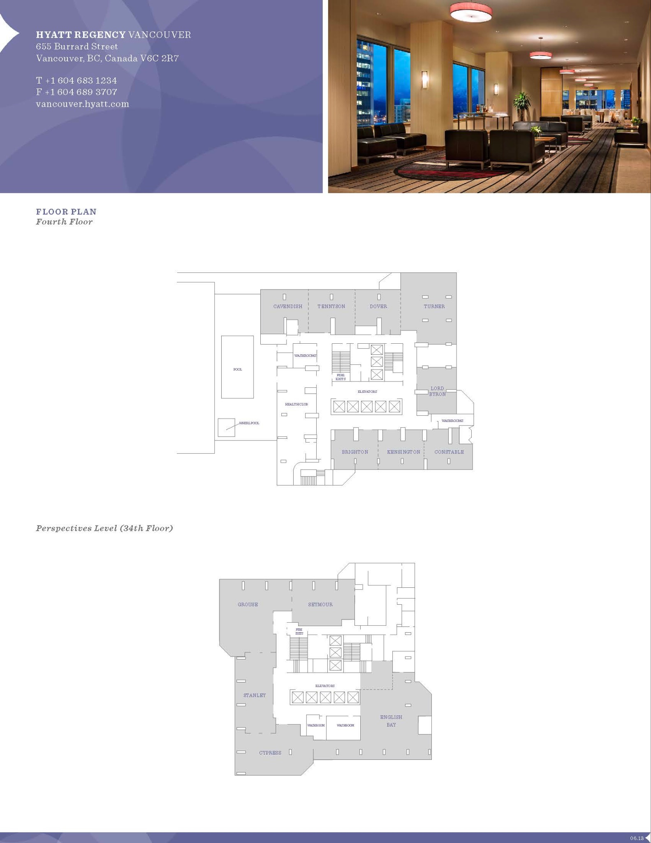
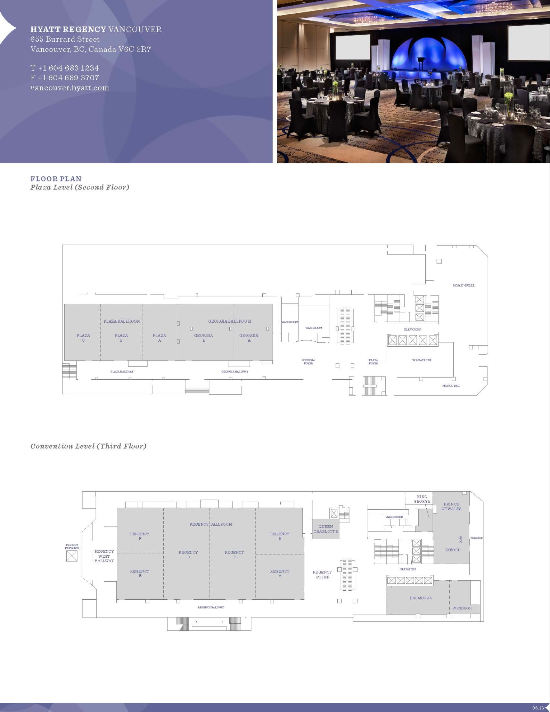

Slide 11
Food and Beverage Breaks
ALL FOOD & BEVERAGE BREAKS ARE FOR REGISTERED ATTENDEES ONLY
Served in the Regency Foyer, 3rd Floor
Light Breakfast
Monday - Friday
7:15 AM - 8:30 AM
Morning Coffee & Tea Break
Monday - Thursday
9:50 AM - 10:35 AM
Afternoon Break
Monday - Thursday
3:15 PM - 4:00 PM
Served on the 34th Floor
Lunch
Monday - Thursday
12:00 PM - 1:30 PM

Slide 12
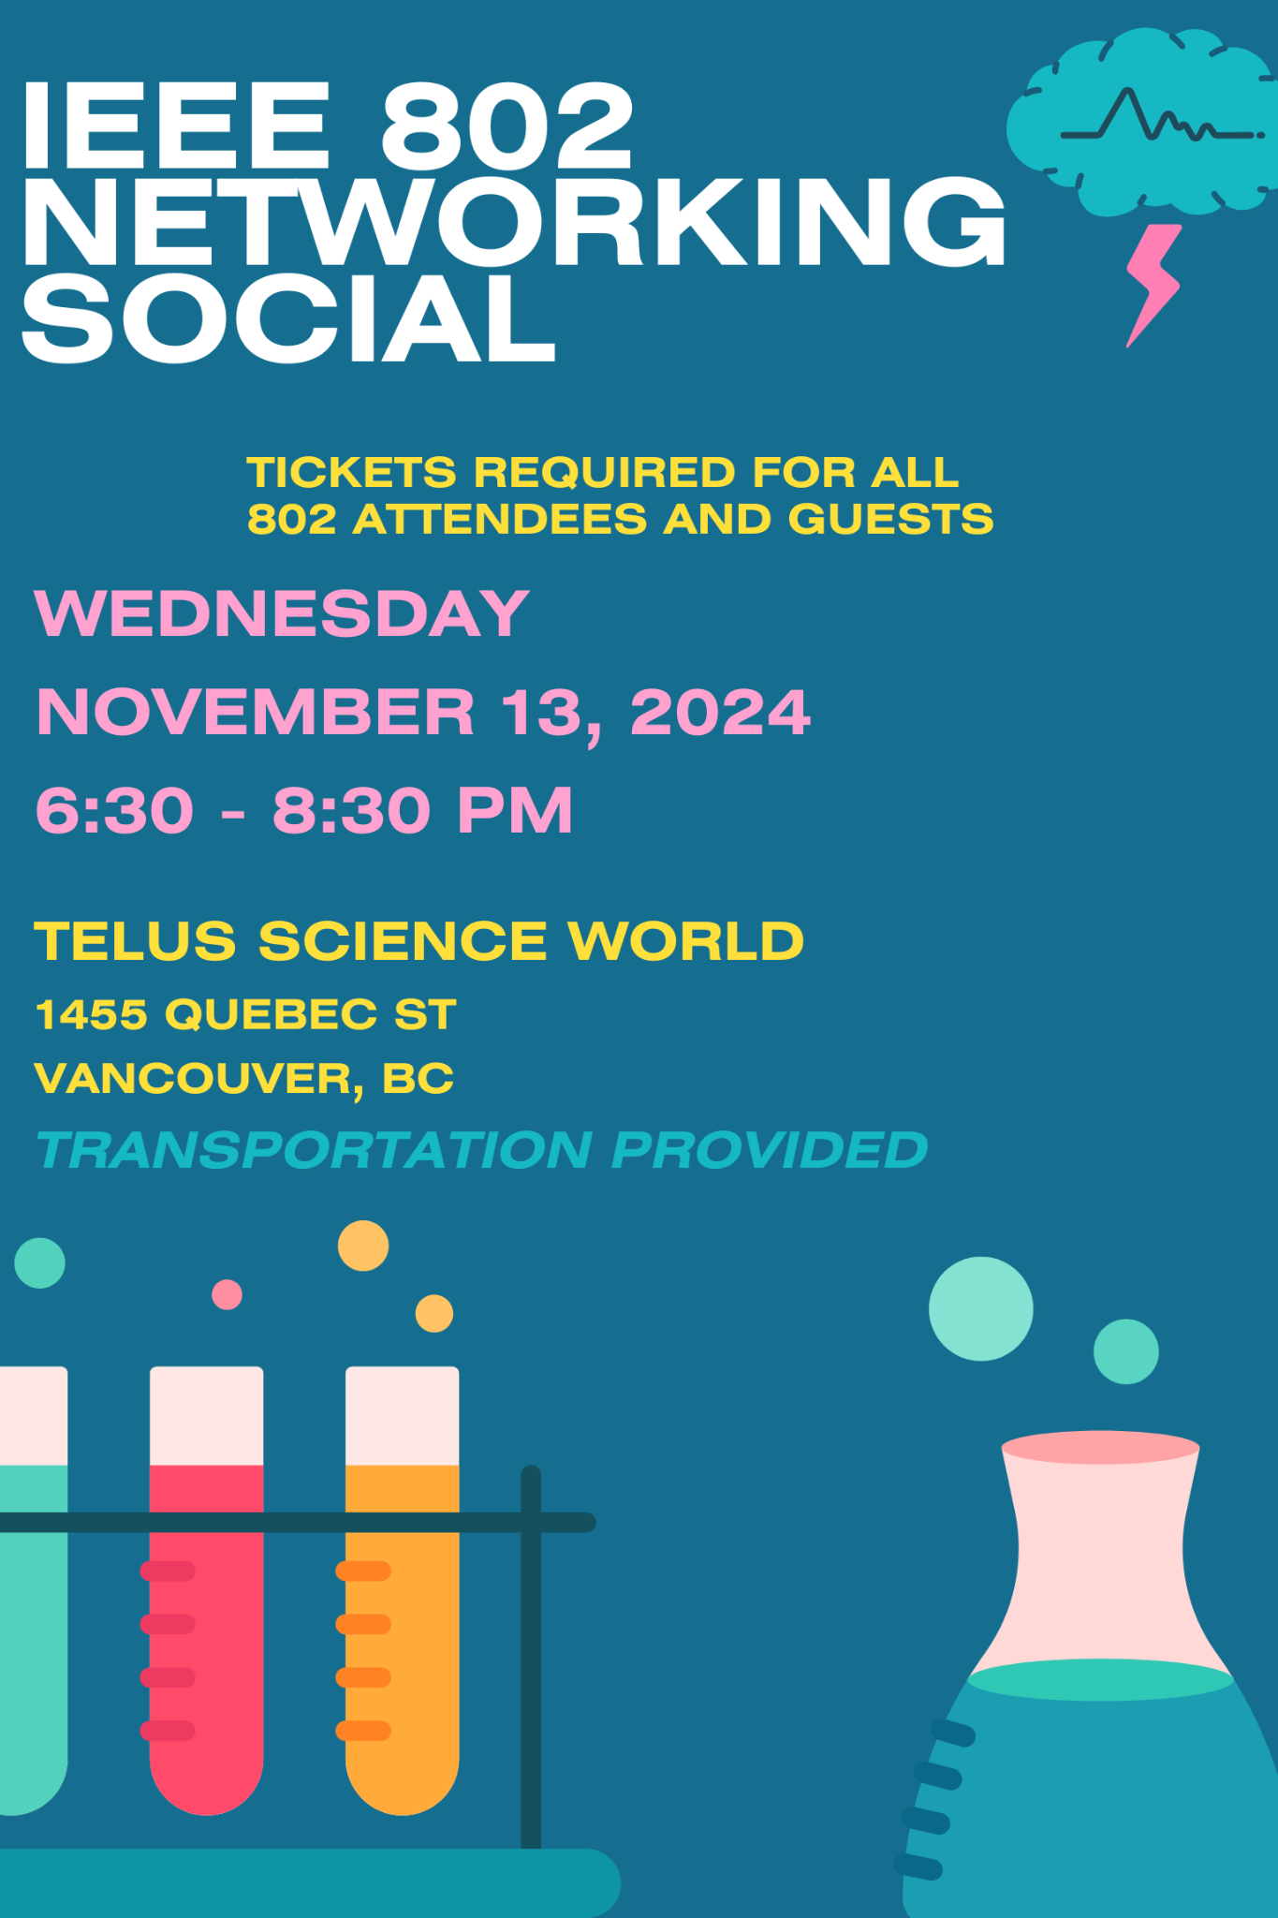
IEEE 802 Networking Social
Wednesday November 13 at 6:30 PM
WHO: Registered Attendee and their Guests who purchased tickets.
WHAT: Networking Reception, Food Stations, Bar Service, Science World Exhibits
WHERE: Telus Science World Vancouver
1455 Quebec Street, Vancouver, BC
TRANSPORTATION:Charter busses will depart from and return to the Melville Street entrance (lower level) of the Hyatt Regency Vancouver starting at 6:10 PM.
All Busses will be marked with an IEEE 802 sign and event staff will be at the hotel and Science World to direct you.
SOCIAL EVENT ATTENDEE & GUEST BADGES
Social Event name badge must be worn by All individuals attending the event (attendees and their guests)
Badges must be picked up before 12:00 PM Wednesday November 13, 2024.

Slide 13
Quick Start Guide to Vancouver
The Destination Vancouver website offers detailed information about all things Vancouver, including:
Vancouver International Airport (YVR) - Guide and Flight Status: YVR
Getting To/From Airport: Transportation | YVR
General Guide to the Vancouver Region: Destination Vancouver
Places to Eat: Places to eat | Destination Vancouver
What kind of weather to expect in Vancouver, BC: Climate & Weather | Destination Vancouver
Emergencies & Health Care:
For emergencies, call 911 immediately or visit an emergency care unit.
For non-emergency health advice, visit HealthLinkBC 24 hours a day.
Currency: The Canadian Dollar (CAD) is used in Vancouver. Most places take Visa, Mastercard, and other major cards, or cash. Withdraw cash from the many ATMs around the city, or at a local currency exchange mart.
Time Zone: Pacific Time GMT -8 hours
Daylight Savings Time ended November 3, 2024.

Slide 14
Thanks for helping us make this session a success, we look forward to working with you again!
Next IEEE 802 Plenary
2025 March IEEE 802 Plenary Session March 9-14, 2025
In-Person participation at the Hilton Atlanta in Atlanta Georgia, USA with remote participation available.
Hotel Reservations and Registration will be available first week of December 2024.
Meeting Planner Questions, please email: 802info@facetoface-events.com

