Slide 1
September 2024 IEEE 802 Wireless Interim Session
Event Summary and Important Information
Prepared By: Face to Face Events, September 4, 2024

Slide 2
Meeting Planner Contact Information
Dawn Slykhouse, Face to Face Events
Mobile: +1 (408) 594-1342
Email: dawns@facetoface-events.com
Lisa Ronmark, Face to Face Events
Mobile: +1 (604) 316-4947
Email: lisa@facetoface-events.com
Stephanie Williams, Face to Face Events
Mobile: +1 (408) 497-9613
Email: stephanie@facetoface-events.com
Meeting Planner Office: Waikoloa 1
Registration: Grand Promenade

Slide 3
Network Access and Support Information
Wireless Interim Session Network
SSID: IEEE802
Password: ieeeieee
This SSID will support all IEEE 802.11 compliant devices using any of the 2.4GHz, 5GHz or 6GHz radio bands.
IEEE 802 Documents: Local Document Server
http://ieee802.linespeed.com/
Onsite Network Support
Members of the Linespeed team can be dispatched by contacting the Meeting Planner directly or by placing a request at the event registration desk.
Linespeed Events Contact Information
Richard Alfvin
Mobile: +1 (585) 781-0952
Email: rick@linespeed.com
Network Office: Waikoloa 1

Slide 4
Audio Visual Support – Onsite support
WHO TO CONTACT IF AUDIO VISUAL EQUIPMENT ISN’T WORKING IN YOUR ONSITE MEETING ROOM
Please contact the Meeting Planner directly if you have any issues with the audio visual equipment in your meeting room. The Meeting Planner will contact support and the appropriate technician will be sent to assist as soon as possible.
Meeting Planner can be reached at:
Registration and Information Desk: Grand Promenade, Convention Level, Hilton Waikoloa Village
Event Office: Waikoloa 1
Via Text or Call: Lisa Ronmark: +1 (604) 316-4947, Stephanie Williams +1 (408) 497-9613
WEBEX AUDIO IN THE ONSITE MEETING ROOM
If you are a local participant, PLEASE, select “Don’t connect to audio” when joining WebEx.
Connecting to the audio, may cause an audio interference or a feedback loop that will disrupt the meeting.

Slide 5
Badge Pick Up and In Person Registration Times and Location
Sunday
Registration Counter, Grand Promenade at Hilton Waikoloa Village
5:00 PM - 7:30 PM
Monday - Wednesday
Registration Counter, Grand Promenade at Hilton Waikoloa Village
7:30 AM - 5:00 PM
Thursday
Event Office, Waikoloa 1, Convention Level, Hilton Waikoloa Village
8:00 AM - 5:00 PM
REGISTRATION FEE: Registration for the IEEE 802 Wireless Interim Session (with fee) is required, whether attending in-person or remotely. Registration Link: https://cvent.me/3kMOBK

Slide 6
IEEE 802 Mixed Mode Mtg Facilitator Training
Sunday September 8th
1:30 PM Hawaii Time
WHO: IEEE 802 WG Session Leaders (and all others interested)
WHAT: IEEE 802 Mixed Mode Meeting facilitator training
How to run a mixed mode meeting that is part of the 2024 September IEEE 802W Interim
WHEN: Sunday 8 September, 1:30 PM Hawaii Time
WHERE: Onsite Meeting Room: Kona 3
WebEx Link: https://ieeesa.webex.com/ieeesa/j.php?MTID=ma730979523f5a87455bdc0f5850ddfd9
WebEX Meeting Number (access code): 2342 413 2294
Meeting password: wireless
or see the IEEE 802 Calendar https://ieee802.org/802tele_calendar.html

Slide 7
Schedule of Meetings and Attendance
In Person Room Assignments: Schedule QR codes posted outside each meeting room and on back of your badge. http://schedule.802world.com/schedule/schedule/show
Virtual Participation details: https://ieee802.org/802tele_calendar.html
ATTENDANCE TOOL (IMAT)
https://imat.ieee.org/my-site/home
REGISTRATION FEE REQUIREMENT REMINDER
Payment of the session registration fee is required for all individuals who participate in any meetings associated with the 2024 September IEEE 802 Wireless Interim Session.
Registration Link: https://cvent.me/3kMOBK

Slide 8
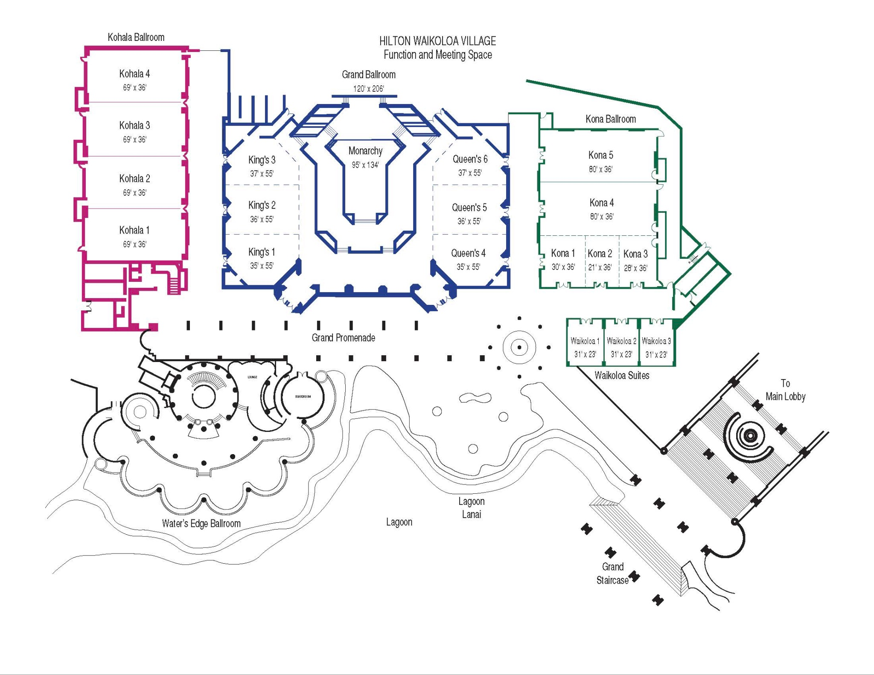
Hilton Waikoloa Village Convention Level Meeting Space Map
Meeting Rooms by Working Group
802.11
Kona 2
Kona 3
Kona 4 / 5
Queen’s 5
Queen’s 6
Waters Edge Board Room
802.15
Kona 1
Queen’s 4
Waikoloa 2
Waikoloa 3
802.18, .19, .24
Waikoloa 3
EVENT OFFICE
Waikoloa 1

Slide 9
Food and Beverage Breaks
FOR REGISTERED ATTENDEES ONLY
Light Breakfast
Lagoon Lanai
Monday - Friday
7:15 AM - 8:30 AM
Morning Coffee & Tea Break
Lagoon Lanai
Monday - Thursday
9:50 AM - 10:35 AM
Lunch
Lagoon Lanai
Monday - Thursday
12:00 PM - 1:30 PM
Afternoon Break
Lagoon Lanai
Monday - Thursday
3:15 PM - 4:00 PM

Slide 10
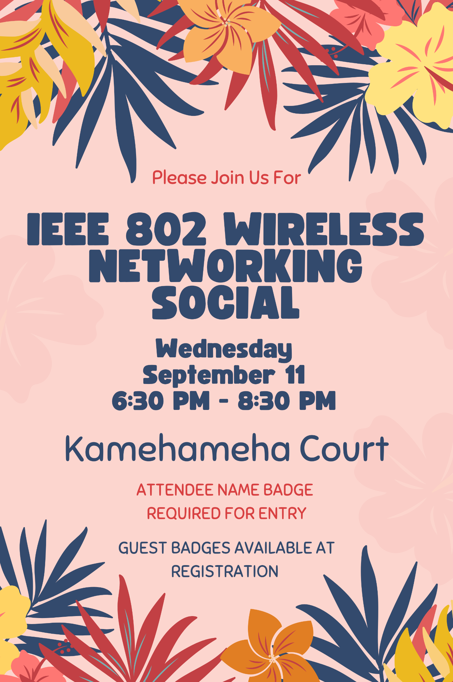
IEEE 802 Wireless Networking Social
Wednesday September 11 at 6:30 PM
WHO: Registered Attendee & Guests who indicated participation on registration form
WHAT: Networking Reception, Food Stations, Bar Service*, Music, Photo Booth
*Complimentary Service 6:30 PM - 7:30 PM, Cash Bar to Follow
WHERE: Kamehameha Court, Hilton Waikoloa
DIRECTIONS: Follow the museum walkway past the main lobby towards the KPC restaurant. Access to the court will be marked with a sign (see poster on this slide), event staff will be onsite to welcome you.
SOCIAL EVENT ATTENDEE & GUEST BADGES
All individuals attending the event (attendees and their guests) must wear a Name Badge. Guest Badges must be picked up before 12:00 PM Wednesday September 11th..

Slide 11
Quick Start Guide to Waikoloa
Places to Eat, Things to Do and FAQ Guide to the Hilton Waikoloa
Onsite Guide to Hilton Waikoloa
Weather Forecast
Waikoloa, HI USA Weather Forecast from AccuWeather
Time Zone - Hawaii Time UTC/GMT -10 hours
Time Zone Tool (What time is at home or where virtual attendees are logging in?) https://www.timeanddate.com/worldclock/meeting.html
Kona International Airport - Guide and Flight Status
Airport Information Website
Arrival and Departure Flight Status
Getting To/From Airport
Driving Directions, SpeediShuttle, Car Rentals at Airport
General Guide to the Kohala Region Including Dining Guide
Big Island Guide - Kohala Region

Slide 12
Nearby Shops & Services
Market & Groceries
Island Gourmet Markets
69-201 Waikoloa Beach Drive, Space B1/B2, Waikoloa, HI 96738
Phone : 808.886.3577
Store Hours: Daily -- 7:00am to 10:00pm
Meat & Seafood: Daily -- 7:00am to 10:00pm
Produce: Daily -- 7:00am to 10:00pm
Deli Hours: Daily -- 7:00am to 10:00pm
Island Gourmet Coffee Hours: Daily -- 7:00am to 10:00pm
Sushi Kaiyo Hours: Daily -- 7:00am to 10:00pm
~Hours Are Subject to Change~
Convenience Store
ABC Store
Located Inside Island Gourmet Market
Shopping District
Kings Shops
Queen’s Marketplace
Waikoloa Plaza
Bank
First Hawaiian Bank
Tel: 808-883-8555
Waikoloa Highlands Center, 68-1845 Waikoloa Rd, Waikoloa Village, HI 96738
Urgent Care Clinic
Kohala Coast Urgent Care located at The Westin Hapuna Beach Resort.
Monday to Friday: 9:00 am to 4:30 pm
Saturday: 9:00 am to 2:00 pm
No appointment is necessary, however if you wish to book an appointment: use Link below
www.kohalacoasturgentcare.com
Dental Clinic
Located Inside Queen’s Marketplace, the Dental Clinic is open Monday through Friday by appointment.
Phone # (808) 886-0891 Website: waikoloadental.com

Slide 13
Thanks for helping us make this session a success, we look forward to working with you again!
2024 November IEEE 802 Plenary Session November 10-15, 2024
In-Person participation at the Hyatt Regency Vancouver in Vancouver British Columbia, Canada with remote participation available.
Hotel Reservations and Registration are available at: https://cvent.meeDZgoD
Immigration Refugees and Citizenship Canada (IRCC), instructions for registered events are available at: IRCC Instructions
General Information about entry into Canada, entry documentation and applications are available at https://cvent.me/b4gDOa
Meeting Planner Questions, please email: 802info@facetoface-events.com

