Slide 1
IEEE 802.1 WG May 2024 Meetings Glenn Parsons – IEEE 802.1 WG chair glenn.parsons@ericsson.com ec-24-0112-00-00EC

Slide 2
Motion
Approve sending P802.1Qdy D2.0 to Standards Association ballot
Confirm the CSD for P802.1Qdy in https://mentor.ieee.org/802-ec/dcn/23/ec-23-0149-00-ACSD-p802-1qdy.pdf
P802.1Qdy D1.3 had 100% approval at the end of the last WG ballot
In the WG, Proposed: János Farkas, Second: Stephan Kehrer
Sending draft (y/n/a): 49, 0, 6
CSD (y/n/a): 47, 0, 6
In EC, mover: Glenn Parsons, Second: David Law
(y/n/a): <y>,<n>,<a>
WG electronic ballot 74 & 75 ended May 17th

Slide 3
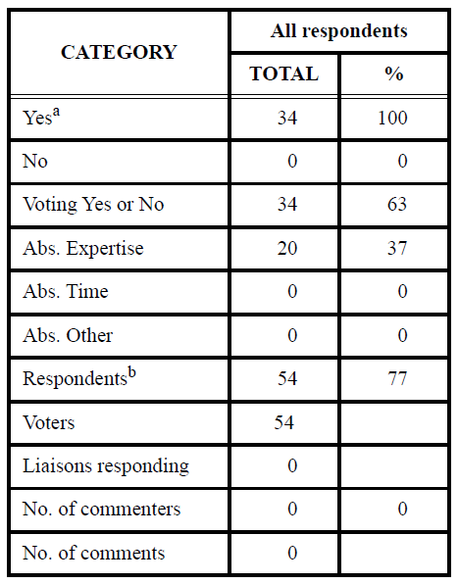
Supporting Information P802.1Qdy
WG ballot (2nd recirc) closed: 18 April 2024
All WG ballot requirements are met
The ballot resulted in
0 Disapprove votes
0 comments
Comment resolution available for
Initial ballot: https://www.ieee802.org/1/files/private/dy-drafts/d1/802-1Qdy-d1-0-dis-v01.pdf
First recirculation: https://www.ieee802.org/1/files/private/dy-drafts/d1/802-1Qdy-d1-2.pdf
Second recirculation: https://www.ieee802.org/1/files/private/dy-drafts/d1/802-1Qdy-d1-3-dis-v02.pdf
Ballot results:

