Slide 1
IMPORTANT INFORMATION
IEEE 802 Wireless Interim Meeting
January 14 – 19, 2024
Hilton Panama

Slide 2
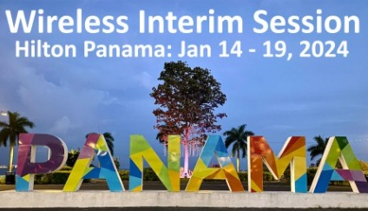
INTERIM MEETING SUPPORTER
We would like to thank Visit Panama, the Panama Convention Bureau, for all their help and support in the planning and preparation of the Interim Meeting and especially for providing funding to further support the meeting.

Slide 3
AUDIO VISUAL:
The Audio Visual is being supplied by INGENTRONICS.
There will be floating AV technicians between the rooms during the meetings.
For any issues, please see a contact a technician from INGENTRONICS.
AUDIO IN MEETING ROOM
If you are a local participant, PLEASE, select “Don’t connect to audio” when joining the WebEx session. Connecting to the audio, may cause an audio feedback loop that prevents the meeting from proceeding

Slide 4
IEEE 802 WIRELESS INTERIM – 802.11 NEWCOMER TRAINING
IN PERSON: 1030am – 1230am Monday 15 January Venetian Room
REMOTE: IEEE 802 Calendar https://ieee802.org/802tele_calendar.html
REGISTRATION FEE: Registration for the IEEE 802 Interim Session (with fee) is required, whether attending in-person or remotely.

Slide 5
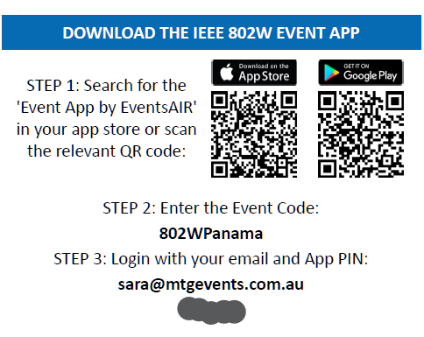
PROGRAM APP - The IEEE 802 Wireless Interim Meeting App information is available on the back of your name badge

Slide 6
COMBINED SCHEDULE
IN PERSON Room Assignments: Schedule QR codes posted outside each meeting room and on the back of your name badge.
REMOTE Participation: https://ieee802.org/802tele_calendar.html
ATTENDANCE TOOL (IMAT) : https://imat.ieee.org/

Slide 7
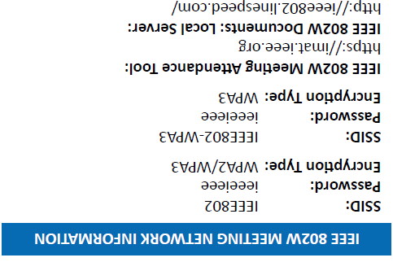
NETWORK ACCESS INFORMATION:
Local Document Server for IEEE 802W Documents:
http://ieee802.linespeed.com/
The network provider for the IEEE 802 Wireless Interim is Linespeed Events. Linespeed are located in the Mystic Room during the meeting.
Details on how to log into the network are printed on the back of your badge.

Slide 8
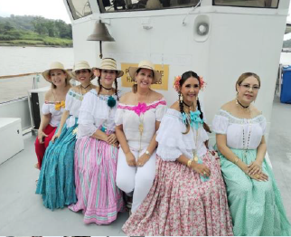
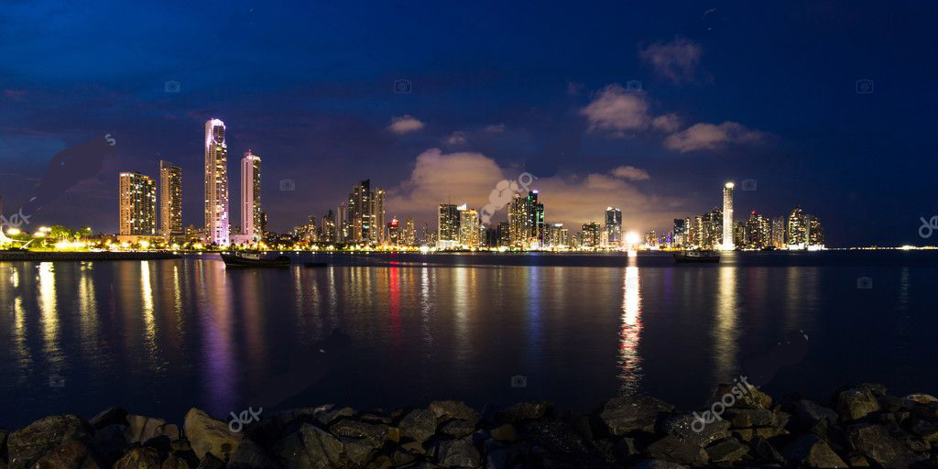
WEDNESDAY SOCIAL AN EVENING ON PANAMA BAY Wednesday September 17, 2024 Time: 6:20pm - 6:45pm: Buses depart Hilton Please meet from 6:20pm – 6:45pm on the street level of the Hilton (L1) for Coach transfer to the Wharf 7:15pm – 9:00pm: Boat cruise on Panama Bay Entertainment: Local Panamanian Entertainment Dress code: Casual Food: Buffet of Local Panama Food & Drinks We look forward to a fun evening and seeing you there.

Slide 9
CATERING:
Breakfast: is included in your room rate if you booked at the Hilton. Breakfast is served in the Society Café.
Morning & Afternoon teas will be served from the foyer areas on both floors, Level B and M.
Lunch: will be held in Society Café, Level: L2, available from 12:00pm – 2:00pm

Slide 10
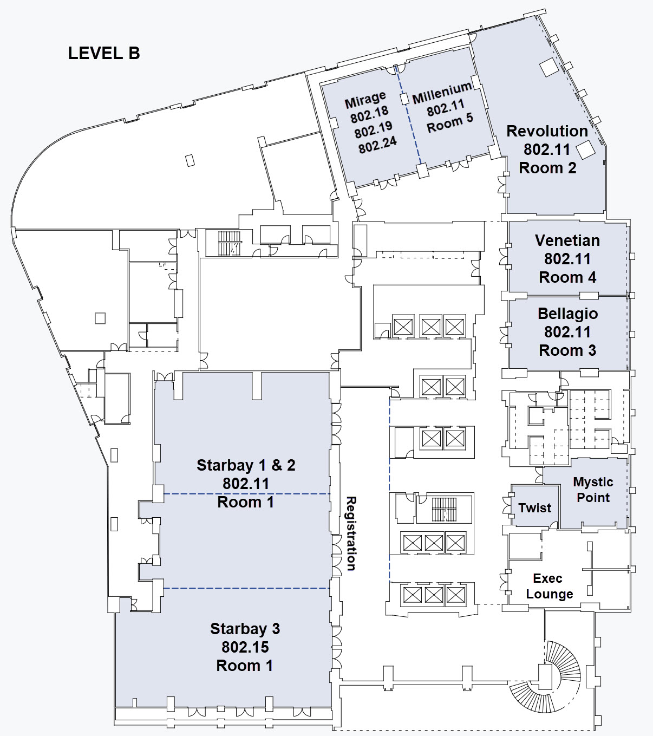
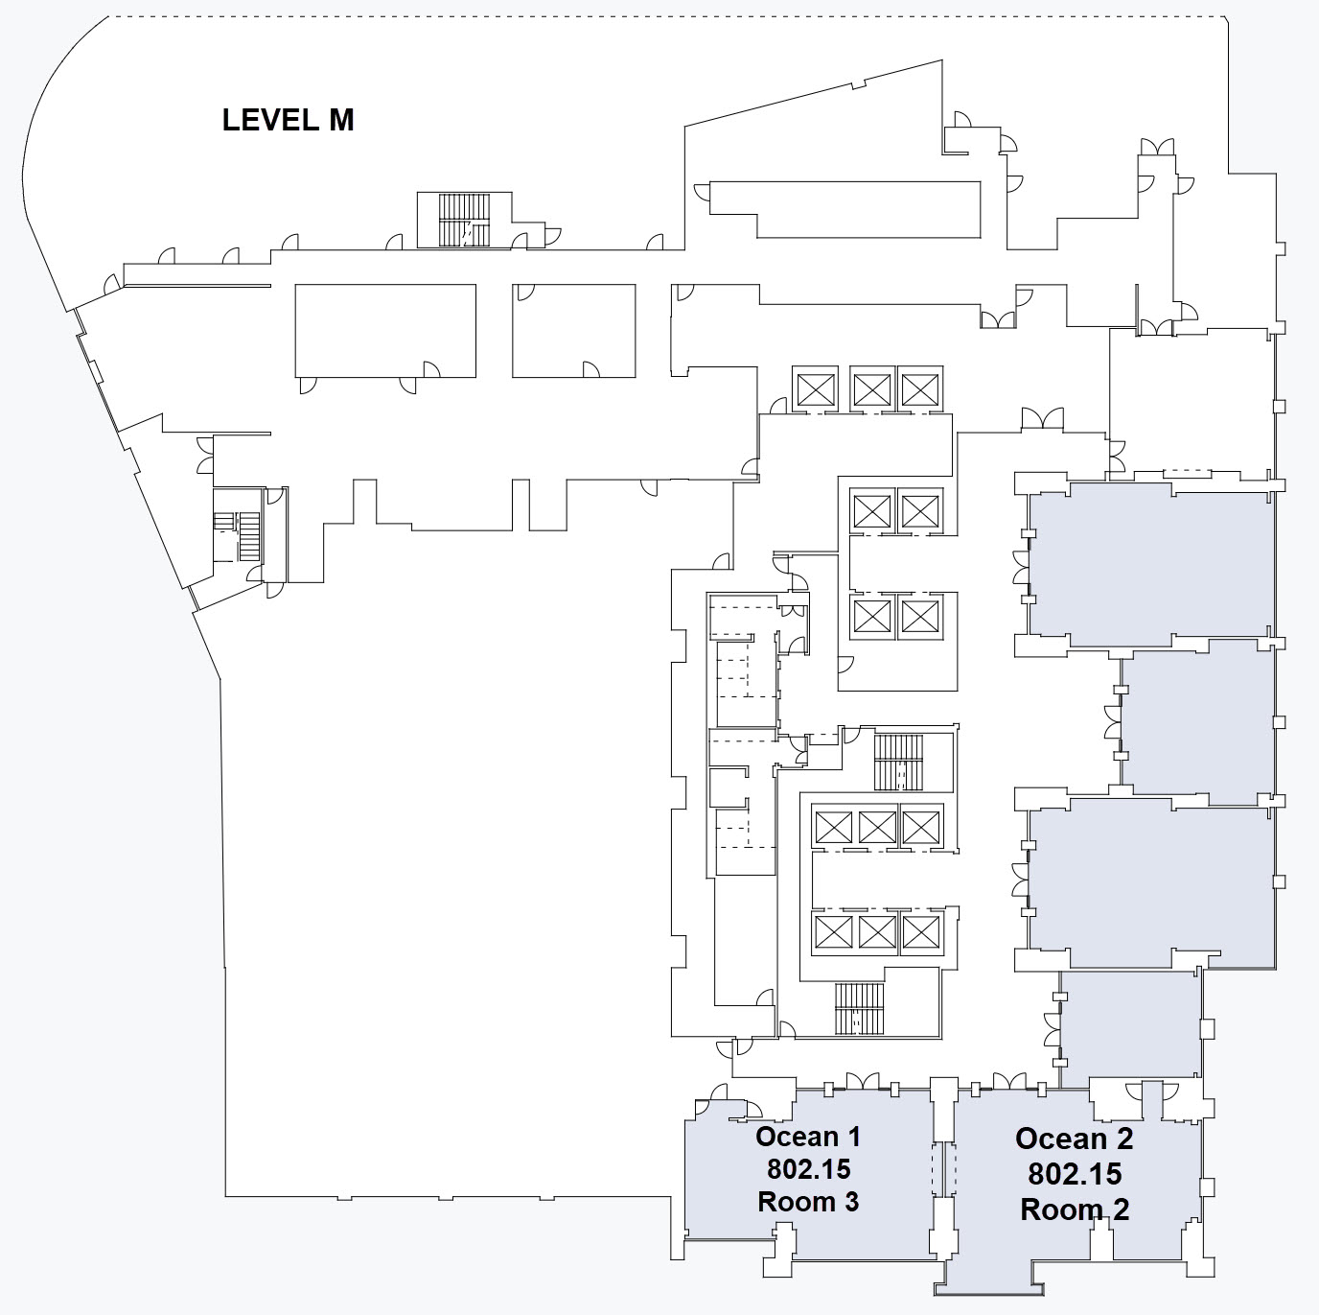
FLOOR PLANS:

Slide 11
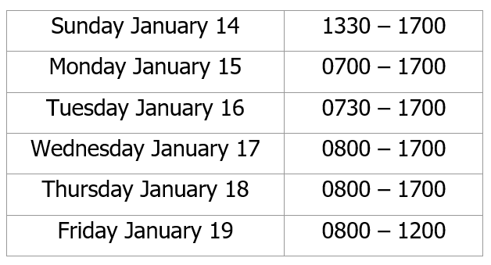
The REGISTRATION DESK will be located in the Hotel Foyer, outside of Starbay 1-2, during the following times:

Slide 12
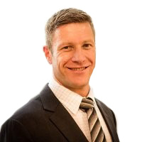
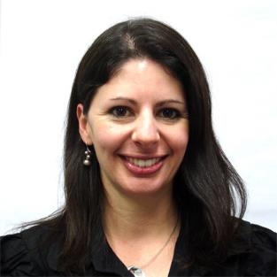
Any Questions Please see Daniel or Sara on the registration desk!
ieee802@mtgevents.com.au

