Slide 1
November 2023 IEEE 802 PlenarySession
Event Summary and Important Information
Prepared By: Face to Face Events, November 11, 2023

Slide 2
Meeting Planner Contact Information
Dawn Slykhouse, Face to Face Events
Mobile: +1 (408) 594-1342
Email: dawns@facetoface-events.com
Lisa Ronmark, Face to Face Events
Mobile: +1 (604) 316-4947
Email: lisa@facetoface-events.com
Stephanie Williams, Face to Face Events
Mobile: +1 (408) 497-9613
Email: stephanie@facetoface-events.com
Meeting Planner Office: Kalia Executive Conference Center, Tiare
Registration: Mid Pacific Conference Center, Coral Lounge

Slide 3
Network Provider Contact Information
Network Provider: Linespeed Events
Richard Alfvin
Mobile: +1 (585) 781-0952
Email: rick@linespeed.com
Network Office: Nautilus I
If the Network Office is closed please check in with Meeting Planner at:
Registration Desk (Coral Lounge) or Meeting Planner Office (Tiare).

Slide 4
IEEE 802 Newcomer Orientation
Monday November 13th at 9:00 AM
WHO: IEEE 802 Newcomers (and all others!)
WHAT: IEEE 802 Orientation Program, Details at <https://t.ly/pdtku>
WHEN: Monday 13 November, 9-10 HST
WHERE: IEEE 802 Calendar https://ieee802.org/802tele_calendar.html
HOW TO PREPARE: Please take an hour and get to up speed with a high-level view of IEEE 802 and how it works before you plunge into the session. IEEE 802.15 First Vice Chair Phil Beecher will lead the program. Your questions will be answered.
REGISTRATION FEE: Registration for the IEEE 802 Plenary Session (with fee) is required, whether attending in-person or remotely.

Slide 5
In Person Registration Times and Location
Sunday
  Registration Counter, Coral Lounge in Mid Pacific Conference Center
  5:00 PM - 7:30 PM
Monday - Wednesday
  Registration Counter, Coral Lounge in Mid Pacific Conference Center
  7:30 AM - 5:00 PM
Thursday
  Event Office, Tiare at Kalia Executive Conference Center
  8:00 AM - 5:00 PM

Slide 6
Network Access Information
SSID: IEEE802
Password: ieeeieee
Encryption Type: WPA2/WPA3
Does not support 6Ghz WiFi
SSID: IEEE802-6G
Password: ieeeieee
Encryption Type: WPA3
Support 6Ghz WiFi
IEEE 802 Documents: Local Document Server
http://ieee802.linespeed.com/
Onsite Network Support
The November 2023 IEEE 802 PlenarySession Network Provider is Linespeed.
Members of the Linespeed team can be dispatched by contacting the Meeting Planner directly or by placing a request at the event registration desk.

Slide 7
Schedule of Sessions and Attendance
SCHEDULE OF SESSIONS
In Person Room Assignments: Schedule QR codes posted outside each meeting room and on your badge hand out. http://schedule.802world.com/schedule/schedule/show
Virtual Participation: https://ieee802.org/802tele_calendar.html
ATTENDANCE TOOL (IMAT)
https://imat.ieee.org/my-site/home
REGISTRATION FEE REQUIREMENT REMINDER
Payment of the session registration fee is required for all individuals who participate in any session associated with the November 2023 IEEE 802 Plenary Session. Registration: https://cvent.me/nwK28E

Slide 8
Audio Visual Support - In Person Sessions
WHO TO CONTACT IF AUDIO VISUAL EQUIPMENT ISN’T WORKING IN YOUR ONSITE MEETING ROOM
Please contact the Meeting Planner directly if you have any issues with the audio visual equipment in your meeting room. The Meeting Planner will contact support and the appropriate technician will be sent to assist as soon as possible.
Meeting Planner can be reached at:
Registration and Information Desk: Coral Lounge
Event Office: Tiare
Via Text or Call: Lisa Ronmark: +1 (604) 316-4947, Stephanie Williams +1 (408) 497-9613
WEBEX AUDIO IN THE ONSITE MEETING ROOM
If you are a local participant, PLEASE, select “Don’t connect to audio” when joining the WebEx session. Connecting to the audio, November cause an audio feedback loop that prevents the meeting from proceeding

Slide 9
Food and Beverage Breaks
FOR REGISTERED ATTENDEES ONLY
Light Breakfast
Coral Lounge, 2nd Floor
Monday - Friday
7:15 AM - 8:15 AM
Morning Coffee & Tea Break
Coral Lounge, 2nd Floor
Monday - Thursday
9:50 AM - 10:35 AM
Lunch
Coral III, 2nd Floor
Monday - Thursday
12:00 PM - 1:30 PM
Afternoon Break
Coral Lounge, 2nd Floor
Monday - Thursday
3:00 PM - 4:00 PM

Slide 10
IEEE 802 Networking Social
Wednesday November 15th at 6:30 PM
WHO: All registered attendees and their guests.
WHAT: Casual Networking Reception with refreshments, bar service and musical entertainment.
WHERE: Great Lawn
PARTICIPATION WRISTBANDS
All individuals (including children over the age 8) attending the Social event must wear a wrist band. Wrist Bands shall be distributed with Name Badges at the Plenary Session registration desk. If you plan to have guests attend please pick up their wrist bands by this time. Late requests may not be accommodated.
Please contact the Meeting Planner if have any questions.

Slide 11
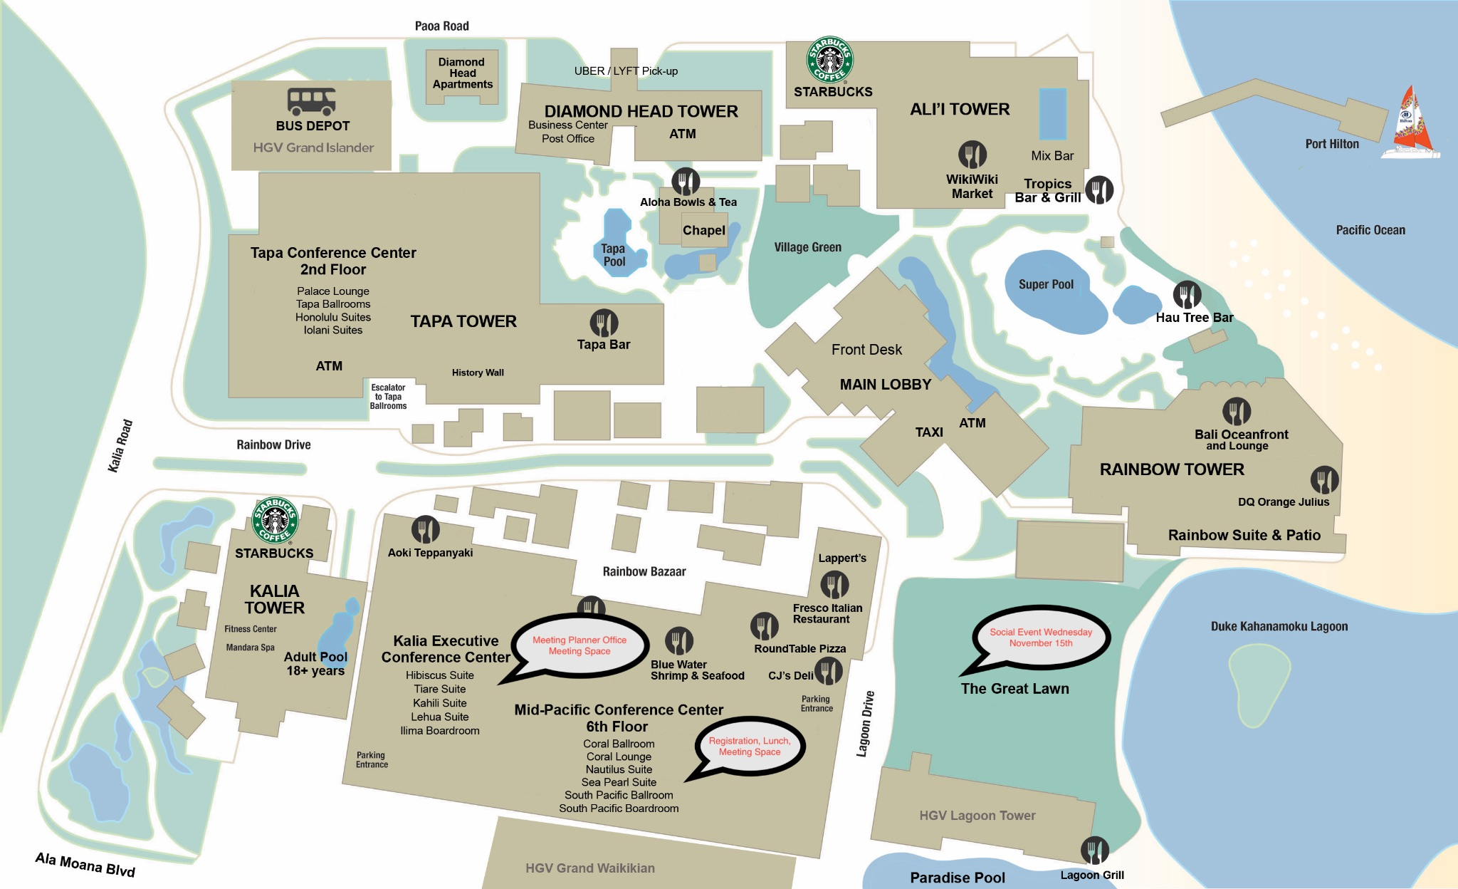
Resort Map - Meeting Space, Lunches, Social Locations Highlighted

Slide 12
Thanks for helping us make this session a success, we look forward to working with you again!
The next IEEE 802 Plenary Session will be March 10-15, 2024. The session will be a Mixed Mode with In-Person participation at the Hyatt Regency Denver. If you have any questions please email: 802info@facetoface-events.com
Information and Registration
  Early Registration Deadline
    Friday January 5, 2024
  Group Hotel Reservations: Hyatt Regency Denver at Colorado Convention Center
    Available Soon
  Hotel Reservation Booking Cut Off Date:
    February 16, 2024

