Slide 1
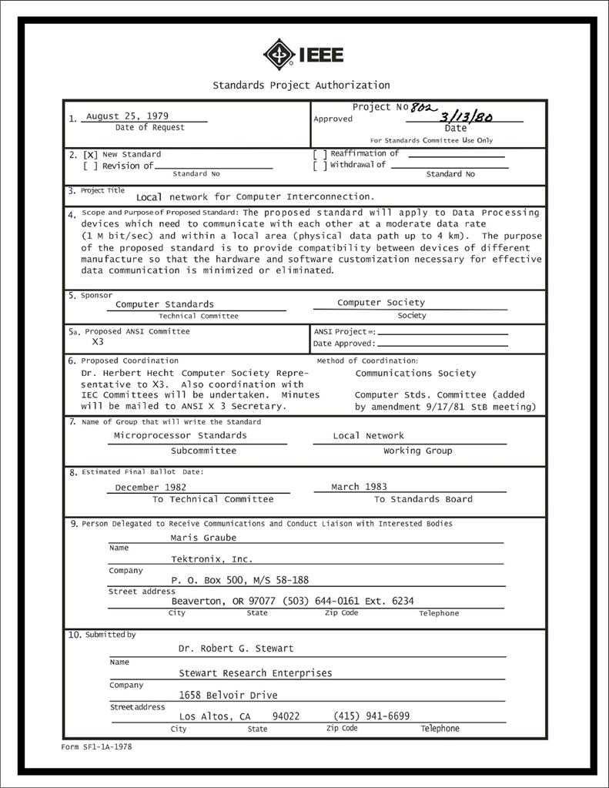
IEEE 802 LMSC Executive Committee 04 April 2023 Electronic Meeting 20:00-22:00 UTC 15:00-17:00 ET
DCN ec-23-082-00-00EC

Slide 2
1.00 Meeting called to order/roll call
2.00 Review/modify/approve agenda
2.01 Participation Slide Set URLs:
https://ieee802.org/sapolicies.shtml
https://standards.ieee.org/content/dam/ieee-standards/standards/web/documents/other/Participant-Behavior-Individual-Method.pdf
Participant behavior is guided by IEEE Code of Ethics & Conduct
Participants shall act independently of others, including employers
Standards activities shall allow the fair & equitable consideration of all viewpoints

Slide 3
3.00 Chair’s Announcements
Proforma:
Use IMAT to log your attendance
Please enable mute when you are not speaking
Please use the chat function to request being put in the queue

Slide 4
6.0 EC Any Other Business?
Any other business?
6.01 Photo Scanning
?

Slide 5
9.0 EC Action Item Status Review
Review Action Items from this meeting
tbd

Slide 6
Adjourn EC Meeting

