Slide 1
802.1 consent agenda items for LMSC Closing Plenary
March 2023
(V4 – 802.1 version #)

Slide 2
Agenda
PARs to NesCom
5.0401 – P802.1ASdm
5.0402 – P802.1Qdt
5.0403 – P802.1Qdx
5.0404 – P802.1DU
5.0405 – P802.1CS/cor1
5.0406 – P802.1Q-2022-REV (48 hour)
5.0407 – P802.1AS-2020-REV (48 hour)
Drafts to SA Ballot
5.0408 – P802.1CS/cor1 conditional
Drafts to RevCom
5.0409 – P802.1Qcz
5.0410 – P802.1AEdk

Slide 3
Agenda
Liaisons and external communications (ME)
7.061 – Approve liaison of drafts for information to ISO/IEC JTC1/SC6 under the PSDO agreement
7.062 – Approve liaison of drafts for adoption to ISO/IEC JTC1/SC6 under the PSDO agreement
Liaisons and external communications (II)
7.063 – Approve 802.1 communication to ITU-T SG15
7.064 – Approve 802.1 communication to ITU-T SG13
7.065 – Approve 802.1 communication with IETF
7.066 – Approve 802.1 communication with LNI 4.0
7.067 – Approve 802.1 communication with 802.11
7.068 – Approve 802.1 communication with BBF

Slide 4
802.1 Motions 2023-03 Consent Agenda PARs to NesCom

Slide 5
Motion – 5.0401
Approve forwarding P802.1ASdm PAR modification documentation in https://www.ieee802.org/1/files/public/docs2023/dm-PAR-modification-0323-v01.pdf to NesCom
Approve CSD modification documentation in https://www.ieee802.org/1/files/public/docs2023/dm-CSD-modification-0323-v01.pdf
In the WG, Proposed: David McCall, Second: Ludwig Winkel
PAR (y/n/a): 44, 0, 2
CSD (y/n/a): 42, 0 , 3
In EC, mover: Glenn Parsons, Second: Roger Marks
(y/n/a): <y>,<n>,<a>

Slide 6
Motion – 5.0402
Approve forwarding P802.1Qdt PAR modification documentation in https://www.ieee802.org/1/files/public/docs2023/dt-PAR-modification-0323-v01.pdf to NesCom
Approve CSD modification documentation in https://www.ieee802.org/1/files/public/docs2023/dt-CSD-modification-0323-v01.pdf
In the WG, Proposed: Paul Congdon, Second: János Farkas
PAR (y/n/a): 40, 2, 7
CSD (y/n/a): 40, 2, 7
In EC, mover: Glenn Parsons, Second: Roger Marks
(y/n/a): <y>,<n>,<a>

Slide 7
Motion – 5.0403
Approve forwarding P802.1Qdx PAR documentation in https://www.ieee802.org/1/files/public/docs2023/dx-PAR-0323-v01.pdf to NesCom
Approve CSD documentation in https://www.ieee802.org/1/files/public/docs2023/dx-CSD-0323-v01.pdf
In the WG, Proposed: Jordon Woods, Second: János Farkas
PAR (y/n/a): 42, 1, 7
CSD (y/n/a): 41, 1, 7
In EC, mover: Glenn Parsons, Second: Roger Marks
(y/n/a): <y>,<n>,<a>

Slide 8
Motion – 5.0404
Approve forwarding P802.1DU PAR documentation in https://www.ieee802.org/1/files/public/docs2023/du-PAR-0323-v01.pdf to NesCom
Approve CSD documentation in https://www.ieee802.org/1/files/public/docs2023/du-CSD-0323-v01.pdf
In the WG, Proposed: Johannes Specht, Second: Paul Congdon
PAR (y/n/a): 38, 6, 6
CSD (y/n/a): 37, 4, 8
In EC, mover: Glenn Parsons, Second: Roger Marks
(y/n/a): <y>,<n>,<a>

Slide 9
Motion – 5.0405
Approve forwarding P802.1CS-2020/Cor1 PAR modification documentation in https://www.ieee802.org/1/files/public/docs2023/cs-2020-cor1-PAR-modification-0323-v01.pdf to NesCom
Note: there is no CSD statement since this maintenance project is not intended to provide any new functionality
In the WG, Proposed: Paul Congdon, Second: Stephan Kehrer
PAR (y/n/a): 42, 0, 7
In EC, mover: Glenn Parsons, Second: Roger Marks
(y/n/a): <y>,<n>,<a>

Slide 10
Motion – 5.0406
Approve forwarding P802.1Q-2022-Rev PAR documentation in https://www.ieee802.org/1/files/public/docs2023/q-rev-draft-PAR-0323-v01.pdf to NesCom Note: there is no CSD statement since this maintenance project is not intended to provide any new functionality
In the WG, Proposed: Mick Seaman Second: Paul Congdon
Sending draft (y/n/a): 45 , 0 , 4
In the EC, mover: Glenn Parsons Second: Roger Marks
(y/n/a): <y> , <n> , <a>

Slide 11
Motion – 5.0407
Approve forwarding P802.1AS-2020-Rev PAR documentation in https://www.ieee802.org/1/files/public/docs2023/as2020-rev-PAR-0323-v02.pdf to NesCom Note: there is no CSD statement since this maintenance project is not intended to provide any new functionality
In the WG, Proposed: Geoff Garner Second: Paul Congdon
Sending draft (y/n/a): 48 , 0 , 1
In the EC, mover: Glenn Parsons Second: Roger Marks
(y/n/a): <y> , <n> , <a>

Slide 12
802.1 Motions 2023-03 Consent Agenda Drafts to SA Ballot

Slide 13
Motion – 5.0408
Conditionally approve sending P802.1CS-2020/Cor1 D2.0 to Standards Association ballot
Note: there is no CSD statement since this maintenance project is not intended to provide any new functionality
P802.1CS-2020/Cor1 had 97% approval at the end of the last Working Group Recirculation ballot
In the WG, Proposed: Paul Congdon Second: János Farkas
(y/n/a): 44, 0 , 5
In EC, mover: Glenn Parsons, Second: Roger Marks
(y/n/a): <y>,<n>,<a>

Slide 14
Supporting information P802.1CS-2020/Cor1
WG ballot closed: 27 February 2023
All WG ballot requirements are met
The ballot resulted in
0 outstanding Disapprove vote
0 outstanding Must Be satisfied comments
Comment resolution available here: https://www.ieee802.org/1/files/private/cs-2020-cor-1-drafts/d1/802-1CS-2020-Cor1-d1-1-dis.pdf
Recirculation ballot will be conducted during April with comment resolution on Maintenance TG calls and during the May 802.1 interim if required. A possible final recirculation in May/June if required with comment resolution in Maintenance TG meetings.
CATEGORY | All Respondents
 | TOTAL | %
Yes | 32 | 100%
No | 0 | 0%
Voting Yes or No | 32 | 64%
Abs. Time | 0 | 0%
Abs. Expertise | 18 | 36%
Abs. Other | 0 | 0%
Respondents | 50 | 68%
Voting members | 73
Non-voting | 0
No. of commenters | 4 | 8%
No. of comments | 13

Slide 15
802.1 Motions 2023-03 Consent Agenda Drafts to RevCom

Slide 16
Motion – 5.0409
Approve sending P802.1Qcz to RevCom
Approve CSD documentation in https://mentor.ieee.org/802-ec/dcn/18/ec-18-0160-00-ACSD-802-1qcz.pdf
P802.1Qcz D2.7 had 100% approval at the end of the last SA ballot
In the WG, Proposed: Paul Congdon Second: János Farkas
Sending draft (y/n/a): 40, 1, 7
CSD (y/n/a): 38, 0 , 9
In EC, mover: Glenn Parsons, Second: Roger Marks
(y/n/a): <y>,<n>,<a>

Slide 17
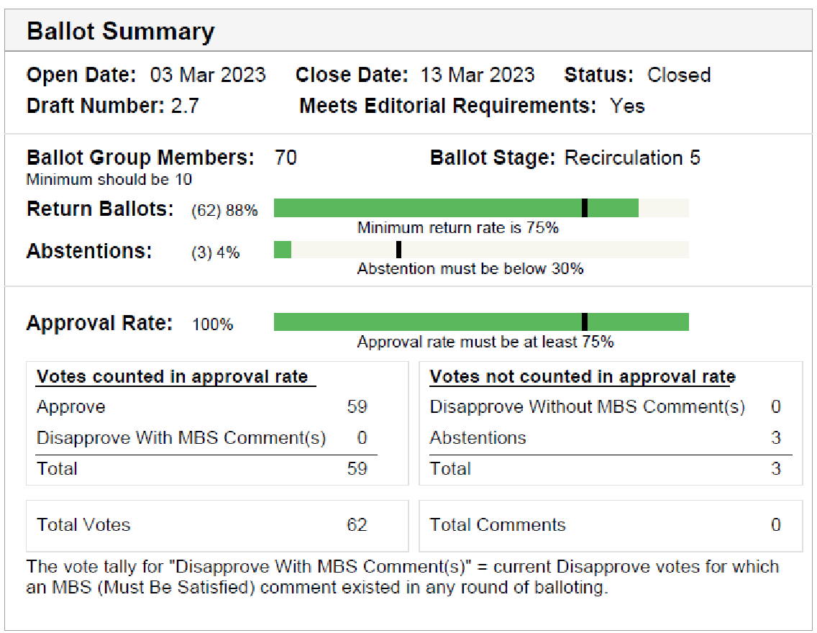
Supporting information P802.1Qcz
Sponsor ballot closed: 13 March 2023
All SA ballot requirements met
Ballot result after comment resolution:
0 outstanding Disapprove votes
0 outstanding Must Be Satisfied (MBS) comments
Disposition is available here: https://www.ieee802.org/1/files/private/cz-drafts/d2/802-1Qcz-d2-7-dis-v01.pdf

Slide 18
Motion – 5.0410
Approve sending P802.1AEdk to RevCom
Approve CSD documentation in https://mentor.ieee.org/802-ec/dcn/19/ec-19-0218-00-ACSD-p802-1aedk.pdf
P802.1AEdk/D2.2 had 97% approval at the end of the last Standards Association recirculation ballot
In the WG, Proposed: Mick Seaman, Second: Don Fedyk
Sending draft (y/n/a): 42, 0, 8
CSD (y/n/a): 42, 0, 8
In EC, mover: Glenn Parsons, Second: Roger Marks
(y/n/a): <y>,<n>,<a>

Slide 19
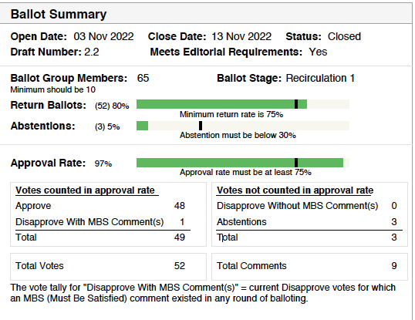
Supporting information P802.1AEdk
SA ballot closed: 13 November 2022
All SA ballot requirements met
Ballot result after comment resolution:
1 outstanding Disapprove votes
0 outstanding Must Be Satisfied (MBS) comments All comments accompanying the Disapprove vote were WITHDRAWN by commenter
Disposition is available here: https://www.ieee802.org/1/files/private/dk-drafts/d2/802-1AEdk-d2-2-sa-recirc-dis3.pdf

Slide 20
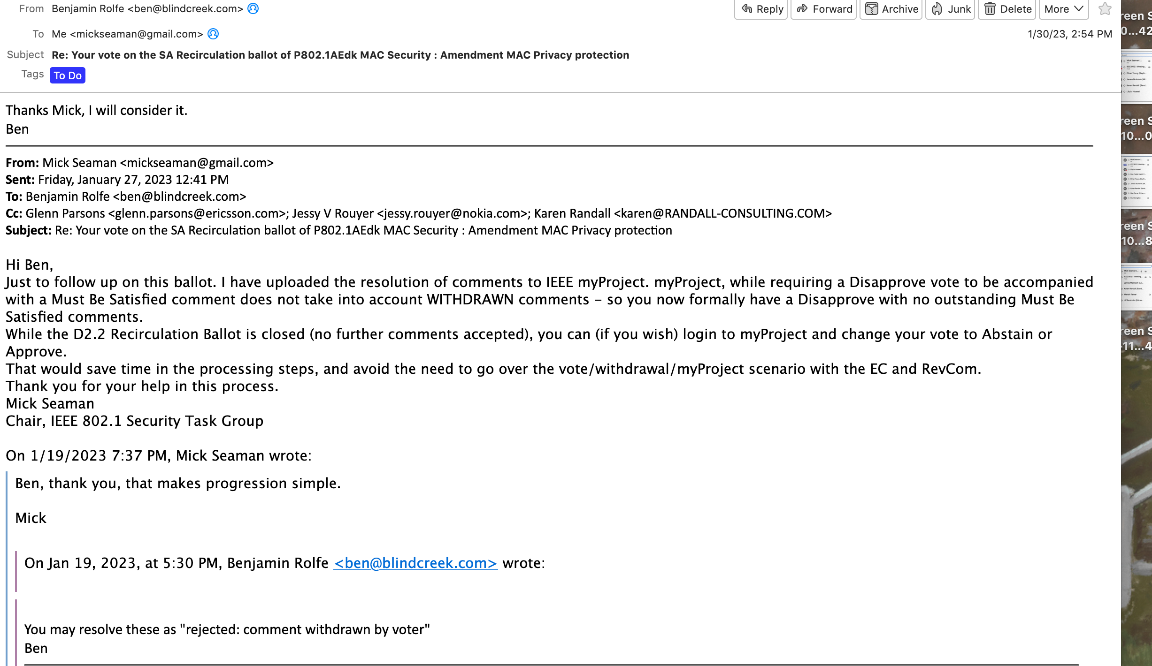
Supporting information P802.1AEdk – 1 –Disapprove comments withdrawn – email from commenter

Slide 21
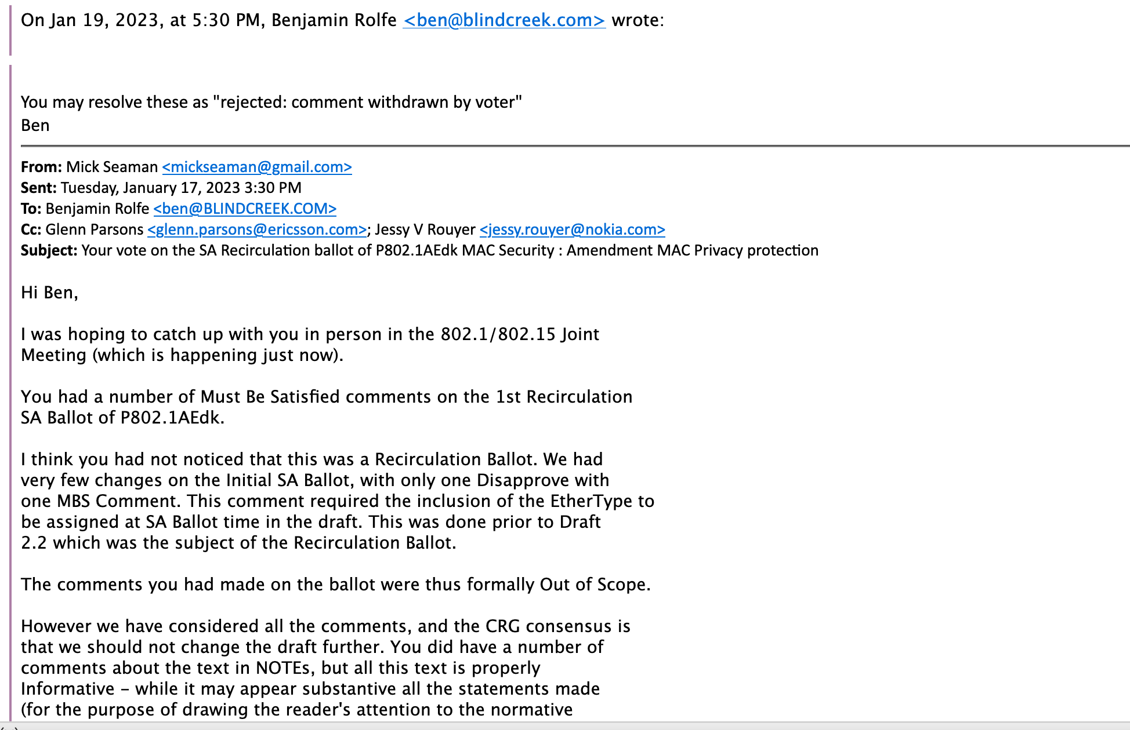
Supporting information P802.1AEdk – 2— Disapprove comments withdrawn – email from commenter cont.

Slide 22
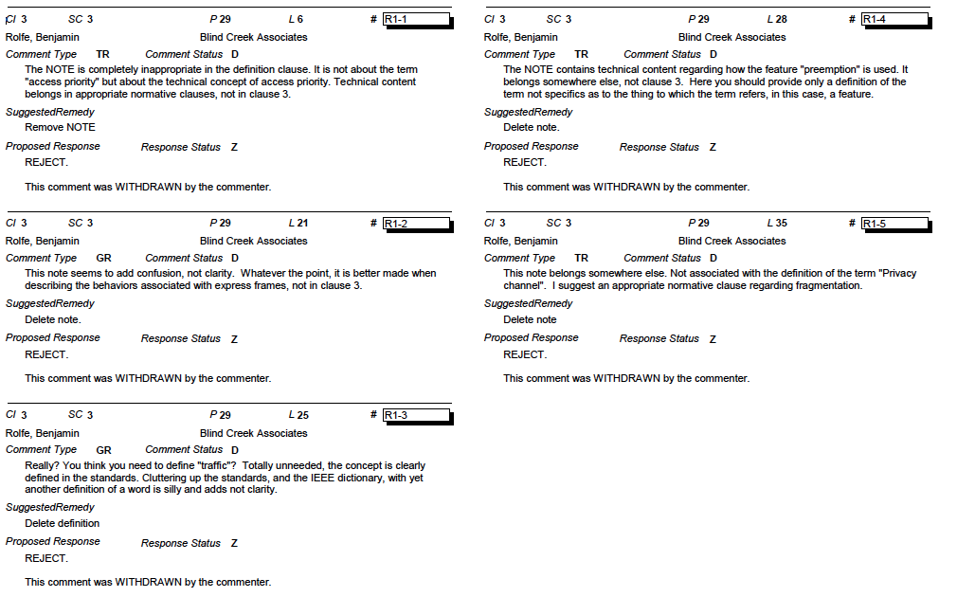
Supporting information P802.1AEdk – 3 – Withdrawn comments

Slide 23
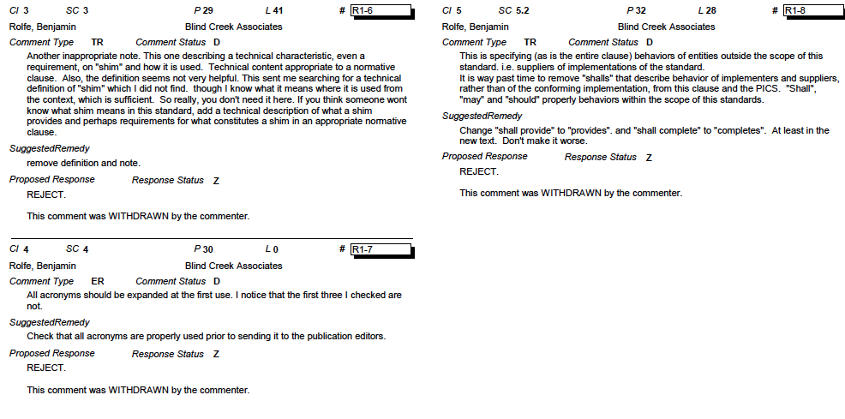
Supporting information P802.1AEdk – 4 – Withdrawn comments cont.

Slide 24
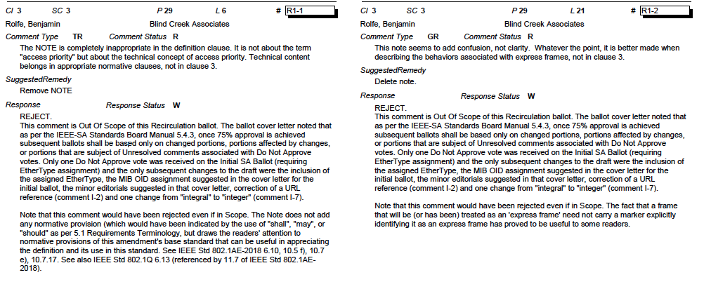
Supporting information P802.1AEdk – 5 – Withdrawn comments – initial CRG resolution

Slide 25
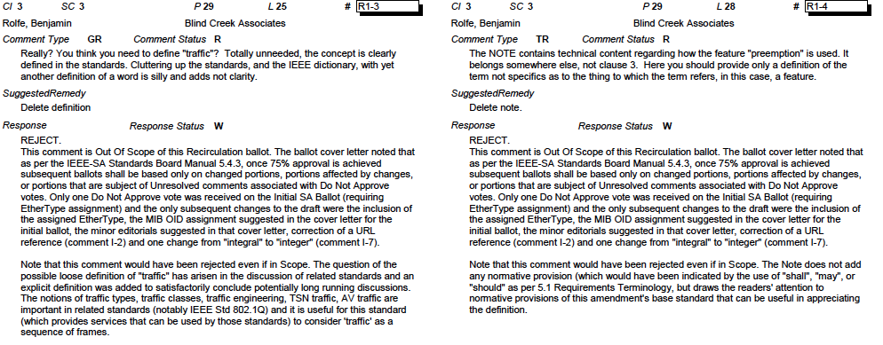
Supporting information P802.1AEdk – 6 – Withdrawn comments cont. – initial CRG resolution

Slide 26
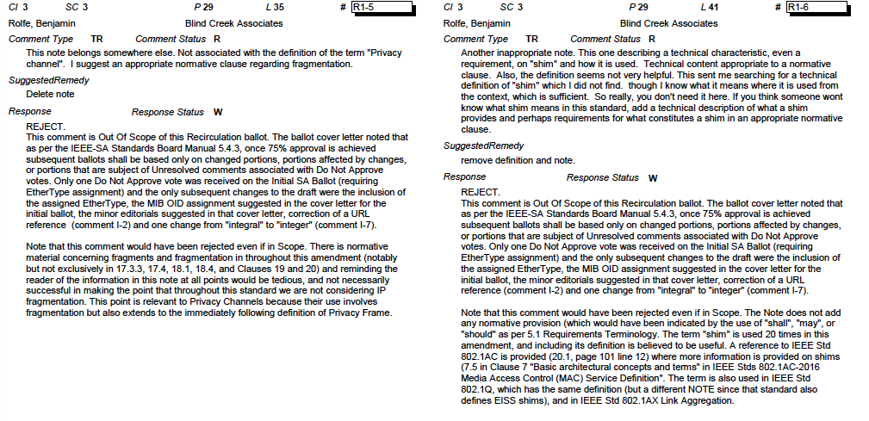
Supporting information P802.1AEdk – 7 – Withdrawn comments cont. – initial CRG resolution

Slide 27
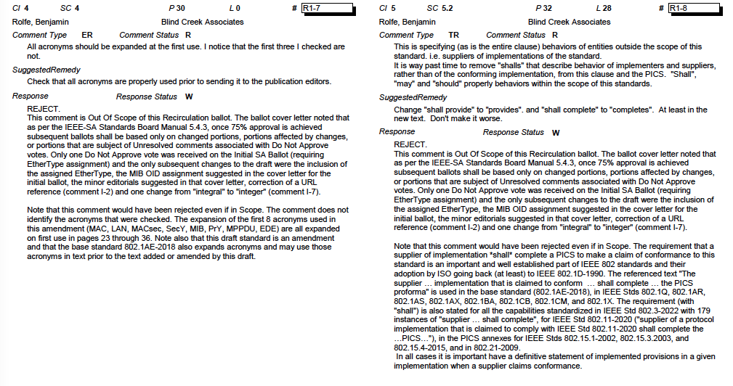
Supporting information P802.1AEdk – 8 – Withdrawn comments cont. – initial CRG resolution

Slide 28
802.1 Motions 2023-03 Consent Agenda Liaisons and external communications (ME)

Slide 29
Motion – 7.061
Approve submission of the following draft(s) to ISO/IEC JTC1/SC6 for information under the PSDO agreement, once SA balloting begins.
IEEE P802.1CS-2020/Cor1
In the WG, Proposed: Paul Congdon Second: Karen Randall
Sending draft (y/n/a): 40, 1, 6
In EC, mover: Glenn Parsons Second: Roger Marks
(y/n/a): <y>,<n>,<a>

Slide 30
Motion – 7.062
Approve submission of the following draft(s) to ISO/IEC JTC1/SC6 for adoption under the PSDO agreement, once approved and published.
IEEE P802.1AEdk
In the WG, Proposed: Paul Congdon Second: Karen Randall
Sending draft (y/n/a): 41, 1, 8
In EC, mover: Glenn Parsons Second: Roger Marks
(y/n/a): <y>,<n>,<a>

Slide 31
802.1 Motions 2023-03 Consent Agenda Liaisons and external communications (II)

Slide 32
Motion – 7.063
Approve https://www.ieee802.org/1/files/public/docs2023/liaison-response-itu-t-sg15-otnt-swp-0323.pdf as communication to ITU-T SG15 on LS15: OTNT Standardization Work Plan Issue 31, granting the IEEE 802.1 WG chair (or his delegate) editorial license.
This approval is under LMSC OM “IEEE 802 LMSC subgroup public statements to government bodies”
In the WG, Proposed: Paul Congdon Second: Karen Randall
Sending liaison (y/n/a): 40, 1, 5
In EC, for information (or motion to block)

Slide 33
Motion – 7.064
Approve https://www.ieee802.org/1/files/public/docs2023/liaison-response-itu-t-SG13-DeterminCommunicSvcsandNetworking-0323.pdf as communication to ITU-T SG13 granting the IEEE 802.1 WG chair (or his delegate) editorial license.
This approval is under LMSC OM “IEEE 802 LMSC subgroup public statements to government bodies”
In the WG (y/n/a): 42, 1, 5
Proposed: János Farkas, Second: Karen Randall
In EC, for information (or motion to block)

Slide 34
Motion – 7.065
Approve https://www.ieee802.org/1/files/public/docs2023/liaison-IETF-RFC7042bis-0323.pdf as communication to IETF regarding review of https://datatracker.ietf.org/doc/draft-eastlake-rfc7042bis/09/, granting the IEEE 802.1 WG chair (or his delegate) editorial license and incorporation of additional RAC approved comments.
In the WG, Proposed: Paul Congdon Second: Karen Randall
Sending draft (y/n/a): 40, 1, 5
In EC, for information

Slide 35
Motion – 7.066
Approve https://www.ieee802.org/1/files/public/docs2023/liaison-response-LNI40-WhitepaperandIEEESAlogorequest-0323.pdf as communication to LNI 4.0, granting the IEEE 802.1 WG chair (or his delegate) editorial license.
In the WG, Proposed: János Farkas Second: Karen Randall
(y/n/a): 40, 2, 5
In the EC, for information

Slide 36
Motion – 7.067
Approve https://www.ieee802.org/1/files/public/docs2023/liaison-response-80211-TSNsupport-0323.pdf as communication to the IEEE 802.11 WG, granting the IEEE 802.1 WG chair (or his delegate) editorial license.
Proposed: János Farkas
Second: Karen Randall
In the WG (y/n/a): 43, 2, 3
In the EC, for information
Notes:
https://www.ieee802.org/1/files/public/docs2023/liaison-response-80211-TSNsupport-0323.pdf

Slide 37
Motion – 7.068
Approve https://www.ieee802.org/1/files/public/docs2023/liaison-response-BBF-1XandYANG-0323.pdf as communication to BBF, granting the IEEE 802.1 WG chair (or his delegate) editorial license.
Proposed: Mick Seaman
Second: Karen Randall
In the WG (y/n/a): 41, 1, 7
In the EC, for information

