Slide 1
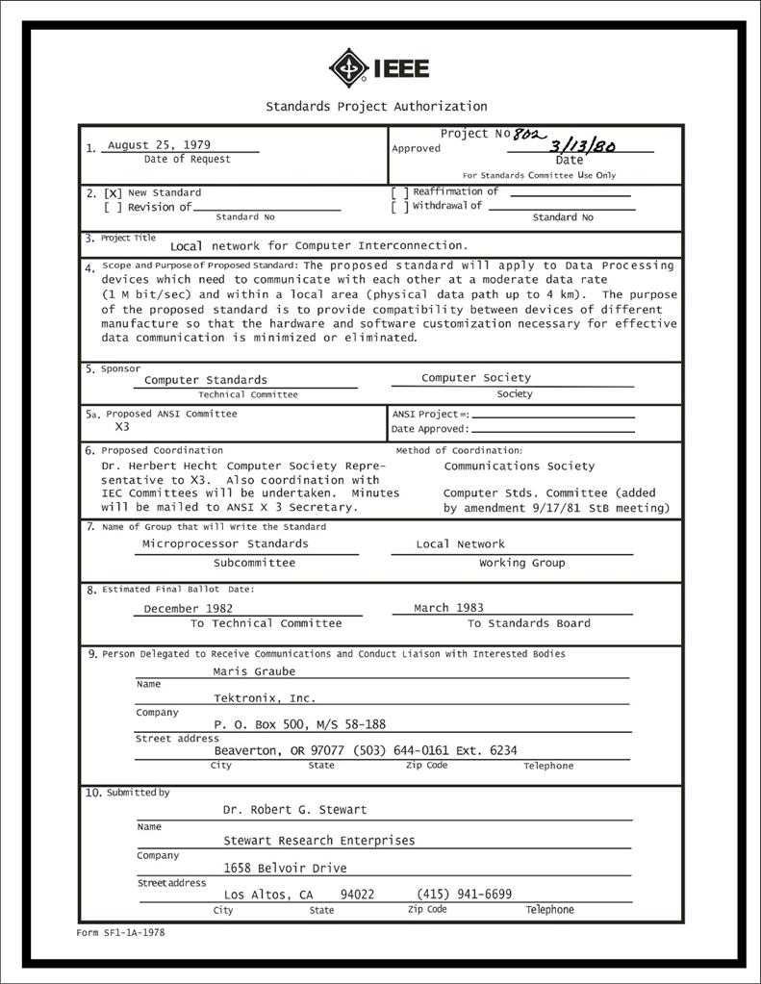
IEEE 802 LMSC Executive Committee 07 February 2023 Electronic Meeting 20:00-22:00 UTC 14:00-16:00 ET
DCN ec-23-023-00-01EC

Slide 2
1.00 Meeting called to order/roll call
2.00 Review/modify/approve agenda
2.01 Participation Slide Set URLs:
https://ieee802.org/sapolicies.shtml
https://standards.ieee.org/content/dam/ieee-standards/standards/web/documents/other/Participant-Behavior-Individual-Method.pdf
Participant behavior is guided by IEEE Code of Ethics & Conduct
Participants shall act independently of others, including employers
Standards activities shall allow the fair & equitable consideration of all viewpoints

Slide 3
3.00 Chair’s Announcements
Proforma:
Use IMAT to log your attendance
Please enable mute when you are not speaking
Please use the chat function to request being put in the queue
Reminder: Peter Yee appointed to 802/JTC1 Standing Committee Chair
Thank you to Andrew Myles for his service.
Announcements:
2023 SA BoG members: Law, Nikolich, Parsons, and Stanley
2023 SA BoG RAC members: Garner, Grow, Levy, Marks (chair), Montemurro, Thompson, Holness, Parsons
2023 SA Stds Board members: Heirtz, Law, Levy, Liu, Myles, Nikolich, Wang
2023 Computer Society Standards Activities Board: Au, Levy, Montemurro, Nikolich, Rosdahl
2023 Technical Activities: Au (Committee on Standards Chair), Nikolich (TA rep to SA)
IEEE Board of Directors
Finance Committee: Nikolich (SA Treasurer),
Conduct Review Committee: Rosdahl and SA Rep to Conference Committee: Rosdahl

Slide 4
6.0 EC Any Other Business?
Any other business?
6.01 IEEE 802 Participants / Senior membership
6.02 2023 Electronic Media Update
?

Slide 5
9.0 EC Action Item Status Review
Review Action Items from this meeting
tbd

Slide 6
Adjourn EC Meeting

