Slide 1
2023 Jan IEEE 802W Mixed-mode Interim AV Training
Date: 2023-01-07
Authors:

Slide 2
Abstract
The 2023 January IEEE 802W Mixed-mode Interim Session will be the second time that IEEE 802W Interim has provided for remote attendance to their Interim sessions. This Training deck is to help with the discussion on what to expect when running a meeting in this fashion. Training sessions are planned for January 9 at 12:00 ET and 20:00 ET and January 15 (13:30 ET), 2023.

Slide 3
Summary of Key Points
Meeting is to be run as an in-person meeting.
Local time zone schedule for meetings
Local participants attend as an in-person meeting
Remote access is provided to remote participants to view/present/interact similarly to on-line meetings (best effort)
In-person participants are admonished (stronger than encouraged) to stay OFF the Audio interface from the Webex/zoom/teams/conference tool of your choice –
Presentation/room computer is logged into conference tool (ideally from a volunteer-supplied PC), and the web-conferencing tool is presenting what is being presented by the local projector.
A chair, vice-chair, or designate, is logged into the conference tool and monitoring the queue (based on experience this is probably a second room log in, since monitoring the queue doesn’t work well when presenting) – this person manages the online queue for the chair to integrate with the floor queue. Fairness for local and remote attendees is responsibility of the officer.
Audio comes from a floor mic or the chair/dias mic which is mixed into room speakers and outgoing sound by the sound board is then connected to the local computer that shares to the remote conference tool.
Working groups need to decide voting rules, etc. for subgroups (some use different rules for electronic meetings than in person – what to use for hybrid?)

Slide 4
Mixed Mode Meeting requirements - (1)
1. Local room requirements:
hear local participants (some microphones may be needed, and the number is per size of room).
See presentations (projection of central machine or chair's machine for local observation).
Local Queue management is by lining up to microphone.
Provide local audio and screen presentation to remote participants (WebEx, Zoom, Proprietary)
Hear remote participants (audio from remote should seamlessly be injected in the local room.)
Remote Queue management to be integrated with local participants queue (Chair may need a VP to watch and manage fair queue access)
Remote presentations need to be presented to Local room. (central machine or chair's machine to project remote shared screen).

Slide 5
Mixed Mode Meeting requirements- (2)
2. Remote access requirements:
Hear local participants (Local participants need to speak into microphone to ensure injected into remote system)
See Local or Remote presentations ( projection of central machine or chair's machine into remote access tool).
Request remote queue (need to indicate desire to speak and be called on when appropriate).
Speak - Need to be able to speak to the Local and remote participants
Present - Need to be able to have a remote presenter (this can be done by the central machine or chair's machine or sharing of remote screen).

Slide 6
Mixed Mode Meeting requirements - (3)
3. General requirements
Local room to integrate local and remote audio
Local room to have a method of sharing remote info to local screen
No requirement for local participants to login to "see" remote information.
Explicitly preclude local participants from connecting audio to prevent audio feedback loop.
2 XLR cables for Audio in/out will be provided to the head table.

Slide 7
Draft Room Resource Allocation
Big meetings
(≥ 100, e.g., WG plenaries)
Medium meetings
(35-100, e.g., Task Forces)
Smaller meetings
(30 or less)
Head table (5)
1 projector/screen
2 tables mics
1 or 2 floor mics
Sound system
(speakers, sound board, etc.)
Ethernet/HDMI/USB
Scarlett Audio Interface
Head table (3)
1 projector/screen
1 table mic
1 floor mic
Sound system
(speakers, sound board, etc.)
Ethernet/HDMI/USB
Scarlett Audio Interface
U-shaped or board meeting setup
1 room microphone
Portable or speakerphone-type
Sound system
(speakers, sound board, etc.)
Ethernet/HDMI/USB
Scarlett Audio Interface

Slide 8
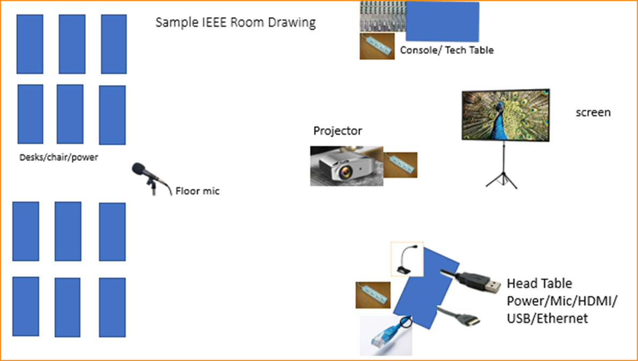
Scarlett
Notes:
This Photo by Unknown Author is licensed under CC BY-NC
This Photo by Unknown Author is licensed under CC BY-SA-NC
This Photo by Unknown Author is licensed under CC BY-SA

Slide 9
Scarlett Solo – Audio Interface

Slide 10
Suggested best practices
One central laptop/computer per meeting connects at head table.
Local speakers queue/speak only at a microphone when called on.
Remote speakers request to speak via chat window and only speak when called on.
Presenters have chair (central laptop) share the presentation
Local attendees when logged into WebEx SHALL NOT connect Audio.
When Starting a meeting the host should do the following:
Select “Meeting” -> “Meeting Options” -> [Disable] “Allow Participant to turn on Video”
Select “Participant” -> [Enable] “Mute on Entry”.
For those Remote Attendees connecting to Webex, Configure Webex Audio to use “Music Mode”.

Slide 11
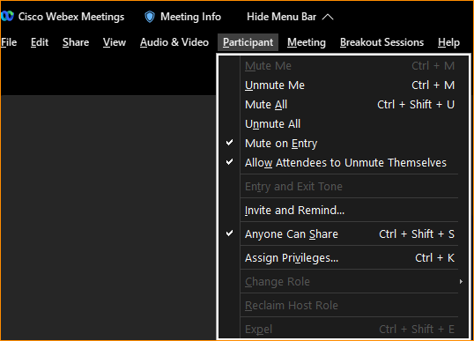
Webex Meeting Options
Select “Participant” -> [Enable] “Mute on Entry”.

Slide 12
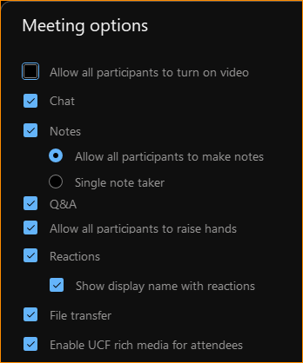
Webex Meeting options
Select “Meeting” -> “Meeting Options” -> [Disable] “Allow Participant to turn on Video”
This conserves bandwidth.

Slide 13
WebEx Settings
Before starting/joining the meeting, you can set up the audio.

Slide 14
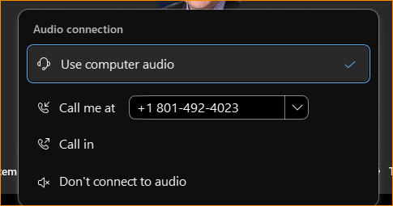
Webex Settings
If you are the Meeting Facilitator (Main Laptop) select “Use computer audio. If you are a local participant, PLEASE, select “Don’t connect to audio”

Slide 15
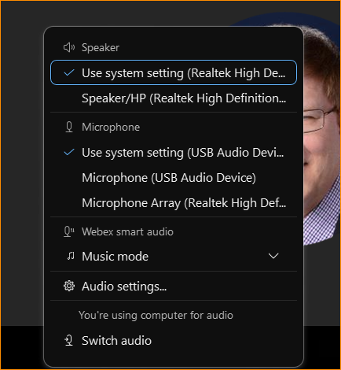
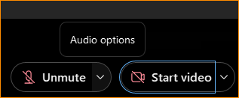
Webex Audio Settings
Next to the “Unmute” text is a drop down arrow. It will give you “Audio options”

Slide 16
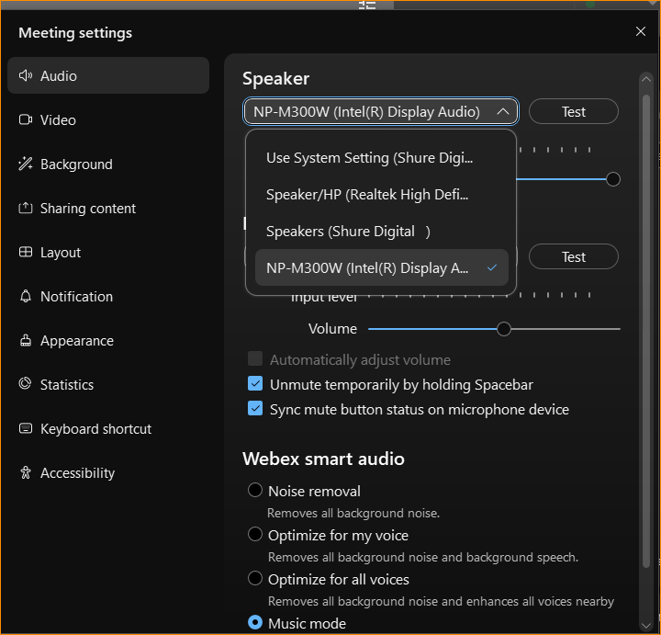
Audio Options in Waikoloa
For Bangkok, the option will be USB speaker

Slide 17
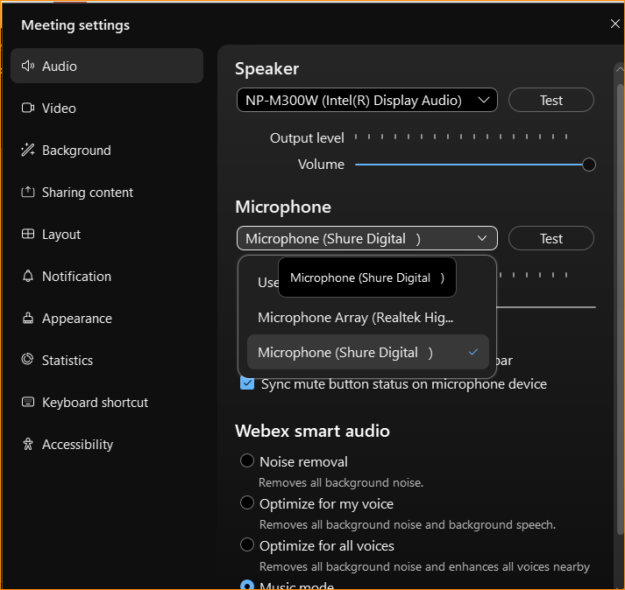
Audio Options in Waikoloa
For Bankgkok, select USB Microphone.

Slide 18
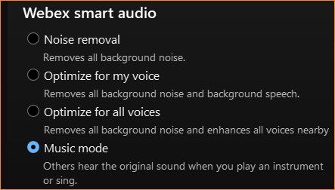
WebEx Settings: Select Music Mode
We observed that when in other modes, the audio from the remote attendee would be distorted or clipped. But when we selected music mode, the audio from the remote attendee was better.

Slide 19
Apple – MAC Settings
The next slides show the setup for the MAC laptops specifically for the Waikoloa Interim, but the settings are similar.

Slide 20
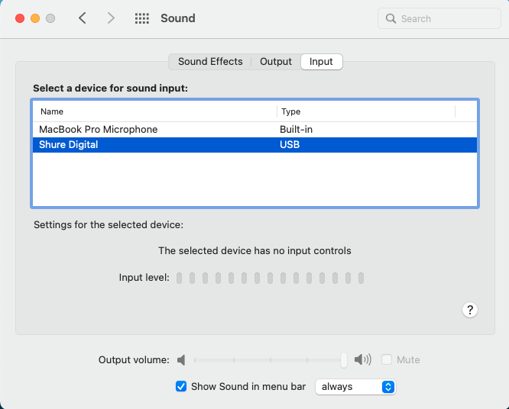

Slide 21
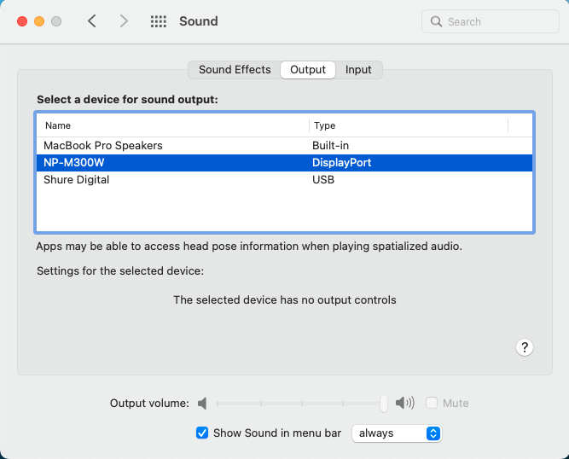

Slide 22
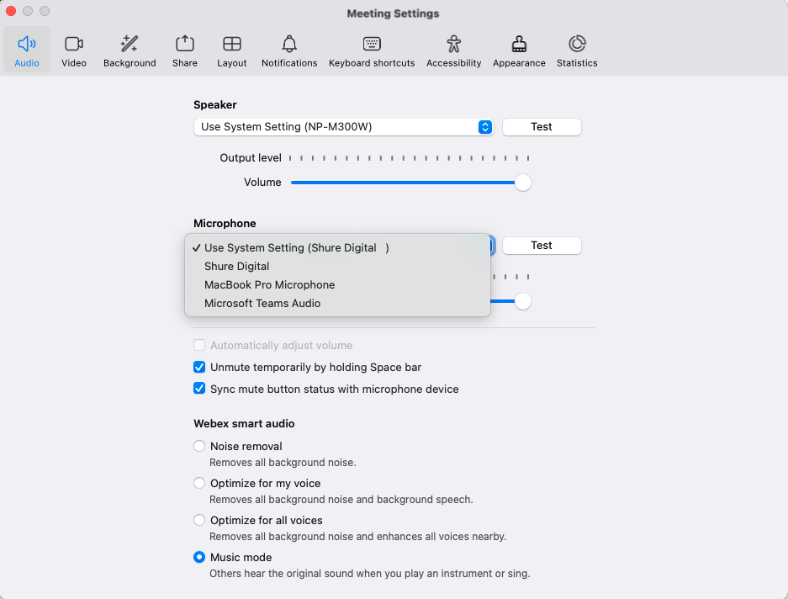

Slide 23
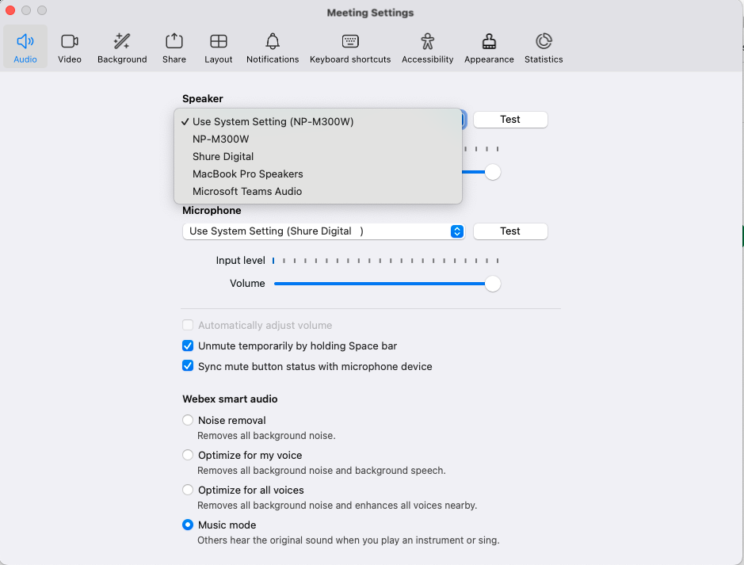

Slide 24
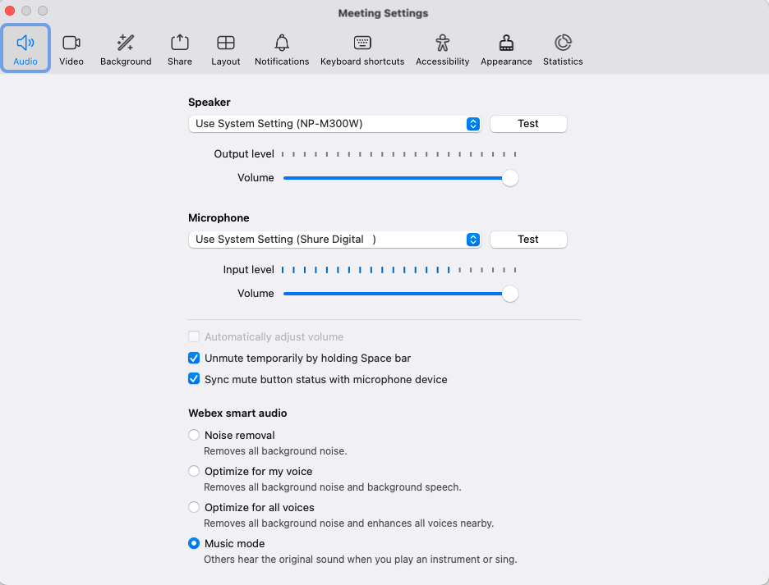

Slide 25
References
Calendar shows meeting room schedule/assignments: https://ieee802.org/802tele_calendar.html

Slide 26
Successful Hybrid Meeting Protocol
Sample Intro Meeting Slide
In-room Attendees:
In Webex choose connect without audio before you join
Use the Webex queue to indicate you want to speak
Wait to be called on while standing/holding a microphone to make a comment
Repeat any questions that are inadvertently asked away from the microphone
Remote Attendees:
Join Webex and set Webex audio as ‘music’
Use the Webex chat window to indicate you want to speak (“q”)
Wait to be called on to speak
Host:
Disable Video for participants
Set up participants to mute on entry
Set up Audio Options:
Microphone -> USB, Speaker -> USB, Smart Audio -> Music
Use a designated person to monitor speaking requests (manage the queue).

