Slide 1
September 2022 IEEE 802 Wireless Interim Session
Event Summary and Important Information
Prepared By: Face to Face Events, September 1, 2022

Slide 2
Meeting Planner and Network Contacts
Meeting Planner: Face to Face Events
Dawn Slykhouse
Mobile: +1 (408) 594-1342
Email: dawns@facetoface-events.com
Lisa Ronmark
Mobile: +1 (604) 316-4947
Email: lisa@facetoface-events.com
Network Provider: Linespeed Events
Richard Alfvin
Mobile: +1 (585) 781-0952
Email: rick@linespeed.com
Meeting Planner and Network Office
Waikoloa 1

Slide 3
In Person Registration Times and Location
Registration and Information Desk
Grand Promenade at Hilton Waikoloa Village Resort
Sunday 3:30 PM - 6:30 PM
Monday 7:30 AM - 5:00 PM
Tuesday, Wednesday, Thursday 7:30 AM - 1:30 PM

Slide 4
Food and Beverage Breaks - Lagoon Lanai
FOR REGISTERED ATTENDEES ONLY
Light Breakfast
Monday - Friday
7:30 AM - 8:30 AM
Lunch
Monday - Friday
12:15 PM - 1:30 PM
Morning Break
Coffee & Tea
Monday - Thursday
9:50 AM - 10:35 AM
Afternoon Break
Coffee, Tea, Lemonade, Ice Tea, Snacks
Monday - Thursday
3:20 PM - 4:05 PM

Slide 5
Schedule of Sessions and Attendance
SCHEDULE OF SESSIONS
In Person Room Assignments: Schedule QR codes posted outside each meeting room and on your badge hand out. http://schedule.802world.com/schedule/schedule/show
Virtual Participation: https://ieee802.org/802tele_calendar.html
ATTENDANCE TOOL (IMAT)
https://imat.ieee.org/my-site/home
REGISTRATION FEE REQUIREMENT REMINDER
Payment of the session registration fee is required for all individuals who participate in any session associated with the September 2022 IEEE 802 Wireless Interim. Registration: https://cvent.me/XDLlAe

Slide 6
Audio Visual Support - In Person Sessions
WHO TO CONTACT IF AUDIO VISUAL EQUIPMENT ISN’T WORKING IN YOUR ONSITE MEETING ROOM
Please contact the Meeting Planner directly if you have any issues with the audio visual equipment in your meeting room. The Meeting Planner will contact support and the appropriate technician will be sent to assist as soon as possible.
Meeting Planner can be reached at:
Registration and Information Desk: Grand Promenade
Event Office: Waikoloa 1
Via Text or Call: Dawn Slykhouse: +1 (408) 594-1342 Lisa Ronmark +1 (604) 316-4947
WEBEX AUDIO IN THE ONSITE MEETING ROOM
If you are a local participant, PLEASE, select “Don’t connect to audio” when joining the WebEx session. Connecting to the audio, may cause an audio feedback loop that prevents the meeting from proceeding

Slide 7
Network Access Information and Support
IEEE 802 Wireless Secure Network Access
Wireless Encryption Protocol: WPA2/WPA3
SSIDS: IEEE802
Password: ieeeieee
Onsite Network Support
The September 2022 IEEE 802 Wireless Interim Session Network Provider is Linespeed.
Members of the Linespeed team will be available in Waikoloa 1 or at a network support desk located in the Grand Promenade.

Slide 8
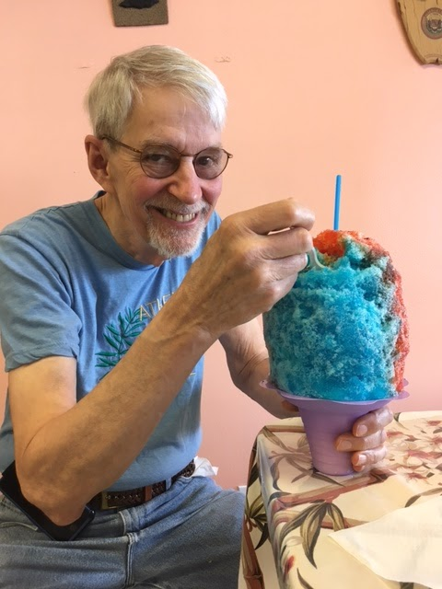
Shave Ice Special
In honor of devoted IEEE 802 Standards leader and 802.15 Working Group Chair, Dr. Robert Heile (1945-2020) we will be providing tickets for Shave Ice treats .
A Shave Ice Food Truck will be serving between 1:00 PM and 4:00 PM on Tuesday September 13th.
The truck will be located in the front entrance of the hotel. We will post signs with directions. Enjoy!

Slide 9
‘So Long and Thanks for All the Fish’
Networking Social and Tribute to Dr. Robert Heile
WHO
Special Honored Guests: Bonnie and Sarah Heile
Registered In-Person attendees* and their guests*.
*Please confirm your planned attendance with the Meeting Planner at the event Registration Desk. Guest Badges available until 4:00 PM Wednesday.
WHEN
Wednesday September 14th , 6:30 PM - 9:00 PM
WHERE
King Kamehameha Court (Luau Location)
WHAT
Food, Drinks, Entertainment, Tribute to Bob Heile
Complimentary Bar Service 6:30 PM - 7:30 PM
The title of this event, So Long and Thanks for All the Fish was borrowed from the Douglas Adams book Hitchhiker's Guide to the Galaxy. It was a favourite parting phrase of Dr. Heile’s at the 802.15 Closing Plenary.

Slide 10
Hawaiian Shirt Contest
All in-person attendees are encouraged to express their Hawaiian Spirit by wearing a Hawaiian print garment like a shirt, dress, sarong, on
Wednesday September 14th.
Honored session guests, Bonnie and Sarah Heile will serve as judges.
Awards and honors will be bestowed at the Thanks for All the Fish, social.

Slide 11
Thanks for helping us make this session a success, we look forward to working with you again!
The next IEEE 802 Plenary Session will be November 13-18, 2022. The session will be a Mixed Mode with In-Person participation at the Marriott Marquis Queen’s Park in Bangkok, Thailand.
Session Information and Registration Link: https://cvent.me/0Vk4Qq
If you have any questions about the current session or the November 2022 IEEE 802 Plenary please contact us:
Face to Face Events
IEEE 802 Wireless Meeting Planner
Email: 802info@facetoface-events.com

