Slide 1
2022 July IEEE 802 Mixed-mode Plenary Meeting AV Training
Date: 2022-08-30
Authors:

Slide 2
Abstract
The 2022 Sept IEEE 802W Mixed-mode Interim Session will be the first time that IEEE 802 Wireless Group has provided for remote attendance to their Interim sessions. This Training deck is to help with the discussion on what to expect when running a meeting in this fashion. Training sessions were given Aug 30, at 12:00 ET and 20:00 ET and Sept 11th (13:30 HT), 2022.

Slide 3
Summary of Key Points
Meeting is to be run as an in-person meeting.
Local time zone schedule for meetings
Local participants attend as an in-person meeting
Remote access is provided to remote participants to view/present/interact similarly to on-line meetings (best effort)
In-person participants are admonished (stronger than encouraged) to stay OFF the Audio interface from the Webex/zoom/teams/conference tool of your choice –
Presentation/room computer is logged into conference tool (ideally from a volunteer-supplied PC), and the web-conferencing tool is presenting what is being presented by the local projector.
A chair, vice-chair, or designate, is logged into the conference tool and monitoring the queue (based on experience this is probably a second room log in, since monitoring the queue doesn’t work well when presenting) – this person manages the online queue for the chair to integrate with the floor queue. Fairness for local and remote attendees is responsibility of the officer.
Audio comes from a floor mic or the chair/dias mic which is mixed into room speakers and outgoing sound by the sound board is then connected to the local computer that shares to the remote conference tool.
Working groups need to decide voting rules, etc. for subgroups (some use different rules for electronic meetings than in person – what to use for hybrid?)

Slide 4
Mixed Mode Meeting requirements - (1)
1. Local room requirements:
hear local participants (some microphones may be needed, and the number is per size of room).
See presentations (projection of central machine or chair's machine for local observation).
Local Queue management is by lining up to microphone.
Provide local audio and screen presentation to remote participants (WebEx, Zoom, Proprietary)
Hear remote participants (audio from remote should seamlessly be injected in the local room.)
Remote Queue management to be integrated with local participants queue (Chair may need a VP to watch and manage fair queue access)
Remote presentations need to be presented to Local room. (central machine or chair's machine to project remote shared screen).

Slide 5
Mixed Mode Meeting requirements- (2)
2. Remote access requirements:
Hear local participants (Local participants need to speak into microphone to ensure injected into remote system)
See Local or Remote presentations ( projection of central machine or chair's machine into remote access tool).
Request remote queue (need to indicate desire to speak and be called on when appropriate).
Speak - Need to be able to speak to the Local and remote participants
Present - Need to be able to have a remote presenter (this can be done by the central machine or chair's machine or sharing of remote screen).

Slide 6
Mixed Mode Meeting requirements - (3)
3. General requirements
Local room to integrate local and remote audio
Local room to have a method of sharing remote info to local screen
No requirement for local participants to login to "see" remote information.
Explicitly preclude local participants from connecting audio to prevent audio feedback loop.

Slide 7
Draft Room Resource Allocation
Big meetings
(≥ 100, e.g., WG plenaries)
Medium meetings
(35-100, e.g., Task Forces)
Smaller meetings
(30 or less)
Head table (5)
1 projector/screen
2 tables mics
1 or 2 floor mics
Sound system
(speakers, sound board, etc.)
Ethernet/HDMI/USB
Head table (3)
1 projector/screen
1 table mic
1 floor mic
Sound system
(speakers, sound board, etc.)
Ethernet/HDMI/USB
U-shaped or board meeting setup
1 room microphone
Portable or speakerphone-type
Sound system
(speakers, sound board, etc.)
Ethernet/HDMI/USB

Slide 8
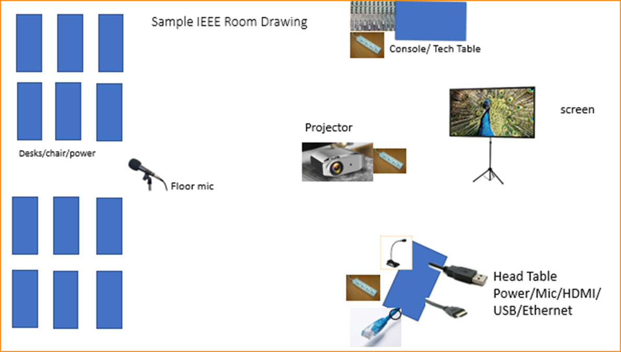
Notes:
This Photo by Unknown Author is licensed under CC BY-NC
This Photo by Unknown Author is licensed under CC BY-SA-NC
This Photo by Unknown Author is licensed under CC BY-SA

Slide 9
Suggested best practices
One central laptop/computer per meeting connects at head table.
Local speakers queue/speak only at microphone
Presenters have chair (central laptop) share the presentation
Local attendees when logged into WebEx SHALL NOT connect Audio.
When Starting a meeting the host should do the following:
Select “Meeting” -> “Meeting Options” -> [Disable] “Allow Participant to turn on Video”
Select “Participant” -> [Enable] “Mute on Entry”.
For those Remote Attendees Connecting to Webex, Configure Webex Audio to use “Music Mode”.

Slide 10
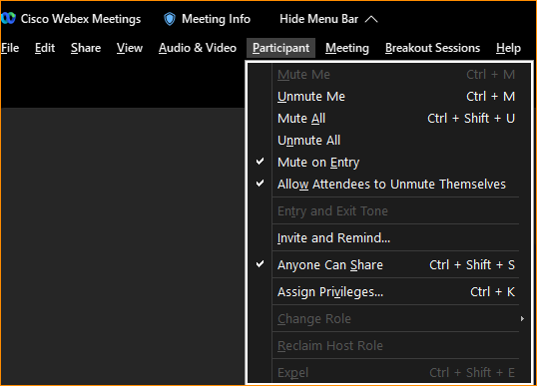
Webex Meeting Options
Select “Participant” -> [Enable] “Mute on Entry”.

Slide 11
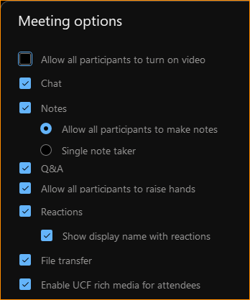
Webex Meeting options
Select “Meeting” -> “Meeting Options” -> [Disable] “Allow Participant to turn on Video”
This conserves bandwidth.

Slide 12
WebEx Settings
Before starting/joining the meeting, you can set up the audio.

Slide 13
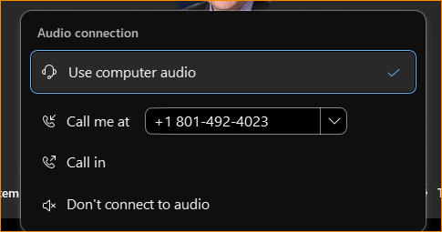
Webex Settings
If you are the Meeting Facilitator (Main Laptop) select “Use computer audio. If you are a local participant, PLEASE, select “Don’t connect to audio”

Slide 14
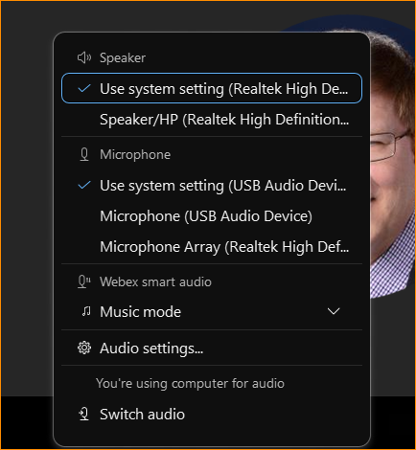
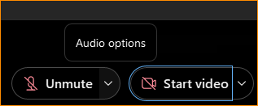
Webex Audio Settings
Next to the “Unmute” text is a drop down arrow. It will give you “Audio options”

Slide 15
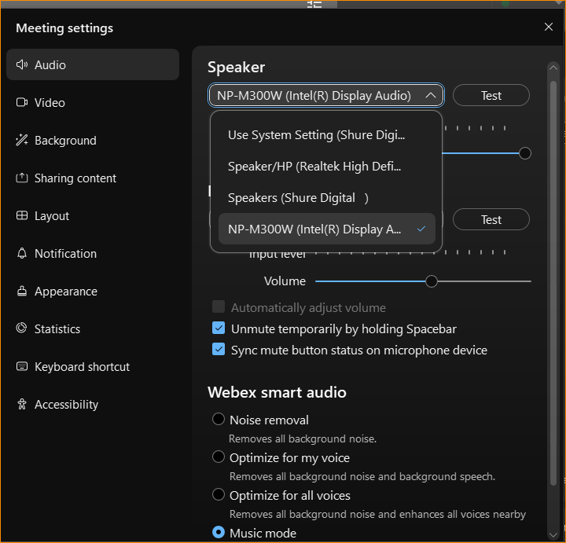
Audio Options in Waikoloa

Slide 16
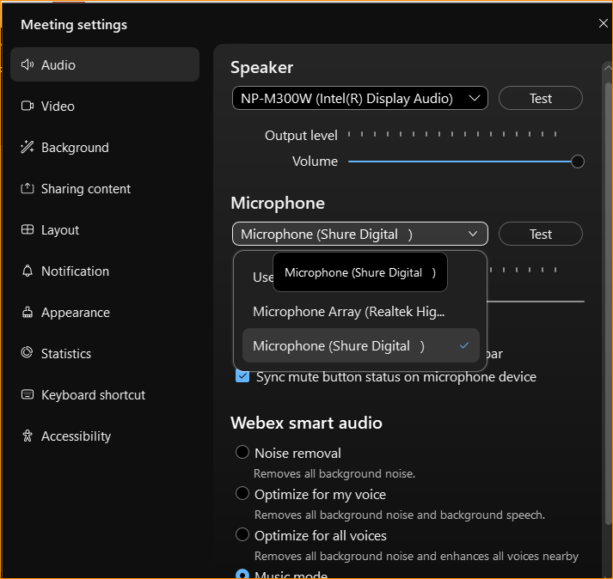
Audio Options in Waikoloa

Slide 17
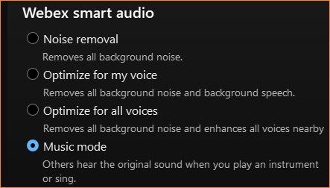
WebEx Settings: Select Music Mode
We observed that when in other modes, the audio from the remote attendee would be distorted or clipped. But when we selected music mode, the audio from the remote attendee was better.

Slide 18
Apple – MAC Settings
The next slides show the setup for the MAC laptops.

Slide 19
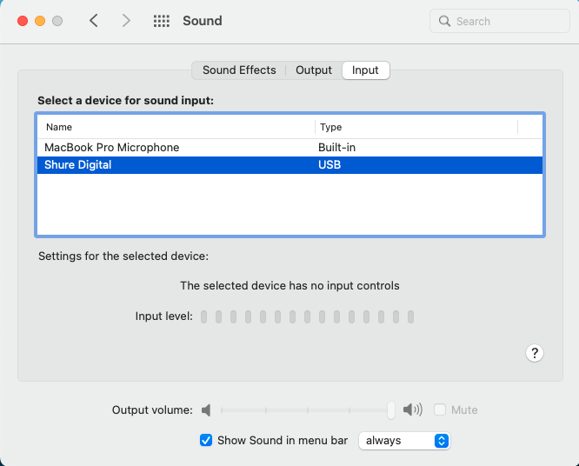

Slide 20
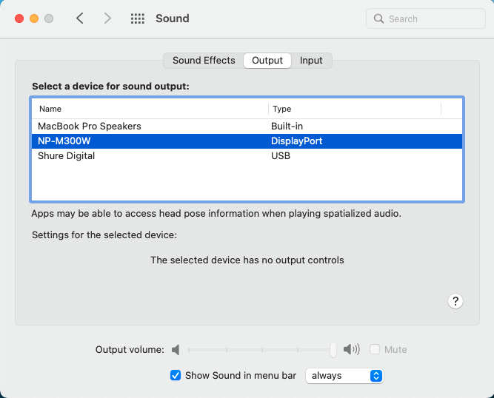

Slide 21
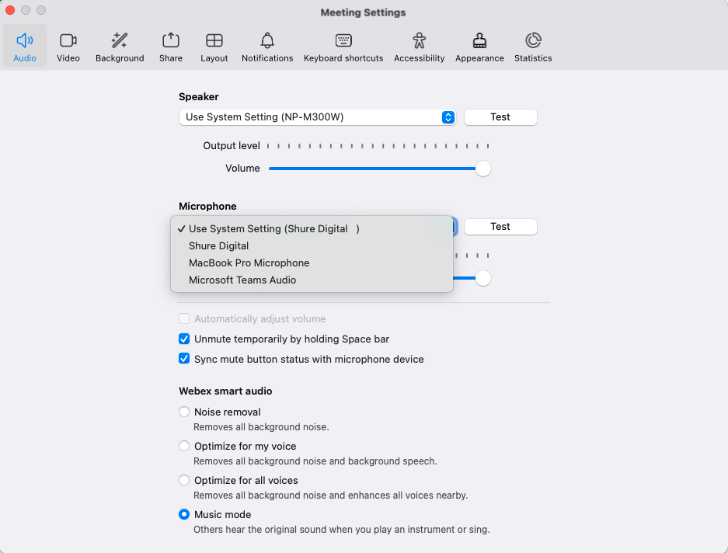

Slide 22
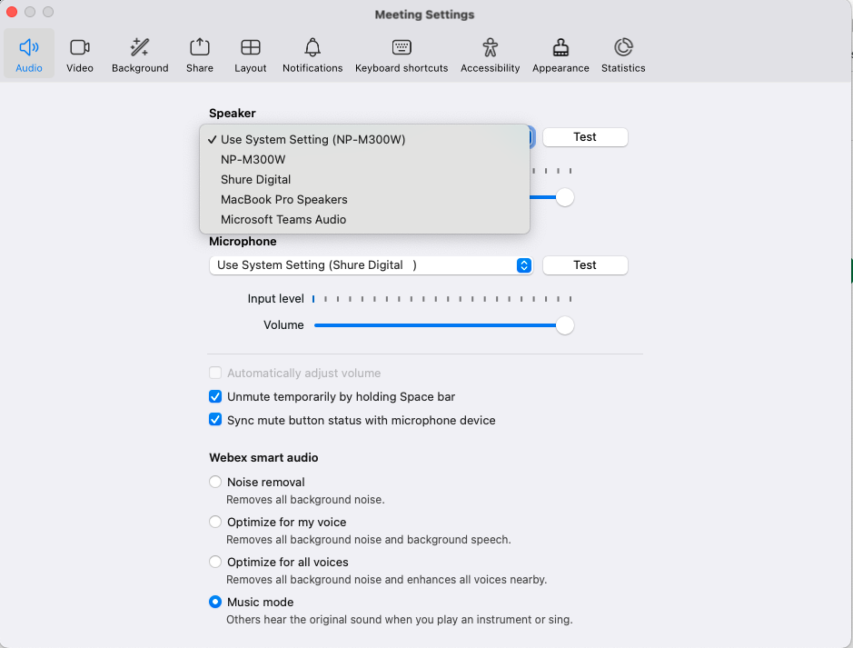

Slide 23
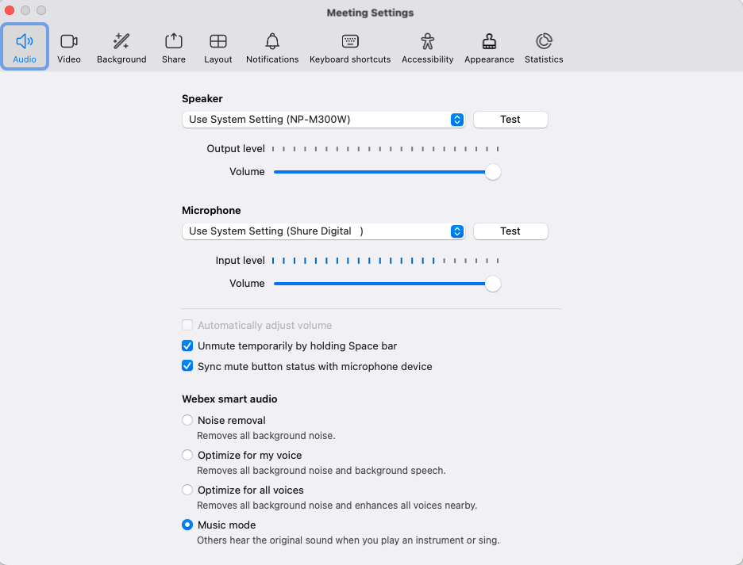

Slide 24
References
Calendar shows meeting room schedule/assignments: https://ieee802.org/802tele_calendar.html

