Slide 1
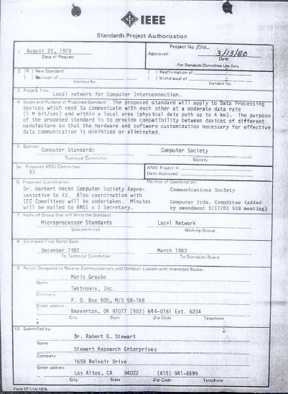
IEEE 802 LMSC 130th Plenary Session (1st mixed mode Plenary Session) 11 July 2022 to 15 July 2022
DCN ec-22-0129-00-00EC

Slide 2
3.0 Participant behavior in IEEE-SA activities is guided by the IEEE Codes of Ethics & Conduct
All participants in IEEE-SA activities are expected to adhere to the core principles underlying the:
IEEE Code of Ethics
IEEE Code of Conduct
The core principles of the IEEE Codes of Ethics & Conduct are to:
Uphold the highest standards of integrity, responsible behavior, and ethical and professional conduct
Treat people fairly and with respect, to not engage in harassment, discrimination, or retaliation, and to protect people's privacy.
Avoid injuring others, their property, reputation, or employment by false or malicious action
The most recent versions of these Codes are available at
http://www.ieee.org/about/corporate/governance

Slide 3
3.0 Participants in the IEEE-SA “individual process” shall act independently of others, including employers
The IEEE-SA Standards Board Bylaws require that “participants in the IEEE standards development individual process shall act based on their qualifications and experience”
This means participants:
Shall act & vote based on their personal & independent opinions derived from their expertise, knowledge, and qualifications
Shall not act or vote based on any obligation to or any direction from any other person or organization, including an employer or client, regardless of any external commitments, agreements, contracts, or orders
Shall not direct the actions or votes of other participants or retaliate against other participants for fulfilling their responsibility to act & vote based on their personal & independently developed opinions
By participating in standards activities using the “individual process”, you are deemed to accept these requirements; if you are unable to satisfy these requirements then you shall immediately cease any participation

Slide 4
3.0 IEEE-SA standards activities shall allow the fair & equitable consideration of all viewpoints
The IEEE-SA Standards Board Bylaws (clause 5.2.1.3) specifies that “the standards development process shall not be dominated by any single interest category, individual, or organization”
This means no participant may exercise “authority, leadership, or influence by reason of superior leverage, strength, or representation to the exclusion of fair and equitable consideration of other viewpoints” or “to hinder the progress of the standards development activity”
This rule applies equally to those participating in a standards development project and to that project’s leadership group
Any person who reasonably suspects that dominance is occurring in a standards development project is encouraged to bring the issue to the attention of the Standards Committee or the project’s IEEE-SA Program Manager

Slide 5
3.02 Fee Waivers
Motion: Approve waiving the plenary session registration fee for the following individuals:
Mover: Glenn Parsons Seconder: Roger Marks
Participant | Affiliation | Rationale
Mr. Rob Wilton rwilton@cisco.com | Cisco IETF Operations & Management Area Director | Attendance at YANGsters meeting to discuss IETF management of YANG ids
Mr. Carsten Bormann cabo@tzi.org | Universität Bremen TZI IETF YANG SID co-author | Attendance at YANGsters meeting to discuss IETF management of YANG ids

Slide 6
3.03 Service Awards
Jay Holcomb
Pat Kinney

Slide 7
4.00 IEEE Staff
Michelle Turner role: 802 lead editorial support title: Managing Editor, Content Production Management
Catherine Berger role: 802 editorial support title: Senior Program & Special Project Manager
Jodi Haasz role: 802 lead supports: dot03 and dot18 groups title: Operational Program Management Senior Manager
Christy Bahn role: supports dot11, dot15, dot19 and, dot24 groups title: Operational Program Management Program Manager
Christian Orlando role: supports dot01 title: Operational Program Management Program Coordinator NOTE additional staff support: Erin Morales, Director, Operational Program Managerment (e.spiewak@ieee.org), Ashley Moran, Program Manager, Operational Program Management (a.f.moran@ieee.org), Patricia Roder, Senior Program Manager, Operational Program Management (p.roder@ieee.org), Malia Zaman, Senior Program Manager, Operational Program Management (m.zaman@ieee.org), Jennifer Santulli, Program Manager, Operational Program Management (j.santulli@ieee.org), Tom Thompson, Program Manager, Operational Program Management (thomas.thompson@ieee.org), Vanessa Lalitte (v.lalitte@ieee.org), Program Coordinator, Operational Program Management, Mike Kipness (m.kipness@ieee.org), Program Manager, Operational Program Management

Slide 8
5.01 Chair’s Announcements

Slide 9
5.01 Chair’s Announcements
In person interaction is vital to our productivity and creativity.
I look forward to a safe and productive return to in person sessions this week.

Slide 10
5.01 Chair’s Announcements
Reminder #1: Please use IMAT to log your attendance
Reminder #2: Interim EC meeting scheduled for 20:00-22:00 UTC 02 August (15:00-17:00 ET)
Reminder #3: closing EC consent agenda items due 19:00 UTC Wednesday 13 July 2022 (14:00 ET) -- 48 hours prior to the start of the closing EC meeting. vote tallies in support of consent agenda items due 17:00 UTC Friday 15 July 2022 (12:00 ET) -- 2 hours prior to the start of the closing EC plenary meeting.
Reminder #4: TBD

Slide 11
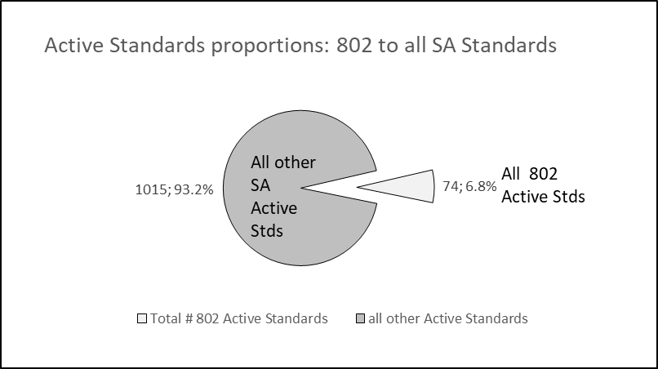
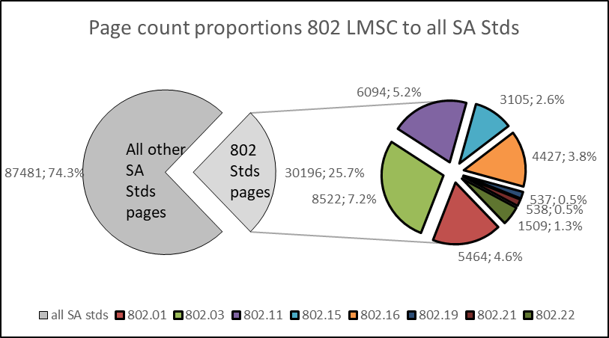
5.01 802 LMSC Analytics

Slide 12
5.02 IEEE SA BoG Actions
SA BoG May 2022
The IEEE SA BOG approved the special use of funds in 2022 in accordance with the IEEE FOM, with the funds coming from the IEEE SA 2021 budget surplus, for a $4.5 Million contribution to the X-Prize Foundation to support the X-Prize IEEE Energizing The Future prize package.
The BOG also approved an additional amount of up to $175,000 to be spent to support related IEEE X-Prize sustainability activities within IEEE, including a student competition.
The BOG approved IEEE SA Individual Membership pricing principles.
802 EC members on the SA BoG
David Law, SASB Chair; George Zimmerman and Glenn Parson, MALs

Slide 13
5.02 IEEE Boards updates
Standards Association Standards Board February 2022
The SASB recognized the Broadcast Technology Society/Broadcast Technology Standards Committee, to be abbreviated as BTS/BTSC, as an official Standards Committee, in accordance with IEEE SASB Bylaws 5.2.2.
802 Members on SASB: David Law, Dorothy Stanley, Jon Rosdahl, Guido Hiertz, Andrew Myles
Computer Society BoG & SAB May 2022
SA Staff internally met with legal, risk, and a few key volunteers to discuss the definition of a “Standards Development Meeting”. This is still early in the investigation and no specific resolution at this time, but there have been discussions if there is a difference between standards development and other SA meetings. Matt Ceglia, SA staff, will continue to provide updates related to the discussion..
IEEE Technical Activities and BoD meetings June 2022
Technical Activities Board (TAB) Committee on Standards (CoS) continues to encourage initiation of standards activities across all TAB Societies and Councils. The VP of Technical Activities has reserved $100k for ‘special projects’. Please contact Paul Nikolich for details.
TAB CoS is working with Roger Fuji, TAB Strategic Planning Committee Chair, to integrate standards activities into the IEEE 2050 Strategic Plan. Please contact Paul Nikolich for details.

Slide 14
5.03 SA Standards Board Actions
802 Project Authorization SASB Approvals March/April 2022
- New: P802.3dg 100 Mb/s over a Single Balanced Pair of Conductors,
P802.3dh Physical Layer Specifications for multi-gigabit optical,
P802.1Qdt Priority-based Flow Control Enhancements
- Extensions: none
- PAR Modifications: none
SASB 802 Standard Ratifications in May/June 2022
IEEE Std 802.3™-2022 Revision/roll up (7023 pages)
IEEE Std 802.3dd™-2022 editorial and technical corrections to PoDL (33 pages)

Slide 15
5.04 LMSC Email Ballot Recap
open date topic yes/no/abs/dnv* result
29MAR Approval of comments to UK Ofcom 09/00/03/01 pass
08APR Approval of ITU-R WP 5A liaisons 08/00/01/04 pass
25MAY Approval of PSDO status report for SC6 10/00/00/03 pass
22JUN Approval of P802.3dg blog post 11/00/00/02 pass
* 802 chair is counted as DNV unless his vote is required

Slide 16
5.05 EC Affiliation Update
IEEE 802 Executive Committee Members
Position | Name | Affiliation
Chair | Paul Nikolich | Self, HPE, Huawei, YAS BBV Origin Wireless, Wyebot
First Vice Chair | James P. K. Gilb | General Atomics Aeronautical Systems, Inc., Univ of San Diego
Second Vice Chair | Roger Marks | EthAirNet Associates, Huawei
Treasurer | George Zimmerman | CME Consulting, Analog Devices, Marvell, Cisco Systems, CommScope, Sen Tekse LLC, APL Group
Recording Secretary | John D'Ambrosia | Futurewei, a U.S. subsidiary of Huawei
Executive Secretary | Jon Rosdahl | Qualcomm Technologies, Inc.
P802.1 High Level Interface (HILI) | Glenn Parsons | Ericsson
P802.3 Ethernet | David Law | Hewlett Packard Enterprise
P802.11 Wireless Local Area Network (WLAN) | Dorothy Stanley | Hewlett Packard Enterprise
P802.15 Wireless Specialty Networks | Pat Kinney | Kinney Consulting, LLC.
P802.18 Radio Regulatory TAG | Jay Holcomb | Itron Inc.
P802.19 Wireless Coexistence | Steve Shellhammer | Qualcomm Technologies, Inc.
P802.24 Vertical Network Applications TAG | Tim Godfrey | Electric Power Research Institute
Member Emeritus Member Emeritus | Geoff Thompson Clint Chaplin | Self, GraCaSI Standards Advisors Self, Samsung Research America
Hibernating Working Groups
P802.16 Broadband Wireless Access | Roger Marks | EthAirNet Associates
P802.21 Media-independent Handover | Subir Das | Peraton Labs
P802.22 Wireless Regional Area Networks | Apurva Mody | A5 Systems, AiRANACULUS, White Space Alliance

Slide 17
5.05 EC Affiliation Update
Changes in affiliation among EC members from previous slide?

Slide 18
5.06 Drafts to SA Ballot
802.01: 802.1Qcw YANG models, 802.1AEdk MAC Privacy and 802f O&A YANG Model for Ethertypes
802.03: P802.3cx Improved PTP timestamping accuracy (Conditional) and P802.3cz Multi-Gigabit Optical Automotive Ethernet (Conditional)
802.11: none
802.15: none
802.19: none

Slide 19
5.07 Drafts to RevCom
802.01: P802.1Q-Rev Bridges
802.03: P802.3ck 100 Gb/s, 200 Gb/s, and 400 Gb/s Electrical Interfaces (Conditional), P802.3cs Increased-reach Ethernet optical subscriber access (Super-PON) and P802.3db 100 Gb/s, 200 Gb/s, and 400 Gb/s Short Reach Fiber (Conditional)
802.11: none
802.15: P805.15.4 Cor1
802.19: none

Slide 20
5.08 Draft Documents or Actions for EC to consider
802.EC: tbd.
802.01: SC6 ballot responses, ITU-T SG15; Technical Plenary Monday night 11 July
802.03: Delegation to ISO/IEC JTC1 SC25/WG3 September 2022 meeting and Direction of IEEE 802.3 delegation to ISO/IEC JTC1 SC25/WG3 September 2022 meeting
802.11: none
802.15: none
802.18: IEEE 802 Regulatory Report and plans for 2022 July plenary
802.19: none
802.24: none
802/JTC1 SC: report
802/ITU SC: report
802/IETF SC: report
802/Wireless Chairs SC: none
802 Public Visibility Standing Committee: none
20

Slide 21
5.09 Draft PARs to NesCom
P60802 - Standard - Time-Sensitive Networking Profile for Industrial Automation, PAR and CSD modified
P802.1Qdv - Amendment: Enhancements to Cyclic Queuing and Forwarding, PAR and CSD
P802.1Qdw - Amendment: Source Flow Control, PAR and CSD
eol
48 hour maintenance policy PARs
P60802 - Standard - Time-Sensitive Networking Profile for Industrial Automation, PAR Extension
P802.1CQ - Standard - Multicast and Local Address Assignment, PAR Extension
P802.1DC - Standard - Quality of Service Provision by Network Systems, PAR Extension
P802.15.4 Revision
PAR withdrawal requests:
none

Slide 22
5.10 Pre-PAR activity
Group | New | Existing
dot01 | none | IC: IEEE 802 Network Enhancements for the Next Decade IC Activity (Nendica)
dot03 | Greater than 50 Gb/s Bidirectional Optical Access PHYs | SG: none IC: New Ethernet Applications (NEA)
dot11 | New MAC/PHY | Topic Interest Groups - AI/ML - Ambient Power Standing Committees Wireless Next Generation

Slide 23
5.10 Pre-PAR activity
Group | New | Existing
dot15 | none | Interest Groups: none Standing Committees: none
dot19 | none | none
dot24 | none | none
dot ECSG | none | none

Slide 24
5.11 802/SA Task Force Topics
802/SA Task Force Electronic Meeting held Monday 25 April 2022 16:00-17:00 ET
Meeting notes at ec-22-0092-00-00EC-25apr2022-802-sa-task-force-notes.docx
Draft Agenda::
IEEE SA tools update & discussion
Mentor, etc. tools – replacement study status, schedule, requirements, etc.
Markus to provide status on the “IEEE Volunteer Document Management Solution (DMS)”
Discuss SA’s plans to continue supplying access to Webex in 2023
Schedule next meeting 4-5pm ET Monday 11 July 2022
Any other business, 5 min, all?
Action item review, 5 min, Nikolich
Adjourn
Action Items from the 25 April 2022 meeting:
AI: Markus to provide status update on the “Volunteer Document Management Solutions” project at the next 802/SA TF meeting on 11 July 2022.
AI: Jodi to obtain feedback from Gary Hoffman on the status of the ‘viability assessment’.
AI: Zimmerman report status on Mixed Mode Meeting Requirements at the next 802/SA TF meeting (11 July 2022).
AI: Jodi to provide feedback on Webex support plans at next 802/SA TF meeting 11 July 2022.
Next 802/SA TF Meeting Scheduled for 4-5pm ET Monday 11 July 2022

Slide 25
5.12 EC Action Item recap
Review Recording Secretary’s list of Open Action Items

Slide 26
5.13 802 LMSC Leadership Workshop
Scheduled for Saturday 16 July 2022
Co-leaders George Zimmerman and Ben Rolfe
Potential topics:
a) 802 Overview and Architecture revision
b) impact of emerging technologies, market trends and regulations on evolving 802 standards
c) mixed mode meetings: requirements, best practices, implementation, costs, P&P impact, etc.
d) long term meeting strategy -- remote only, mixed-mode, in-person only
e) tools: stability and evolution to improved platforms
f) assess relationships with regulators, external SDOs and alliances
g) 802 Next Gen Technologies Workshop improvements

Slide 27
5.14 802 LMSC Secondary Representative to the RAC
Motion
Approve Geoff Thompson to serve as 802 LMSC's secondary representative to the SA RAC for the 2023/2024 term
Mover Marks, Seconder D'Ambrosia

Slide 28
5.15 802 IEEE Milestone Project Status Update
Geoff Thompson

Slide 29
11.0 Cross 802 Activities EC Meeting Schedule (all times ET)
LMSC Rules TBD Sun 10 July
Orientation 09:00-10:00 Mon 11 July
Opening EC Meeting 08:00-10:30 Mon 11 July
Technical Plenary 18:00- 20:00 Mon 11 July
802/JTC1 Stdng Cmte TBD July
Public Visibility Stdng Cmte TBD July
Restructuring Ad Hoc TBD July
802/ITU Stdg Cmte TBD July
Closing EC Meeting 13:00-18:00 Fri 15 July
802 Leadership Workshop 08:00-17:00 Sat 16 July

Slide 30
End of Opening EC Meeting

