Slide 1

IEEE 802 LMSC
129th Plenary Session
(6th electronic Plenary Session)
04 March 2022 to
18 March 2022
DCN ec-22-0066-00-00EC

Slide 2
2.01 Participant behavior in IEEE-SA activities is guided by the IEEE Codes of Ethics & Conduct
All participants in IEEE-SA activities are expected to adhere to the core principles underlying the:
  IEEE Code of Ethics
  IEEE Code of Conduct
The core principles of the IEEE Codes of Ethics & Conduct are to:
  Uphold the highest standards of integrity, responsible behavior, and ethical and professional conduct
  Treat people fairly and with respect, to not engage in harassment, discrimination, or retaliation, and to protect people's privacy.
  Avoid injuring others, their property, reputation, or employment by false or malicious action
The most recent versions of these Codes are available at
  http://www.ieee.org/about/corporate/governance

Slide 3
2.01 Participants in the IEEE-SA “individual process” shall act independently of others, including employers
The IEEE-SA Standards Board Bylaws require that “participants in the IEEE standards development individual process shall act based on their qualifications and experience”
This means participants:
  Shall act & vote based on their personal & independent opinions derived from their expertise, knowledge, and qualifications
  Shall not act or vote based on any obligation to or any direction from any other person or organization, including an employer or client, regardless of any external commitments, agreements, contracts, or orders
  Shall not direct the actions or votes of other participants or retaliate against other participants for fulfilling their responsibility to act & vote based on their personal & independently developed opinions
By participating in standards activities using the “individual process”, you are deemed to accept these requirements; if you are unable to satisfy these requirements then you shall immediately cease any participation

Slide 4
2.01 IEEE-SA standards activities shall allow the fair & equitable consideration of all viewpoints
The IEEE-SA Standards Board Bylaws (clause 5.2.1.3) specifies that “the standards development process shall not be dominated by any single interest category, individual, or organization”
  This means no participant may exercise “authority, leadership, or influence by reason of superior leverage, strength, or representation to the exclusion of fair and equitable consideration of other viewpoints” or “to hinder the progress of the standards development activity”
This rule applies equally to those participating in a standards development project and to that project’s leadership group
Any person who reasonably suspects that dominance is occurring in a standards development project is encouraged to bring the issue to the attention of the Standards Committee or the project’s IEEE-SA Program Manager

Slide 5
3.00 Chair’s Announcements

Slide 6
3.00 Chair’s Announcements
  Reminder #1: Please use IMAT to log your attendance
  Reminder #2: Interim EC meeting scheduled for 20:00-22:00 UTC 5 April (15:00-17:00 ET)
  Reminder #3: Please consider nominating individuals to leadership positions in the
    IEEE
    Computer Society
    Standards Association

Slide 7
3.0 March 2022 802 LMSC Elections
IEEE 802 LMSC Elections to be conducted at the March 2022 Plenary Session
802 Working Group and Technical Advisory Groups to hold elections for Chair and Vice Chair positions during the plenary session
  Reminder to Chairs, please record and report numerical results of all elections
802 Executive Committee Elections/Confirmations at the closing 802 EC meeting
  802 LMSC Chair to be elected by non-appointed EC voting members
  802 LMSC Appointed position candidates to be confirmed by EC voting members
  802 LMSC WG/TAG Chair and Vice Chair position candidates to be confirmed by EC voting members
  Non-voting 802 LMSC position candidates to be confirmed by EC voting members

Slide 8
3.0 802 Chair and Appointed Officer Candidates
Paul Nikolich is standing for re-election as Chair of 802 LMSC
If Nikolich is re-elected, he plans to fill the 802 Appointed Officer positions as follows:
- First Vice Chair - James Gilb, Second Vice-Chair - Roger Marks,
- Recording Secretary - John D’Ambrosia, Executive Secretary - Jon Rosdahl and
- Treasurer - George Zimmerman.
Nikolich also plans to appoint the following individuals to fill the non-voting positions of 802:
- Member Emeritus Treasurer Advisor - Clint Chaplin,
- 802 Member Emeritus-Advisor - Geoff Thompson and
- Hibernating Working Group Chairs:
802.16 - Roger Marks, 802.21 - Subir Das and 802.22 - Apurva Mody.
Details of the March 2022 IEEE 802 LMSC Executive Committee election process are defined in
https://mentor.ieee.org/802-ec/dcn/22/ec-22-0032-00-00EC-march-2022-ec-election-appointment-process.pdf

Slide 9
3.01 802 Elected Positions – Active Groups
 | Position | Individual | Vote | Endorse. / Affil.
802 | Chair | Paul Nikolich |  | Submitted
802.1 | Chair | Glenn Parsons | 53 / 1/ 3 | Submitted
 | Vice-Chair | Jessy Rouyer | 51 / 2/ 3 | Submitted
802.3 | Chair | David Law | 121 / 0 | Submitted
 | Vice-Chair | Adam Healey | 118 / 0 | Submitted
802.11 | Chair | Dorothy Stanley | 129 / 0 / 5 | Submitted
 | Vice-Chair | Jon Rosdahl | 124 / 0 / 7 | Submitted
 | Vice-Chair | Robert Stacy | 120 / 0 / 9 | Submitted
802.15 | Chair | Clint Powell | 52 / 0 / 2 | Submitted
 | Vice-Chair | Phil Beecher | 39 / 0 / 2 | Submitted
802.18 | Chair | Edward Au | 20 / 8 / 3 | Submitted
 | Vice-Chair | Stuart Kerry | 28 / 0 / 0 | Submitted
 | Vice-Chair | Al Petrick | 29 / 0 / 0 | Submitted
802.19 | Chair | Steve Shellhammer | 32 / 0 | Submitted
 | Vice-Chair | Tuncer Baykas | 32 / 0 | Submitted
802.24 | Chair | Tim Godfrey | 8 / 0 / 0 | Submitted
 | Vice-Chair | Ben Rolfe | 8 / 0 / 0 | Submitted9

Slide 10
3.01 Motion – IEEE 802 Standards Committee WG / TAG Officer Confirmations
Per IEEE 802 WG P&P Section 3.1 Election or Appointment of Officers
  A Working Group may elect a new Chair or Vice Chair at any plenary session, subject to confirmation by the IEEE 802 LMSC Sponsor
Move to confirm the 802 LMSC elected positions on slide 9 of
ec-22-0066-00-00EC
  WG/TAG Chair
  WG/TAG Vice-Chair
All voting member of the LMSC Executive Committee are eligible to vote.
Moved: Jay Holcomb Second: James Gilb

Slide 11
3.02 Motion – IEEE 802 Standards Committee Chair
Per IEEE 802 LMSC P&P Section 3.1 Election or appointment of LMSC officers
  The LMSC Chair is elected by the WG Chairs and TAG Chairs who are Voting Members of the LMSC and is confirmed by the Computer Society VP of Standards Activities.
Move to elect Paul Nikolich as IEEE LMSC 802 Standards Committee Chair
Moved: Tim Godfrey Second: David Law

Slide 12
3.03 802 Positions Appointed by Chair
 | Position | Individual | Endorse. / Affil.
802 | 1st Vice Chair | James Gilb | Submitted
 | 2nd Vice Chair | Roger Marks | Submitted
 | Executive Secretary | Jon Rosdahl | Submitted
 | Recording Secretary | John D’Ambrosia | Submitted
 | Treasurer | George Zimmerman | Submitted
 | Member Emeritus | Geoff Thompson | Submitted
 | Member Emeritus, Treasurer Advisor | Clint Chaplin | Submitted
802.16 (hibernating) | Chair | Roger Marks | Submitted
802.21 (hibernating) | Chair | Subir Das | Submitted
802.22 (hibernating) | Chair | Apurva Mody | Submitted

Slide 13
3.03 Motion - IEEE 802 Standards Committee Appointed Positions
Move to confirm the slate of appointments listed on slide 12 of
ec-22-0066-01-00EC
Moved: Jon Rosdahl Second: David Law
All voting member of the LMSC Executive Committee are eligible to vote.

Slide 14
3.04 Motion - IEEE 802 Standards Committee Appointed Positions – Standing Committee Chairs
Per IEEE 802 P&P Section 4 Membership
  Appointment to each non-voting membership position is subject to confirmation by the LMSC.
Move to confirm appointed positions
  Andrew Myles as IEEE 802/JTC1 SC Chair
  Glenn Parsons as IEEE 802/ITU SC Chair
  John D’Ambrosia as IEEE 802/Public Visibility SC Chair
  Dorothy Stanley as IEEE 802/IETF SC Chair and Wireless Chairs SC Chair
Moved: George Zimmerman Second: James Gilb
Motion to Table the motion until July 2022 plenary. Moved-Dorothy
Chair – declares the motion to be out of order

Slide 15
3.05 Recognition
Outgoing IEEE 802 LMSC Leadership – Thank You!
  Pat Kinney 802.15 WG Chair
  Rick Alfin 802.15 WG Vice Chair
  Jay Holcomb 802.18 TAG Chair

Slide 16
4.04 802 Restructuring Ad Hoc Update
Did not meet
Next meeting scheduled for 19 April 2022
  Hope to have updates from Mixed Mode Meeting and Future Meeting sub-ad hocs

Slide 17
8.06 EC Action Item recap
Review Recording Secretary’s list of Open Action Items

Slide 18
8.07 802/SA Task Force Topics
802/SA Task Force Electronic Meeting held Monday 31 January 2022 16:00-17:00 ET
Meeting notes at ec-22-0028-00-00EC-31jan2022-802-sa-task-force-mtg-notes.docx
Agenda:
Action Items:
AI: Markus to share IEEE IT recommendations and rough schedule with 802 at the next 802/SA Task Force meeting 28 FEB 2022
AI: Markus to investigate SA’s ability to support mixed mode meetings and report back at the next 802/SA Task Force meeting 28 FEB 2022
AI: Nikolich to ask Zimmerman to supply 802’s mixed mode meeting requirements based on his ad-hoc Mixed Mode Meeting Best Practices draft 28 FEB 2022
AI: Markus to ask Adam Newman if he can put PLAN B into action and report back to the 802 EC as soon as possible. PLAN B consists of contacting the original Mentor SW developer, Biveo, or a SW contractor with the skills to refactor Mentor into a maintainable SW platform to eliminate the risk of Mentor failing.
Next 802/SA TF Meeting Tentatively Scheduled for 4-5pm ET Monday 21 March 2022

Slide 19
8.08 802 Leadership Workshop
The last Workshop was held in July 2018.
Is there interest in conducting a 1 day Workshop in July 2022?
Potential topics:
a) 802 Overview and Architecture revision
b) impact of emerging technologies, market trends and regulations on evolving 802 standards
c) mixed mode meetings: requirements, best practices, implementation, costs, P&P impact, etc.
d) long term meeting strategy -- remote only, mixed-mode, in-person only
e) tools: stability and evolution to improved platforms
f) assess relationships with regulators, external SDOs and alliances

Slide 20
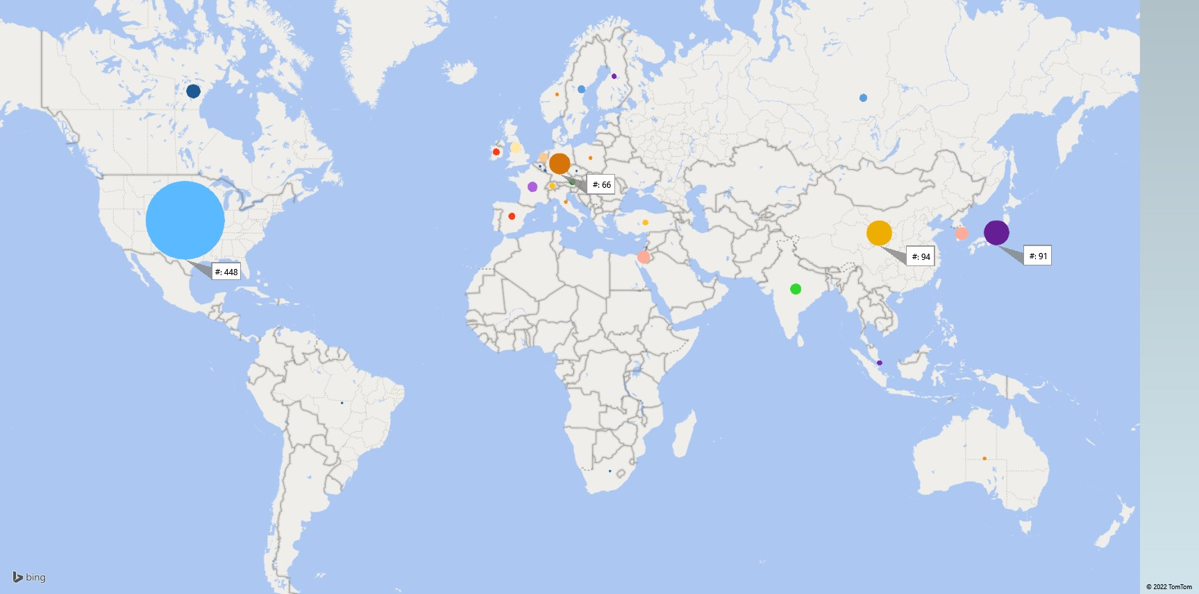
8.09 Registrant Locations

Slide 21
country3 | # | continent
USA | 448 | Americas
Canada | 28 | Americas
Brazil | 1 | Americas
China | 94 | Asia/Oceania
Japan | 91 | Asia/Oceania
Republic of Korea | 24 | Asia/Oceania
India | 18 | Asia/Oceania
Taiwan (Province of China) | 17 | Asia/Oceania
Russian Federation | 9 | Asia/Oceania
Singapore | 4 | Asia/Oceania
Australia | 2 | Asia/Oceania
Germany | 66 | Europe Africa
Israel | 24 | Europe Africa
United Kingdom | 17 | Europe Africa
France | 15 | Europe Africa
Netherlands | 12 | Europe Africa
Sweden | 9 | Europe Africa
Spain | 7 | Europe Africa
Ireland | 7 | Europe Africa
Austria | 6 | Europe Africa
Turkey | 5 | Europe Africa
Switzerland | 5 | Europe Africa
Finland | 4 | Europe Africa
Poland | 2 | Europe Africa
Norway | 2 | Europe Africa
Italy | 2 | Europe Africa
Hungary | 2 | Europe Africa
South Africa | 1 | Europe Africa
Luxembourg | 1 | Europe Africa
Czech Republic | 1 | Europe Africa
Belgium | 1 | Europe Africa

Slide 22
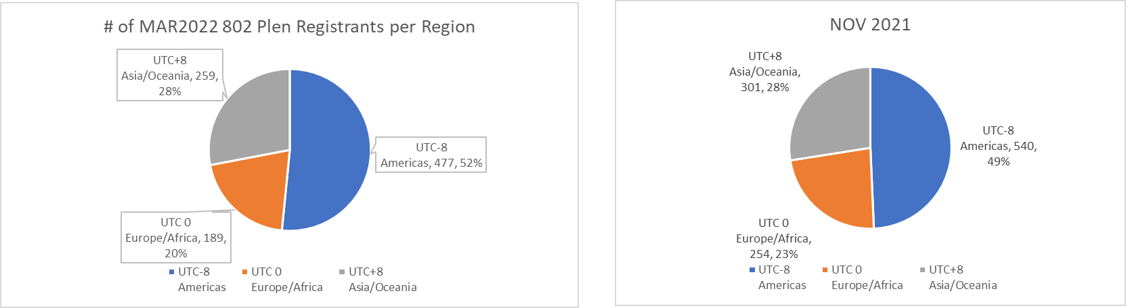
8.09 Registrant Time Zones
925 registrants
1095 registrants

Slide 23
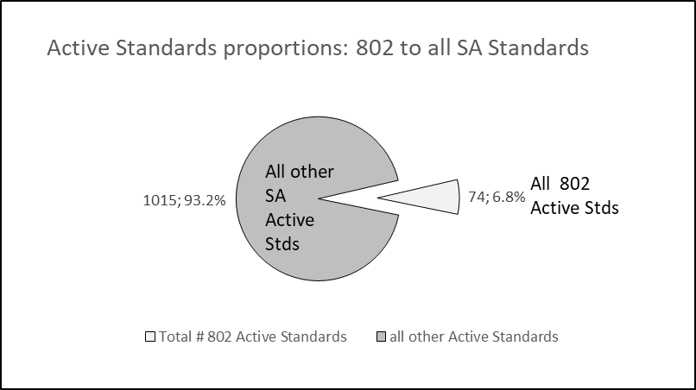
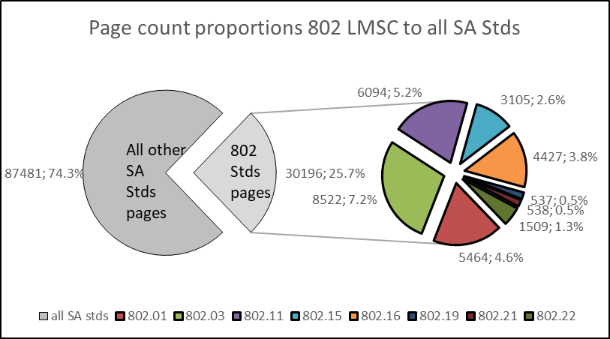
8.09 802 LMSC Analytics

Slide 24
End of Opening EC Meeting

