Slide 1
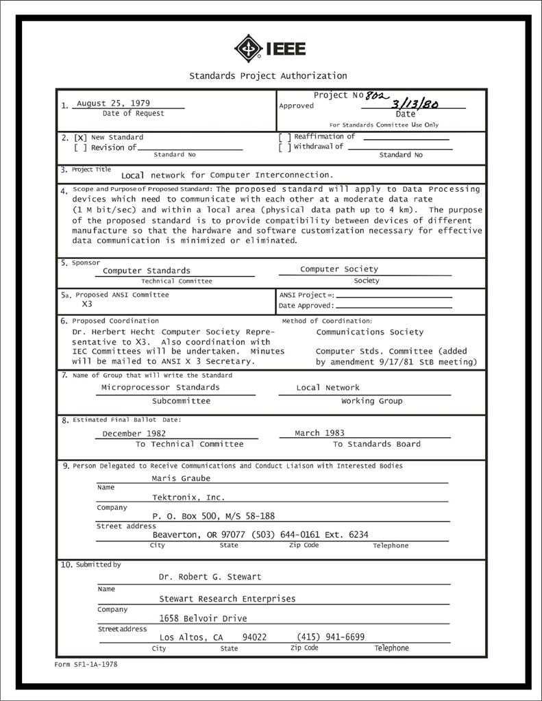
IEEE 802 LMSC Executive Committee 07 DEC 2021 Electronic Meeting 19:00-21:00 UTC 14:00-16:00 ET
DCN ec-21-0305-00-00EC

Slide 2
1.00 Meeting called to order/role call
2.00 Review/modify/approve agenda
2.01 Participation Slide Set URLs:
https://ieee802.org/sapolicies.shtml
https://standards.ieee.org/content/dam/ieee-standards/standards/web/documents/other/Participant-Behavior-Individual-Method.pdf
Participant behavior is guided by IEEE Code of Ethics & Conduct
Participants shall act independently of others, including employers
Standards activities shall allow the fair & equitable consideration of all viewpoints

Slide 3
3.00 Chair’s Announcements
Reminder #1: Use IMAT to log your attendance
Reminder #2: Please enable mute when you are not speaking
Reminder #3: Please use the Chat function to request being put in the queue
Reminder #4: Next 802 EC telecon
Reminder #5: Next 802/SA Task Force meeting: tentatively 4-5pm ET Monday 13 DEC 2021

Slide 4
3.05 802 Restructuring Ad Hoc update
Next meeting: 1-2pm ET Tuesday 14 December 2021
Operational Efficiency sub-ad hoc. BenR to host further discussion via EC reflector or telecon and report status at next ad hoc meeting.
Quality Standards sub-ad hoc. GeoffT and ApurvaM to host further discussion via EC reflector or telecon and report status at next ad hoc meeting.
External Influence ad hoc. TuncerB and JayH volunteered to lead discussion topic prior to the next restructuring ad hoc meeting.
Strategy sub-ad hoc. PaulN leading discussion on this topic.
Technical Coherence sub-ad hoc, RogerM to lead discussion on this topic prior to the next restructuring ad hoc meeting.
Mixed Mode Meeting Evaluation sub-ad hoc split into two tracks - Near Term Transition options led by George Zimmerman - Long Term Future Meeting options led by Andrew Myles.
PaulN to capture the mission/purposed statement in the 802 Chair’s Guideline, with the direction that it be made publicly visible (e.g., on the www.ieee802.org home page).

Slide 5
3.05 802 Restructuring sub-ad hoc updates
6a) Mixed Mode Best Practices ad hoc Chair: George Zimmerman
6b) Future meeting vision ad hoc Chair: Andrew Myles

Slide 6
9.0 EC Action Item Status Review
Action item review
TBD

Slide 7
Adjourn EC Meeting

