Slide 1
IEEE 802 July 2021
Public Visibility
Standing Committee Report
IEEE 802 Nov 2021 Plenary
Opening Mtg – 05 Nov 2021

Slide 2
Agenda – Wed, Nov 17 21
Time: 3pm to 4:00pm ET, Meeting Info
Agenda
  Review of Social Media Stats
  802 Webpage Update
  Future Tech Talks

Slide 3
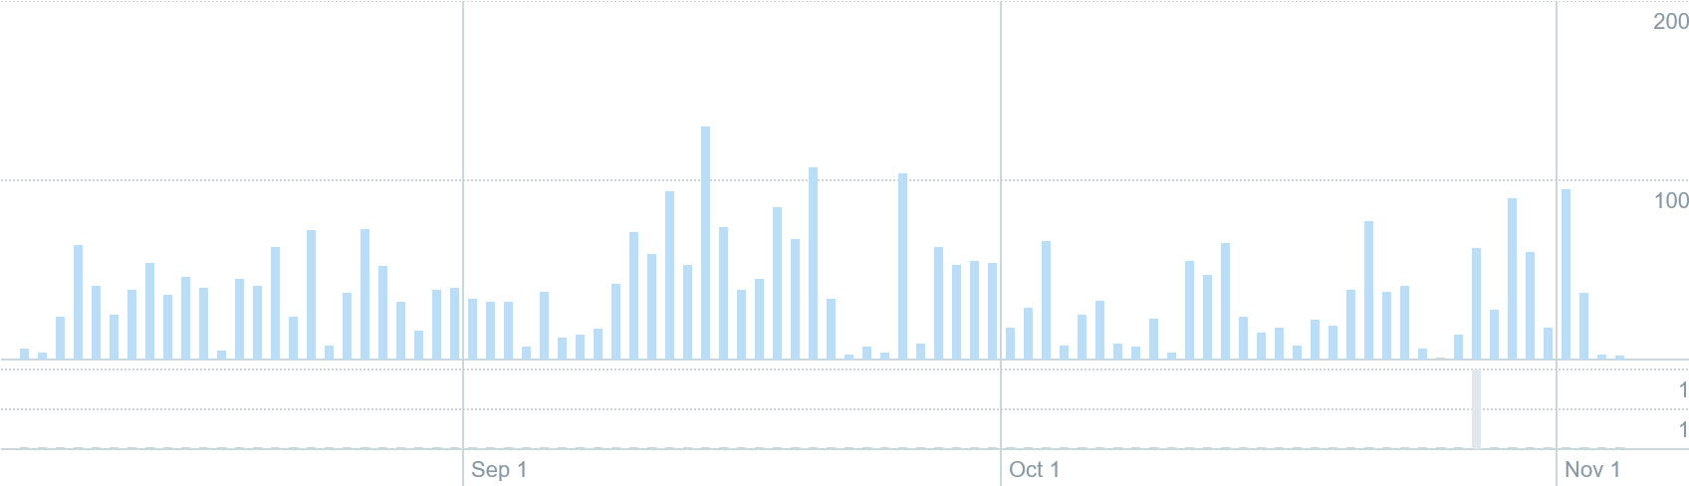
Social Media Related Tools
Twitter
Twitter (@IEEE802)
  233 followers
  Last 90 days (Aug 7 – Nov 4)
    3.5k impressions
LinkedIn
  314 followers (+37% since Jul 21)

Slide 4
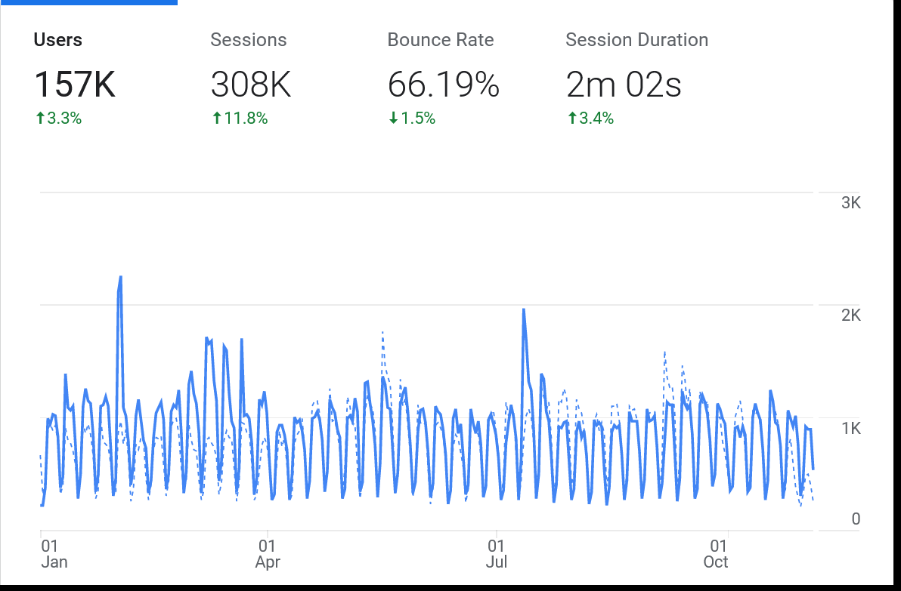
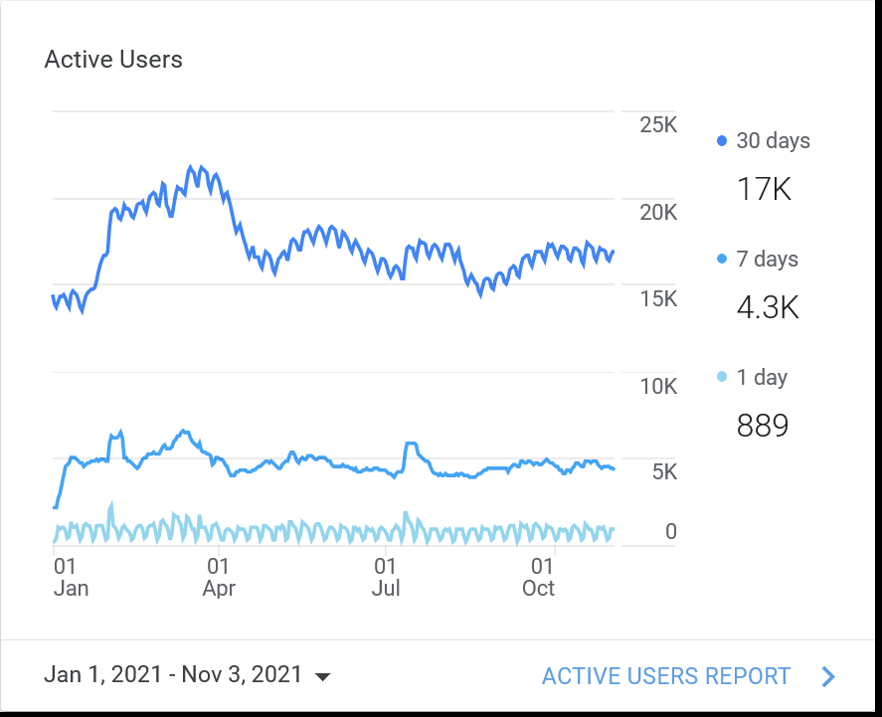
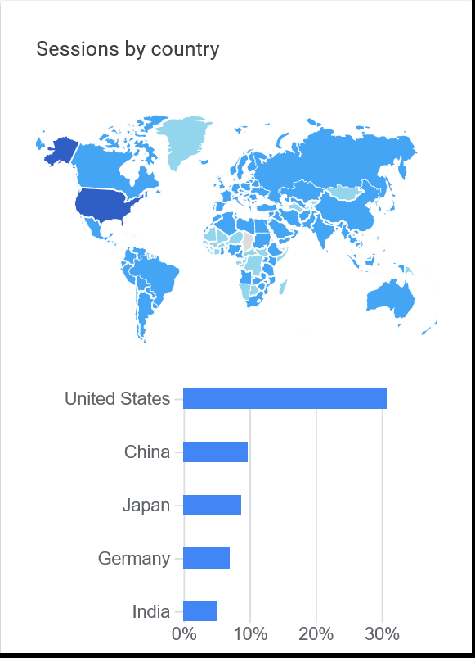
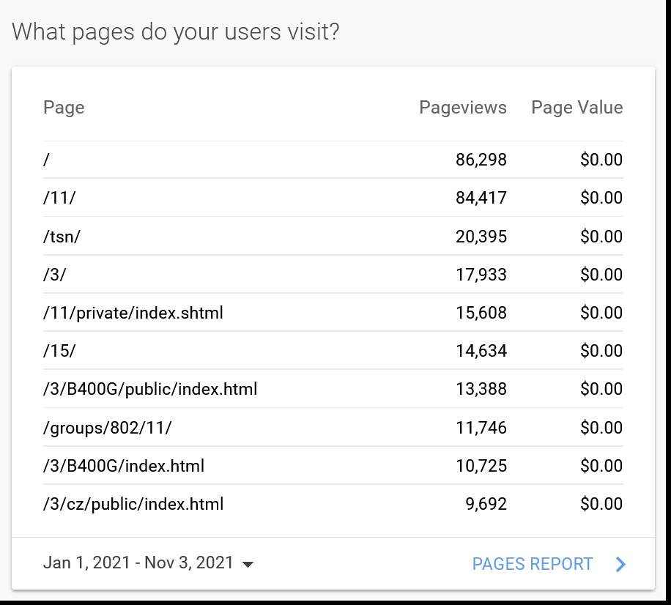
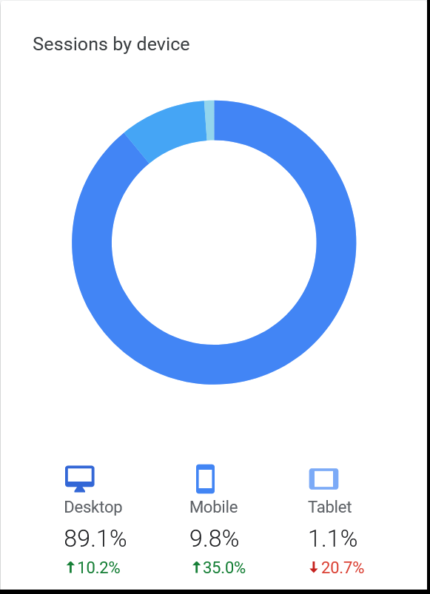
Google Analytics 802 (Jan 1 – Nov 3, 2021)

Slide 5
Webpage Review
“News about IEEE 802” added on 802 Main Page
Links to Twitter / LinkedIn only seen on 802.1
Has Google Analytics code been added to all webpages?

Slide 6
IEEE EA Future Tech Talks
  08 Dec 21 - Next Generation of 802 Networking Standards, Nikolich / Gilb
  12 Jan 22 – TSN – Nikolich / Parsons
  23 Feb 22 - 200 GbE, 400 GbE, 800GbE, and 1.6 TbE – Nikolich / D’Ambrosia
  30 Mar 22 - Single Pair Ethernet – Nikolich / Zimmerman
  27 Apr 22 – 802.15 – Nikolich / Rolfe
  25 May 22 - 802.19.3 - Coexistence of 802.11 and 802.15.4 in Sub-1 GHz frequency bands – Nikolich / Rolfe
  Tentative - 22 Jun 22 – Coexistence – Nikolich / Myles

Slide 7
Closing Report Update
To Be Added

Slide 8
Backup

Slide 9
802 Public Visibility SC Scope, Duties, Membership
  Scope and Duties
  To raise industry awareness in timely fashion of IEEE 802 WG / TAG activities
  Develop social media content based on IEEE 802 WG / TAG activities
    Twitter - https://twitter.com/ieee802
    LinkedIn – https://www.linkedin.com/company/ieee802
    IEEE-SA 802 - https://standards.ieee.org/featured/802/index.html
  Content
    Review Pre 802 Plenary meetings for social media messaging: PARs to be considered, Tutorials, [802.3] Call-for-Interests, New Task Force formations
    Review Post 802 Plenary meetings for social media messaging: Study Group formations, IEEE 802 Position Approvals
    Other 802 related material for social media messaging: Press Releases, White Paper publications, Other 802 approved news, 802 WG / TAG Activities with IEEE-SA
    IEEE-SA Standards Board Related - PAR Approvals, Standards Approval, Standards Publication,
  Membership
  Membership in the Standing Committee is open to anyone that wishes to participate (ideally at least one participant from each 802 WG and TAG)

