Slide 1
IEEE 802 Executive Secretary Report for 2021 July Electronic
Jon Rosdahl IEEE 802 Executive Secretary jrosdahl@ieee.org

Slide 2
IEEE 802 EC Opening Plenary July 9, 2021
1 Item:
6.02 Current / Future venues

Slide 3
6.02 Current / Future venues
2021-11 – Vancouver, Canada
Go/No Go decision will be July 9th (or July 23th)
Status update on Vancouver –
See doc EC 802-21/153r0:
https://mentor.ieee.org/802-ec/dcn/21/ec-21-0153-00-00EC-802-1121-vancouver-bc-canada-plenary-status.pptx
in contact with hotel representatives–
Worked with hotel for extension of next penalty deadline.
“extend your group’s current cancellation tier below to September 8, 2021, and the last tier will start September 9, 2021, to arrival (November 10, 2021).”
This moves the start of Potential Penalty of CAD$380,924.25. Current Liquid Damages are CAD$190,462.13
Only applies if we cancel for non-exceptional reasons.
Request to Change Go/No Go to Sept 7th.
Notes:
Current potential penalty $190,462.13 to (Sept 8)
Sept 9 to arrival

Slide 4
Future Venue Contract Status
2022-03 – Disney Springs Hilton
Contract executed – (802Fin-19/47r0)
Start more contacting in July
Go/No Go Decision about November 2nd
2022-07 - Sheraton Le Centre Montreal
Contract executed (802Fin-18/24r0)
2022-11 - Marriott Marquis Queen’s Park
Replacement for 2020-11
Executed end of April (802Fin-21/21r0).

Slide 5
Contracts in process
2024-03 Hyatt Regency Denver
Rebooking from 2021 March
Executed end of June.
2024-07 Sheraton Montreal
Contract negotiations stalled with COVID.
Need to complete
2024-11 – Tentatively looking at Bangkok, but Face to Face Events and Mtg Events are proposing other possible venues.

Slide 6
2023-07 Berlin
Estrel Berlin is in the process of completing the contract processing.
Contract is two parts and requiring 2 processing reviews for tax/legal.
Contracts are with IEEE Legal review now.

Slide 7
Current Commitments
2021 | November | Hyatt Regency Vancouver
2022 | March | Hilton Buena Vista Palace
2022 | July | Sheraton Le Centre Montreal
2022 | November | Marriott Marquis Queen’s Park
2023 | March | Hilton Atlanta
2023 | July | Estrel Berlin
2023 | November | Hawaiian Village
2024 | March | Hyatt Regency Denver
2024 | July | Sheraton Le Centre Montreal
2024 | November | Marriott Marquis Queen’s Park -- TBC
2025 | March | Hilton Atlanta
2025 | July | Marriott Madrid Auditorium
2025 | November
2026 | March | Hyatt Regency Chicago
2026 | July
2026 | November
2027 | March
2027 | July
2027 | November | Hawaiian Village

Slide 8
Straw poll request
For the 2021 July Electronic Plenary, a request is made for each WG to conduct a straw poll with the following question:
Will you attend the 2021 November IEEE 802 Plenary if held in-person at the Hyatt Regency Vancouver in Vancouver, Canada Nov 14-19, 2021?
Yes or No
Please report the result
if you choose to ask a different question, please include the question in your result report.

Slide 9
IEEE 802 EC Closing Plenary July 23th, 2021
4 items:
4.03 – Future Venues
8.043 – Executive Secretary Report
8.06 -- Monthly 802 EC Telecons
8.07 -- Call for Tutorials for November

Slide 10
Current Commitments
2021 | November | Hyatt Regency Vancouver
2022 | March | Hilton Buena Vista
2022 | July | Sheraton Le Centre Montreal
2022 | November | Marriott Marquis Queen’s Park
2023 | March | Hilton Atlanta
2023 | July | Estrel Berlin
2023 | November | Hawaiian Village
2024 | March | Hyatt Regency Denver
2024 | July | Sheraton Le Centre Montreal
2024 | November | TBC – May need for COVID adjustment (2021-11)
2025 | March | Hilton Atlanta
2025 | July | Marriott Madrid Auditorium
2025 | November | TBC – May need for COVID adjustment (2022-03)
2026 | March | Hyatt Regency Chicago
2026 | July
2026 | November
2027 | March
2027 | July
2027 | November | Hawaiian Village
Highlighted Venues are COVID adjustments.

Slide 11
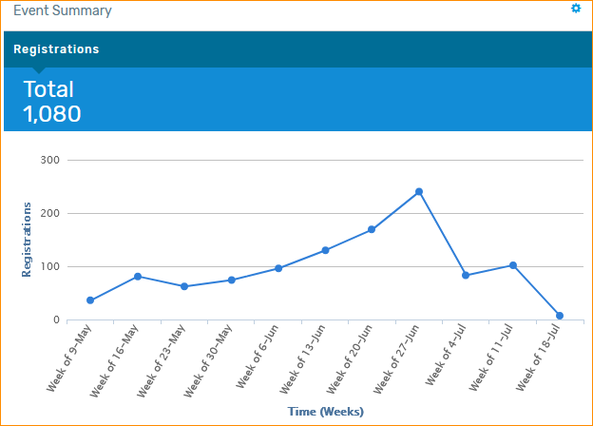
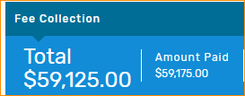
2021 July 802 Electronic Plenary
23 abandoned registration process.
98% success rate.
WG Chairs:
Remember to check that all your attendees marked IMAT. We will check IMAT record against the registration list
Notes:
23 abandoned the registration process – 98% success rate.

Slide 12
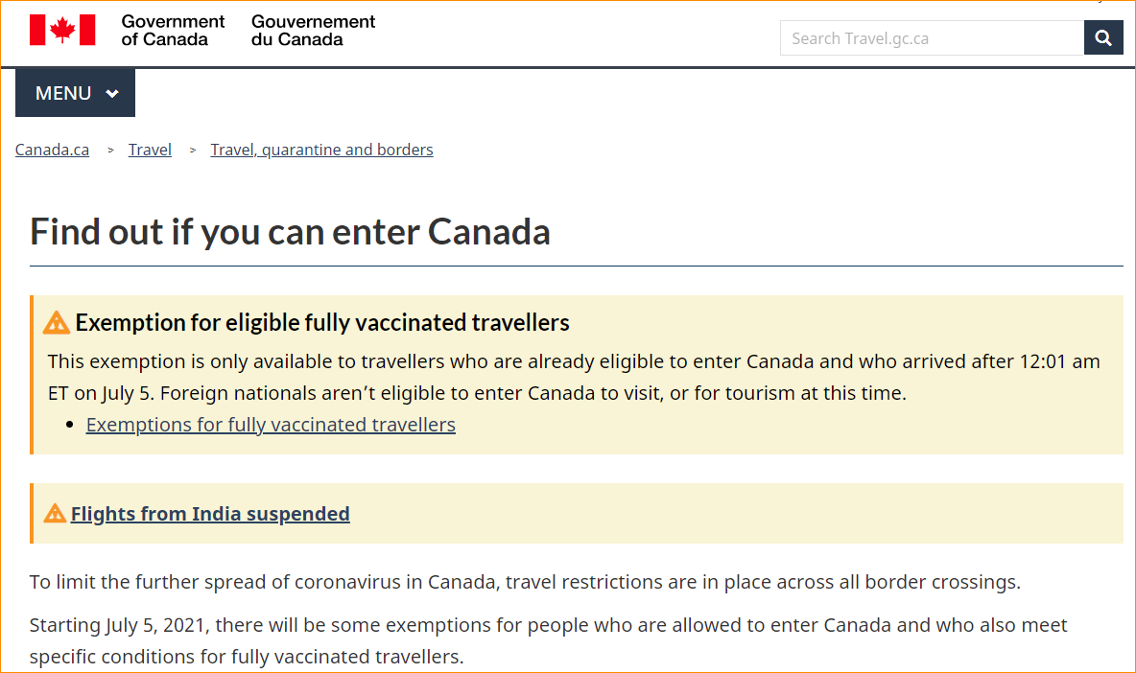
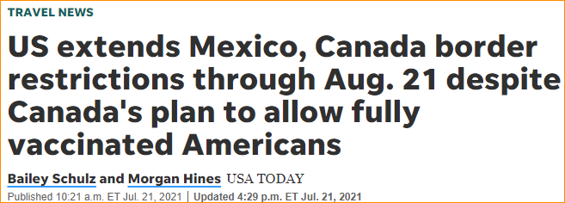
Canada Updates
Find out if you can enter Canada: https://travel.gc.ca/travel-covid/travel-restrictions/wizard-start
Update from Face to Face Events: https://mentor.ieee.org/802-ec/dcn/21/ec-21-0153-01-00EC-802-1121-vancouver-bc-canada-plenary-status.pptx
Travel authorizations not always bi-lateral

Slide 13
More Updates from Canada
Notes:
https://marketing.destinationcanada.com/acton/rif/43329/s-005a-2107/-/l-0005:10d2/q-0006/showPreparedMessage?utm_term=View%20Online&utm_campaign=Canada%20announces%20next%20phase%20to%20easing%20border%20measures%20for%20fully%20vaccinated%20travellers%20&utm_content=email&utm_source=Act-On+Software&utm_medium=email&cm_mmc=Act-On%20Software-_-email-_-Canada%20announces%20next%20phase%20to%20easing%20border%20measures%20for%20fully%20vaccinated%20travellers%20-_-View%20Online&sid=TV2:pGkSGrF5Z

Slide 14
July Polling Results
Yes – No – No Response
802.15 29 – 42 – 29
802.18 19 – 13 – 4

Slide 15
Planned Polling in August
Status changes constantly.
Please Poll (again) your WG if they will attend Nov Plenary –
Results will be used as input to discussion on Sept 7th.
Question to Ask: Will you attend the 2021 November IEEE 802 Plenary if held in-person at the Hyatt Regency Vancouver in Vancouver, Canada Nov 14-19, 2021?
Yes or No
Please report the result
if you choose to ask a different question, please include the question in your result report.

Slide 16
Other Proactive Efforts
I am a member of IEEE Conferences Committee – ICC
Working with Face to Face Events, we are in contact with each of the upcoming Venues.
Monitoring World Conditions and Pandemic reports
We are looking for responsible/reasonable options –
Do we hold the meeting, do we not.
Can we Reschedule?
Can we avoid penalty payments?
Moving targets – Moving opinions – Moving solutions.
Current Future Venue Status is tracked in doc 802 EC-20/0001r5:
https://mentor.ieee.org/802-ec/dcn/20/ec-20-0001-05-00EC-802-plenary-future-venue-contract-status.xlsx

Slide 17
IEEE MCE – ICC Report reminders
Hybrid Conference – high level considerations
Having in person in 2022 comes with some risks
Not everyone may be ready to travel
Not all exhibitors may be allowed to exhibit
Use caution in contracting and setting budget goals
Take action to mitigate financial risk
Understand commitments – what contracts are signed?
Understand if Force Majeure will be in effect in contract? Was it signed prior to March 2020? If not, is there specific language in place regarding COVID -19?
As a sponsoring portfolio – what is your total commitment tolerance?
Can you renegotiate terms and scope/scale to mitigate risk now. Hint – there may still be time for your suppliers to re-sell space and make a new arrangement.
Insurance will not cover COVID-19 claims
Planning for a Hybrid event requires change
It DOES NOT MEAN live streaming is required.
It DOES NOT MEAN you will have pre-2020 attendance levels
Don’t forget to address new audiences discovered in 2020 who can’t travel.
Notes:
https://agd.ieee.org/mpt/Uploads/1/Handler.ashx?att=/Uploads/1/16970/16970_120517_PPT__MCE_1.pptx&aid=16970

Slide 18
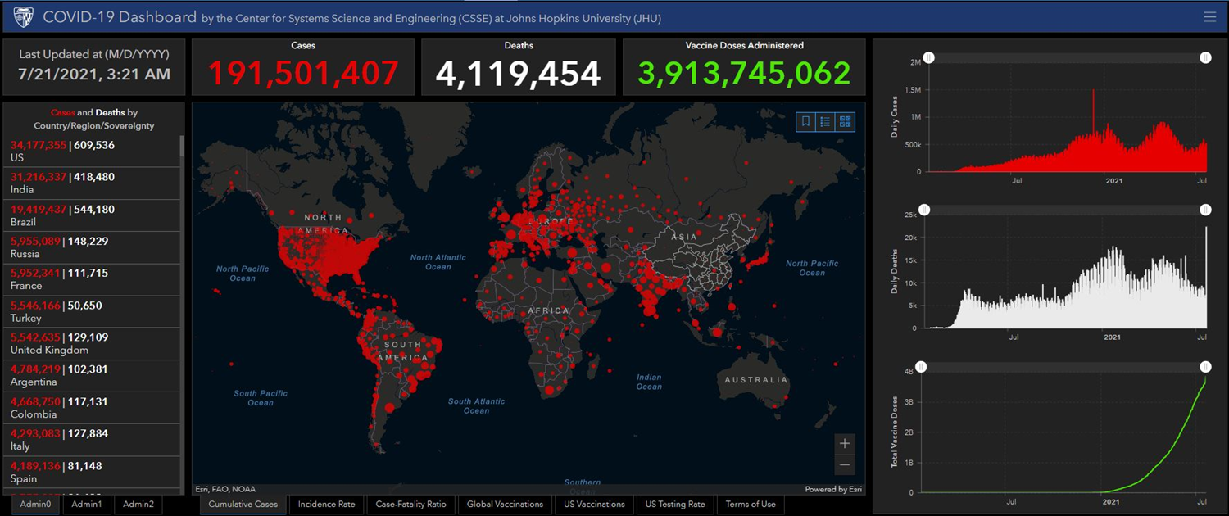
COVID-19 Dashboard report

Slide 19
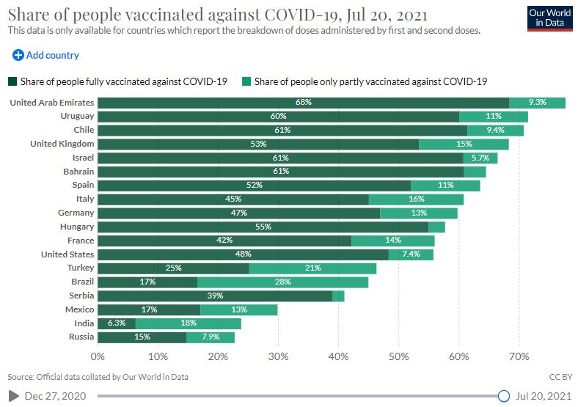
Vaccination report

Slide 21
8.043 – Executive Secretary Report
Deferred.

Slide 22
8.06 Monthly IEEE 802 EC Telecons
August 3, 2021
September 7, 2021
October 5, 2021
November 2, 2021
Call Time: 3:00 PM - 5:00 PM Tuesday, (UTC-04:00) Eastern Time (US & Canada)
Recurrence: Occurs the first Tuesday of every month effective 4/6/2021 until 12/7/2021 from 7:00 PM to 9:00 PM, (UTC+00:00) Monrovia, Reykjavik

Slide 23
8.06 Monthly IEEE 802 EC Telecons
Whereas we are only 11 days until the next scheduled IEEE 802 EC Telecon,
Move to cancel the August 3, 2021 Telecon
Moved: Rosdahl
2nd: Shellhammer
Results:

Slide 24
8.07 Call for Tutorials for November
Tutorials may be held electronic:
In person Tutorials:
Tutorial Request form:
Generic: http://www.ieee802.org/802_tutorials/802_Tutorial_Request_Form.doc
Nov specific: To be made if Plenary changed to Electronic
As a reminder, please refer to Chair's Guidelines section 2.5 Tutorials for the logistics for participating in sponsoring/presenting a Tutorial.
Note that Tutorial times are limited to 80 minutes with 10 minutes to allow for presenters to setup and depart.
All requests for Tutorials must be made by 21 September 2021
Notes:
All official tutorial request forms must be submitted no later than 45 days in advance of the Plenary Session.
Approved Tutorial Requests will be assigned a time slot based on the order in which they were received.
The Final Tutorial Schedule will be posted at http://802world.org/plenary and http://ieee802.org no less than 30 days in advance of the Plenary Session.

