Slide 1
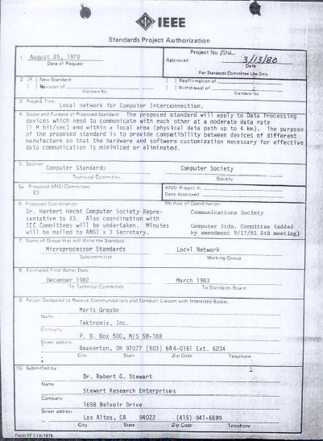
IEEE 802 LMSC Executive Committee 06 April 2021 Electronic Meeting 19:00-21:00 UTC 15:00-17:00 ET
DCN ec-21-0086-00-00EC

Slide 2
1.00 Meeting called to order/role call
2.00 Review/modify/approve agenda
2.01 Participation Slide Set URLs:
https://ieee802.org/sapolicies.shtml
https://standards.ieee.org/content/dam/ieee-standards/standards/web/documents/other/Participant-Behavior-Individual-Method.pdf
Participant behavior is guided by IEEE Code of Ethics & Conduct
Participants shall act independently of others, including employers
Standards activities shall allow the fair & equitable consideration of all viewpoints

Slide 3
3.00 Chair’s Announcements
Reminder #1: Use IMAT to log your attendance
Reminder #2: Please enable mute when you are not speaking
Reminder #3: Please use the Chat function to request being put in the queue
Reminder #4: Encourage participation on Restructuring 802 ad hoc topics – next meeting 17:00-18:00 UTC Tuesday 20 April 2021
Reminder #5: Next 802 EC telecon 19:00-21:00 UTC Tuesday 04 May 2021

Slide 4
Additional possible items as appropriate

Slide 5
Adjourn EC Meeting

