Slide 1
IEEE 802 LMSC Restructuring ad hoc Operational Efficiency Sub-ad hoc 5 April 2021
DCN ec-21-0065-00-00EC

Slide 2
Goals
PAR Process:
Document a proposed review process to present to the EC
Consider greater consistency across working groups?
Identify other efficiency improvement in PAR/CSD
Review CSD format for updates/improvement?
Other steps we should add/delete/modify?
Training:
Better characterize the issues in the current process (define the problem)

Slide 3
Agenda
Proposed Agenda
Review
Discuss ideas for PAR process improvements
Plan for work on improving leadership training
AoB

Slide 4
Actions
Schedule virtual meeting to develop PAR process proposal
Ben
Present to EC in April call
Ben and everyone who joins the call

Slide 5
Operational Efficiency Ideas: PARs
Adopt handling PARs in between plenary sessions
Allow consideration on monthly EC interim electronic meetings that precede a NesCom meeting
Retain the same review process level of rigor
> 30 day review period
Can announce prior to EC call n, review by EC on call n+1
Additional work for WGs:
Need to review PARs on monthly (electronic or in person)
Otherwise the same process
Additional work for EC
Need to review PARs more often
May or may not see more PARs
So workload likely distributed more evenly

Slide 6
Requirements for the PAR review process
Maintain or improve upon current level of review rigor
Assure PARs and CSDs get the same or greater exposure
Ensure enough time for review, comment, revision and response
Posting and noticing at least 30 (45?) days ahead of EC meeting
Possible improvements:
Improve the technical review of PARs
More flexibility and time for groups to review and prepare comment
More time for originating group to improve based in input
Could increase review period and still improve response and efficiency
Align with NESCOM schedule
More opportunities to move new projects forward
NESCOM schedule varies year by year (??)

Slide 7
Par Review Considerations
Possibly 7 PAR review cycles per year
But fewer PARs per cycle
Typically from 10 to 20 PARs per year
Number of projects per year likely to stay the same
Spreads the work out over more time
Group review process may change
Dot-3 and Dot-11 have a PAR review meeting
Dot-11
2 meetings during plenary
WG Opening – identify PARs to review and PAR review meeting
Initial comments brought to mid week
Second meeting to go over replies to comments, result brought to closing
Anytime after PAR+CSD is available comments can be collected to discuss at the meeting
So prep time before review meeting is valuable
Comments are usually sent informally to originating WG
Could be done via virtual meeting

Slide 8
Technical Quality of PAR Review
Lack of consistency across (and even within) WGs
Coherence of 802 “brand”
Maintaining the high technical quality of 802 standards
Need to identify criteria for “technical quality”
Need metrics
Action: Paul to call Geoff and define “technical quality”

Slide 9
Proposed Recommendation
Amend rules to allow consideration at any duly noticed EC meeting
Identify the necessary rules that need to change
Develop proposed text for rules committee
Develop annual calendar for 802 PAR review process
Posting (submission) deadlines, comment deadline, Response / revision deadline
Depends on IEEE-SA Standards Board (SASB) calendar

Slide 10
NesCom/RevCom schedule
Schedule is different every year
Depends on IEEE-SA Standards Board schedule
No consistent release date for future schedule
Not currently available past end of 2021
As shown on SASB Calendar:
Four NesCom/RevCom meetings explicitly shown
Three occur during "SASB Series" shown on calendar
Submission deadline:
40 days prior for all but “last quarterly”
50 days prior for last quarterly

Slide 11
Example Calendar Alignment
NesCom/RevCom Meeting | NesCom/RevCom Submission | EC Approval | Comment Response | Comment Received | PAR & CSD Posted | Notes
26 January 2021 | 11 December 2020 | 13 Nov | -- | -- | -- | --
24 March 2021* | 12 February 2021 | 13 Nov | -- | -- | -- | --
28 April 2021 | 18 March 2021 | 18 Mar | 17 Mar | 10 Mar | 02 Feb | March Plenary EC Closing
15 June 2021 | 06 May 2021 | 04 May | 03 May | 26 Apr | 27 Mar | May 4th interim call June 1st with pre-submission
22 September 2021* | 13 August 2021l | 03 Aug | 02 Aug | 26 Jul | 19 Jul | August 3rd interim call Sept 7th with pre-submission
22 October 2021 | 10 September 2021 | 07 Sep | 06 Sep | 30 Aug | 23 Aug | September 7th interim call October 5th with pre-submission
07 December 2021* | 18 October 2021 | 05 Oct | 04 Oct | 27 Sep | 20 Sep | October 5th interim call November plenary with pre-submission
*During SASB series

Slide 12
Example, Current Schedule
NesCom/RevCom Meeting | NesCom/RevCom Submission | EC Approval | Comment Response | Comment Received | PAR & CSD Posted | Notes
26 January 2021 | 11 December 2020 | 13 Nov | -- | -- | -- | November Plenary EC Closing
24 March 2021* | 12 February 2021 | 13 Nov | -- | -- | --
28 April 2021 | 18 March 2021 | 18 Mar | 17 Mar | 10 Mar | 02 Feb | March Plenary EC Closing
15 June 2021 | 06 May 2021
22 September 2021* | 13 August 2021 | 16 Jul | 15 Jul | 08 Jul | 04 Jun | July Plenary EC Closing
22 October 2021 | 10 September 2021
07 December 2021* | 18 October 2021 | 19 Nov | 18 Nov | 11 Nov | 09 Oct | July Plenary EC Closing November Plenary with pre-submission
*During SASB series

Slide 13
Training
Identified issues so far:
Observed some participants don’t know the process and rules
Frequent debates on calls that are clearly settled if the rules and guidance documents are brought into the discussion
Hierarchy of rules not understood
Solutions not obvious
Rules and guidance documents readily available now
Links on 802 home page, WG home pages
This is included in the newbie training now
Informed leadership is readily available (and mostly consistent)
Objective: ensure better training of leadership
Training and qualification of TG/TF leaders
Mentorship of new leaders –
Starting with pre-PAR activities, continue throughout
Leverage experienced folks other than WG chairs

Slide 14
Next Call
19th April same time 1.5 hours
On 802 Meeting Calendar
802 Restructuring sub-ad hoc on Operational Efficiency
Mon, April 19, 13:00 – 14:30 ET Apr 19, 202

Slide 15
Background Slides
NesCom Schedule

Slide 16
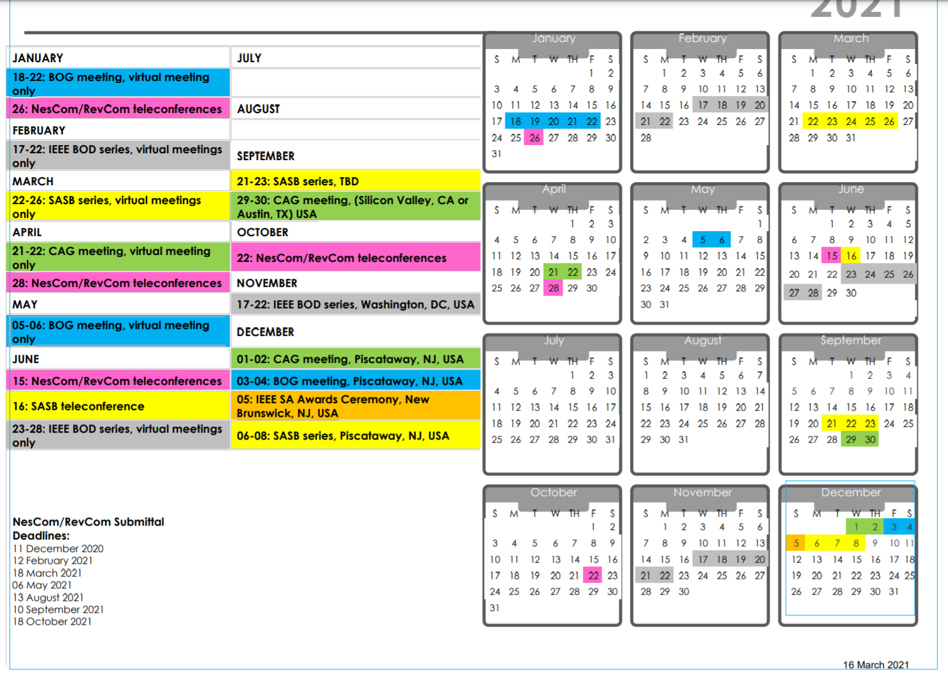

Slide 17
NesCom/RevCom Submittal Deadlines:
11 December 2020
12 February 2021
18 March 2021
06 May 2021 – May 4th EC call
13 August 2021 – Aug 3rd EC call
10 September 2021 – Sept 7th call
18 October 2021 – Oct 5th call

