Slide 1
OmniRAN TG perspective on cost and benefits of 5G SC options
Max Riegel
802.1 OmniRAN TG chair
2016-03-15

Slide 2
Introduction
Current topic of OmniRAN TG:
P802.1CF: Network Reference Model and Functional Description of IEEE 802 Access Network
More details on content on next slide
Generic functional model of IEEE 802 access network based on Ethernet link
Applicable to all IEEE 802 technologies supporting Ethernet
Kind of ‘Stage 2’ specification according to ITU-T terminology
Purely based on existing IEEE 802 standards
Recommended practice (only ‘should’ statements)
Intention to support broader managed deployment of IEEE 802 technologies throughout various industries
No intention to define future mobile network architecture
However P802.1CF applicable to part of 5G scenarios

Slide 3
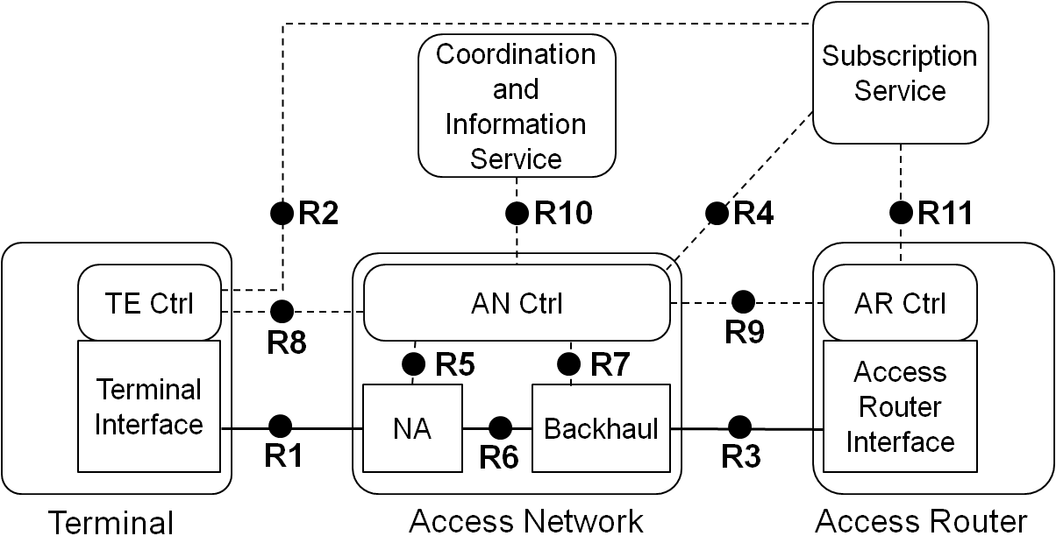
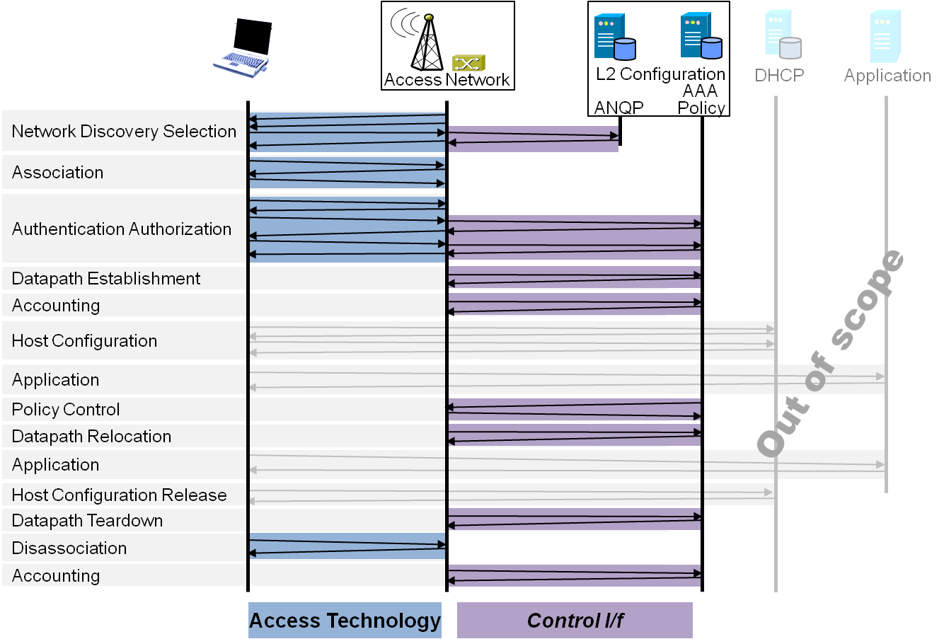
P802.1CF: Network Reference Model and Functional Description of IEEE 802 Access Network
Overview
References, definitions, acronyms and abbreviations
Conformance
Network Reference Model
Basic concepts and terminology
Overview of NRM
Basic, enhanced and comprehensive NRM
Deployment scenarios
Functional Design and Decomposition
Access Network Setup
Network Discovery and Selection
Association and Disassociation
Authentication and Trust Establishment
Data path establishment, relocation and teardown
Authorization, QoS and policy control
Monitoring and statistics
Fault diagnostics and maintenance
SDN Abstraction
Annex:
Privacy Engineering
Applicability to non-IEEE 802 PHY layer technologies
Bibliography

Slide 4
Assumptions about network integration of the various 5G Radio Access Technologies
From the NGMN Alliance 5G whitepaper:
Fully leveraging the capabilities of IEEE 802 technologies would require an appropriate IEEE 802 network interface towards the 5G NW functions (core).

Slide 5
P802.1CF Interface option to 5G
IEEE 802 Access Network
5G NW Functions
???
Subscription
Service
Coordination and Information Service
Network Management Service
R2
R10
R11
R12
R4
AN Ctrl
TE Ctrl
AR Ctrl
R8
R9
Terminal Interface
R5
R7
Access Router Interface
NA
Backhaul
R1
R6
R3
Terminal
Access Network
Access Router
5G Radio

Slide 6
OmniRAN P802.1CF evaluation of options
IEEE 5G
Benefits: full deployment support of IEEE 802 technologies in future mobile networks
Costs: full set of network standards to address all the various 5G requirements
IMT-2020 – single technology
Benefits: (single radio technology gets IMT-2020 stamp)
Costs: potentially an amendment to P802.1CF for addressing generic 5G architecture (t.b.d.)
IMT-2020 – set of technologies
Benefits: (a few radio technologies get IMT-2020 stamp)
Costs: potentially a bigger amendment to P802.1CF for addressing generic 5G architecture (t.b.d.)
IMT-2020 – external proposal
Benefits: (IMT-2020 stamp for IEEE 802.11)
Costs: likely none, as no IEEE 802 network has to be exposed in IMT-2020 application

