Slide 1
IEEE 802 Marketing Update
Nov 2013 Plenary
Date: 2013-11-11
Author
John D’Ambrosia, Dell

Slide 2
Abstract
Agenda Items
Monday:
5.11 II 802 Messaging and Public Visibility Plans for 2014
5.12 II Activities - Ethernet 40th Celebration

Slide 3
Supporting Documents
IEEE-SA Marketing Update
https://mentor.ieee.org/802-ec/dcn/13/ec-13-0058-00-00SA-ieee-802-mktg-update.xlsx

Slide 4
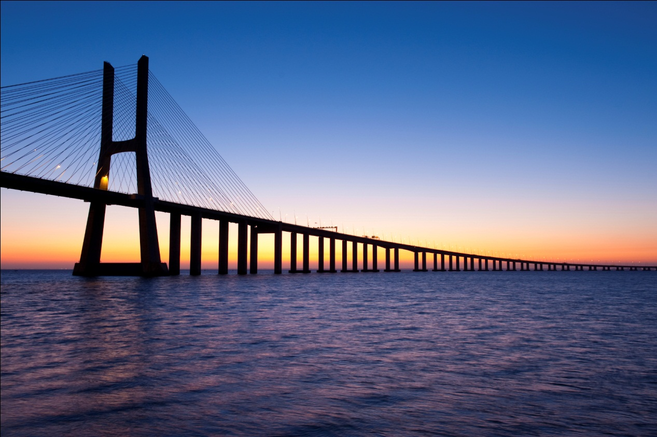
2014: Bridging to the Future of Networking
What is the message
for IEEE 802?
Working with IEEE-SA on a
marketing framework plan

Slide 5
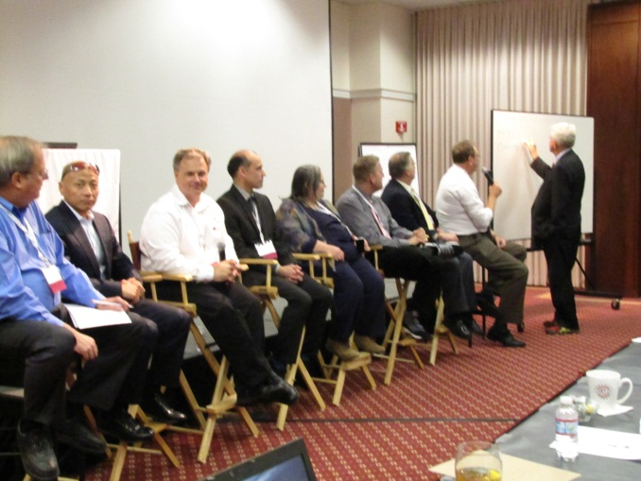
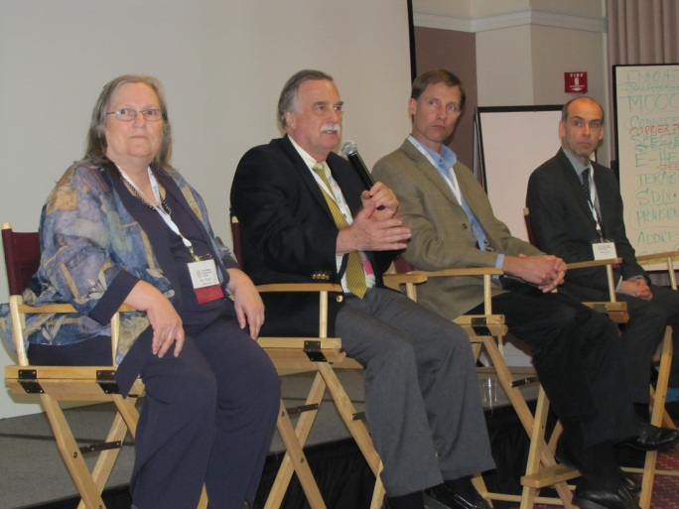
Successful Example - Ethernet Alliance TEF: “The Future of Ethernet” Panels
Bob Metcalfe’s “Ethernet, Networking & Standards” Innovation Panel
Synergy Between IEEE 802 Wired and Wireless Technologies

Slide 6
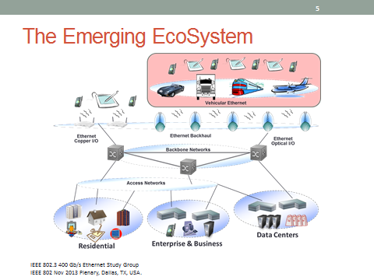
Source: Carlson_400_01_1113.pdf

Slide 7
40th Anniversary Celebration
Keynote Speech: Dr. Robert Metcalfe
  Video recorded by IEEE-SA
Panel Session – “Back to the Future… of Ethernet”
  Panel Moderator – Steve Carlson
  Panelist – Dr. Robert Metcalfe
  Panelist – Dr. David Boggs
  Panelist – Ron Crane
  Panelist – Thomas Hogenmuller
Videos
  China Network World – Ethernet 40th Anniversary Tribute
  IEEE-SA Montage Video

