Slide 1
Marketing and PR Results
40th Anniversary of Ethernet
30 Years of IEEE 802.3™ Ethernet Standards
John D’Ambrosia
Chair, IEEE 802.3 400 Gb/s
Ethernet Study Group

Slide 2
IEEE-SA 40th Anniversary of Ethernet
Marketing and PR Strategy
Developed integrated marketing and PR strategy to promote the 40th Anniversary of Ethernet and its economic, social, political and technological impact on society – associated with IEEE 802.3 Ethernet standards development activities
Launched the IEEE-SA campaign in May centered around the 40th Anniversary of Ethernet
The rolling-thunder campaign will continue throughout 2013 with a comprehensive range of marketing, PR and social media activities – including creation of digital media, to highlight the innovations and global impact of IEEE 802.3 Ethernet Standards

Slide 3
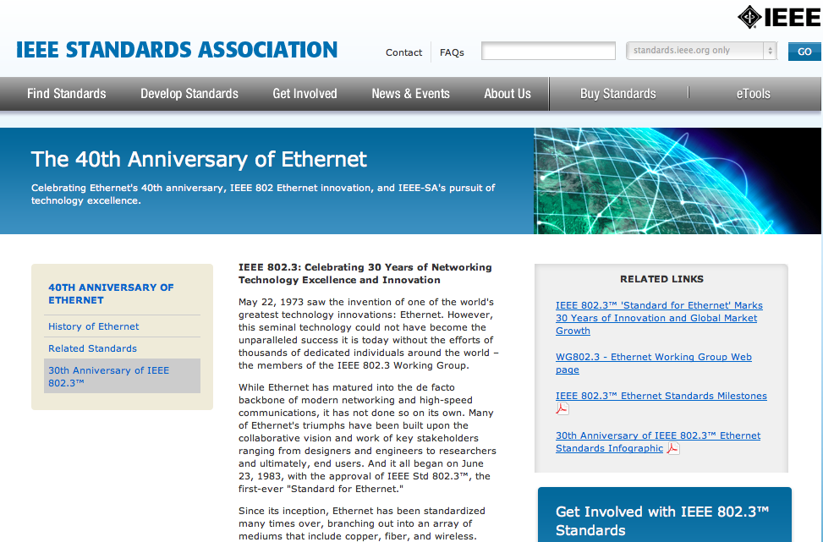
Created Dedicated 40th and 30th Anniversary of Ethernet Web Site Landing Pages
http://standards.ieee.org/events/ethernet/

Slide 4

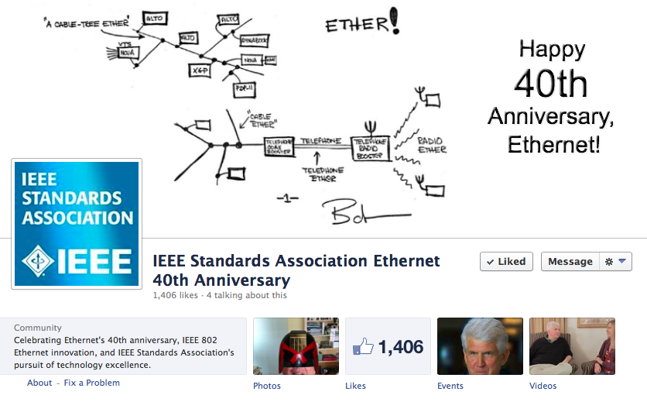
Established Dedicated Facebook Page
Quickly Gained More than 1,400 Likes
https://www.facebook.com/Ethernet40thAnniversaryIEEESA

Slide 5






Issued 5 IEEE Ethernet Press Releases

Slide 6






Press Releases
International Translation and Outreach

Slide 7
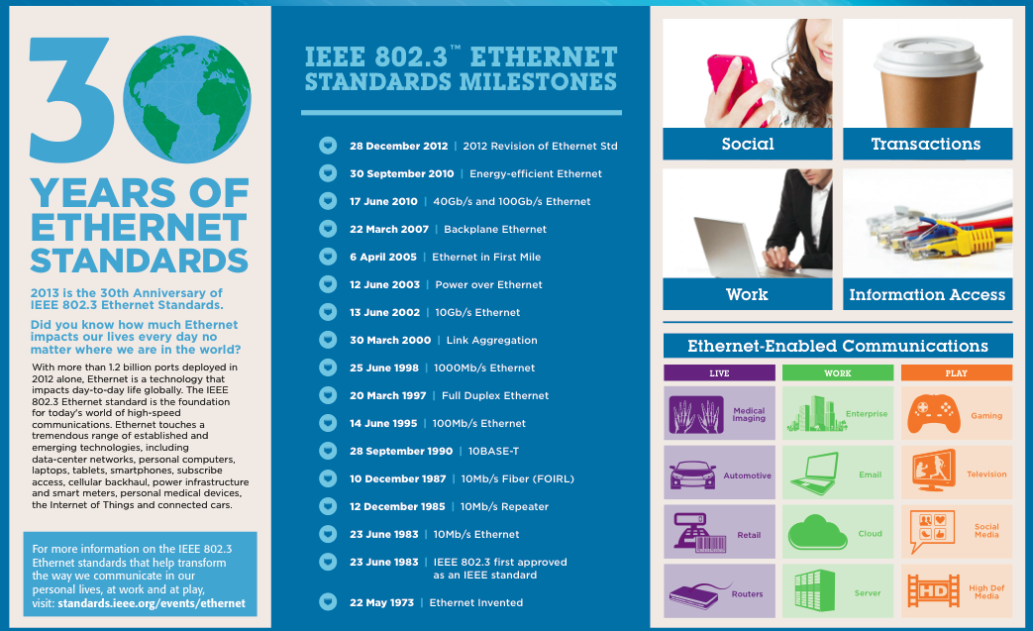
Created and Published 30th Anniversary of
IEEE 802.3™ Ethernet Standards Infographic

Slide 8









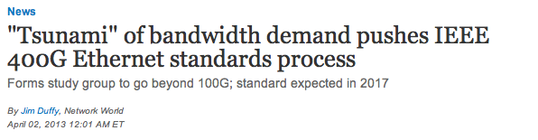
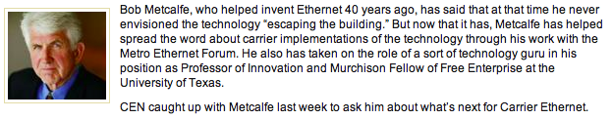




Generated Media Coverage

Slide 9




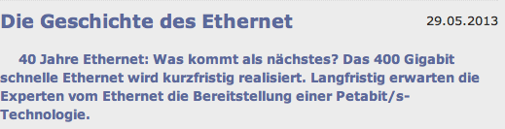



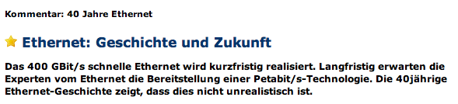

Secured Global Media Coverage

Slide 10


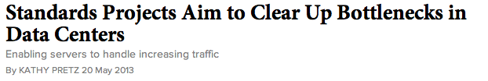

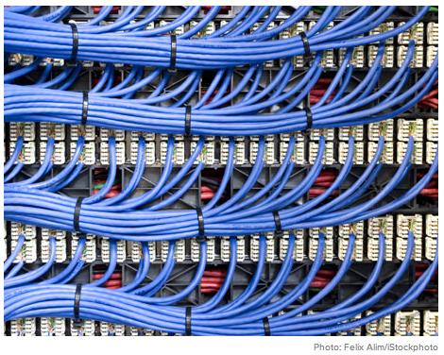
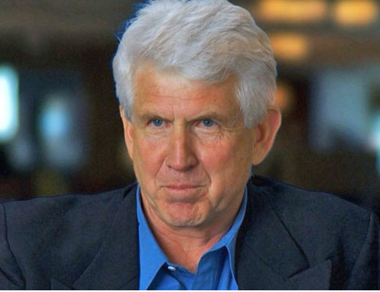
Secured Features and Bylined Articles
GigaOm – PoE by Wael Diab
FierceSmartGrid – Ethernet Enabling Smart Grid Q&A with James Gilb
Intelligent Utility – Ethernet's impact on the energy/utility space by James Gilb
John Day's Automotive – Ethernet in Vehicles by Steve Carlson
Wireless Design and Development – Ethernet's impact on the wireless space 802 end to end solution by Bruce Kraemer and John D’Ambrosia
Plus:
  IEEE AESS – short side bar on 40th anniversary of Ethernet
  IEEE History Center – article covering 40 years of Ethernet

Slide 11
Global Press Activities
North America Media Interviews
  Network World
  Electronic Design Magazine
  Telo Medios
  Lightwave
  Slashdot
  EDN
  Wired
  Carrier Ethernet News
Korea Press Seminar – Wael Diab presented on 40th Anniversary of Ethernet
China press activities – Wael Diab presented on 40th Anniversary of Ethernet

Slide 12
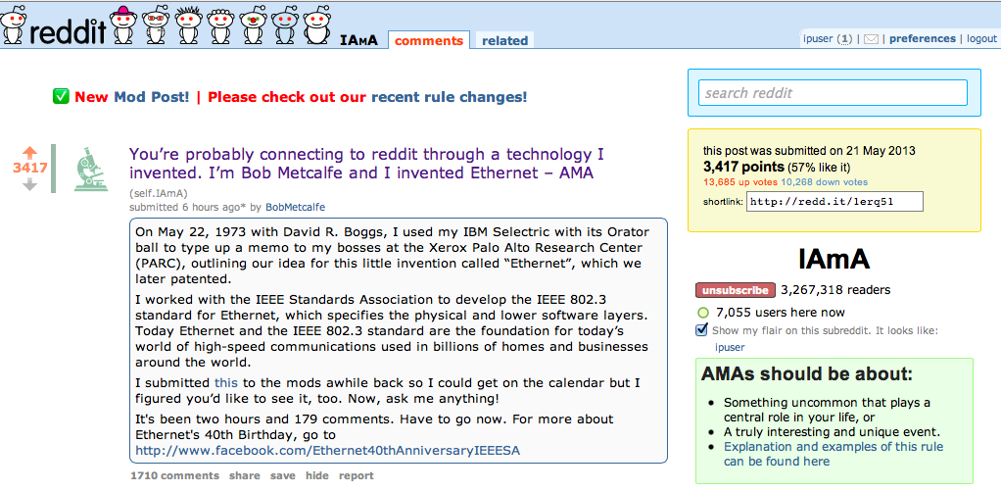
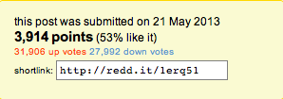
Secured Bob Metcalfe for IEEE-SA reddit AMA on 40th Anniversary of Ethernet

Slide 13
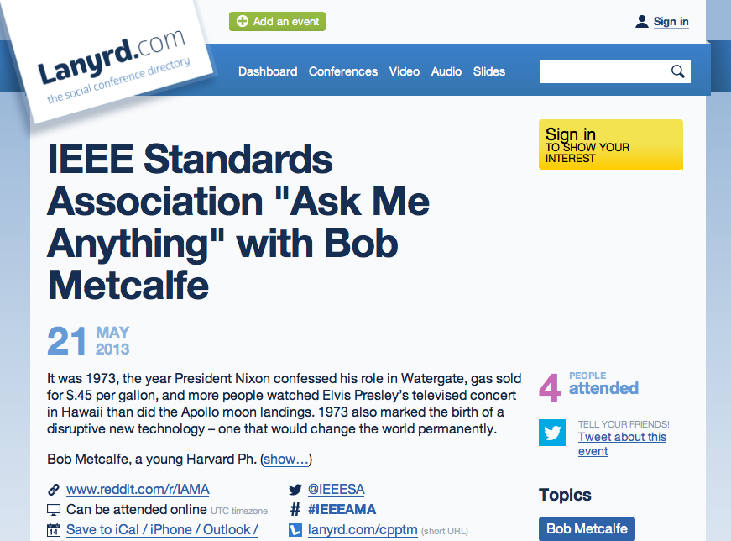
Established Lanyrd Event for Metcalfe AMA

Slide 14




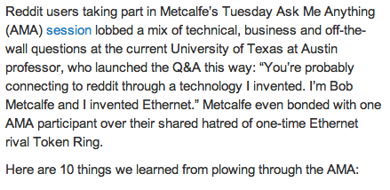
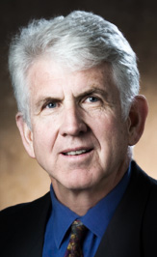
Secured Pre- & Post- Coverage of
Bob Metcalfe’s reddit AMA

Slide 15
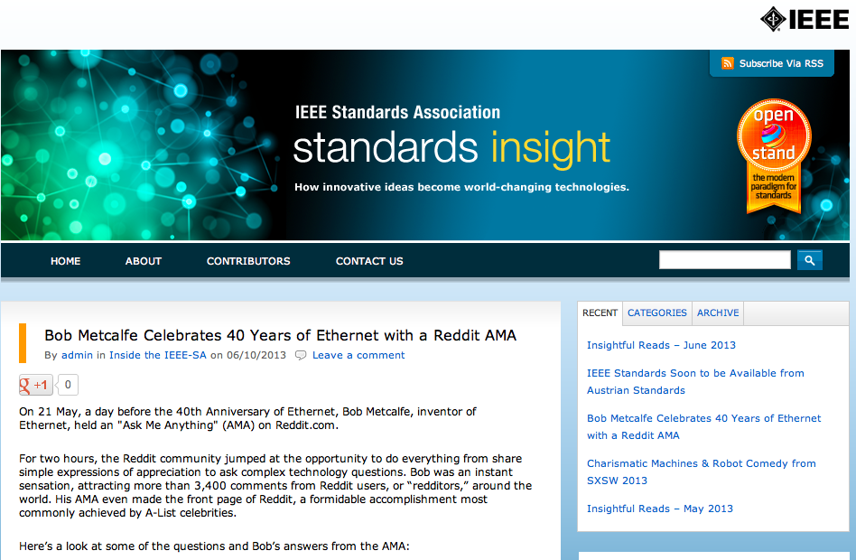
Promoted Metcalfe AMA on IEEE-SA Standards Insight Blog

Slide 16
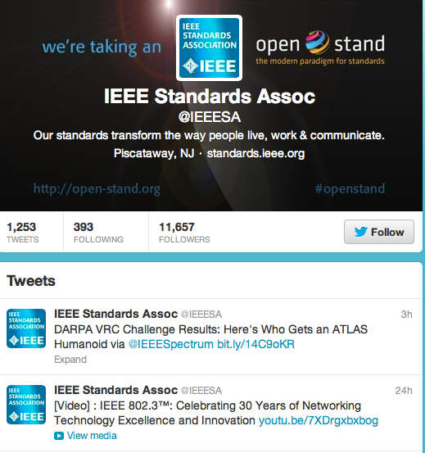

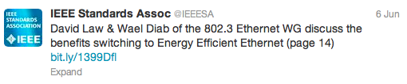
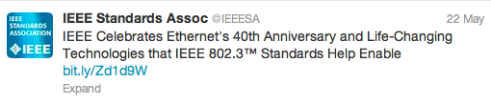
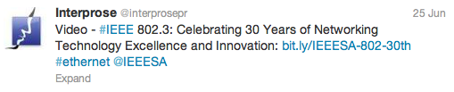

Promoted IEEE Ethernet on Twitter

Slide 17
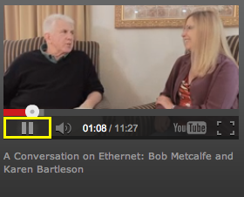
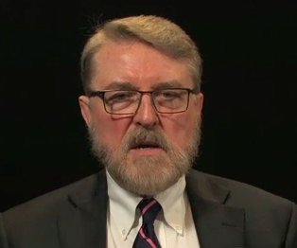
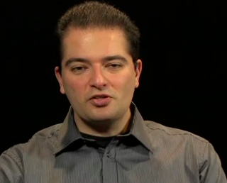
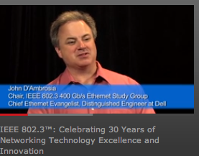
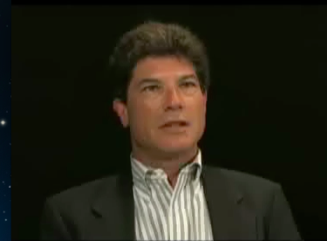
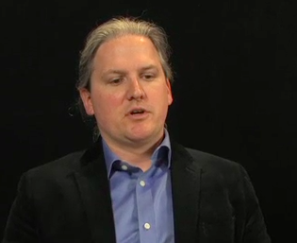
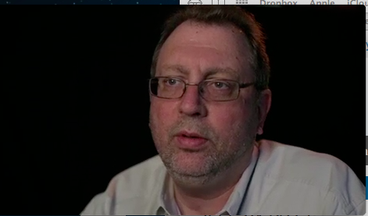
Created Rich Media
Karen Bartleson and Bob Metcalfe at SXSW
Various video interviews taken at IEEE 802 Interim
  Steve Carlson, Wael Diab, John D’Ambrosia, Howard, Frazier, Adam Healy, and more
Paul Nikolich stand-alone

Slide 18
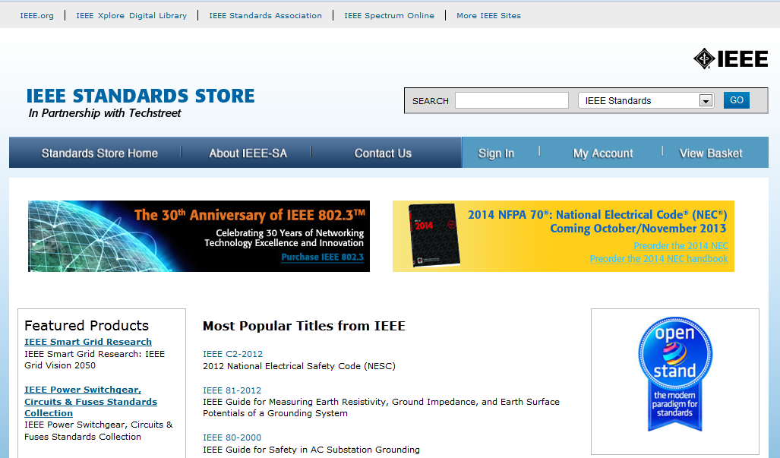
Published Banner Image on IEEE Standards Store

Slide 19

Distributed eblast on IEEE 802.3 30th Anniversary

Slide 20
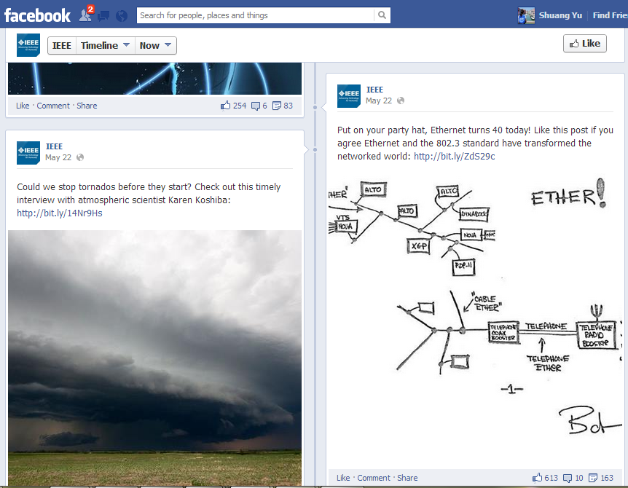
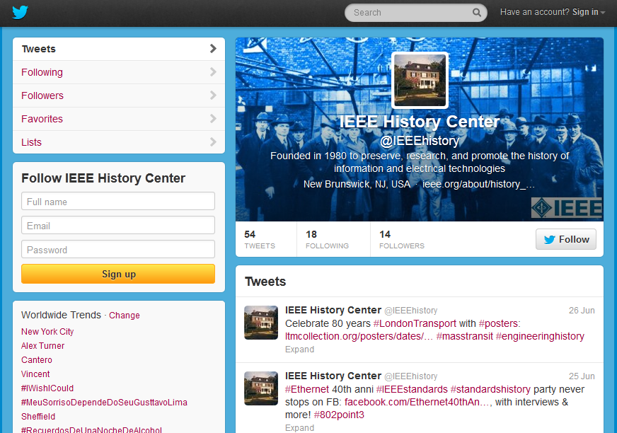
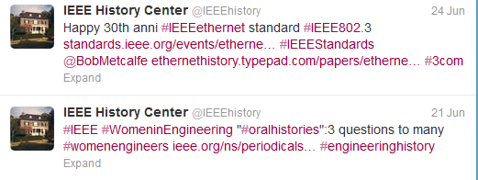
Collaborated with other IEEE OUs

Slide 21


International CES 2014
Created and submitted speaker proposal by Steve Carlson on Ethernet in the Automobile
  Technology Track
  Topic: Just Around the Bend: How Technology will Change Driving

Slide 22
Developed Ethernet Anniversary PowerPoint Slides for IEEE 802.3 WG Members

