Slide 1
[IEEE P3079 Session #13 WG Closing Plenary]
[Sangkwon Peter Jeong / JoyFun]

Slide 2
Compliance with IEEE Standards Policies and Procedures
Subclause 5.2.1 of the IEEE-SA Standards Board Bylaws states, "While participating in IEEE standards development activities, all participants...shall act in accordance with all applicable laws (nation-based and international), the IEEE Code of Ethics, and with IEEE Standards policies and procedures."
The contributor acknowledges and accepts that this contribution is subject to
The IEEE Standards copyright policy as stated in the IEEE-SA Standards Board Bylaws, section 7, http://standards.ieee.org/develop/policies/bylaws/sect6-7.html#7, and the IEEE-SA Standards Board Operations Manual, section 6.1, http://standards.ieee.org/develop/policies/opman/sect6.html
The IEEE Standards patent policy as stated in the IEEE-SA Standards Board Bylaws, section 6, http://standards.ieee.org/guides/bylaws/sect6-7.html#6, and the IEEE-SA Standards Board Operations Manual, section 6.3, http://standards.ieee.org/develop/policies/opman/sect6.html

Slide 3
IEEE 3079 HMD Based VR Sickness Reducing Technology Dongil Dillon Seo, dillon@volercreative
IEEE 3079 Session #13 WG Closing Plenary
Date: 2020-02-06
Author(s):
Name | Affiliation | Phone [optional] | Email [optional]
Jeong, Sangkwon Peter | JoyFun | +82 10 8667 7329 | ceo@joyfun.kr

Slide 4
Session Time and Location
 | Monday (February 3, 2020) | Tuesday (February 4, 2020) | Wednesday (February 5, 2020) | Thursday (February 6, 2020) | Friday (February 7, 2020)
AM-1 8:00-10:00a |  | WG Meeting |  |  | WG Meeting
AM-2 10:30-12:30 | Open Plenary Roll Call Reviewing last meeting minutes (Introducing participants) | MTP Latency IG Meeting | MTP Latency IG Meeting | MTP Latency IG Meeting | WG Closing Plenary
PM-1 1:30 – 3:30p | WG Meeting | WG Meeting | WG Meeting | WG Meeting
PM-2 4:00 – 6:00p | WG Meeting | WG Meeting | WG Meeting
※ Location
SAPPHIRE Room Ⅲ, SONO Calm Yeosu Hotel, 111, Odongdo-ro, Yeosu, Jeollanam-Do, KOREA

Slide 5
WG Motions

Slide 6
WG Motion #1
Move to approve the ‘3079-20-0002-00-0000-Session-13-Agenda’
Move: Sangkwon Peter Jeong
Second: Beom-Ryeol Lee
For Agree: 04
Against: 00
Abstain: 00
Motion Passes

Slide 7
WG Motion #2
Move to approve the Meeting minutes ‘3079-19-0063-02-0002-Status of the Immersive Media Standard: Related to Test Model for Immersive Video (TMIV) for 3DoF+’
Move: Hyun Kyoon Lim
Second: Dong Soo Choi
For Agree: 04
Against: 00
Abstain: 00
Motion Passes

Slide 8
WG Motion #3
Move to approve the ‘3079-19-0037-02-0002-SHVC(Scalable HEVC) Experiment: 360 VR Video Service with 16K Resolution based on Tiled Adaptive Streaming’
Move: Hyun Kyoon Lim
Second: Dong Soo Choi
For Agree: 04
Against: 00
Abstain: 00
Motion Passes

Slide 9
WG Motion #4
Move to approve the ‘3079-20-0005-00-0000-Voting Members Status of the IEEE 3079’
Move: Sangkwon Peter Jeong
Second: Dong Soo Choi
For Agree: 04
Against: 00
Abstain: 00
Motion Passes

Slide 10
WG Motion #5
Move to approve the ‘3079-20-0007-00-0003-Low-Latency-AR-VR-Devices-on-5G-MEC’
Move: Beom-Ryeol Lee
Second: Jeong, Sangkwon Peter
For Agree: 04
Against: 00
Abstain: 00
Motion Passes

Slide 11
WG Motion #6
Move to approve the ‘3079-20-0008-00-0000-Viewport Tile Selection Experiment Using Test Model for Immersive Video (TMIV)’
Move: Hyun Kyoon Lim
Second: Dong Soo Choi
For Agree: 04
Against: 00
Abstain: 00
Motion Passes

Slide 12
WG Motion #7
Move to approve the ‘3079-20-0006-00-0000-The Result of Motion by email’
Move: Jeong, Sangkwon Peter
Second: Hyun Kyoon Lim
For Agree: 04
Against: 00
Abstain: 00
Motion Passes

Slide 13
WG Motion #8
Move to approve the ‘3079-20-0013-00-0000-Meeting Agenda for MTP Latency IG’
Move: Hyun Kyoon Lim
Second: Dong Soo Choi
For Agree: 04
Against: 00
Abstain: 00
Motion Passes

Slide 14
WG Motion #9
Move to approve the ‘3079-20-0010-00-0000-Review of New System to measure motion-to-photon Latency of Virtual Reality Head Mounted Display’
Move: Hyun Kyoon Lim
Second: Dong Soo Choi
For Agree: 04
Against: 00
Abstain: 00
Motion Passes

Slide 15
WG Motion #10
Move to approve the ‘3079-20-0011-00-0000-Review of Perceptual Tolerance to Motion-To-Photon Latency’
Move: Hyun Kyoon Lim
Second: Dong Soo Choi
For Agree: 04
Against: 00
Abstain: 00
Motion Fails

Slide 16
WG Motion #11
Move to approve the ‘3079-20-0004-00-0000-Propose to new PAR of the ‘Mixed Reality Standard Framework for Motion Learning’’
Move: Sangkwon Peter Jeong
Second: Beom-Ryeol Lee
For Agree: 01
Against: 03
Abstain: 00
Motion Fails

Slide 17
WG Motion #12
Move to approve the ‘3079-19-0034-00-0000-The Analysis of Head Tracking Latency in Psychophysics’
Move: Dong Soo Choi
Second: Hyun Kyoon Lim
For Agree: 04
Against: 00
Abstain: 00
Motion Passes

Slide 18
WG Motion #13
Move to approve the ‘3079-19-0034-00-0000-The review of the MTP latency sensing in complex VE’
Move: Dong Soo Choi
Second: Hyun Kyoon Lim
For Agree: 04
Against: 00
Abstain: 00
Motion Passes

Slide 19
WG Motion #14
Move to approve the ‘3079-19-0017-00-0002-Database-Construction-for-Quantitative-Analysis-of-VR-Sickness’
Move: Beom-Ryeol Lee
Second: Dong Soo Choi
For Agree: 04
Against: 00
Abstain: 00
Motion Passes

Slide 20
WG Motion #15
Move to approve the ‘3079-19-0018-00-0002-Predicting-and-Editing-VR-Sickness-Level’
Move: Beom-Ryeol Lee
Second: Hyun Kyoon Lim
For Agree: 04
Against: 00
Abstain: 00
Motion Passes

Slide 21
WG Motion #16
Move to approve the ‘3079-20-0014-00-0000-Dataset-for-Quantitative-Analysis-of-VR-Sickness’
Move: Beom-Ryeol Lee
Second: Sangkwon Peter Jeong
For Agree: 04
Against: 00
Abstain: 00
Motion Passes

Slide 22
WG Motion #17
Move to approve the ‘Publicly open ‘Dataset for Quantitative Analysis of VR Sickness’ to IEEE 3079 web site’
Move: Beom-Ryeol Lee
Second: Sangkwon Peter Jeong
For Agree: 04
Against: 00
Abstain: 00
Motion Passes

Slide 23
Attendees
Sangkwon Peter Jeong | JoyFun Inc.,
Beom-Ryeol Lee | ETRI
Hyun Kyoon Lim | KRISS
Dong Soo Choi | Dong-A University
Soonbin Lee | SUNGKYUNKWAN UNIVERSITY

Slide 24
Development Timeline
PAR approved: 12/2016
Working Group 1st Letter Ballot: 06/2019 (20 days) - Before July meeting
Working Group 2nd Letter Ballot: 09/2019 (20 days) - Before October meeting
Open Sponsor Ballot Invitation: 10/2019 (30 days)
Start Sponsor Ballot: 12/2019 (30 days)
Start Recirculation 1st Ballot: 03/2020 (10 days)
Start Recirculation 2nd Ballot: 06/2020 (10 days)
Submit to RevCom: 08/2020
Publishing: 01/2021
Open Sponsor Ballot Invitation
Mandatory Editorial Coordination submission
WG 2nd
letter Ballot
WG Meeting to address comments
Ballot Resolution Telecon 1
WG 3rd
letter Ballot
Sent comments to the WG
Sent comment to the WG
Ballot Resolution Telecon1
WG 1st
letter Ballot
Start Sponsor
Ballot
Start Recirculation
1st Ballot
Start Recirculation
2nd Ballot
RevCom comment review
Submit to RevCom
SASB Approval
Publishing
07/2019
09/2019
10/2019
11/2019
02/2020
04/2020
06/2020
08/2020
10/2020
01/2021
12/2019
12/2019
03/2020
05/2020
07/2020
09/2020

Slide 25
Future Sessions – 2020
April 20-24, 2020, KRISS Office, 267 Gajeong-ro, Yuseong-gu, Daejeon, Republic of Korea
July 6-10, 2020, IEEE-SA Office, E-1904 Aoyama-Twin Tower Bldg., 1-1-1 Minami-aoyama, Minato-ku, Tokyo, Japan
October 19-23, 2020, ETRI Office, Busan Cultural Content Complex, Busan, Republic of Korea

Slide 26
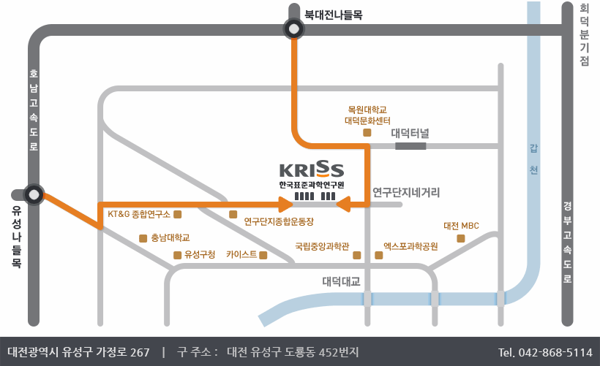
Information of next meeting
WG Documents:
https://mentor.ieee.org/3079/documents
Food and Beverages:
Lunch Time: 12:30PM –1:30PM
Afternoon Coffee break: 3:30PM-4:00PM
Registration: https://events.vtools.ieee.org/m/221359
Location: 267 Gajeong-ro, Yuseong-gu, Daejeon

Slide 27
Work item for next meeting
Comment received and Resolution by result of the 1st Sponsor Ballot of the P3079 draft document
Start to the new PAR for the ‘Mixed Reality Standard Framework for Motion Learning’
Decision for submit of the new PAR for the ‘Motion to Photon (MTP) Latency in Virtual Environments’

Slide 28
Session Time and Location
 | Monday (April 20, 2020) | Tuesday (April 21, 2020) | Wednesday (April 22, 2020) | Thursday (April 23, 2020) | Friday (April 24, 2020)
AM-1 9:00-10:30a |  | MTP Latency IG Meeting | MTP Latency IG Meeting | MTP Latency IG Meeting | WG Meeting
AM-2 11:00a-12:30p | Open Plenary Roll Call Reviewing last meeting minutes (Introducing participants) | 3079.2 TG | 3079.2 TG | 3079.2 TG | WG Closing Plenary
PM-1 1:30 – 3:30p | WG Meeting | WG Meeting | WG Meeting | WG Meeting
PM-2 4:00 – 6:00p | WG Meeting | WG Meeting | WG Meeting | WG Meeting
※ Location
KRISS Office, 267 Gajeong-ro, Yuseong-gu, Daejeon, Republic of Korea

Slide 29
Thank You

