Slide 1
[Low latency AR/VR devices on 5G MEC]
[Beom-Ryeol Lee, Youngho Lee, Wookho Son / ETRI]

Slide 2
Compliance with IEEE Standards Policies and Procedures
Subclause 5.2.1 of the IEEE-SA Standards Board Bylaws states, "While participating in IEEE standards development activities, all participants...shall act in accordance with all applicable laws (nation-based and international), the IEEE Code of Ethics, and with IEEE Standards policies and procedures."
The contributor acknowledges and accepts that this contribution is subject to
The IEEE Standards copyright policy as stated in the IEEE-SA Standards Board Bylaws, section 7, http://standards.ieee.org/develop/policies/bylaws/sect6-7.html#7, and the IEEE-SA Standards Board Operations Manual, section 6.1, http://standards.ieee.org/develop/policies/opman/sect6.html
The IEEE Standards patent policy as stated in the IEEE-SA Standards Board Bylaws, section 6, http://standards.ieee.org/guides/bylaws/sect6-7.html#6, and the IEEE-SA Standards Board Operations Manual, section 6.3, http://standards.ieee.org/develop/policies/opman/sect6.html

Slide 3
IEEE 3079 HMD Based VR Sickness Reducing Technology Dongil Dillon Seo, dillon@volercreative
Low latency AR/VR devices on 5G MEC
Date: 2020-02-03
Author(s):
Name | Affiliation | Phone [optional] | Email [optional]
Beom-Ryeol Lee | ETRI | +82 10 8880 3347 | lbr@etri.re.kr
Youngho Lee | ETRI | +82 10 3008 5770 | jason0720@etri.re.kr
Wookho Son | ETRI | +82 10 8759 3602 | whson@etri.re.kr

Slide 4
Contents
MTP Latency
Motion Processing and Rendering
Mobile Edge Computing
HW acceleration for Low Latency

Slide 5
MTP Latency
VR System
Total Motion-to-Photon Latency ≤20ms
HMD
Motion
Input
New Image
Output
①
1ms
⑦
Pixel
Switching
1ms
IMU
90Hz OLED Display 11ms
⑥
②
Write Display
Local Content Server
⑤
Data Processing Unit
2ms
Remote Content Server
③
④
Data Processing Unit
2ms
※ 3079-18-0035-00-0003 Network Diagrams for HMD based VR Service

Slide 6
Use cases for network configuration
Case | Status of each node |  |  |  |  |  |  | Remarks
 | ① | ② | ③ | ④ | ⑤ | ⑥ | ⑦
1 | direct | Wired connection (e.g. HDMI) | Wired WAN | Wired WAN | Wired connection (e.g. HDMI) | chip | display Panel | Wired Network | VIVE / Oculus / PS VR
2 | direct | on Board | Wireless WLAN | Wireless WAN | on Board | chip | display Panel | Wireless Network | Gear VR or Oculus GO
3 | direct | on Board | Cellular network | Cellular network | on Board | chip | display Panel | Mobile Network | Gear VR or Oculus GO
4 | direct | LAN / Wireless connection | n/a | n/a | LAN / Wireless connection | chip | display Panel | Local Network | VIVE / Oculus / PS VR
5 | Sensor Network | Wired connection (e.g. HDMI) | n/a | n/a | Wired connection (e.g. HDMI) | chip | display Panel | Motion Sensing | Whole kinds HMD
6 | direct | on Board | Cellular network / Wireless LAN | Cellular network / Wireless LAN | on Board | chip | display Panel | Network Handover | Gear VR or Oculus GO
※ 802.21-18-0039-02-0000 New Diagram for Network Enablers
for seamless HMD based VR Content Service

Slide 7
Req. on MPT latency
MTP latency: 10~20msec
Resolution full-view sphere video: 12K~24K
Resolution on FOV: 4K ~
FOV: 120 degree ~
Frame rate: 60~120fps
Refresh rate: 90Hz
Device cost: low
Battery consumption: minimum
Tethered or standalone devices
Content downloading or streaming
Operator’s traffic: minimum

Slide 8
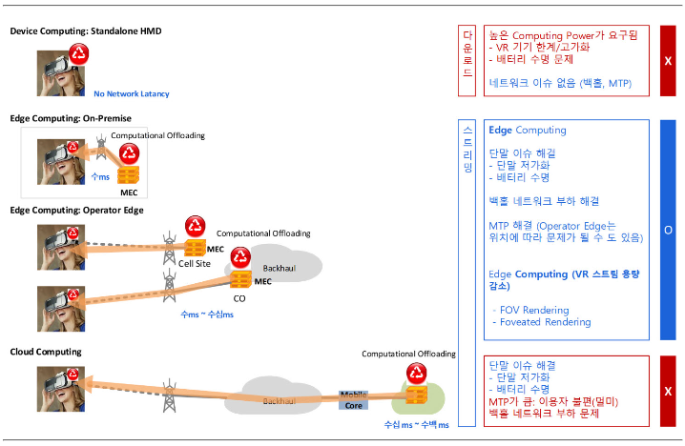
Edge Computing
Edge Computing
※ https://netmanias.com/ko/?m=view&id=blog&no=13939
VR and Edge Computing, Dec 12, 2018

Slide 9
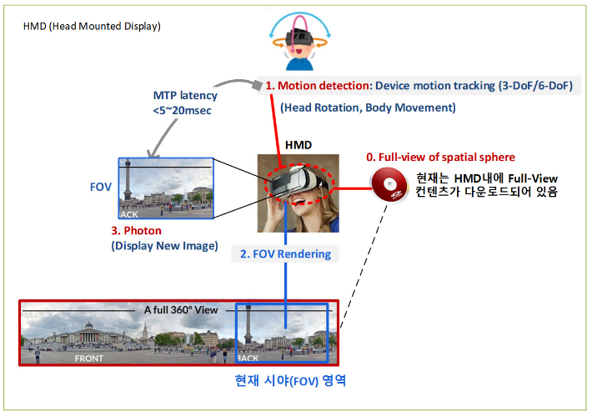
Motion processing and Rendering
1. Standalone HMD – FOV Rendering
Full-view content downloaded
Current FOV region
※ https://netmanias.com/ko/?m=view&id=blog&no=13939
VR and Edge Computing, Dec 12, 2018

Slide 10
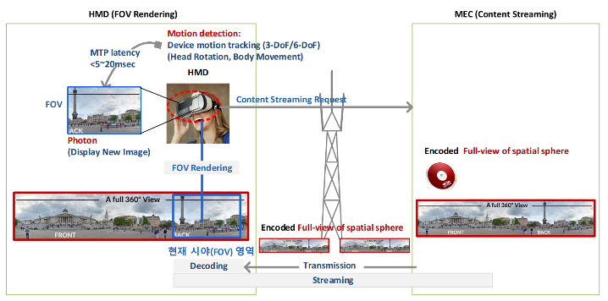
Motion processing and Rendering
2. VR streaming – Full view streaming/transmission
Current FOV region
※ https://netmanias.com/ko/?m=view&id=blog&no=13939
VR and Edge Computing, Dec 12, 2018

Slide 11
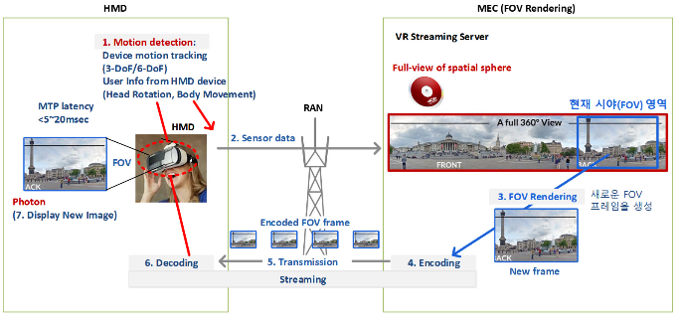
Motion processing and Rendering
3. VR streaming – FOV streaming/transmission
Current FOV region
Create new FOV frame
※ https://netmanias.com/ko/?m=view&id=blog&no=13939
VR and Edge Computing, Dec 12, 2018

Slide 12
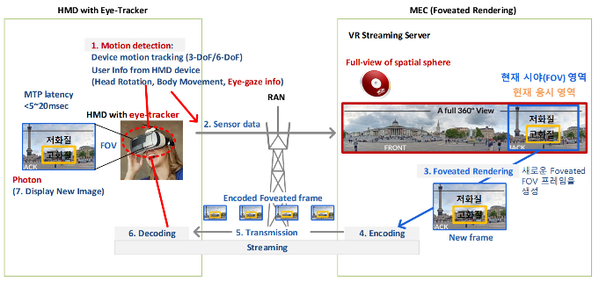
Motion processing and Rendering
4. VR streaming – FOV + Foveated Rendering transmission
Current FOV region
Current viewing area
Create new Foveated FOV frame
Low Quality
High Quality
※ https://netmanias.com/ko/?m=view&id=blog&no=13939
VR and Edge Computing, Dec 12, 2018

Slide 13
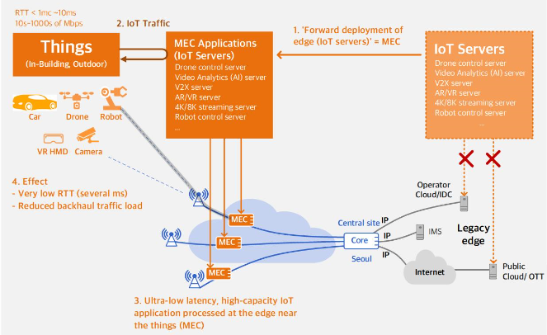
Mobile Edge Computing(MEC)
※ https://www.netmanias.com/en/?m=view&id=oneshot&no=14276
MEC Concept and deployment Architecture in 4G and 5G Network, May 22, 2019

Slide 14
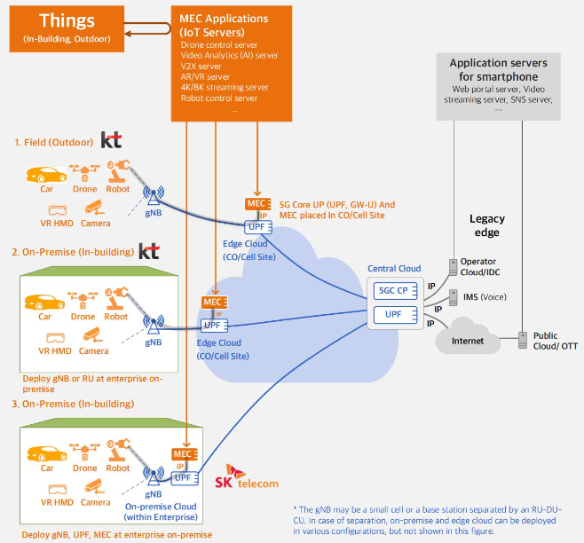
MEC Deployment in 5G Networks
※ https://www.netmanias.com/en/?m=view&id=oneshot&no=14276
MEC Concept and deployment Architecture in 4G and 5G Network, May 22, 2019
※ https://www.netmanias.com/en/?m=view&id=oneshot&no=14276
MEC Concept and deployment Architecture in 4G and 5G Network, May 22, 2019

Slide 15
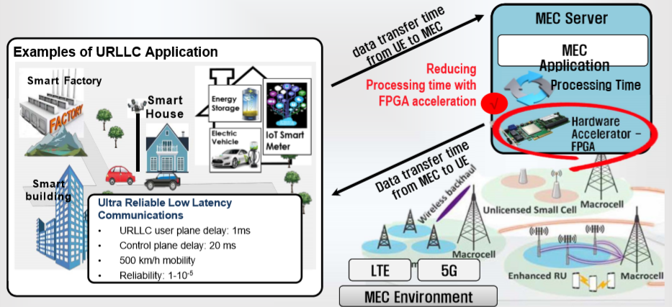
URLLC(Ultra Reliable Low Latency Communication)
※ Technical trends of Mobile Edge Computing, KAIST

Slide 16
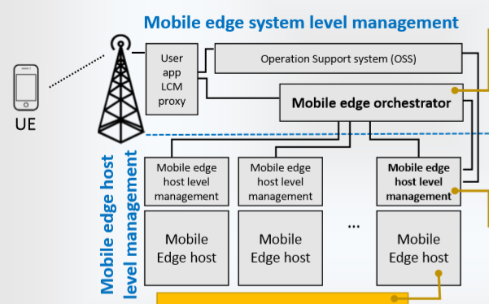
ETSI Standardization: MEC Referece Architecture
※ ETSI “ETSI GS MEC 003v Mobile edge Computing Framework and Reference Architecture”

Slide 17
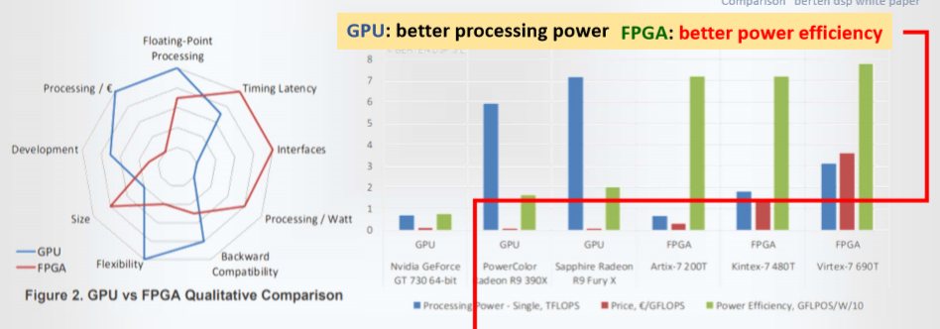
HW Acceleration for Low Latency
※ Technical trends of Mobile Edge Computing, KAIST

Slide 18
Conclusions
Req. of MTP Latency
Reference model of MEC
Consider low latency key factors
Further issues : Req. of Low latency on 5G MEC

Slide 19
Thank You

