Slide 1
SHVC(Scalable HEVC) Experiment:
360 VR Video Service with 16K Resolution based on Tiled
Adaptive Streaming
Presenter: Jong-Beom Jeong (uof4949@skku.edu)
SoonBin Lee, Jong-Beom Jeong, Eun-Seok Ryu
Multimedia Computing Systems Lab. (MCSL)
http://mcsl.skku.edu
Department of Computer Education
Sungkyunkwan University

Slide 2
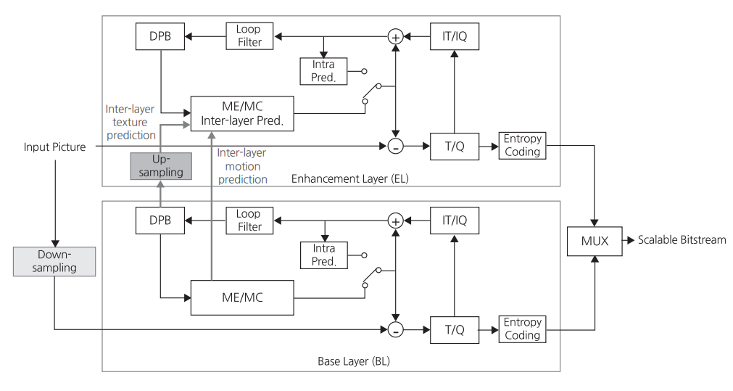
Scalable HEVC(SHVC)
Background
For Scalable HEVC
Multi-layer Structure (Base layer and Enhancement layer)
Inter-layer prediction for referencing between two layers
Architecture of SHVC
3079-19-0037-01-0002

Slide 3
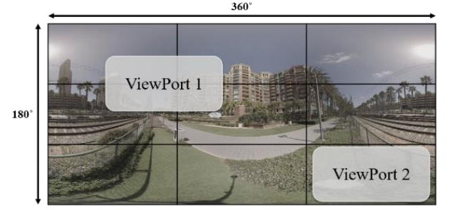
Tiled Adaptive Streaming
Background
Multi Layered Rendering 360 VR
ROI-based HEVC tiled adaptive streaming for 360 VR video
360 VR Tile Streaming for User’s Viewport
3079-19-0037-01-0002

Slide 4
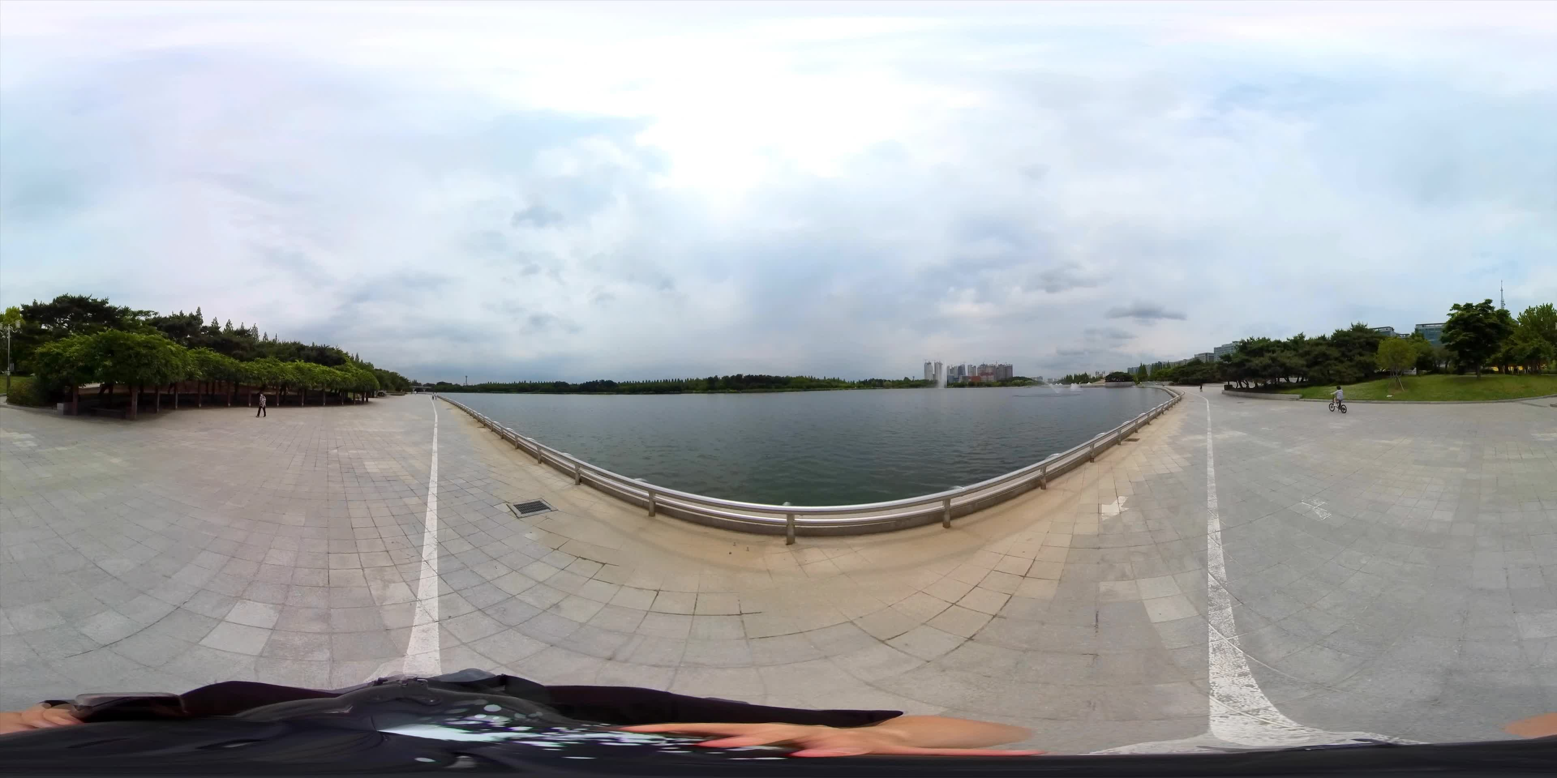
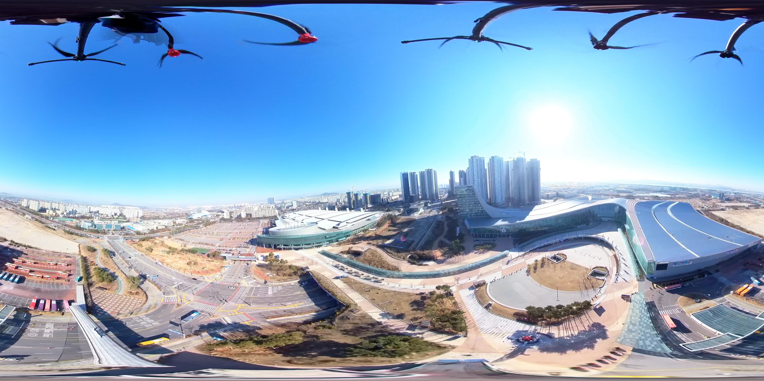
Test Sequences
Test Sequences
Lake Park Riding 16K
Ilsan KINTEX Drone 16K
Sequence name | Resolution | Frame count | Frame rate
Lake Park Riding 16K | 15360x7680 | 300 | 30
Ilsan KINTEX Drone 16K | 15360x7680 | 300 | 30
3079-19-0037-01-0002

Slide 5
Experimental Results
Server
2 linux servers (ubuntu 16.04) were used in experiment
One has 2 intel xeon E5-2687w (12 cores, 24 threads) CPUs and 128GB memory
Another has 2 intel xeon E5-2620 (6 cores, 12 threads) CPUs and 128GB memory
Memory requirement is very high in SHM encoding process (>50GB)
Software
SHM 12.0
HM 16.9
3079-19-0037-01-0002

Slide 6
Experimental Results (-Cont’d)
Experimental results for Lake Park Riding 16K and Ilsan KINTEX Drone 16K
For the objective evaluation, Y-PSNR is used
Lack of time, We experimented only 17 frame
We compare SHVC and HEVC-Simulcast
SHVC is slightly better, but not significantly.
Sequence | BD-rate | DeltaQP | Group of Pictures (GOP) | Frame | Tile Scheme (EL)
Lake Park Riding 16K | -4.20% | 5 | 16 | 17 | 20x20 Unifrom
Ilsan KINTEX Drone 16K | -7.52% | 5 | 16 | 17 | 20x20 Uniform
Results of SHVC BD-rate compare to HEVC-Simulcast
3079-19-0037-01-0002

Slide 7
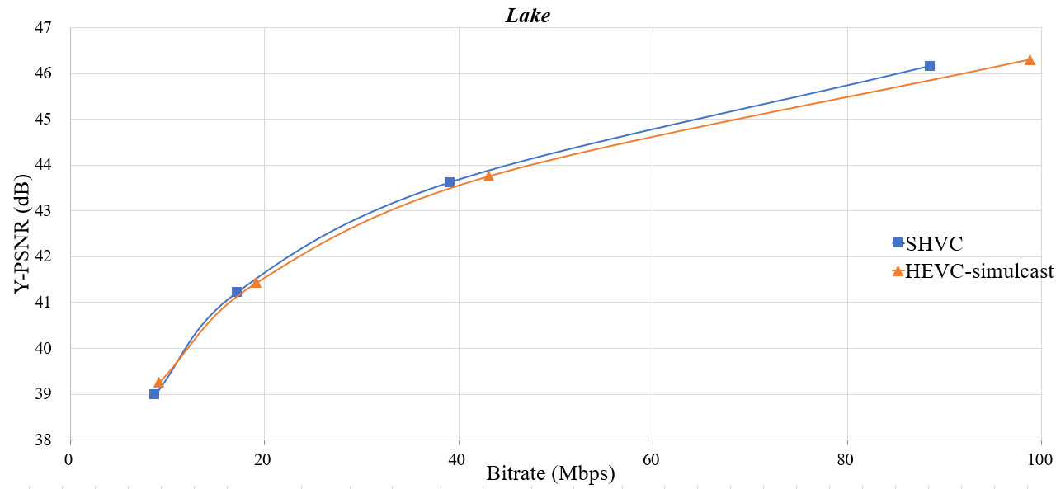
Experimental Results (-Cont’d)
RD-curve of Lake Park Riding 16K
3079-19-0037-01-0002

Slide 8
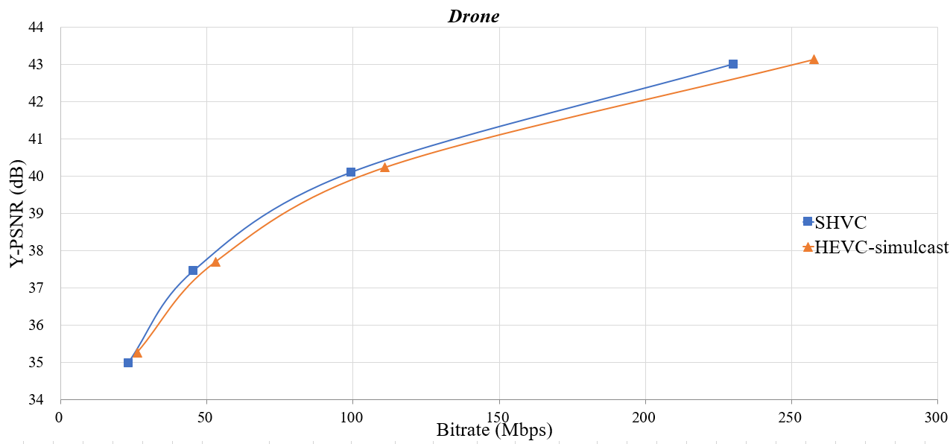
Experimental Results
RD-curve of Ilsan KINTEX Drone 16K
3079-19-0037-01-0002

