Slide 1
[IEEE P3079 Session #7 WG Opening Plenary]
[Dillon Seo / VoleR Creative]

Slide 2
Compliance with
IEEE Standards Policies and Procedures
Subclause 5.2.1 of the IEEE-SA Standards Board Bylaws states, "While participating in IEEE standards development activities, all participants...shall act in accordance with all applicable laws (nation-based and international), the IEEE Code of Ethics, and with IEEE Standards policies and procedures."
The contributor acknowledges and accepts that this contribution is subject to
The IEEE Standards copyright policy as stated in the IEEE-SA Standards Board Bylaws, section 7, http://standards.ieee.org/develop/policies/bylaws/sect6-7.html#7, and the IEEE-SA Standards Board Operations Manual, section 6.1, http://standards.ieee.org/develop/policies/opman/sect6.html
The IEEE Standards patent policy as stated in the IEEE-SA Standards Board Bylaws, section 6, http://standards.ieee.org/guides/bylaws/sect6-7.html#6, and the IEEE-SA Standards Board Operations Manual, section 6.3, http://standards.ieee.org/develop/policies/opman/sect6.html

Slide 3
IEEE 3079
HMD Based 3D Content Motion Sickness Reducing Technology
Dongil Dillon Seo, dillon@volercreative
Opening Plenary
Date: 2018-10-06
Author(s):
Name | Affiliation | Phone [optional] | Email [optional]
Seo, Dongil Dillon | VoleR Creative | +82 10 3135 3194 | dillon@volercreative.com
Jeong, Sangkwon Peter | JoyFun | +82 10 8667 7329 | ceo@joyfun.kr

Slide 4
Session Time and Location
 | Monday (October 8, 2018) | Tuesday (October 9, 2018) | Wednesday (October 10, 2018) | Thursday (October 11, 2018)
AM-1 8:00-10:00a |  | WG Meeting | WG Meeting | WG Meeting
AM-2 10:30-12:30 | Open Plenary Roll Call Reviewing last meeting minutes (Introducing participants) | WG Meeting | WG Meeting | WG Closing Plenary
PM-1 1:30 – 3:30p | WG Meeting | WG Meeting | WG Meeting
PM-2 4:00 – 5:00p | WG Meeting | WG Meeting | WG Meeting
※ Location
Default Meeting Room: 1 Fusionopolis Walk #04-07 South Tower, Solaris, IEEE-SA Office, Singapore, Singapore

Slide 5
Attendance
Electronic Attendance ONLY
Electronic Attendance
  IMAT System
    https://imat.ieee.org/attendance
  Mark attendance during every session

Slide 6
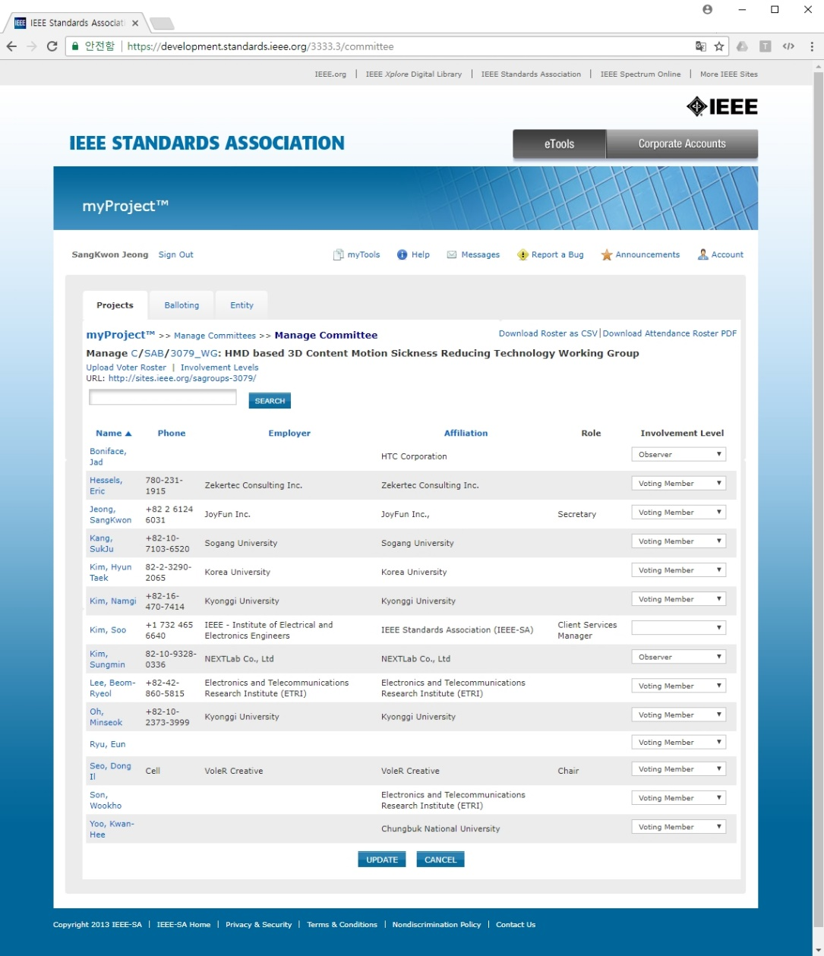
Attendance
Total number of IEEE 3079 WG sessions: 13
07 sessions for 50% attendance to be counted towards WG voting membership
All attendance records are reported on the meeting minutes
  Please check the attendance records for any errors

Slide 7
Voting Membership
3079 Voting Membership described in
  DCN#: 3-17-0046-00-0000
Maintenance of Voting Membership
  Two Plenary sessions out of four consecutive Plenary sessions on a moving window basis
WG Letter Ballots
  WG members are expected to vote on WG LBs
  Failure to vote on 2 out of last 3 WG LBs could result
  in loss of voting rights
Subir Das, Chair 802.21 WG

Slide 8
Miscellaneous Meeting Logistics
WG Documents: https://mentor.ieee.org/3079/documents
Food and Beverages:
  Lunch Time: 12:30PM –1:30PM
  Afternoon Coffee break: 3:30PM-4:00PM

Slide 9
Registration and Media Recording
Each Attendee must provide contact information and pay conference fee
Conference fee has to be paid through the registration desk
Failure to pay conference fee results in loss of credit for voting rights
Photography not permitted unless approved by WG Chair
Audio taping of IEEE 3079 meetings is NOT allowed
Media – Press and Analyst briefings
  Only the 3079 WG Chair is allowed to give verbal statements/interviews to the media on behalf of the IEEE 3079 working group

Slide 10
Membership & Anti-Trust
Individual membership
  In all IEEE standards meetings, membership is by individual, hence you do not represent a company or organization.
Anti-Trust laws
  The Anti-Trust laws forbid the discussion of prices within our meetings.

Slide 11
The IEEE-SA strongly recommends that at each WG meeting the chair or
a designee:
  Show slides #1 through #4 of this presentation
  Advise the WG attendees that:
    The IEEE’s patent policy is consistent with the ANSI patent policy and is described in Clause 6 of the IEEE-SA Standards Board Bylaws;
    Early identification of patent claims which may be essential for the use of standards under development is strongly encouraged;
    There may be Essential Patent Claims of which the IEEE is not aware. Additionally, neither the IEEE, the WG, nor the WG chair can ensure the accuracy or completeness of any assurance or whether any such assurance is, in fact, of a Patent Claim that is essential for the use of the standard under development.
  Instruct the WG Secretary to record in the minutes of the relevant WG meeting:
    That the foregoing information was provided and that slides 1 through 4 (and this slide 0, if applicable) were shown;
    That the chair or designee provided an opportunity for participants to identify patent claim(s)/patent application claim(s) and/or the holder of patent claim(s)/patent application claim(s) of which the participant is personally aware and that may be essential for the use of that standard
    Any responses that were given, specifically the patent claim(s)/patent application claim(s) and/or the holder of the patent claim(s)/patent application claim(s) that were identified (if any) and by whom.
  The WG Chair shall ensure that a request is made to any identified holders of potential essential patent claim(s) to complete and submit a Letter of Assurance.
  It is recommended that the WG chair review the guidance in IEEE-SA Standards Board Operations Manual 6.3.5 and in FAQs 12 and 12a on inclusion of potential Essential Patent Claims by incorporation or by reference.
  Note: WG includes Working Groups, Task Groups, and other standards-developing committees with a PAR approved by the IEEE-SA Standards Board.

Slide 12
Participants, Patents, and Duty to Inform
All participants in this meeting have certain obligations under the IEEE-SA Patent Policy. Participants:
  “Shall inform the IEEE (or cause the IEEE to be informed)” of the identity of each “holder of any potential Essential Patent Claims of which they are personally aware” if the claims are owned or controlled by the participant or the entity the participant is from, employed by, or otherwise represents
    “Personal awareness” means that the participant “is personally aware that the holder may have a potential Essential Patent Claim,” even if the participant is not personally aware of the specific patents or patent claims
  “Should inform the IEEE (or cause the IEEE to be informed)” of the identity of “any other holders of such potential Essential Patent Claims” (that is, third parties that are not affiliated with the participant, with the participant’s employer, or with anyone else that the participant is from or otherwise represents)
  The above does not apply if the patent claim is already the subject of an Accepted Letter of Assurance that applies to the proposed standard(s) under consideration by this group
Quoted text excerpted from IEEE-SA Standards Board Bylaws subclause 6.2
Early identification of holders of potential Essential Patent Claims is strongly encouraged
No duty to perform a patent search

Slide 13
Call for Potentially Essential Patents
If anyone in this meeting is personally aware of the holder of any patent claims that are potentially essential to implementation of the proposed standard(s) under consideration by this group and that are not already the subject of an Accepted Letter of Assurance:
  Either speak up now or
  Provide the chair of this group with the identity of the holder(s) of any and all such claims as soon as possible or
  Cause an LOA to be submitted

Slide 14
Participation in IEEE 3079 Meetings
All participation in IEEE 3079 Working Group meetings is on an individual basis
• Participants in the IEEE standards development individual process shall act based on their qualifications and experience. (https://standards.ieee.org/develop/policies/bylaws/sb_bylaws.pdfsection 5.2.1)
• IEEE 3079 Working Group membership is by individual; “Working Group members shall participate in the consensus process in a manner consistent with their professional expert opinion as individuals, and not as organizational representatives”. (subclause 4.2.1 “Establishment”, of the IEEE 3079 Working Group Policies and Procedures)
Participants have an obligation to act and vote as an individual and not under the direction of any other individual or group. A Participant’s obligation to act and vote as an individual applies in all cases, regardless of any external commitments, agreements, contracts, or orders.
Participants shall not direct the actions or votes of any other member of an IEEE 3079 Working Group or retaliate against any other member for their actions or votes within IEEE 3079 Working Group meetings, see https://standards.ieee.org/develop/policies/bylaws/sb_bylaws.pdf section 5.2.1.3 and the IEEE 3079 Working Group Policies and Procedures, subclause 3.4.1 “Chair”, list item x.
By participating in IEEE 3079 meetings, you accept these requirements. If you do not agree to these policies then you shall not participate.

Slide 15
Other Guidelines for IEEE WG Meetings
All IEEE-SA standards meetings shall be conducted in compliance with all applicable laws, including antitrust and competition laws.
  Don’t discuss the interpretation, validity, or essentiality of patents/patent claims.
  Don’t discuss specific license rates, terms, or conditions.
    Relative costs, including licensing costs of essential patent claims, of different technical approaches may be discussed in standards development meetings.
      Technical considerations remain primary focus
  Don’t discuss or engage in the fixing of product prices, allocation of customers, or division of sales markets.
  Don’t discuss the status or substance of ongoing or threatened litigation.
  Don’t be silent if inappropriate topics are discussed … do formally object.
---------------------------------------------------------------
See IEEE-SA Standards Board Operations Manual, clause 5.3.10 and “Promoting Competition and Innovation: What You Need to Know about the IEEE Standards Association's Antitrust and Competition Policy” for more details.

Slide 16
Copyright
Under the current US copyright law — the author of information is deemed to own the copyright from the moment of creation
The IEEE Bylaws require copyright of all material to be held by the IEEE
  Must consult with IEEE for re-use of copyright material
The IEEE Standards accomplishes transfer of copyright ownership through the Project Authorization Request (PAR) process

Slide 17
Work Status
Working Group Status
  Developing of the standard document
  Processing to New PAR

Slide 18
Objectives for the October Meeting
Work/discussion on
  Discuss about ‘Content requirements’
  Discuss about ‘Network requirements’
  Discuss about ‘Display requirements’
  Decide on location of the Next Year meetings
  Next Busan meeting

Slide 19
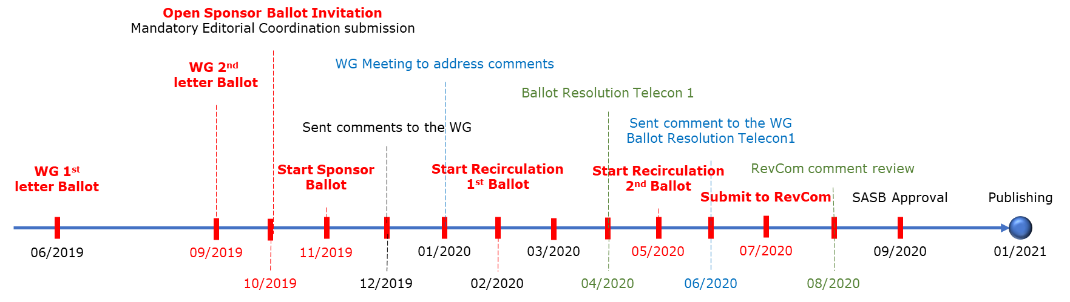
Development Timeline
PAR approved: 12/2016
Working Group 1st Letter Ballot: 06/2019 (20 days)
- Before July meeting
Working Group 2nd Letter Ballot: 09/2019 (20 days)
- Before October meeting
Open Sponsor Ballot Invitation: 10/2019 (30 days)
Start Sponsor Ballot: 11/2019 (30 days)
Start Recirculation 1st Ballot: 02/2020 (10 days)
Start Recirculation 2nd Ballot: 05/2020 (10 days)
Submit to RevCom: 07/2020
Publishing: 01/2021

Slide 20
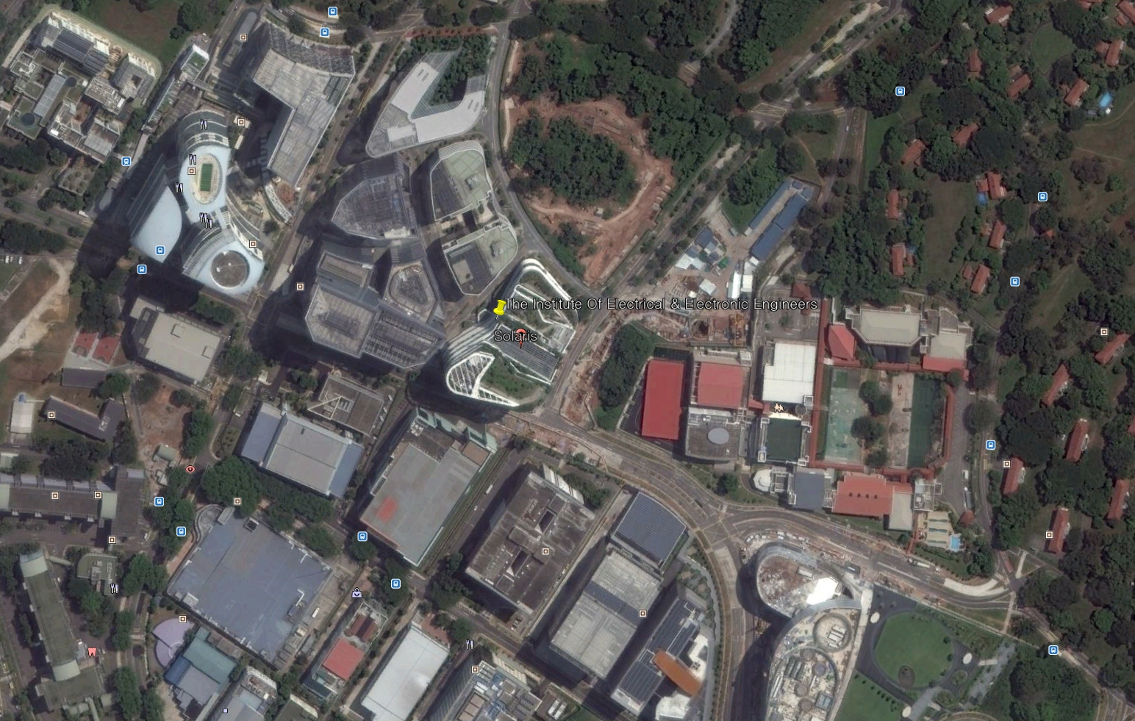
Information of Next Meeting Area

Slide 21
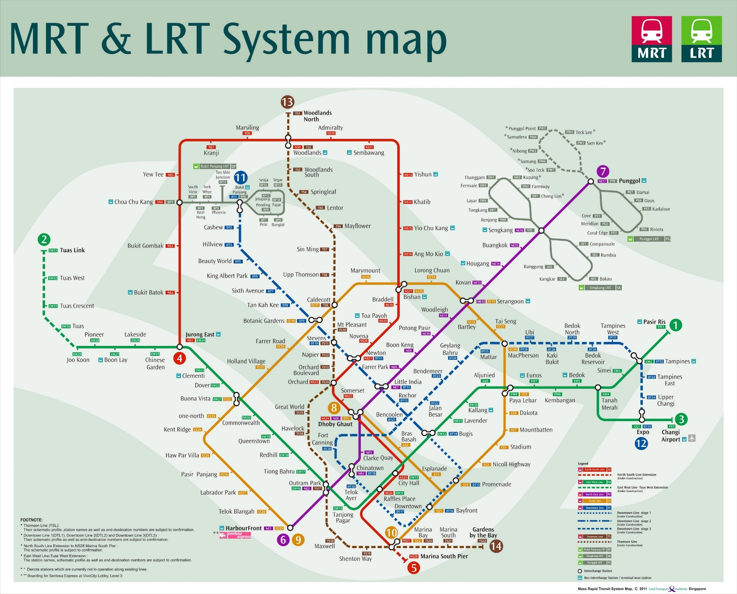
Information of Next Meeting Area
9호선 Circle Line
One-north 역
창이 공항

Slide 22
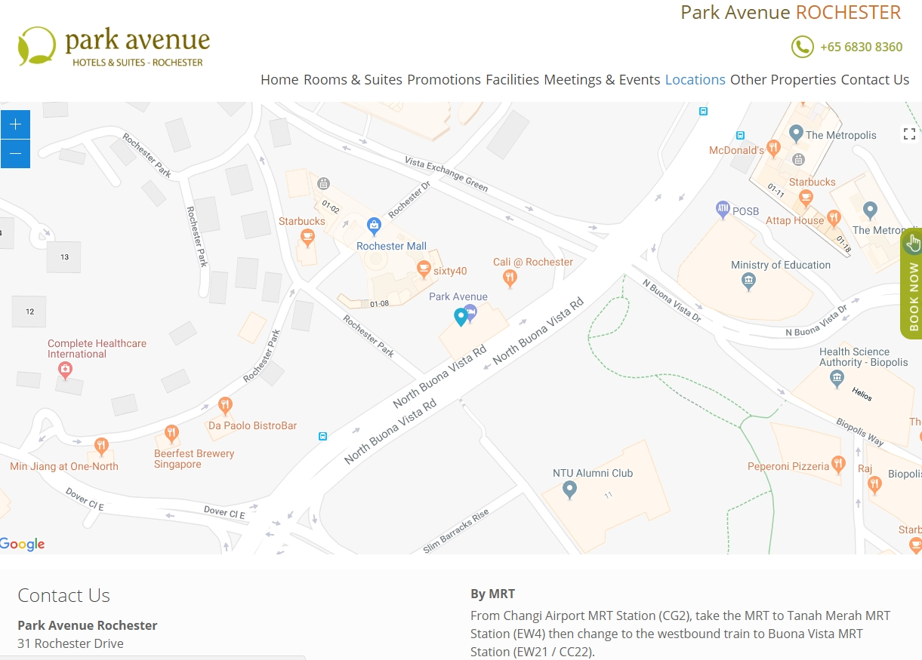
Information of Residences
Location: Park Avenue Rochester 31 Rochester Drive Singapore 138637
Web site: https://parkavenueintl.com/parkavenuerochester/location/

Slide 23
Future Sessions – 2019
January 28- February 01, 2018, Busan, Korea
April 22-26, 2018, 3 Park Avenue, (​IEEE-SA Office), New York City, New York 10016
July 8-12, 2018, IEEE Technology Centre GmbH, (​IEEE-SA Office), Heinestrabe 30, 1020 Vienna Austria
October 07-11, 2018, TBD, Southeast ASIA

Slide 24
Thank You

