Slide 1
IEEE IAS Technical Books Coordinating Committee (IAS/TBCC)
Webinar on the Mentor Collaboration Tool
Lisa Perry
16 June 2014

Slide 2
Overview
Mentor
  Roster
  WG roles and Mentor involvement levels
  Mail
  Document repository

Slide 3
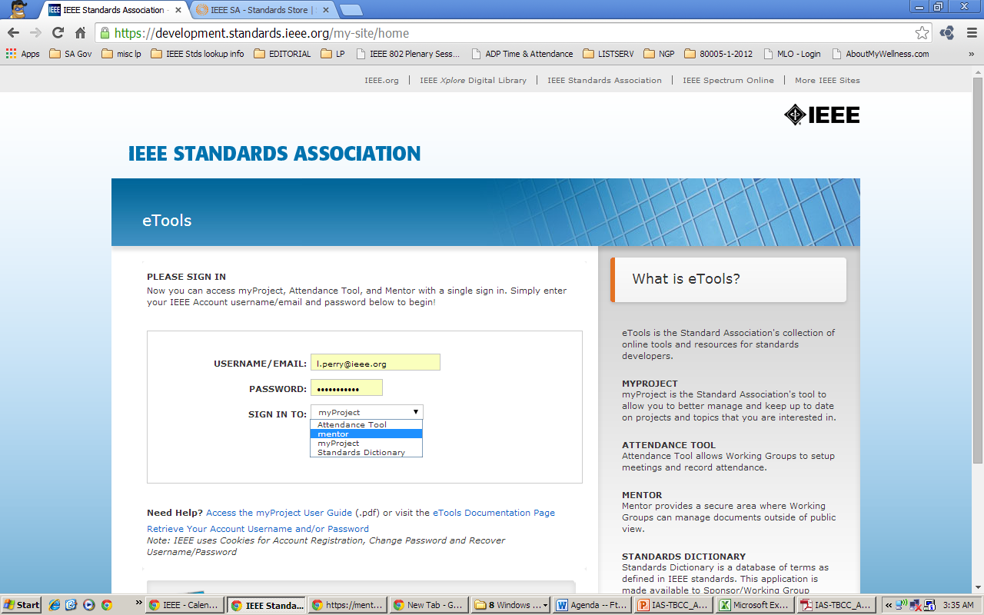
How to Access Mentor
Login at http://development.standards.ieee.org/

Slide 4
Mentor – Collaboration tool
Roster
    https://mentor.ieee.org/3000-stds/dcn/14/stds-14-0041-TBCC-mentor-roster-list.pdf
      If you need access to the Mentor workspace, check the roster at the URL above.
      If your name is not listed, send request to be added to the workspace to l.perry@ieee.org
      (cc: WG Chair and Vice Chair).
  WG roles and Mentor Involvement Levels
WG role | Mentor involvement levels | Documents | Mail
WG Chair Vice Chair* | Admin | -View public/private -Post -Delete | -View -Send -Delete
WG Member Vice Chair* | Members | -View public/private -Post | -View -Send
— | Guests | -View public/private | -View
— | Interested | -View public | -No access
*Vice Chairs may be assigned as Admin or Member, depending on the needs of the WG.

Slide 5
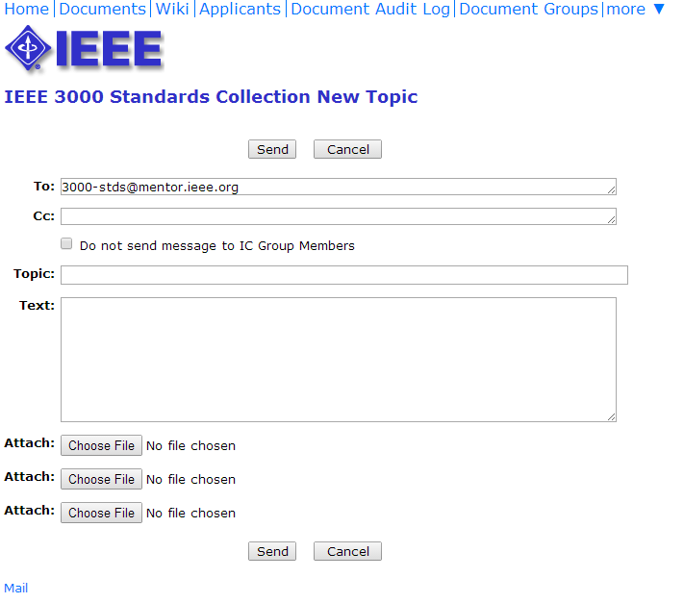
Mentor – Collaboration tool (cont.)
Mail – Two ways to send
  Send through Web interface (must login to the workspace)

Slide 6
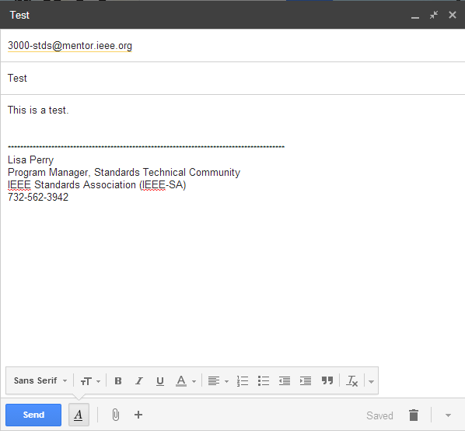
Mentor – Collaboration tool (cont.)
Mail – Two ways to send
  Send via email (must send from the email associated with your account)

Slide 7
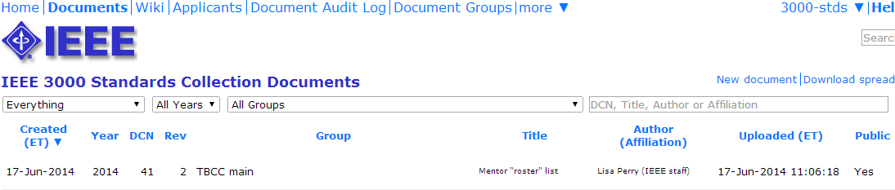
Document Repository
  For each document that is uploaded, the system provides a unique ID and file name

Slide 8

Mentor – Collaboration tool (cont.)
File name is stds-14-0041-02-TBCC-mentor-roster-list.pdf
  stds-14-0041-02-TBCC-mentor-roster-list.pdf

Slide 9
Mentor – Collaboration tool (cont.)
Documents
  Create links to documents posted to Mentor
    Send links in Mentor mail, e.g., when looking for reviewers
    Applies to public and private documents
    Copy URL from the address bar in your browser and paste into email
      NOTE: Links will access the document, not necessarily the latest version
      To create link to latest version automatically, delete the revision number from the link
      E.g., using the roster link from previous page, you would delete “0041”
        Before:
        https://mentor.ieee.org/3000-stds/dcn/14/stds-14-0041-00-TBCC-mentor-roster-list.pdf
        After:
        https://mentor.ieee.org/3000-stds/dcn/14/stds-14-00-TBCC-mentor-roster-list.pdf

