Slide 1
[Presentation for evaluation method of VR/AR/MR/XR Training System]
[Wonki Hong / Korea Electronics Association(KEA)
Suhhee Yoo / Korea Electronics Association(KEA) ]
Feb 15, 2022

Slide 2
Compliance with
IEEE Standards Policies and Procedures
Subclause 5.2.1 of the IEEE-SA Standards Board Bylaws states, "While participating in IEEE standards development activities, all participants...shall act in accordance with all applicable laws (nation-based and international), the IEEE Code of Ethics, and with IEEE Standards policies and procedures."
The contributor acknowledges and accepts that this contribution is subject to
The IEEE Standards copyright policy as stated in the IEEE-SA Standards Board Bylaws, section 7, http://standards.ieee.org/develop/policies/bylaws/sect6-7.html#7, and the IEEE-SA Standards Board Operations Manual, section 6.1, http://standards.ieee.org/develop/policies/opman/sect6.html
The IEEE Standards patent policy as stated in the IEEE-SA Standards Board Bylaws, section 6, http://standards.ieee.org/guides/bylaws/sect6-7.html#6, and the IEEE-SA Standards Board Operations Manual, section 6.3, http://standards.ieee.org/develop/policies/opman/sect6.html

Slide 3
IEEE 2888
Interfacing Cyber and Physical World Working Group
Kyoungro Yoon, yoonk@konkuk.ac.kr
Presentation for evaluation method of VR/AR/MR/XR Training System
Date: 2022-02-14
Author(s):
Name | Affiliation | Phone | Email
Wonki Hong | Korea Electronics Association | +82 10 9030 6775 | hongwk@gokea.org
Suhhee Yoo | Korea Electronics Association | +82 10 7370 4838 | shyoo@gokea.org

Slide 4
Contents
Introduction
Terms and Definitions
Evaluation factors
Conclusions

Slide 5
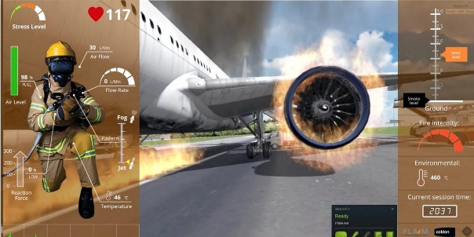
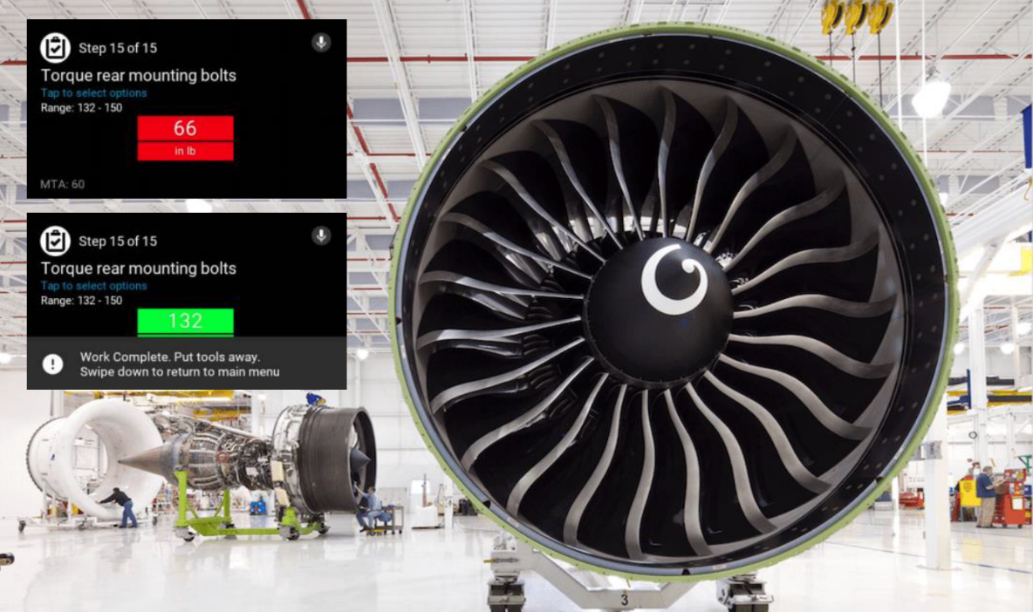
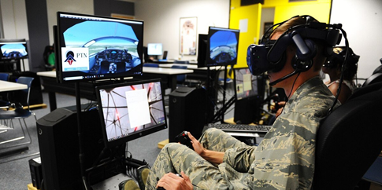
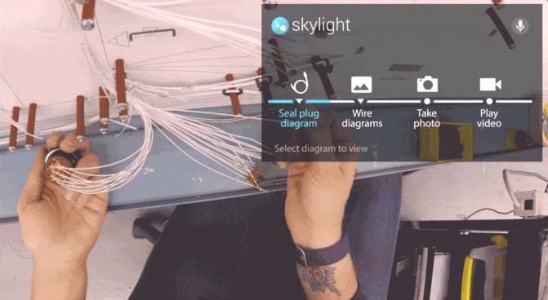
1. Introduction
Background
This document proposes standardized guidelines for the evaluation method of VR/AR/MR/XR training systems in various industrial areas to reduce high-cost and high-risk compared to the training systems in the real world.
For example, the military, police, and firefighting fields has showed high-risk, high-cost to provide training system in the real world. Therefore, VR training system for their fields has been developed for a long time.

Slide 6
1. Introduction
Scope
In this document, VR/AR/MR/XR training systems are intended to increase trainees’ manipulation and procedural skills or knowledge in a specific area using VR/AR/MR/XR technology. Therefore, this document focuses on the training effect from the trainee’s perspective.
Also, it should provide feedback such as spent time and completion rate, scores, pass/fail to trainees so that they can check differences before and after the training.
< Scope of VR/AR/MR/XR training system >
1 | Should measure training effect from the trainee’s perspective
2 | Should utilize VR/AR/MR/XR technology to reduce high-risk or high-cost
3 | Should provide Feedback system - Examples of feedback : Spent time, completion rate, scores, pass/fail

Slide 7
2. Terms and Definitions
The VR/AR/MR/XR training system can be distinguished into two types
Functional training
- Objective : To increase trainee’s manipulation of equipment or procedural skills
- Characteristics
∙ Repeat specific motions or sequences to operate equipment
∙ Check feedbacks provided by training system to improve their skills.
Situational training
- Objective : To increase trainee’s decision-making ability in specific situations
- Characteristics
∙ May have manuals of proper response in each situation
∙ Provide feedbacks (scores based on trainees’ response, proper behavior in a specific situation)
∙ Generally complex than functional training
Training type | Examples in the manufacturing field | Examples in the public field
Functional Training | Welding, Electrical Equipment, Assembly etc. | Fire extinguisher operation, Gun manipulation, Protective gear wearing, etc.
Situational Training | Toxic Gas leak accident, Prevention of fall/entanglement accident, etc. | Tactical Training, Building fire suppression, Rescue, etc.

Slide 8
3. Evaluation factors
Effectiveness
Factors which VR/AR/MR/XR trainee is anticipated to achieve after training system
It would be different to various types of training system
Examples
  Increase of immersion
  Increase of interest
  Accuracy of task
  Completeness of task
  Completion time of task
Measurement methods
  Questionnaire
  Physiological signals (e.g : EEG, PPG)
  Eye -tracking

Slide 9
3. Evaluation factors
Usability
Attribute that assesses how easy VR/AR/MR/XR training systems are to use
Examples
  Controllability
  Visibility
  Stability
  Safety
Measurement methods
  Questionnaire
  Physiological signals (e.g : EEG, PPG)
  Eye -tracking

Slide 10
3. Evaluation factors
Example questionnaires of usability factors
Usability factors |  | Questions
Controllability | Flexibility and efficiency | How simple is the head movement to manipulate the UI while wearing the HMD? How simple is the operation and controller operation for the input? How many different ways are there to do a single task?
 | Controllable Range | To what extent is it possible to start or end content while wearing the HMD? How is it possible to change the settings of the HMD and contents while wearing the HMD? To what level can you manipulate content while wearing an HMD
 | Consistency | How consistent is the motion for input and control of the controller while wearing the HMD? How consistent is the motion for input and controller operation while wearing the HMD to start using the content and operating the content?
Visibility | System visibility | How much can you grasp the progress and current status of the content while wearing the HMD? How easy is it to grasp the user’s locations and orientation in virtual space? How much is it possible to understand the situation outside the content and outside the HMD while wearing the HMD?
 | Consistent with Reality | How consistent is the language or icon of the UI with reality How much is the same language or icon for UI manipulation consistent with reality?
 | Simple Design | How much extra head movement is needed for UI manipulation while wearing HMD? How clear is the distinction between content and UI for manipulation?
Stability | Mistake and accident prevention design | How confusing is the operation for input and control of the controller while wearing the HMD? How far can the user know the result of the input while wearing the HMD? How many warnings are there for giving a hard to revert order? How low is the risk of safety accidents due to external circumstances while wearing an HMD?
 | Error countermeasure | In the event of an error, how far is the recovery possible while wearing the HMD? When an error occurs, how far can the situation be grasped while wearing the HMD? If the motion input assumed during development is not recognized, how much are the means to replace it?
 | User help | How much do you get help while wearing the HMD?
Safety | Motion sickness and visual fatigue | Do you feel dizziness while wearing the HMD? Do you feel visual fatigue while wearing the HMD?
Ref : Han, S., Jeong, H., Lee, H., & Lee, J. (2021). Development of Evaluation Scheme for Usability of AR/VR Contents. Journal of Convergence for Information Technology, 11(3), 236-249.

Slide 11
4. Conclusions
Applied to VR/AR/MR/XR training system in various fields to increase training effect
Scope of VR/AR/MR/XR training system
Feedback system
Evaluating factors in trainee’s perspective
Utilize VR/AR/MR/XR technology
Evaluation factors
Effectiveness : Increase of immersion, interest, accuracy, spent time etc.
Usability : controllability, visibility, stability, safety etc.
We suggest discussing the proposals mentioned above during the IEEE 2888.5 meeting session and standardizing them in the IEEE 2888.5 project.

Slide 12
Thank You

