Slide 1
[Implementation Use Case of Interfacing Cyber and Physical World Framework]
[Changseok Yoon / KETI]
[Tae-Gil Kwon / KETI]
[Tae-Beom Lim / KETI]

Slide 2
Compliance with
IEEE Standards Policies and Procedures
Subclause 5.2.1 of the IEEE-SA Standards Board Bylaws states, "While participating in IEEE standards development activities, all participants...shall act in accordance with all applicable laws (nation-based and international), the IEEE Code of Ethics, and with IEEE Standards policies and procedures."
The contributor acknowledges and accepts that this contribution is subject to
The IEEE Standards copyright policy as stated in the IEEE-SA Standards Board Bylaws, section 7, http://standards.ieee.org/develop/policies/bylaws/sect6-7.html#7, and the IEEE-SA Standards Board Operations Manual, section 6.1, http://standards.ieee.org/develop/policies/opman/sect6.html
The IEEE Standards patent policy as stated in the IEEE-SA Standards Board Bylaws, section 6, http://standards.ieee.org/guides/bylaws/sect6-7.html#6, and the IEEE-SA Standards Board Operations Manual, section 6.3, http://standards.ieee.org/develop/policies/opman/sect6.html

Slide 3
IEEE 2888
Interfacing Cyber and Physical World Working Group
Kyoungro Yoon, yoonk@konkuk.ac.kr
Implementation Use Case of Interfacing Cyber and Physical World Framework
Date: 2022-02-16
Author(s): Changseok Yoon, Tae-Gil Kwon, Tae-Beom Lim
Name | Affiliation | Phone | Email
Changseok Yoon | KETI | +82 10 2324 4393 | csyoon@keti.re.kr
Tae-Gil Kwon | KETI | +82 10 4040 6701 | tgkwon@keti.ac.kr
Tae-Beom Lim | KETI | +82 10 3257 4460 | tblim@keti.kr

Slide 4
Contents
Introduction
Basic target digital twin framework
Implementation of digital twin framework
Another use cases: Virtual measurement system
Future works for digital twin implementation

Slide 5
Introduction
It is an important work to check whether the proposed digital twin frameworks (IEEE2888.1/2/3) can be effectively utilized. However, the standard does not include specific examples of how actual physical things and digital things are configured and operated.
Accordingly, it provides a practical example of how the IEEE2888-based digital twin framework is implemented and operated using specific hardware architecture and software frameworks. By analyzing the result of the demonstration, We can identify which functions should be included in the framework for the supplement.

Slide 6
Basic Digital Twin Framework

Slide 7
Overall Goal of Our Implementation

Slide 8

Hardware architecture of digital twin system
Sensors &
Actuators
Virtual World
Server
IEEE 802.3
JSON
Message
Format
Sensor / Event Data
Actuator Control Command
Sensor
Processing Unit #1
Sensor
Processing Unit #1
...
Sensor
Processing Unit #1
RS-485
Hardware
Optimized
Message
Format

Slide 9


Software Processing Framework
Virtual World Server
Sensor/
Actuator
Box
Sensor/
Actuator
Box
SPU
Data Preprocessing Unit
Virtual World
Multi-Sensor
Box #1
Sensor
Processing Unit #1
Pub
Sub
Pub
Sub
Digital Twin Server
MQTT Broker
(A)
DPIM
MQTT Broker
(B)
Sub
Pub
Sub
Pub
Multi-Sensor
Box #2
OR
…
…
…
InfluxDB
Multi-Sensor
Box #N
Message
Adapter
Grafana
Sensor
Processing Unit #2

Slide 10
Message Transaction Between
Physical Devices (Uplink)
Data Preprocessing Adapter
Digital Twin Server
{
“spuId”: “value”,
“boxes”: [
{
“boxId”: “value”,
“time”: value,
“fields”:
{
“time”: value
“sensorName”: value, // Temperature
“sensorName”: value, // Humidity
“sensorName”: value, // CO2
“sensorName”: value, // CO
“sensorName”: value, // O2
“sensorName”: value, // Dust
“sensorName”: value // Spark
}
}
]
vibs: [
{
“vibId”: “value”,
“time”: value,
“fields”: {
“time”: value,
“vibration”: value
}
}
]
}
{
“time":(int),
"spus":[{
"spuId":"(str)",
"boxes": [{
"boxId":"(str)",
"time":(int),
"fields":{
"sensorName":(int/float),
"sensorName”:(int/float)
}
}]
}]
}
time ①
time ②
time ③

Slide 11
Message Transaction Between
Physical Devices (Downlink)
Data Preprocessing Adapter
Digital Twin Server
"time": 1641534720709468416,
"spus": [
{
"spuId": "spu0",
"boxes": [
{
"boxId": "box1",
"time": 1641534720709468416,
"commands": {
"intensity": 100
}
},
{
"boxId": "box2",
"time": 1641534720709468416,
"commands": {
"intensity": 0
}
},
{
"boxId": "box3",
"time": 1641534720709468416,
"commands": {
"intensity": 0
}
}
]
},
]
"lightCommandData": { "type": "object", "properties": { "color": { "$ref": "#/definitions/colorType" }, "intensity": { "type": "integer", "minimum": 0, "maximum": 100 }, "intensityUnit": { "$ref": "#/definitions/unitType" } } },

Slide 12
End-to-End Timing Synchronized Message Process
Sensor Node
Sensor Process Unit
Sensor Node
Sensor Node
Process 1
Process 3
MQ : Message Queue
SN : Sensor Node
Ready
Initialization
Sensor Node
Yes
MQ Receive
Delay
Clock Counter On
Sensing Request
Data Parse
Sensor Read
Data Request
For a single SN
No
Data Decode
Clock Counter Off
Finish to
Read all SN?
MQ Transmit
Process 5
MQ Receive
Server
Addr True?
MQ
MQ
MQTT Broker
Yes
Process 2
Process 4
MQTT Publish
Data + CLK
Return
Data Receive
MQ Receive
Error Check
JSON Transformation
MQ Transmit
MQ
Timestamp
MQ Transmit

Slide 13

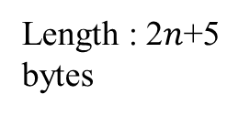

Data Packet
SPU to SCU Packet
Word Head
ADDR
CMD
Word Tail
ERR
Check
Length : 7 bytes
2 byte
1 byte
1 byte
2 byte
1 byte
SCU to SPU Packet
…
Word Head
ADDR
Num of Sensors
Sensor Data 0
Clock Count 0
Length : 2$n$+5 bytes
2 byte
1 byte
1 byte
2 byte
2 byte
Sensor Data $n$
Clock Count $n$
Word Tail
ERR
Check
2 byte
2 byte
2 byte
1 byte

Slide 14
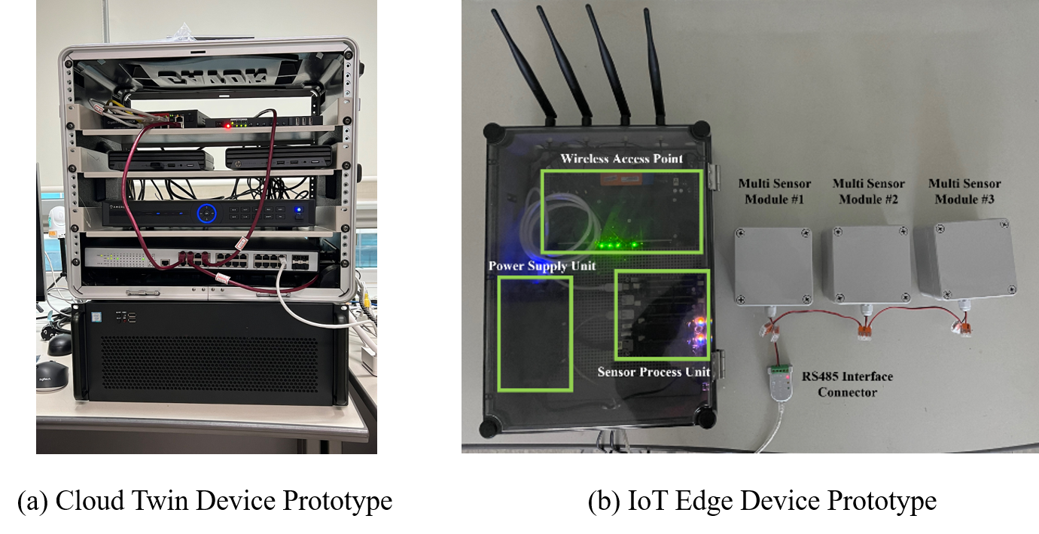
Hardware Implementation of Digital Twin

Slide 15
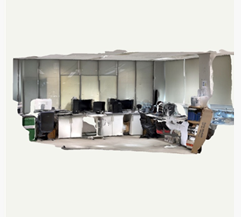
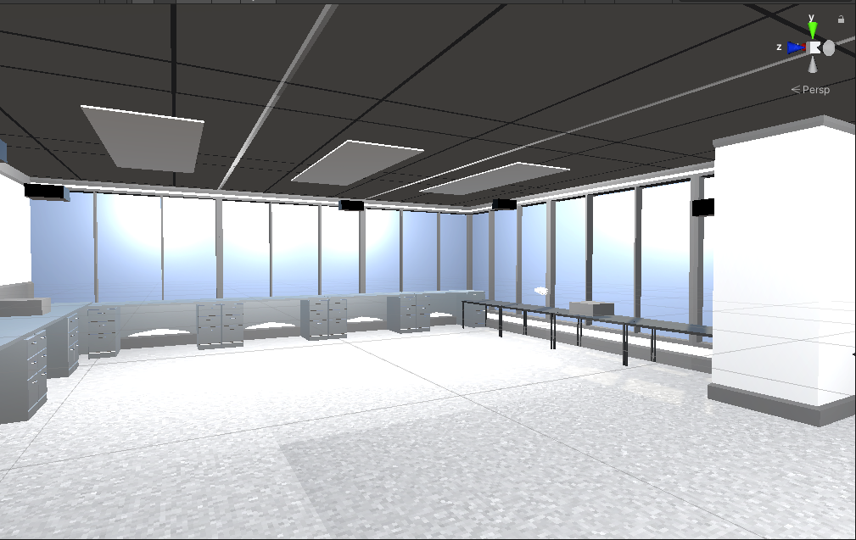
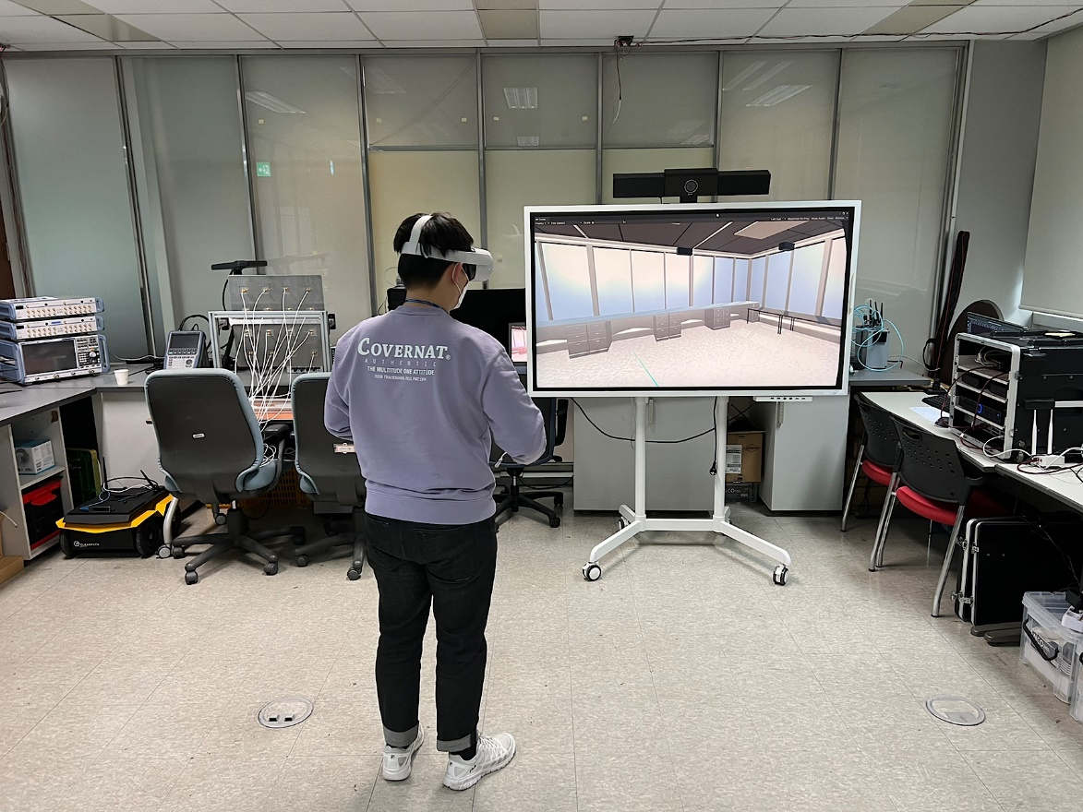
Indoor Basic Demonstration Test
Sensor
Boxes
Sensor
Processing
Unit
3D Scanning
Simplified
3D Modeling with
Physical & Digital
Synchronization
Demonstration
Based on IEEE2888

Slide 16
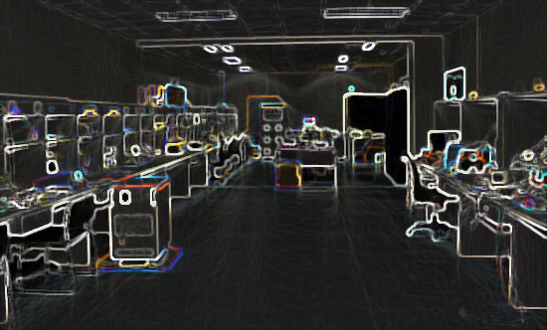
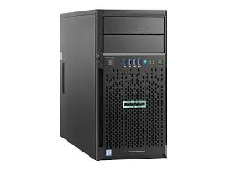

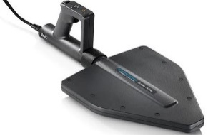
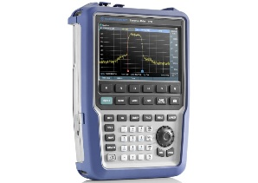
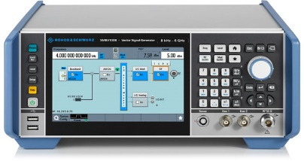
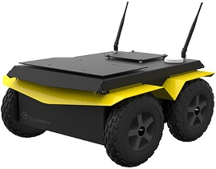
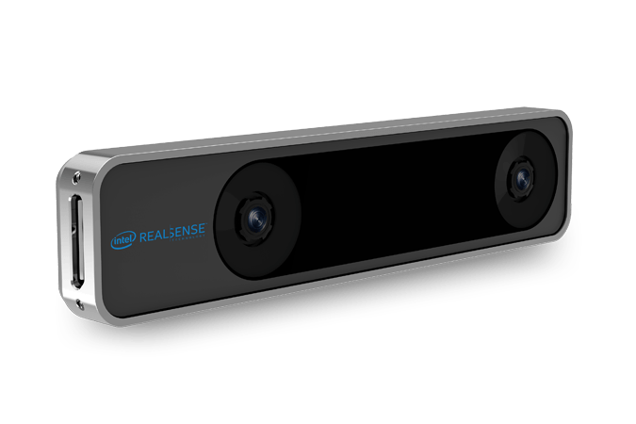
Use Case #2: Virtual Measurements
Virtual World
Measurements
Simulation &Digital twin server
Transmitter
Model
Export
Receiver
Simulation using MATLAB
Virtual world for RF measurement environment
Standard Command for
Programmable Instruments (SCPI)
Real World
Measurements
Ultra wideband
Antenna
Spectrum
Analyzer
Send RF signal over
the indoor environment
Indoor
Tracking
Sensor
Signal Generator
Moving
Platform

Slide 17
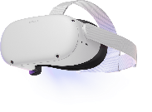
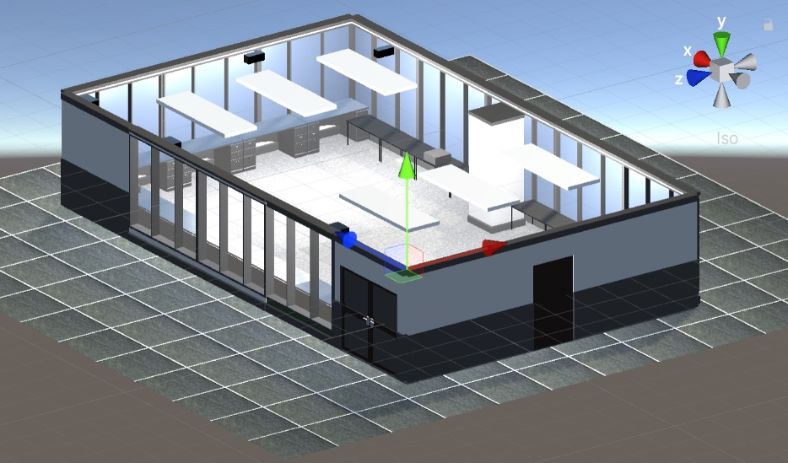
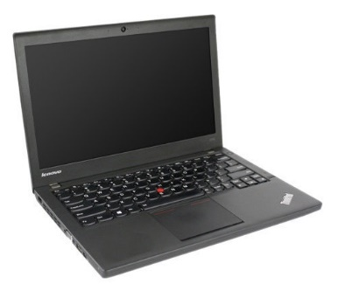
Use Case #2: Virtual Measurements
Digital World Server
Moving Platform

Slide 18


Use Case #2: Virtual Measurements
Digital Twin Server
Calculation
Module
Database
Export Module
Physical
Moving platform
Data Processing
Server
Digital Twin Client
Viewer
Integration
Module
Visualization Module
Tracking
System
Video Sensor
Preprocessing Module
Simulation Server
IMU Sensor
Command
Module
Simulation
Module
MQTT Broker

Slide 19
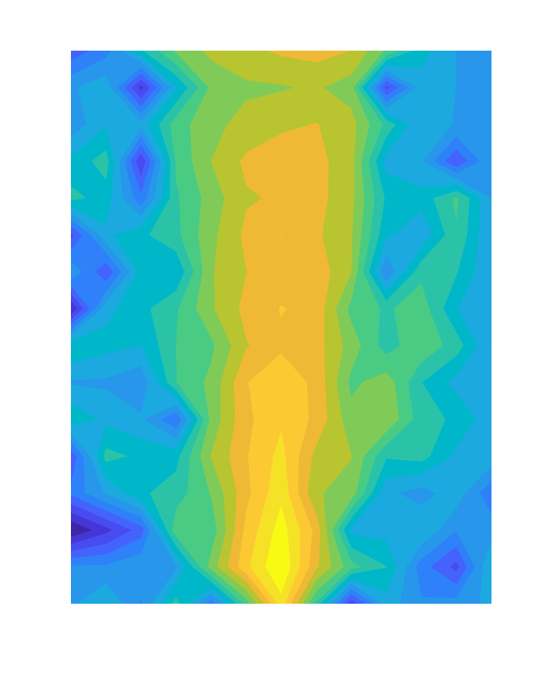
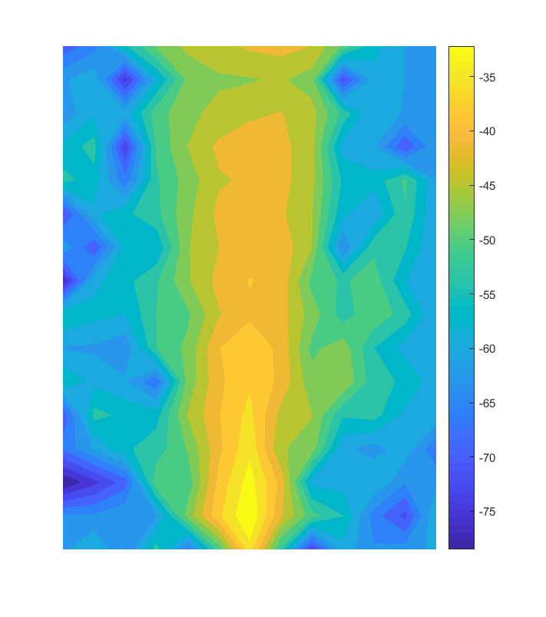
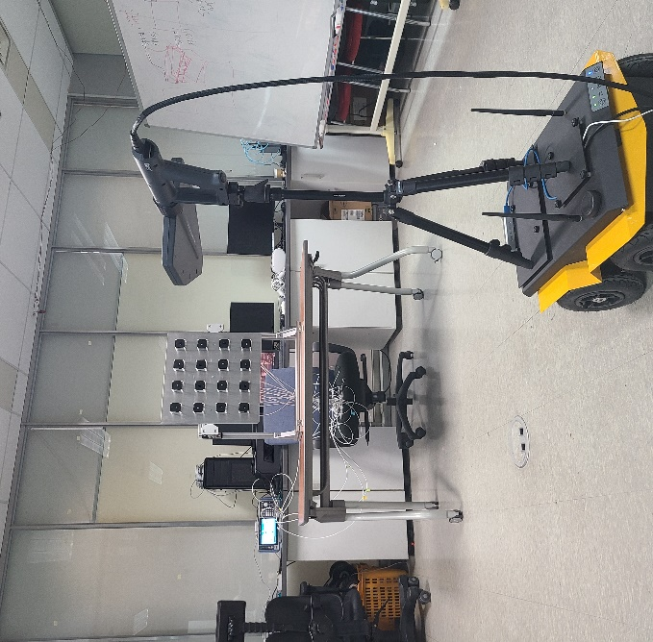
Use Case #2: Virtual Measurements
Realization
Digital Twin Automated
Measurements Platform
Virtualization
Virtual Space RF propagation measurement/simulation platform
2.4 GHz RF Beamforming
Received Power Map using
Automated Measurement System

Slide 20
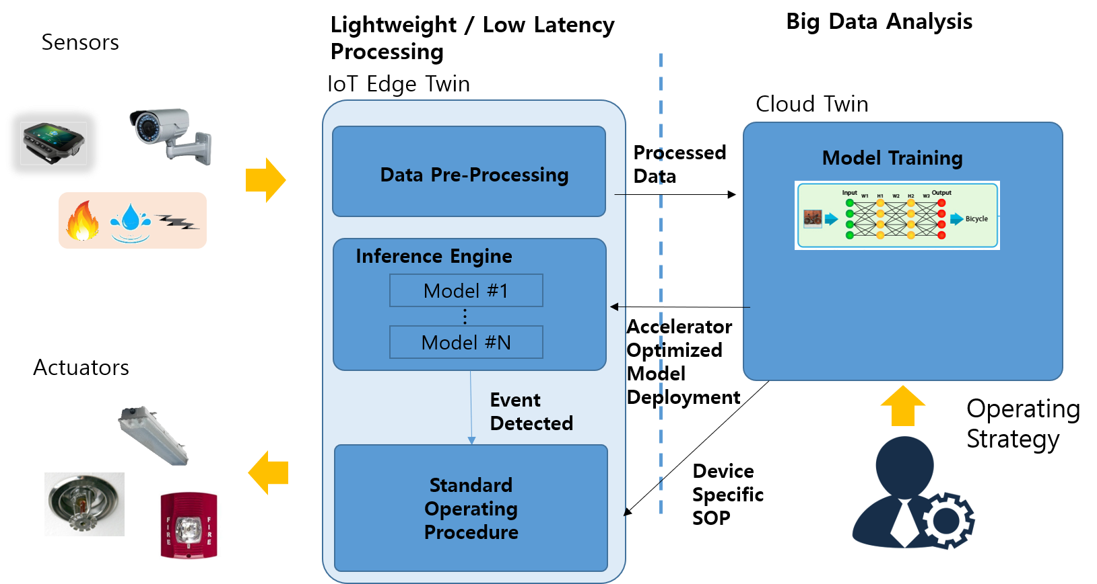
Future Works
We will develop the smart facility management system including digital world / physical world in which various sensors and actuators are synchronized and operated using the proposed digital twin architecture.

Slide 21
Thank You

