Slide 1
[Large Space VR Disaster Response Training System Framework for IEEE P2888.4]
[Jeonghwoan Choi / Skonec Entetainment. Co., Ltd. ]
October 19, 2021

Slide 2
Compliance with IEEE Standards Policies and Procedures
Subclause 5.2.1 of the IEEE-SA Standards Board Bylaws states, "While participating in IEEE standards development activities, all participants...shall act in accordance with all applicable laws (nation-based and international), the IEEE Code of Ethics, and with IEEE Standards policies and procedures."
The contributor acknowledges and accepts that this contribution is subject to
The IEEE Standards copyright policy as stated in the IEEE-SA Standards Board Bylaws, section 7, http://standards.ieee.org/develop/policies/bylaws/sect6-7.html#7, and the IEEE-SA Standards Board Operations Manual, section 6.1, http://standards.ieee.org/develop/policies/opman/sect6.html
The IEEE Standards patent policy as stated in the IEEE-SA Standards Board Bylaws, section 6, http://standards.ieee.org/guides/bylaws/sect6-7.html#6, and the IEEE-SA Standards Board Operations Manual, section 6.3, http://standards.ieee.org/develop/policies/opman/sect6.html

Slide 3
IEEE 2888 Interfacing Cyber and Physical World Working Group Kyoungro Yoon, yoonk@konkuk.ac.kr
Large Space VR Disaster Response Training System Framework for IEEE P2888.4
Date: 2021-10-19
Author(s):
Name | Affiliation | Phone | Email
Jeonghwoan Choi | Skonec Co., Ltd | +82 10 3042 8901 | jordhanchoi@skonec.com
Nam, HyeonWoo | Dongduk Women’s Univ. | +82 10 5313 1197 | hwnam@dongduk.ac.kr
Kim Jae Yeong | Skonec Co., Ltd | +82 10 3909 4151 | ohho1220@skonec.com

Slide 4
Large Space VR Disaster Response Training System Framework
Actuators
Disaster VR Content
Sensors
Autuator
Data manager
Disaster Anlayzer
Content Server
Sensor
Data manager
Command Data Converter
Command Data Converter
Sensor Data Converter
large fan
Optical System
Content Observer
Content Clients(1..n)
fragrance generator
Gloves
Game Engine
Sensor Data Converter
hot air blower
Game Engine
Treadmill
Etc...
Etc…
In the Sensors part, the data obtained from the position and motion recognition sensors are delivered to Disaster VR Content clients through the sensor data converter.
In the Disaster VR Content part, the data received from the Sensor part is reflected to the content client, and the Disaster Anlayzer sends it to the Actuators part through the Command Data Converter..
(Also the observer is a client too, it does not receive sensor data and reflects the user's position and motion to the observer in real time.)
In the Actuators part, the data received from the Disaster VR Content part is operated through the Command Data converter.

Slide 5
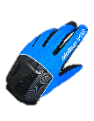
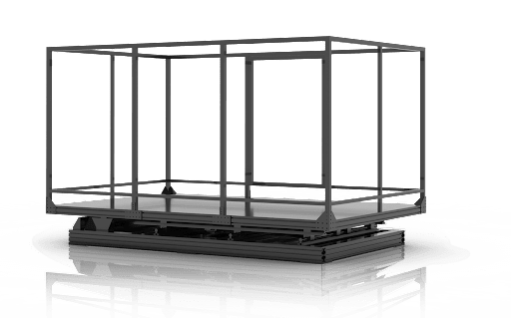
Use Case of Large Space VR Disaster Response Training System
Disaster VR Content
personal
simulation Scheme
Sensors
HMD data
(Haptic Gloves,
other equipment
signal data)
Disaster
VR Content client
(trainer’s computer)
HMD data
(Haptic Gloves,
other equipment signal data)
Personalized
sensory equipment
Disaster
VR Content
server
X n
X n
Sensors
System
Scenario
information
Scenario information
motion recognition computer
(User action data processing)
User’s position and
motion recognition scheme
Motion Tracking
Construction Equipment
IR camera
IR mark
IR mark
data
IR mark data
Observer and Control Scheme
Actuators
Observable data
User monitoring
computer
Actuators data
management computer
Control training
Unexpeted situation,
User’s information
operational
control system
Actuators
System
control system
Training results,
Record training,
Replay training
Post-training
evaluation
Actuator machine
X n

Slide 6
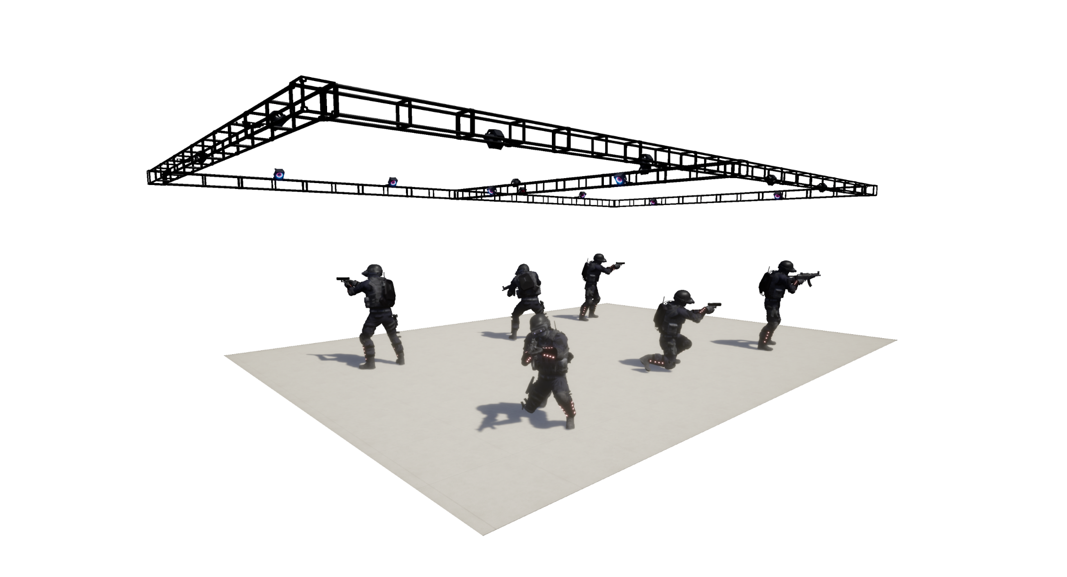
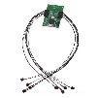
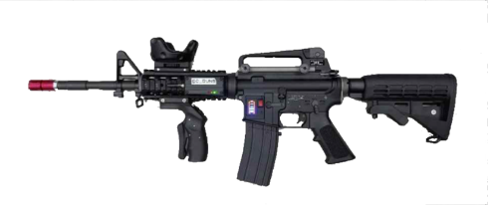
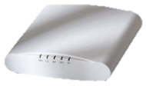
Large Space VR Disaster Response Training System of User Tracking Use case
- User Position and Motion Recognition Scheme
Attached sensor for motion recognize to trainees and sensory equipment
location tracking camera
POE
Position and motion recognition computer
trainer’s
computer
wireless AP
Active mark
It is possible to check the sensory equipment data that is converted according to the user's interaction by enhancing the matching precision between the real space and the VR space.
Based on 3D spatial location information matching technology, direct interaction is possible by matching the location of objects in the real space with the 3D virtual image in the virtual space using sensory equipment.
It proceeds to enable precise tracking by attaching a marker that can recognize the location and motion to the user.
Motion sensors are attached to the location of the user's head, upper body, arms, and HMD is worn to enable walking like in real life, providing a maximized sense of reality like a real situation.

Slide 7
Thank You

