Slide 1
[Holographic Visualization for IEEE P2888.6]
[Youngmin Kim / Korea Electronics Technology Institute ]
Oct 18, 2021

Slide 2
Compliance with IEEE Standards Policies and Procedures
Subclause 5.2.1 of the IEEE-SA Standards Board Bylaws states, "While participating in IEEE standards development activities, all participants...shall act in accordance with all applicable laws (nation-based and international), the IEEE Code of Ethics, and with IEEE Standards policies and procedures."
The contributor acknowledges and accepts that this contribution is subject to
The IEEE Standards copyright policy as stated in the IEEE-SA Standards Board Bylaws, section 7, http://standards.ieee.org/develop/policies/bylaws/sect6-7.html#7, and the IEEE-SA Standards Board Operations Manual, section 6.1, http://standards.ieee.org/develop/policies/opman/sect6.html
The IEEE Standards patent policy as stated in the IEEE-SA Standards Board Bylaws, section 6, http://standards.ieee.org/guides/bylaws/sect6-7.html#6, and the IEEE-SA Standards Board Operations Manual, section 6.3, http://standards.ieee.org/develop/policies/opman/sect6.html

Slide 3
IEEE 2888 Interfacing Cyber and Physical World Working Group Kyoungro Yoon, yoonk@konkuk.ac.kr
Holographic Visualization for IEEE P2888.6
Date: 2021-10-18
Author(s):
Name | Affiliation | Phone | Email
Youngmin Kim | Korea Electronic Technology Institute | +82 10 8756 6690 | rainmaker@keti.re.kr
Sangkwon Peter Jeong | JoyFun Inc. | +82 10 8667 7329 | ceo@joyfun.kr

Slide 4
JPEG Pleno
JPEG Pleno aims to provide a standard framework for representing new imaging modalities, such as texture-plus-depth, light field, point cloud, and holographic imaging.
Ad-hoc group
Light Field
Point Cloud
Holography

Slide 5
JPEG Pleno Framework
Overall Framework

Slide 6
JPEG Pleno Workplan
Current Status
Part | Title | WD | CD | DIS | FDIS | IS
1 | JPEG Pleno: Framework | 18/01 | 19/03 | 19/07 | 20/01 | 20/10
2 | JPEG Pleno: Light Field Coding | 18/04 | 19/01 | 19/07 | 20/04 | 21/04
3 | JPEG Pleno: Conformance Testing | 19/11 | 20/07 | 20/10 | - | 21/04
4 | JPEG Pleno: Reference Software | 19/11 | 20/07 | 20/10 | - | 21/04
Part-AMD | Title | WD | CDAM | DAM | FDAM | AMD
2-AMD1 | JPEG Pleno: Profiles and levels for JPEG Pleno Light Field Coding System | 20/04 | 20/07 | 20/10 | - | 21/04
JPEG Hologram in 5th MPEG Newmedia Forum (2021. 08. 17.~18.)

Slide 7
JPEG Pleno Holography
Data Representation
Hologram types(amplitude/phase/complex), format, spatial resolution, 16-bit bit-depth, 32-bit floating point, colour space, hologram sequences
Coding
Near-lossless and loss coding, lossless coding, efficiency, quality control, perceptual coding, random access, scalability, error resilience
Algorithmic Complexity
Computational and memory complexity, parallel processing, hardware implementation
Additional Functionalities
JPEG Pleno framework architecture, metadata, privacy and security, editing and manipulation

Slide 8
JPEG Pleno Holography Database
Collection of Test Data (https://jpeg.org/plenodb/)
OCHs(Optically captured holograms) and CGHs
Static holograms and dynamic holograms
Imaging holograms and metrological holograms
Mono holograms and color holograms
Complex holograms and inteferograms
Binary holograms and gray-scale holograms
NRSH (Numerical Reconstruction and Software for Holography/Matlab)
Verified by holograms in JPEG Pleno DB
Support GUI and batch file with configuration files
Experimental results(Depth change/Parallax view change)

Slide 9
Quality Assessment
Common Test Condition
Object Quality Assessment (SNR/PSNR/SSIM/VIFp, RMSE, etc.)
Subject Quality Assessment (Numerical reconstructions/plane&viewing angle)
Subjective Evaluation Protocol
Metrological Quality Assessment

Slide 10
IEEE 2888.6
Holographic Visualization Framework
Holographic Visualization
Virtual World
Real World
Virtual Object 1
Realized Object 1
Virtual Object 2
Realized Object 2
Virtual Object N
Realized Object N

Slide 11
IEEE 2888.6 (Continue)
Virtual Object Information
Object Coordination
Object Color Information
Lighting Information
Virtual World Information
Holographic Visualization
Holographic Printing(Static): Stereogram/Wavefront
Holographic Display(Dynamic): Large size/HMD
Holographic Authoring Tool: Virtual Object Information Collect, Virtual Object Arrangement, Holographic Reconstruction Algorithm, etc.
Holographic Authoring Tool

Slide 12
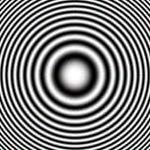
Hologram Generation Pipeline
Target object
Generation pipeline
Fringe image
Complex field distribution at hologram plane
Amplitude or phase-only image
Rendering
considering
display structure
CG
model
Mesh
Point cloud
Free-space propagation of object
Encoding
Normalization
Preproduction data
Depth map
Light field
Real object
Fringe image

Slide 13
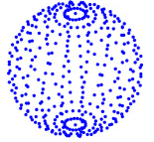
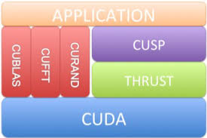
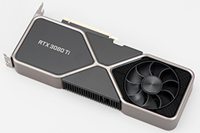
Hologram Generation Framework
Quasi 2D convolution
Point cloud data
Kernel of each point
Implementation using Shader framework
...
...
Total complex field
Amplitude
Phase
Multiple FFTs (Fast Fourier Transforms)
RGBD data
Implementation using CUDA
Rendering
CG model
Color image
Depth map
Depth slice image
Observer
Plane 0
Plane 2
Plane 4
Plane 1
Plane 3

Slide 14
Holographic Printing
Holographic film
Demagnification
…
…
Hogel
SLM (low SBP)
Object beam
Holographic
emulsion
Reference beam

Slide 15
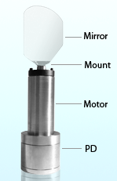
Holographic Display
Spatial multiplexing
Temporal multiplexing
SLM
(usually DMD)
Typical SLM shape
FPCB
Active area
…
Some optical components
which change the propagation direction
- e.g., galvano mirror, acousto-optic modulator
Bezel
Physical tiling of SLMs
…
…
…
After images of SLM

Slide 16
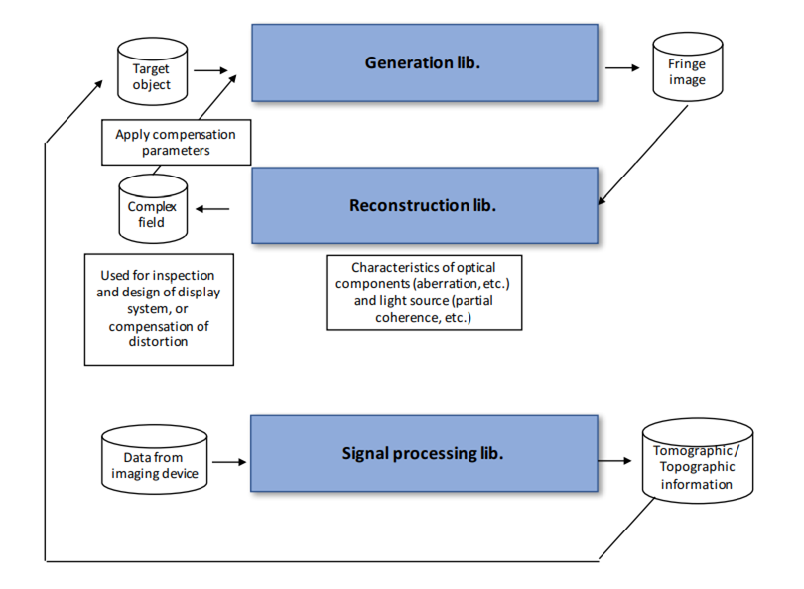
Openholo Library

Slide 17
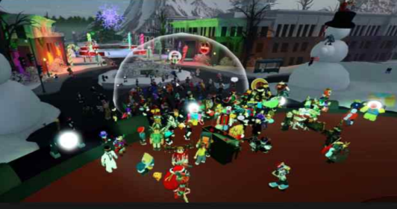
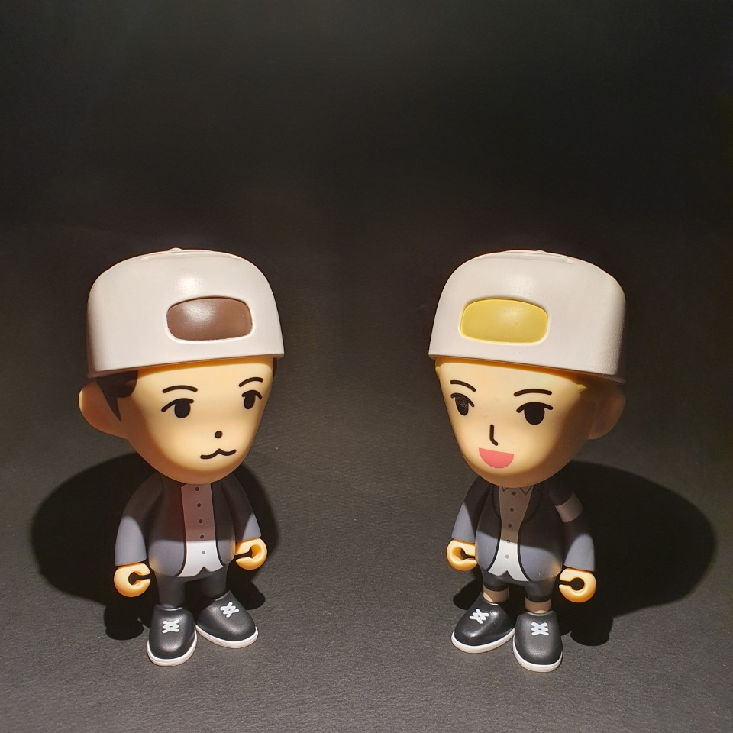
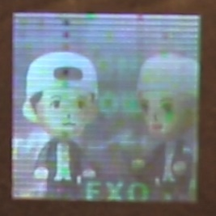
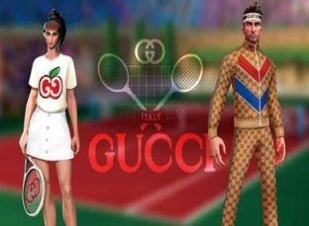
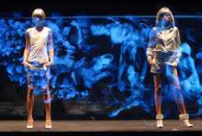
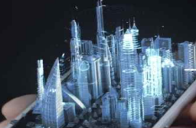
Usecase
Holographic Visualization
Virtual World
Real World
Virtual world
Holographic Printing
Character, Brand
Holographic Display

Slide 18
Thank You

