Slide 1
[Evaluation method of VR/AR/MR/XR Training System]
[Wonki Hong / Korea Electronics Association(KEA) ]
June 30, 2021

Slide 2
Compliance with
IEEE Standards Policies and Procedures
Subclause 5.2.1 of the IEEE-SA Standards Board Bylaws states, "While participating in IEEE standards development activities, all participants...shall act in accordance with all applicable laws (nation-based and international), the IEEE Code of Ethics, and with IEEE Standards policies and procedures."
The contributor acknowledges and accepts that this contribution is subject to
The IEEE Standards copyright policy as stated in the IEEE-SA Standards Board Bylaws, section 7, http://standards.ieee.org/develop/policies/bylaws/sect6-7.html#7, and the IEEE-SA Standards Board Operations Manual, section 6.1, http://standards.ieee.org/develop/policies/opman/sect6.html
The IEEE Standards patent policy as stated in the IEEE-SA Standards Board Bylaws, section 6, http://standards.ieee.org/guides/bylaws/sect6-7.html#6, and the IEEE-SA Standards Board Operations Manual, section 6.3, http://standards.ieee.org/develop/policies/opman/sect6.html

Slide 3
IEEE 2888
Interfacing Cyber and Physical World Working Group
Kyoungro Yoon, yoonk@konkuk.ac.kr
Evaluation method of VR/AR/MR/XR Training System
Date: 2021-06-30
Author(s):
Name | Affiliation | Phone | Email
Wonki Hong | Korea Electronics Association | +82 10 9030 6775 | hongwk@gokea.org
Jeonghwoan Choi | Skonec Co., Ltd | +82 10 3042 8901 | jordhanchoi@skonec.com
Sang-Kyun Kim | Myongji University | +82 10 6406 8163 | goldmunt@gmail.com

Slide 4
Background
VR/AR/MR/XR applications in many enterprise area :
Manufacturing : XR Collaboration tool, AR guide, VR twin
Training : VR Simulation, AR Manual, Knowledge adoption
Healthcare : AR Assistant, 3D Anatomy, Digital Therapeutics
Construction : Design ~ Construction ~ Evaluation.
Retail : AR fit&try on, VR shopping

Slide 5
Background
Especially, Training area in VR/AR/MR/XR applications :
In Korea,
100+ VR training system use cases
  Manufacture(55%), Medical(26%), Military(11%), Gov, etc
500+ VR training system has been developed or on developing
→ Can be a solution to High risk, High cost in the training area

Slide 6
Background
Highlights of new technology adoption in the enterprise industry :
Effectiveness : Accuracy and completeness, context of use
Efficiency : Time, human effort, money, materials
Satisfaction : User’s physical, cognitive, emotional responses
→ Usability is also important in the VR/AR/MR/XR field.
(Refer to International Standard from ISO TC 159)

Slide 7
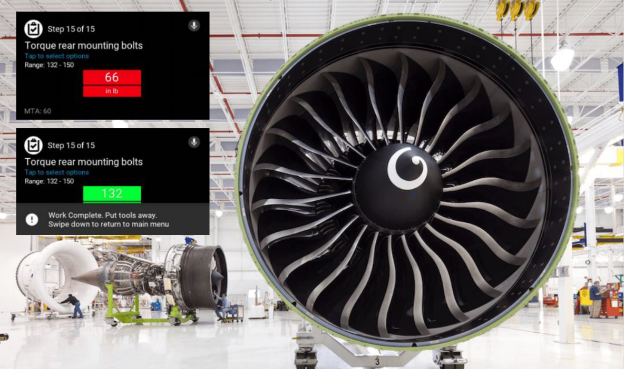
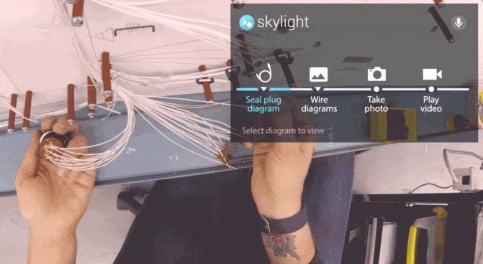
Background
Cases of evaluation usability in VR/AR/MR/XR applications:

Slide 8
Overview of VR training system
VR training system is :
Key users : Trainer(teacher, operator), Trainee(student)
Material : VR HMD+Contents, Simulator
Task/Process : Virtually experience ~ performance evaluation
Feature : Immersive, Realistic, Simulation, Safe, Low cost
Type
  Single / Multiple trainee
  Repeated task / Situation handling

Slide 9
Overview of VR training system
How can we evaluate VR/AR/MR/XR applications to encourage the industry?
Before the release of VR/AR/MR/XR applications, testing
in the actual environment
in the similar environment
Simulation
Launching the products without test can be dangerous
Possible options
to evaluate effectively!

Slide 10
Overview of VR training system
Before VR training system, there has been lots of research areas about :
Face to face training
Computer Based Training(CBT)
E-learning System(Online)
Game based training(High DoF), etc.

Slide 11
Evaluation of VR training system
Consideration
Effectiveness : Task completeness
Efficiency : Training time, mental and physical effort
Satisfaction : User’s physical, cognitive, emotional responses
→ Objective, Quantitative analysis

Slide 12
Evaluation of VR training system
In terms of usability test in VR training system :
Effect of training performance
→ before and after comparison / old and new comparison
Efficiency of training performance
→ time, cost, mental and physical effort, etc
Satisfaction of trainers and trainees
Acceptability of operator and trainers

Slide 13
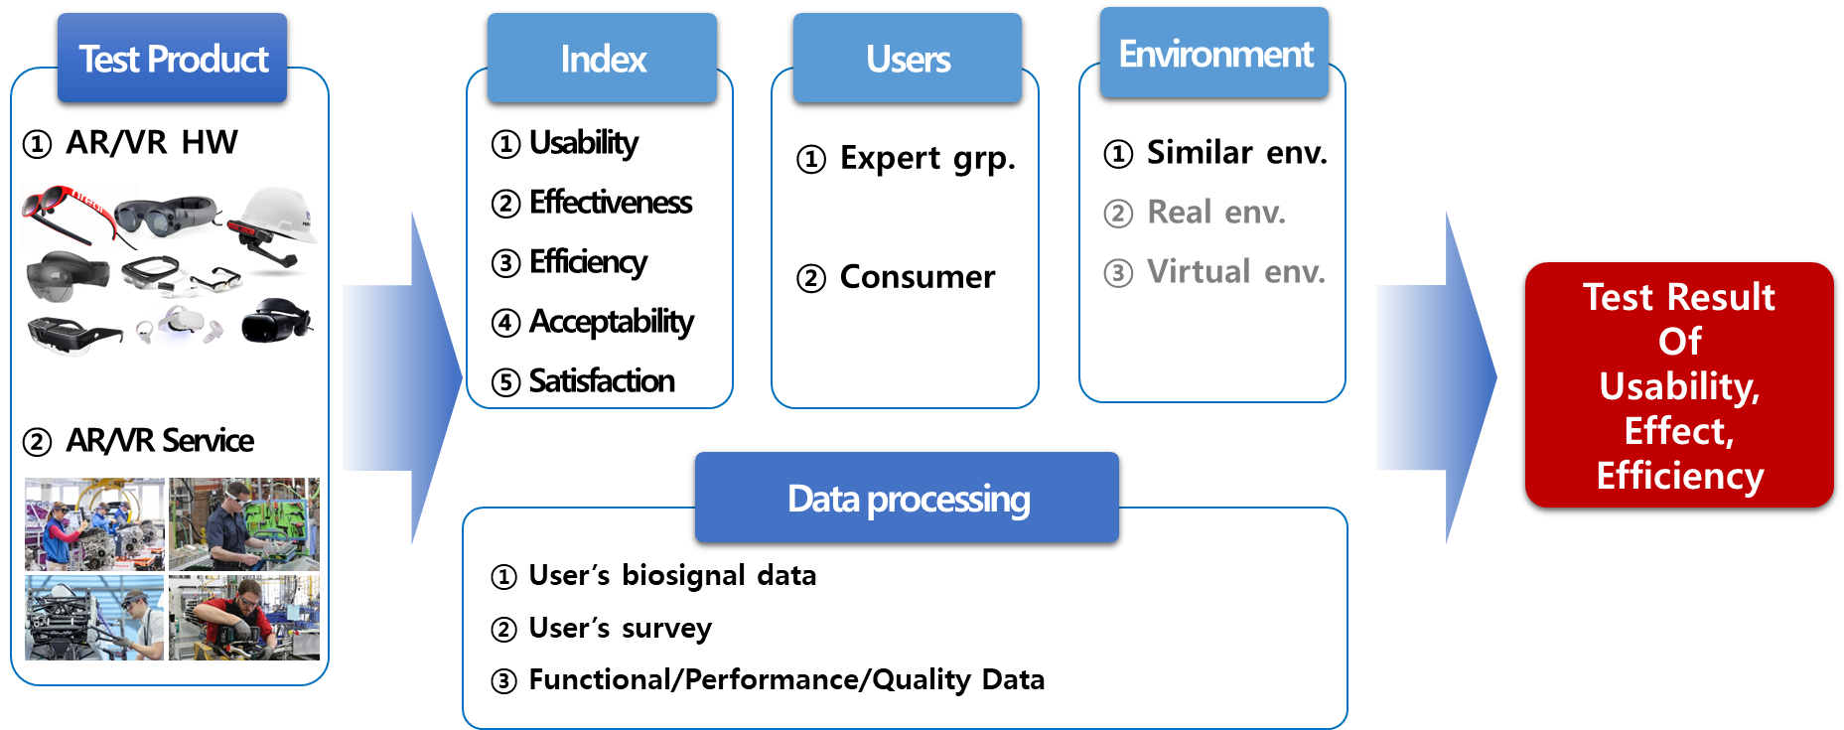
Evaluation of VR training system
KEA’s evaluation framework of user testing (on developing)

Slide 14
Evaluation of VR training system
KEA’s evaluation framework of user testing (on developing)
Planning the test
>
Designing the test
>
Test
>
Results
Analysis of product
features
Experimental design
Pilot test
Analysis of users’ data,
response, etc
Definition of the user
group, environment
Recruitment of
participants
Main test
Reporting results
Users’ behavior, task
User scenario

Slide 15

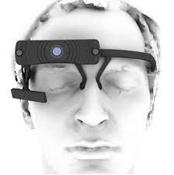
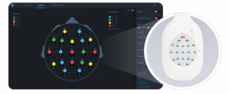
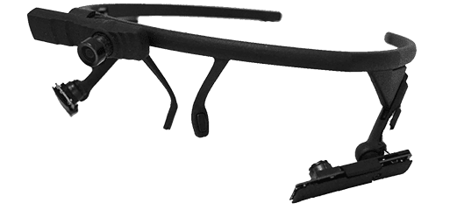
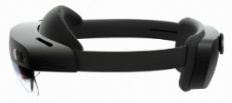
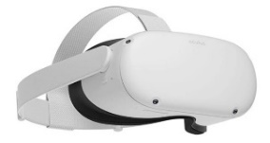
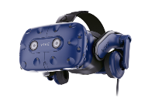
Evaluation of VR training system
KEA’s XR Center (opening in 2021)
Locations : DMC in Seoul, Korea
Developed by : KEA, SBA, KETI, KCL
Infra : Testing room, VR/AR devices, bio-signal measurement devices
Bio signal measuring device : EEG, Eye tracking, PPG, ECG, etc
EEG(medical grade)
Eye tracking glasses
AR/VR Devices
Hololens 2
Oculus Quest2
VIVE Pro eye

Slide 16
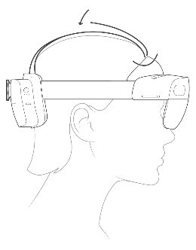
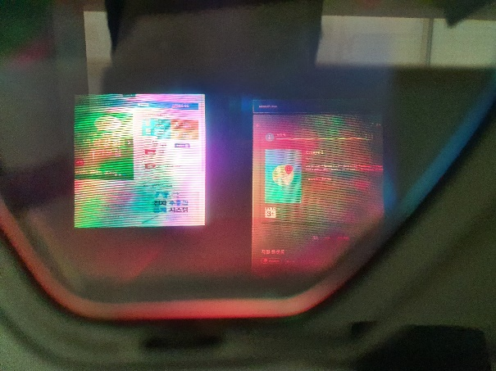
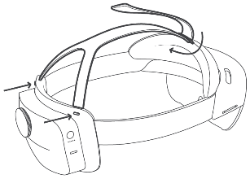
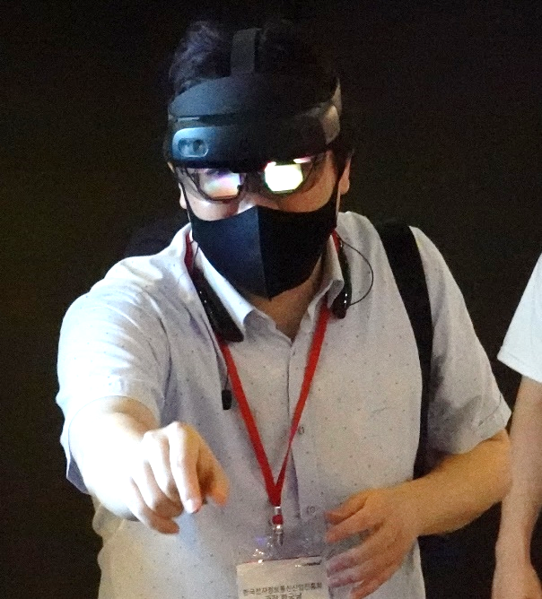
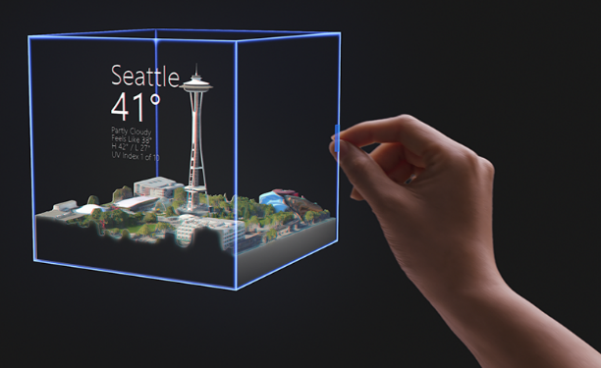
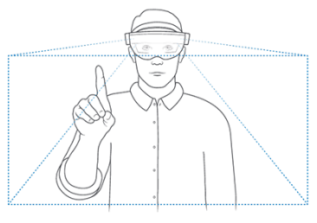
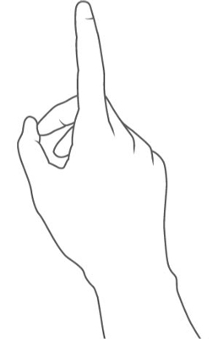
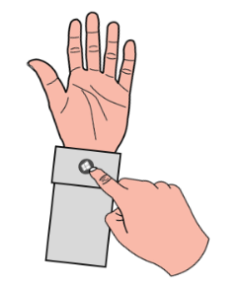
Evaluation of VR training system
User testing case : AR Device (on going)
Readability
Wearability
Easy of use

Slide 17
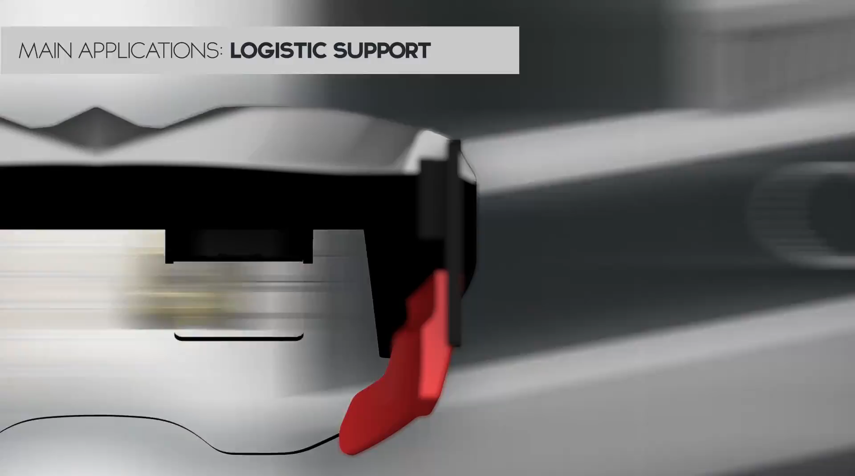
Evaluation of VR training system
User testing case : AR SW+Contents (on going)
Usability of SW/Contents
Effectiveness (Before / After comparison)
Efficiency (Before / After comparison)
Old and New technology comparison
.
.
.
AR Guide in Manufacturing

Slide 18
Thank You

