Slide 1
[Evaluation method of VR/AR/MR/XR Training System]
[Wonki Hong / Korea Electronics Association(KEA) ]
June 30, 2021

Slide 2
Compliance with
IEEE Standards Policies and Procedures
Subclause 5.2.1 of the IEEE-SA Standards Board Bylaws states, "While participating in IEEE standards development activities, all participants...shall act in accordance with all applicable laws (nation-based and international), the IEEE Code of Ethics, and with IEEE Standards policies and procedures."
The contributor acknowledges and accepts that this contribution is subject to
The IEEE Standards copyright policy as stated in the IEEE-SA Standards Board Bylaws, section 7, http://standards.ieee.org/develop/policies/bylaws/sect6-7.html#7, and the IEEE-SA Standards Board Operations Manual, section 6.1, http://standards.ieee.org/develop/policies/opman/sect6.html
The IEEE Standards patent policy as stated in the IEEE-SA Standards Board Bylaws, section 6, http://standards.ieee.org/guides/bylaws/sect6-7.html#6, and the IEEE-SA Standards Board Operations Manual, section 6.3, http://standards.ieee.org/develop/policies/opman/sect6.html

Slide 3
IEEE 2888
Interfacing Cyber and Physical World Working Group
Kyoungro Yoon, yoonk@konkuk.ac.kr
Evaluation method of VR/AR/MR/XR Training System
Date: 2021-06-30
Author(s):
Name | Affiliation | Phone | Email
Wonki Hong | Korea Electronics Association | +82 10 9030 6775 | hongwk@gokea.org
Jeonghwoan Choi | Skonec Co., Ltd | +82 10 3042 8901 | jordhanchoi@skonec.com

Slide 4
Background
VR/AR/MR/XR applications in many enterprise area :
Manufacturing : XR Collaboration tool, AR guide, VR twin
Training : VR Simulation, AR Manual, Knowledge adoption
Healthcare : AR Assistant, 3D Anatomy, Digital Therapeutics
Construction : Design ~ Construction ~ Evaluation.
Retail : AR fit&try on, VR shopping

Slide 5
Background
Especially, Training area in VR/AR/MR/XR applications :
In Korea,
100+ VR training system use cases
  Manufacture(55%), Medical(26%), Military(11%), Gov, etc
500+ VR training system is developed or on developing
Good signal from High risk, High cost in training area

Slide 6
Background
Key point of new technology adoption in enterprise area :
Effectiveness : Accuracy and completeness, context of use
Efficiency : Time, human effort, money, materials
Satisfaction : User’s physical, cognitive, emotional responses
→ Usability is also important in VR/AR/MR/XR field.
(Refer to International Std from ISO TC 159)

Slide 7
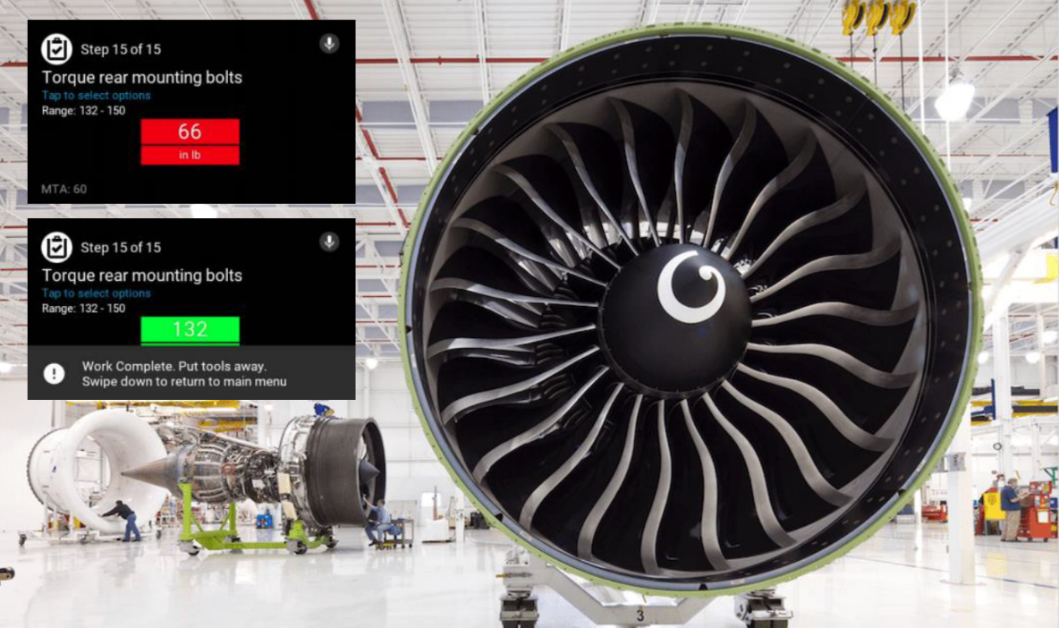
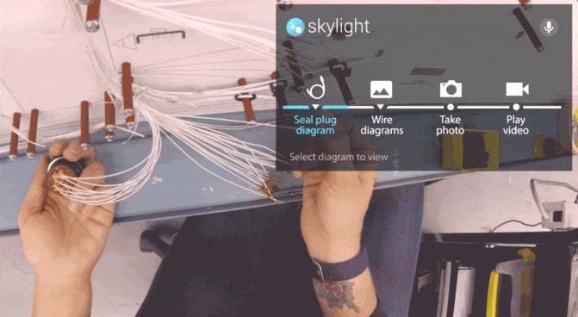
Background
Cases of evaluation usability in VR/AR/MR/XR applications:

Slide 8
Overview of VR training system
VR training system is :
Key users : Trainer(teacher, operator), Trainee(student)
Material : VR HMD+Contents, Simulator
Task/Process : Virtually experience ~ performance evaluation
Feature : Immersive, Realistic, Simulation, Safe, Low cost
Type
  Single / Multiple trainee
  Repeated mastery / Handling situation

Slide 9
Overview of VR training system
How we evaluation about VR/AR/MR/XR applications for spread?
Before release,
Real test is best.
Test in similar environment is good.
Simulation test is also good.
proceeding no test could be bad.
Possible to proof effect!

Slide 10
Overview of VR training system
Before VR training system, there are lots of research about :
Face to face training
Computer Based Training(CBT)
E-learning System(Online)
Game based training, etc.

Slide 11
Evaluation method of VR training system
Consideration
Effectiveness : Trainers/Trainees completeness
Efficiency : Training time for performance goals, Users effort
Satisfaction : User’s physical, cognitive, emotional responses
→ Objective, Quantitative

Slide 12
Evaluation method of VR training system
In terms of usability test in VR training system :
Effect of training performance
→ btw before and after, btw old and new
Efficiency of training performance
→ time, cost, human effort, etc
Satisfaction to trainers and trainees in operating
Acceptability to operator and trainers

Slide 13
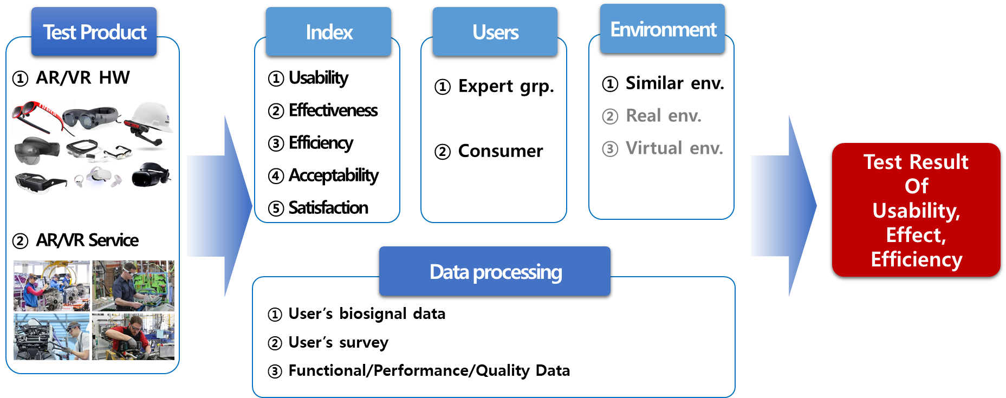
Evaluation method of VR training system
KEA’s evaluation framework of user testing (on developing)

Slide 14
Evaluation method of VR training system
KEA’s evaluation framework of user testing (on developing)
Test Plan
>
Test Design
>
Proceeding
>
Result
Purpose, Analyze
of product
Test method design
Pilot test
Analyze user’s data,
response, etc
Definition Users
Group, environment
Call for attendee
Test proceeding
Report result
Users behavior, task
Design task and use
scenario

Slide 15

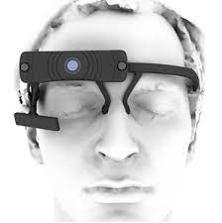
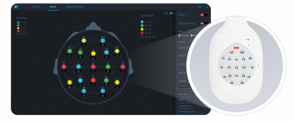
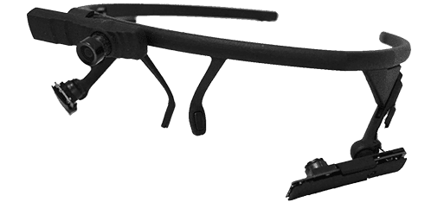
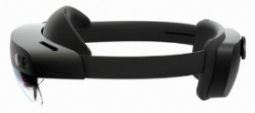
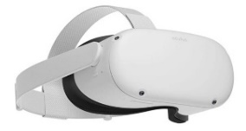
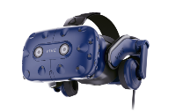
Evaluation method of VR training system
KEA’s XR Center on construction (open in 2021)
Locations : DMC in Seoul, Korea
Developed by : KEA, SBA, KETI, KCL
Infra : Testing room, VR/AR devices, bio signal measuring device
Bio signal measuring device : EEG, Eye tracking, PPG, ECG, etc
EEG(medical deivce)
Eye tracking glasses
AR/VR Devices
Hololens 2
Oculus Quest2
VIVE Pro eye

Slide 16
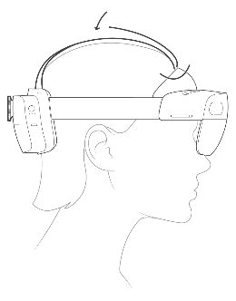
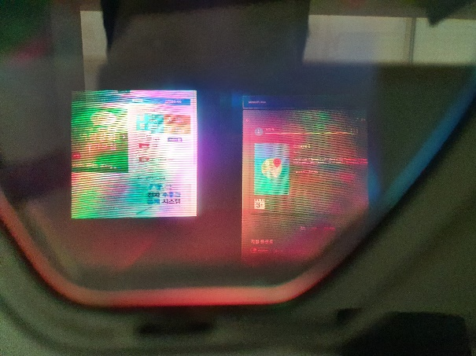
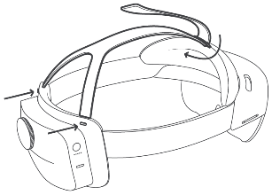
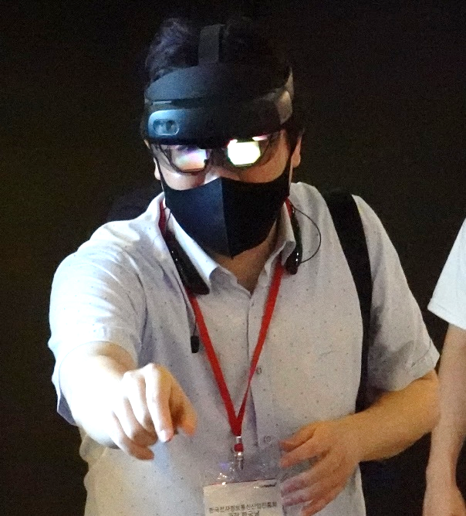
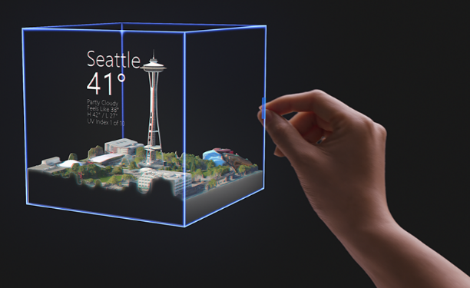
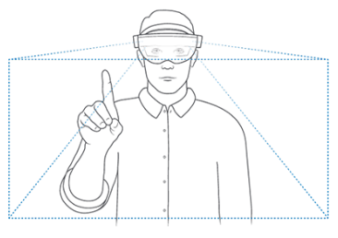
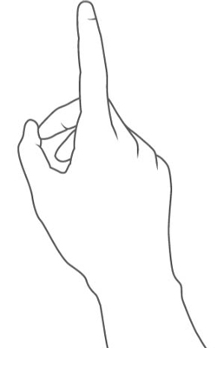
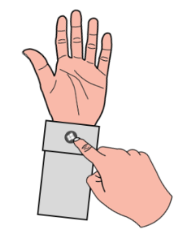
Evaluation method of VR training system
User testing case : AR Device (on going)
Readablity
Wearability
Convenience

Slide 17
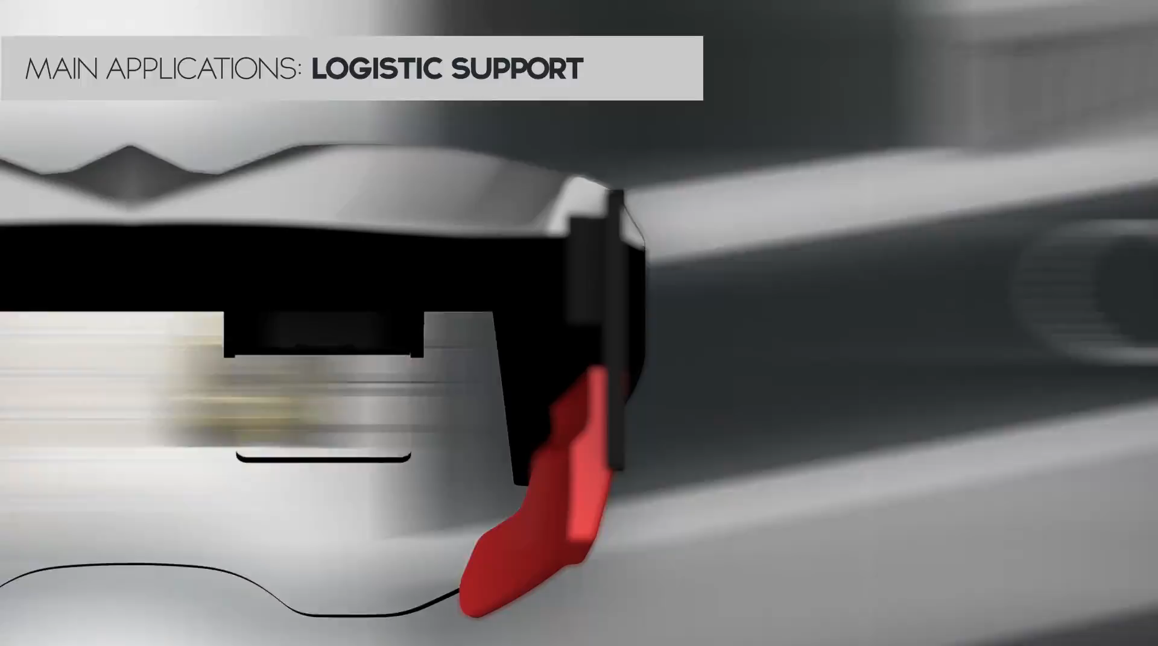
Evaluation method of VR training system
User testing case : AR SW+Contents (on going)
착용성
Usability of SW/Contents
Effectiveness btw Before / After
Effeciency btw Before / After
Compare btw Old / New tech.
.
.
.
AR Guide in Manufacturing

Slide 18
Thank You

