Slide 1
[Large Space VR Disaster Response Training System
Use case for IEEE P2888.4]
[Jeonghwoan Choi / Skonec Entetainment. Co., Ltd. ]
Jun 26, 2021

Slide 2
Compliance with
IEEE Standards Policies and Procedures
Subclause 5.2.1 of the IEEE-SA Standards Board Bylaws states, "While participating in IEEE standards development activities, all participants...shall act in accordance with all applicable laws (nation-based and international), the IEEE Code of Ethics, and with IEEE Standards policies and procedures."
The contributor acknowledges and accepts that this contribution is subject to
The IEEE Standards copyright policy as stated in the IEEE-SA Standards Board Bylaws, section 7, http://standards.ieee.org/develop/policies/bylaws/sect6-7.html#7, and the IEEE-SA Standards Board Operations Manual, section 6.1, http://standards.ieee.org/develop/policies/opman/sect6.html
The IEEE Standards patent policy as stated in the IEEE-SA Standards Board Bylaws, section 6, http://standards.ieee.org/guides/bylaws/sect6-7.html#6, and the IEEE-SA Standards Board Operations Manual, section 6.3, http://standards.ieee.org/develop/policies/opman/sect6.html

Slide 3
IEEE 2888
Interfacing Cyber and Physical World Working Group
Kyoungro Yoon, yoonk@konkuk.ac.kr
Large Space VR Disaster Response Training System Use case for IEEE P2888.4
Date: 2021-06-26
Author(s):
Name | Affiliation | Phone | Email
Jeonghwoan Choi | Skonec Co., Ltd | +82 10 3042 8901 | jordhanchoi@skonec.com
Nam, HyeonWoo | Dongduk Women’s Univ. | +82 10 5313 1197 | hwnam@dongduk.ac.kr

Slide 4
Contents
System Architecture
Use case

Slide 5
System Architecture
Send to Sensing Data
Server
Request for Situation Analysis
Disaster Scenario
Command for
user action
Motion Capture System
Situation Judgment & Control System
Command Display on HMD
Sensing Data Gathering
Optical Cameras
Gloves
IMU Sensor on HMD
Etc…
Actuator
User Action

Slide 6
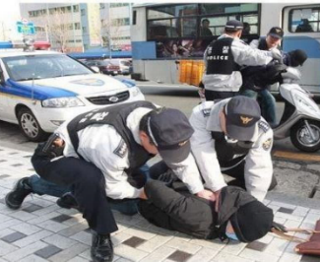
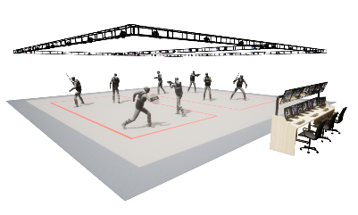

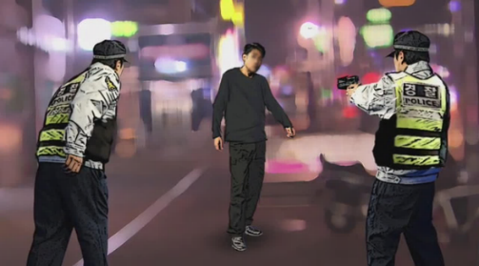





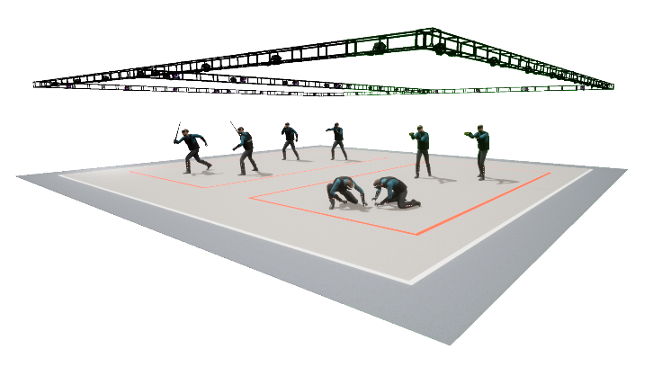
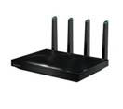

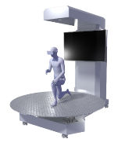
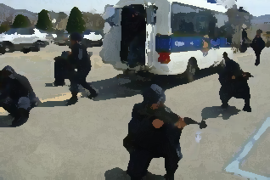

Use case – Public security response training system linked with large space & actuator
o Example of system development
- Building a virtual environment at the actual measurement level of practical security incidents of natural walking movement based on large space
- Long-distance travel is built with actuator movement system
- Application of tangible VR technology based on real-time user location/motion tracking
- Developing collaborative training scenarios and designing multi-user movement lines by interlocking large spaces and actuators
Movement system for large space
Large space & actuator linkage system
(Motion Capture System)
Optical camera
User location information
Virtual reality
Client 실행
User observation in virtual space
user
Interaction
POE
BackPacPC
HMD
Gloves
14M
14M
Actual Movement system
VR
Wallk Through
System operation tool– AdminClient
ServerPC
Virtual reality
Actuator movement system
AP
Tablet PC
System operation tool
– Operating Manager
Actual Movement system
Virtual reality
Actuator

Slide 7
Thank You

