Slide 1
[IEEE 2888 Session #7 WG Opening Plenary]
[Sangkwon Peter Jeong / JoyFun]

Slide 2
Compliance with
IEEE Standards Policies and Procedures
Subclause 5.2.1 of the IEEE-SA Standards Board Bylaws states, "While participating in IEEE standards development activities, all participants...shall act in accordance with all applicable laws (nation-based and international), the IEEE Code of Ethics, and with IEEE Standards policies and procedures."
The contributor acknowledges and accepts that this contribution is subject to
The IEEE Standards copyright policy as stated in the IEEE-SA Standards Board Bylaws, section 7, http://standards.ieee.org/develop/policies/bylaws/sect6-7.html#7, and the IEEE-SA Standards Board Operations Manual, section 6.1, http://standards.ieee.org/develop/policies/opman/sect6.html
The IEEE Standards patent policy as stated in the IEEE-SA Standards Board Bylaws, section 6, http://standards.ieee.org/guides/bylaws/sect6-7.html#6, and the IEEE-SA Standards Board Operations Manual, section 6.3, http://standards.ieee.org/develop/policies/opman/sect6.html

Slide 3
IEEE 2888
Interfacing Cyber and Physical World Working Group
Kyoungro Yoon, yoonk@konkuk.ac.kr
Session #7 WG Opening Plenary
Date: 2021-06-23
Author(s): Sangkwon Peter Jeong
Name | Affiliation | Phone | Email
Jeong, Sangkwon Peter | JoyFun | +82 10 8667 7329 | ceo@joyfun.kr

Slide 4
Session Time and Location
 | Monday (June. 28, 2021) | Tuesday (June. 29, 2021) | Wednesday (June. 30, 2021) | Thursday (July. 01, 2021) | Friday (July. 02, 2021)
AM 1 9:00-10:30a |  | TG 2888.1 Meeting (Topic: Input contribution documents review) | TG 2888.4 Meeting (Topic: Input contribution documents review) | TG 2888.1 Meeting (Topic: Output Editing and Summary)
AM 2 11:00-12:30 |  | TG 2888.2 Meeting (Topic: Input contribution documents review) | TG 2888.4 Meeting (Topic: Input contribution documents review) | TG 2888.4 Meeting (Topic: Output Editing and Summary)
PM 1 1:30 – 3:00p | WG Open Plenary | TG 2888.3 Meeting (Topic: Input contribution documents review) | TG 2888.3 Meeting (Topic: Output Editing and Summary) | WG Meeting (Topic: TGs Summary)
PM 2 3:30 – 5:00p | WG Meeting | Joint TG (2888.1 & 2888.2) | TG 2888.2 Meeting (Topic: Output Editing and Summary) | WG Closing Plenary
※ Location
Grand Sumorum Hotel Conference Room B+C

Slide 5
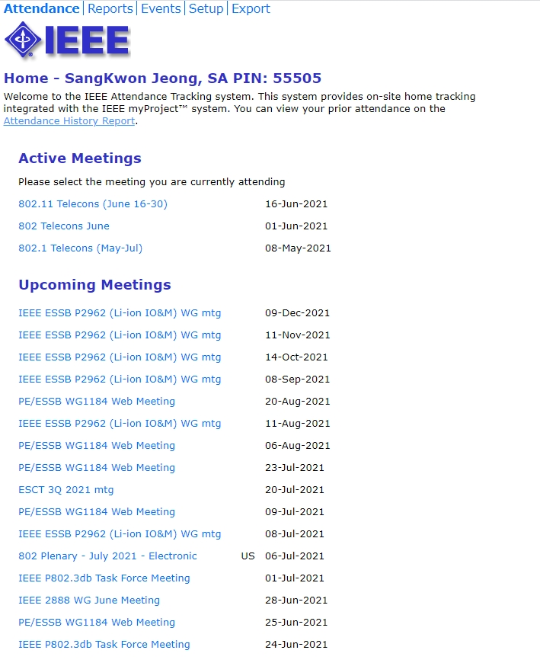
Attendance
Electronic Attendance ONLY
Electronic Attendance
  IMAT System
    https://imat.ieee.org/attendance
  Mark attendance during every session

Slide 6
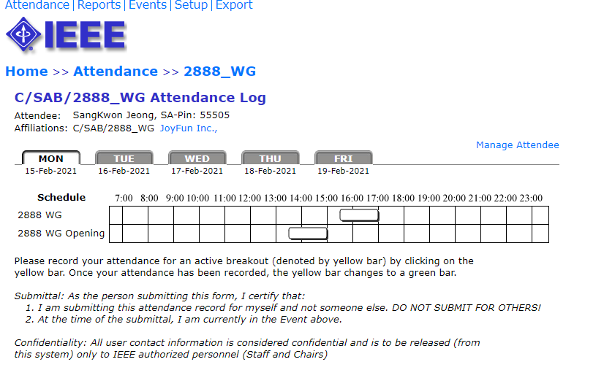
Attendance
Total number of IEEE 2888 WG timeslots: 14
7 timeslots for 50% attendance to be counted towards WG voting membership
All attendance records are reported on the meeting minutes
  Please check the attendance records for any errors

Slide 7
Voting Membership
2888 Voting Membership described in
  DCN#: 2888-20-0042-00-0000
Maintenance of Voting Membership
  Missing 3 out of last 4 meetings may result in loss of voting rights
WG Letter Ballots
  WG members are expected to vote on WG LBs
  Failure to vote on 2 out of last 3 WG LBs could result
  in loss of voting rights (ref. 4.3.2 WG P&P)

Slide 8
Miscellaneous Meeting Logistics
WG Documents: https://mentor.ieee.org/2888/documents
WG Voting Member only: https://ieee-sa.imeetcentral.com/2888-wg/
Food and Beverages
  Morning break: 10:30am – 11:00am
  Lunch Time: 12:30pm – 1:30pm
  Afternoon break: 3:00pm – 3:30pm
  Dinner Time: 5:00pm –6:30pm

Slide 9
Registration and Media Recording
Each Attendee must provide contact information and pay conference fee
Conference fee has to be paid through the registration desk
Failure to pay conference fee results in loss of credit for voting rights
Photography not permitted unless approved by WG Chair
Audio taping of IEEE 2888 meetings is NOT allowed
Media – Press and Analyst briefings
  Only the 2888 WG Chair is allowed to give verbal statements/interviews to the media on behalf of the IEEE 2888 working group

Slide 10
Membership & Anti-Trust
Individual membership
  In all IEEE standards meetings, membership is by individual, hence you do not represent a company or organization.
Anti-Trust laws
  The Anti-Trust laws forbid the discussion of prices within our meetings.

Slide 11
Instructions for the WG Chair
The IEEE-SA strongly recommends that at each WG meeting the chair or a designee:
  Show slides #10 through #15 of this presentation
  Advise the WG attendees that:
    IEEE’s patent policy is described in Clause 6 of the IEEE-SA Standards Board Bylaws;
    Early identification of patent claims which may be essential for the use of standards under development is strongly encouraged;
    There may be Essential Patent Claims of which IEEE is not aware. Additionally, neither IEEE, the WG, nor the WG Chair can ensure the accuracy or completeness of any assurance or whether any such assurance is, in fact, of a Patent Claim that is essential for the use of the standard under development.
  Instruct the WG Secretary to record in the minutes of the relevant WG meeting:
    That the foregoing information was provided and that slides 11 through 14 were shown;
    That the chair or designee provided an opportunity for participants to identify patent claim(s)/patent application claim(s) and/or the holder of patent claim(s)/patent application claim(s) of which the participant is personally aware and that may be essential for the use of that standard
    Any responses that were given, specifically the patent claim(s)/patent application claim(s) and/or the holder of the patent claim(s)/patent application claim(s) that were identified (if any) and by whom.
  The WG Chair shall ensure that a request is made to any identified holders of potential essential patent claim(s) to complete and submit a Letter of Assurance.
  It is recommended that the WG Chair review the guidance in IEEE-SA Standards Board Operations Manual 6.3.5 and in FAQs 14 and 15 on inclusion of potential Essential Patent Claims by incorporation or by reference.
  Note: WG includes Working Groups, Task Groups, and other standards-developing committees with a PAR approved by the IEEE-SA Standards Board.

Slide 12
Participants have a duty to inform the IEEE
  Participants shall inform the IEEE (or cause the IEEE to be informed) of the identity of each holder of any potential Essential Patent Claims of which they are personally aware if the claims are owned or controlled by the participant or the entity the participant is from, employed by, or otherwise represents
  Participants should inform the IEEE (or cause the IEEE to be informed) of the identity of any other holders of potential Essential Patent Claims
  Early identification of holders of potential Essential Patent Claims is encouraged

Slide 13
Ways to inform IEEE
Cause an LOA to be submitted to the IEEE-SA (patcom@ieee.org); or
Provide the chair of this group with the identity of the holder(s) of any and all such claims as soon as possible; or
Speak up now and respond to this Call for Potentially Essential Patents
If anyone in this meeting is personally aware of the holder of any patent claims that are potentially essential to implementation of the proposed standard(s) under consideration by this group and that are not already the subject of an Accepted Letter of Assurance, please respond at this time by providing relevant information to the WG Chair

Slide 14
Other guidelines for IEEE WG meetings
All IEEE-SA standards meetings shall be conducted in compliance with all applicable laws, including antitrust and competition laws.
  Don’t discuss the interpretation, validity, or essentiality of patents/patent claims.
  Don’t discuss specific license rates, terms, or conditions.
    Relative costs of different technical approaches that include relative costs of patent licensing terms may be discussed in standards development meetings.
      Technical considerations remain the primary focus
  Don’t discuss or engage in the fixing of product prices, allocation of customers, or division of sales markets.
  Don’t discuss the status or substance of ongoing or threatened litigation.
  Don’t be silent if inappropriate topics are discussed … do formally object.
---------------------------------------------------------------
For more details, see IEEE-SA Standards Board Operations Manual, clause 5.3.10 and
Antitrust and Competition Policy: What You Need to Know at http://standards.ieee.org/develop/policies/antitrust.pdf

Slide 15
Patent-related information
  The patent policy and the procedures used to execute that policy are documented in the:
    IEEE-SA Standards Board Bylaws (http://standards.ieee.org/develop/policies/bylaws/sect6-7.html#6)
    IEEE-SA Standards Board Operations Manual (http://standards.ieee.org/develop/policies/opman/sect6.html#6.3)
  Material about the patent policy is available at
  http://standards.ieee.org/about/sasb/patcom/materials.html
  If you have questions, contact the IEEE-SA Standards Board Patent Committee Administrator at patcom@ieee.org

Slide 16
IEEE SA COPYRIGHT POLICY
By participating in this activity, you agree to comply with the IEEE Code of Ethics, all applicable laws, and all IEEE policies and procedures including, but not limited to, the IEEE SA Copyright Policy.
Previously Published material (copyright assertion indicated) shall not be presented/submitted to the Working Group nor incorporated into a Working Group draft unless permission is granted.
Prior to presentation or submission, you shall notify the Working Group Chair of previously Published material and should assist the Chair in obtaining copyright permission acceptable to IEEE SA.
For material that is not previously Published, IEEE is automatically granted a license to use any material that is presented or submitted.

Slide 17
IEEE SA COPYRIGHT POLICY
The IEEE SA Copyright Policy is described in the IEEE SA Standards Board Bylaws and IEEE SA Standards Board Operations Manual
IEEE SA Copyright Policy, see
Clause 7 of the IEEE SA Standards Board Bylaws
https://standards.ieee.org/about/policies/bylaws/sect6‐7.html#7
Clause 6.1 of the IEEE SA Standards Board Operations Manual
https://standards.ieee.org/about/policies/opman/sect6.html
IEEE SA Copyright Permission
https://standards.ieee.org/content/dam/ieee‐standards/standards/web/documents/other/permissionltrs.zip
IEEE SA Copyright FAQs
http://standards.ieee.org/faqs/copyrights.html/
IEEE SA Best Practices for IEEE Standards Development
http://standards.ieee.org/develop/policies/best_practices_for_ieee_standards_development_051215.pdf
Distribution of Draft Standards (see 6.1.3 of the SASB Operations Manual)
https://standards.ieee.org/about/policies/opman/sect6.html

Slide 18
Copyright
Under the current US copyright law — the author of information is deemed to own the copyright from the moment of creation
The IEEE Bylaws require copyright of all material to be held by the IEEE
  Must consult with IEEE for re-use of copyright material
The IEEE Standards accomplishes transfer of copyright ownership through the Project Authorization Request (PAR) process

Slide 19
Objectives for the June Meeting
Work and Discuss
  Review and improvement of IEEE 2888.x Drafts
  Review input contributions
  Discussion of IEEE 2888.1
  Discussion of IEEE 2888.2
  Discussion of IEEE 2888.3
  Discussion of IEEE 2888.4

Slide 20
Development Timeline for IEEE 2888.1
PAR approved: 09/2019
Working Group 1st Letter Ballot: 06/2021 (20 days)
- Before July meeting
Working Group 2nd Letter Ballot: 09/2021 (20 days)
- Before October meeting
Open Sponsor Ballot Invitation: 10/2021 (30 days)
Start Sponsor Ballot: 11/2021 (30 days)
Start Recirculation 1st Ballot: 02/2022 (10 days)
Start Recirculation 2nd Ballot: 05/2022 (10 days)
Submit to RevCom: 07/2022
Publishing: 01/2023
Open Sponsor Ballot Invitation
Mandatory Editorial Coordination submission
WG 2nd
letter Ballot
WG Meeting to address comments
Ballot Resolution Telecon 1
Sent comments to the WG
Sent comment to the WG
Ballot Resolution Telecon1
PAR
Approve
WG 1st
letter Ballot
Start Sponsor
Ballot
Start Recirculation
1st Ballot
Start Recirculation
2nd Ballot
RevCom comment review
Submit to RevCom
SASB Approval
Publishing
09/2019
06/2021
09/2021
11/2021
01/2022
03/2022
05/2022
07/2022
09/2022
01/2023
10/2021
12/2021
02/2022
04/2022
06/2022
08/2022

Slide 21
Development Timeline for IEEE 2888.4
PAR approved: 12/2020
Working Group 1st Letter Ballot: 11/2022 (20 days)
- Before February meeting
Working Group 2nd Letter Ballot: 04/2023 (20 days)
- Before June meeting
Open SA Ballot Invitation: 09/2023 (30 days)
Start SA Ballot: 10/2023 (30 days)
Start Recirculation 1st Ballot: 03/2023 (10 days)
Start Recirculation 2nd Ballot: 04/2023 (10 days)
Submit to RevCom: 05/2024
Publishing: 08/2024
Open SA Ballot Invitation
Mandatory Editorial Coordination submission
Use Cases
Generation
Actuator Control
Situation Judgment & Control System
2nd Draft for Letter Ballot
Setup a standardization plan
Disaster Scenario
IoT control Server
1st Draft for Letter Ballot
3rd Draft for SA Ballot
4th Draft for SA Ballot
Final
Approve
&
Published
Virtual Object Generation
WG 1st
letter Ballot
Start
1st SA
Ballot
Start
2nd SA
Ballot
PAR
Approve
Terms & Definition
Sensor data
Draft Writing
WG 2nd
Letter Ballot
12/2020
02/2021
11/2021
04/2022
09/2022
11/2022
04/2023
09/2023
01/2024
08/2024
02/2021
07/2021
02/2022
07/2022
10/2022
02/2023
08/2023
10/2023
03/2024

Slide 22
Future Sessions – 2021
If the COVID-19 situation does not get better and the travel restrictions are lifted, the following meetings will be changed to on-line meeting only.
For those who have difficulties in traveling due to various reasons, on-line meeting support will be always provided.
October 18-22, Gangnam 2nd ToZ meeting room, Baekam Bldg. 459 Gangnamdaero Seocho-gu, Seoul, Korea

Slide 23
Future Sessions – 2022
If the COVID-19 situation does not get better and the travel restrictions are lifted, the following meetings will be changed to on-line meeting only.
For those who have difficulties in traveling due to various reasons, on-line meeting support will be always provided.
February 14 - 18, 1 Fusionopolis Walk #04-07 South Tower, Solaris, (IEEE-SA Office), Singapore, Singapore
June 27 - July 1, IEEE-SA Office, 17th Floor, 3rd Park Ave. New York City, New York 10016
October 17-21, Gangnam 2nd ToZ meeting room, Baekam Bldg. 459 Gangnamdaero Seocho-gu, Seoul, Korea

Slide 24
Thank You

