Slide 1
[Standardization Action Plan for IEEE P2888.4]
[Jeonghwoan Choi / Skonec Entetainment. Co., Ltd. ]
February 14, 2021

Slide 2
Compliance with
IEEE Standards Policies and Procedures
Subclause 5.2.1 of the IEEE-SA Standards Board Bylaws states, "While participating in IEEE standards development activities, all participants...shall act in accordance with all applicable laws (nation-based and international), the IEEE Code of Ethics, and with IEEE Standards policies and procedures."
The contributor acknowledges and accepts that this contribution is subject to
The IEEE Standards copyright policy as stated in the IEEE-SA Standards Board Bylaws, section 7, http://standards.ieee.org/develop/policies/bylaws/sect6-7.html#7, and the IEEE-SA Standards Board Operations Manual, section 6.1, http://standards.ieee.org/develop/policies/opman/sect6.html
The IEEE Standards patent policy as stated in the IEEE-SA Standards Board Bylaws, section 6, http://standards.ieee.org/guides/bylaws/sect6-7.html#6, and the IEEE-SA Standards Board Operations Manual, section 6.3, http://standards.ieee.org/develop/policies/opman/sect6.html

Slide 3
IEEE 2888
Interfacing Cyber and Physical World Working Group
Kyoungro Yoon, yoonk@konkuk.ac.kr
Standardization Action Plan for IEEE P2888.4
Date: 2021-02-15
Author(s):
Name | Affiliation | Phone | Email
Jeonghwoan Choi | Skonec Co., Ltd | +82 10 3042 8901 | jordhanchoi@skonec.com
Jeong, Sangkwon Peter | JoyFun | +82 10 8667 7329 | ceo@joyfun.kr
Nam, HyeonWoo | Dongduk Women’s Univ. | +82 10 5313 1197 | hwnam@dongduk.ac.kr

Slide 4
Contents
Introduction (Scope & Need)
System Architecture
Use case
System setup
Conclusions

Slide 5
Introduction
Scope
This document is to provide a standard architecture of a system used when creating VR content for training in preparation for disaster situations that are difficult to implement in the real world.
The scope of this standard may include techniques for the construction of a system that defines various interactive interface guidelines to provide effective interaction to users, and provides disaster response training.
Need
It is most effective to establish a virtual reality training system for safe education and training in training situations for dangerous disaster situations.
In order to implement a training system to prepare for disaster situations that can occur in various forms and environments, it is necessary to construct a space suitable for the situation and create a scenario.
Since the training system using virtual reality must provide the real situation with a minimum error range, accuracy and reliability must be guaranteed.
In order to ensure meaningful and effective accuracy and reliability of all systems, the “Architecture for Virtual Reality Disaster Response Training System with Six degrees of Freedom” standard should be development.

Slide 6
System Architecture
Send to Sensing Data
Server
Request for Situation Analysis
Disaster Scenario
Motion Capture System
IOT Control Server
Virtual Object
Actuator
Real Object
Command for
user action
Situation Judgment & Control System
Sensing Data Gathering
Optical Cameras
Gloves
IMU Sensor on HMD
Command Display on HMD
User Action

Slide 7
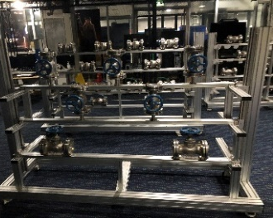
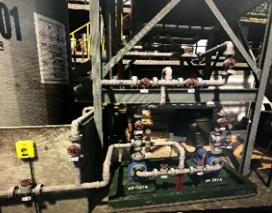

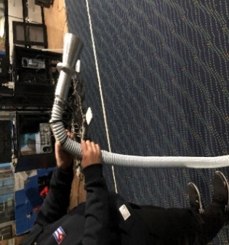

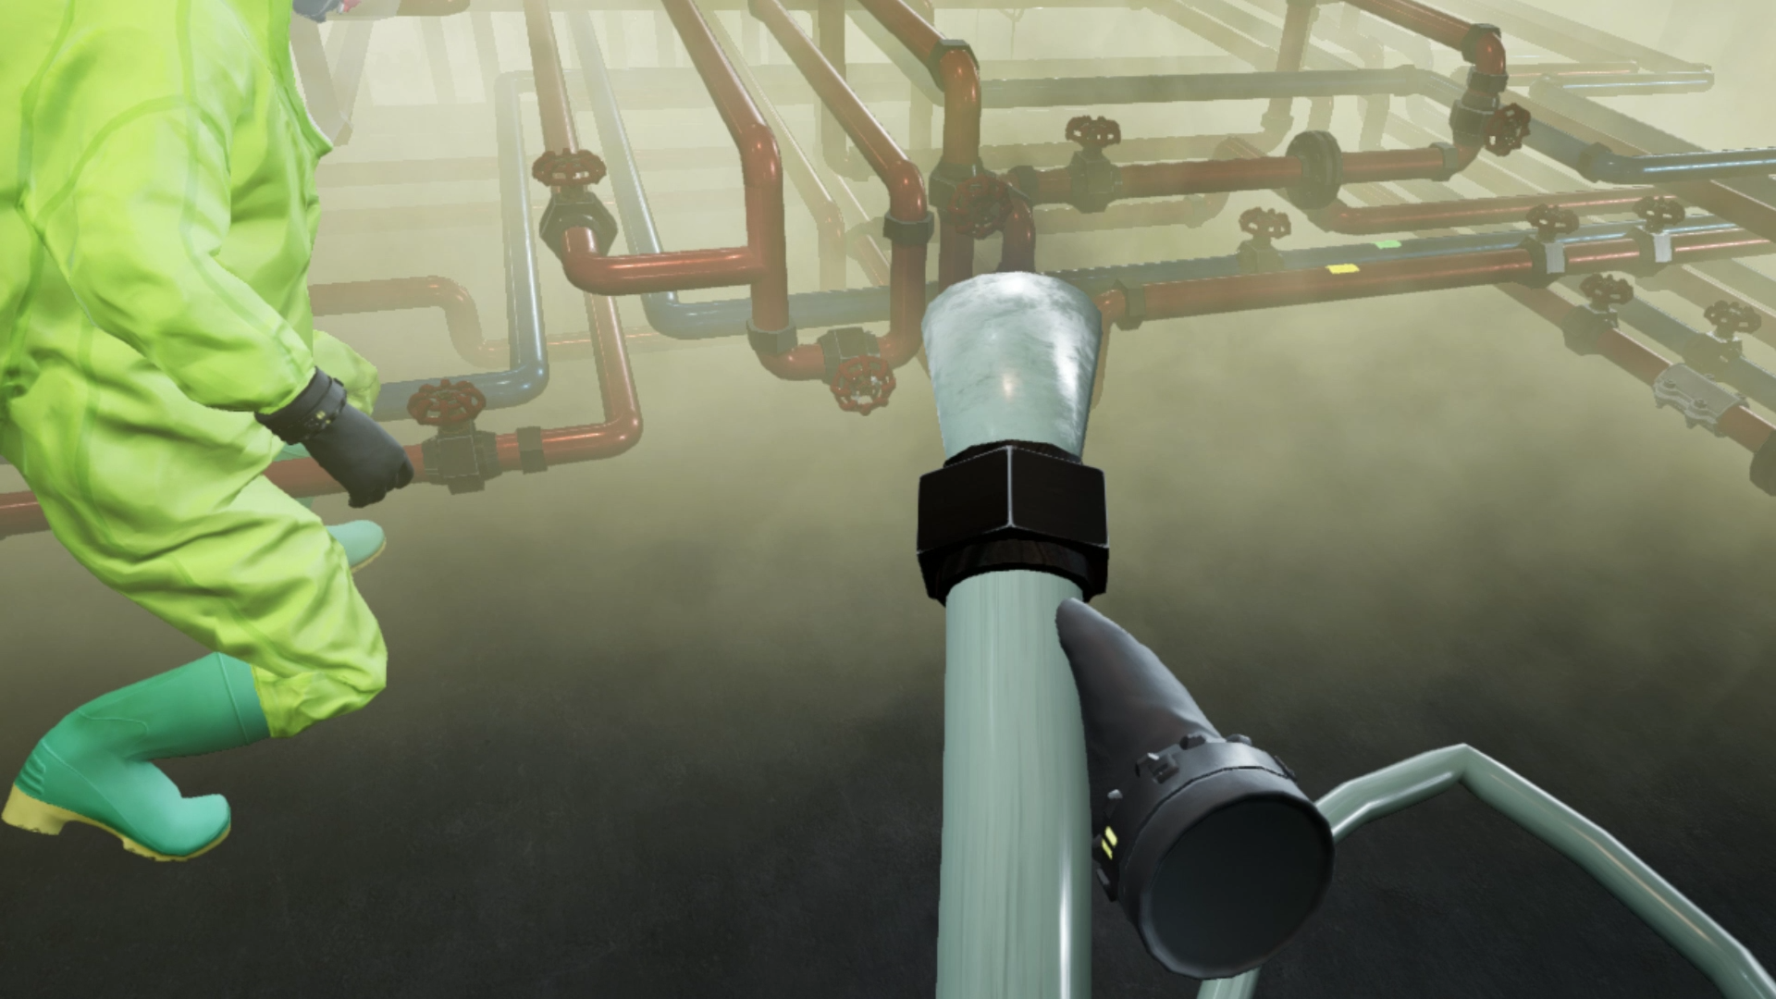




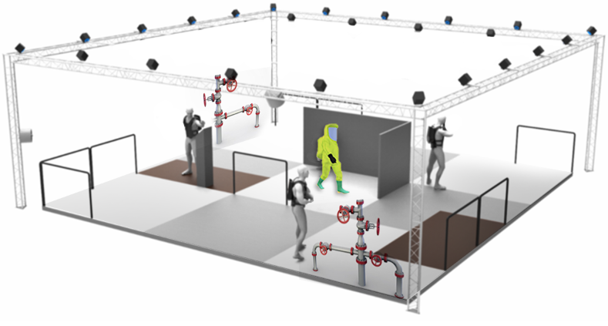
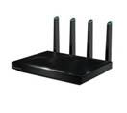

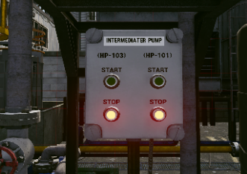
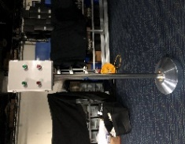
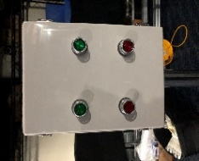
Use case – Chemical Accident Disaster Prevention Training System
Example of development of a virtual reality training program capable of chemical accident disaster prevention training
Establishment of a large space virtual environment based on actual chemical facilities
Applied haptic VR technology based on real-time user location/motion tracking
Development of training scenarios for collaboration with 4-5 people and design of multi-user flow
Accurate interaction between real tangible equipment and virtual equipment is applied
Establish a training evaluation system using data of users in a large space acquired during training
Hydrochloric Acid Valve Station
Digital twin system design in a large space
(Motion Capture System)
Optical camera
User location information
Real tangible equipment
Vitual
Client Exe
User observation in virtual space
user
Interaction
POE
Scrubber set
BackPacPC
HMD
Gloves
Vibration
VR
Wallk Through
System operation tool– AdminClient
ServerPC
Real tangible equipment
Virtual
Pump control panel
AP
Tablet PC
System operation tool
– Operating Manager
Real tangible equipment
Virtual

Slide 8
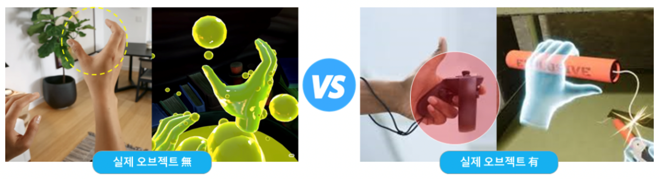
System setup – Digital twin
Matching real objects and objects in virtual space
It is a technology that allows users to feel the sense of touch by matching real objects with virtual objects. It provides objects that can be touched in real space, and it provides excellent immersion to users by matching the objects in various forms in the virtual space. .
Non Real tangible equipment
Real tangible equipment
By adding a vibration function or button to an actual object, you can provide feedback on the interaction to the user in the form of vibration.
As shown in the picture above, real objects can be expressed in various forms in virtual space, so you can freely express them according to the purpose and purpose of the content.
Benefit
By giving various shapes and functions to one object in the real space to be matched, there is no need to produce objects according to functions, so development cost is reduced.
In reality, objects with problems such as cost and size can be implemented in virtual space, so it is possible to provide various experiences to users.

Slide 9
Standardization schedule for IEEE 2888.4
Open SA Ballot Invitation
Mandatory Editorial Coordination submission
Use Cases
Generation
Actuator Control
Situation Judgment & Control System
2nd Draft for Letter Ballot
Setup a standardization plan
Disaster Scenario
IoT control Server
1st Draft for Letter Ballot
3rd Draft for SA Ballot
4th Draft for SA Ballot
Final
Approve
&
Published
Virtual Object Generation
WG 1st
letter Ballot
Start
1st SA
Ballot
Start
2nd SA
Ballot
PAR
Approve
Terms & Definition
Sensor data
Draft Writing
WG 2nd
Letter Ballot
12/2020
02/2021
11/2021
04/2022
09/2022
11/2022
04/2023
09/2023
01/2024
01/2024
02/2021
07/2021
02/2022
07/2022
10/2022
02/2023
08/2023
10/2023
03/2024

Slide 10
Thank You

