Slide 1
[Corrected semantics of basic structures for sensor data]
[Sang-Kyun Kim / Myongji University]

Slide 2
Compliance with IEEE Standards Policies and Procedures
Subclause 5.2.1 of the IEEE-SA Standards Board Bylaws states, "While participating in IEEE standards development activities, all participants...shall act in accordance with all applicable laws (nation-based and international), the IEEE Code of Ethics, and with IEEE Standards policies and procedures."
The contributor acknowledges and accepts that this contribution is subject to
The IEEE Standards copyright policy as stated in the IEEE-SA Standards Board Bylaws, section 7, http://standards.ieee.org/develop/policies/bylaws/sect6-7.html#7, and the IEEE-SA Standards Board Operations Manual, section 6.1, http://standards.ieee.org/develop/policies/opman/sect6.html
The IEEE Standards patent policy as stated in the IEEE-SA Standards Board Bylaws, section 6, http://standards.ieee.org/guides/bylaws/sect6-7.html#6, and the IEEE-SA Standards Board Operations Manual, section 6.3, http://standards.ieee.org/develop/policies/opman/sect6.html

Slide 3
IEEE 2888 Interfacing Cyber and Physical World Working Group Kyoungro Yoon, yoonk@konkuk.ac.kr
Corrected semantics of basic structures for sensor data
Date: 2020-11-22
Author(s):
Name | Affiliation | Phone | Email
Sang-Kyun Kim | Myongji University | +82 10 6406 8163 | goldmunt@gmail.com
Min-Hyuk Jeong | Myongji University | +82 10 3248 4909 | jmh8900@gmail.com
Kyoungro Yoon | Konkuk University | +82 10 5177 3768 | yoonk@konkuk.ac.kr
Sangkwon Peter Jeong | JoyFun | +82 10 8667 7329 | ceo@joyfun.kr
Dong Soo Choi | Dong-A University | +82 10 9318 4170 | soochoi@dau.ac.kr
HyeonWoo Nam | Dongduck Women’s Univ. | +82 10 5313 1197 | hwnam@dongduk.ac.kr
Jeonghwoan Choi | Skonec Entertainment Co., Ltd | +82 10 3042 8901 | jordhanchoi@skonec.com

Slide 4
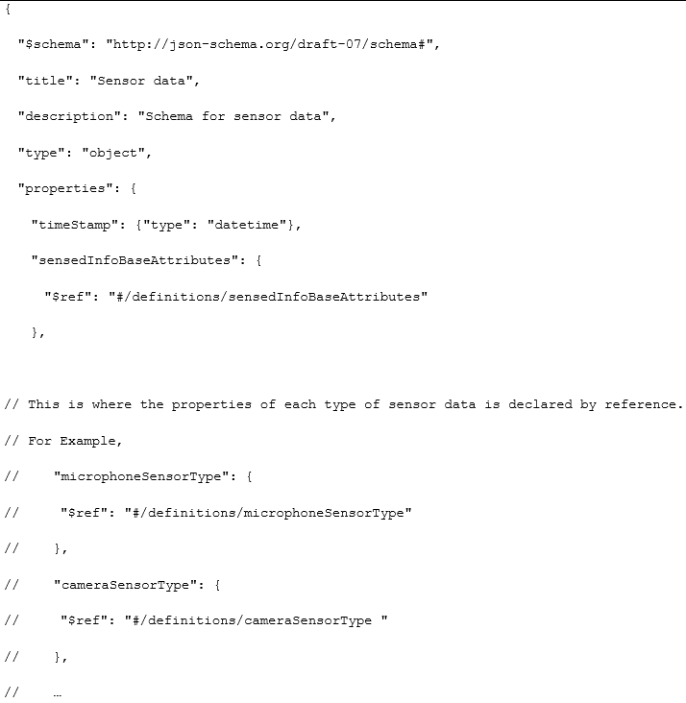
Corrected semantics for base sensor data

Slide 5
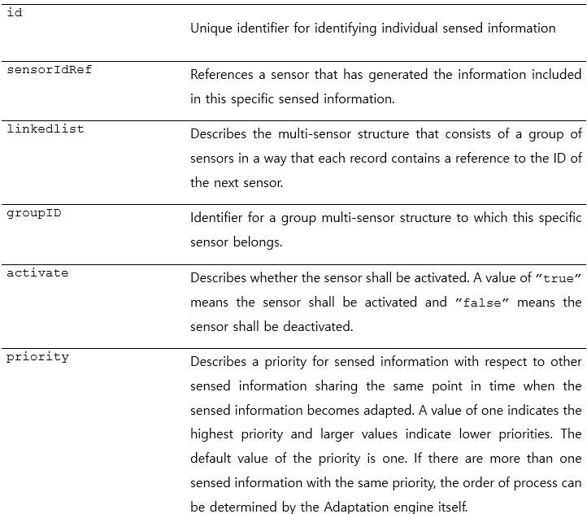
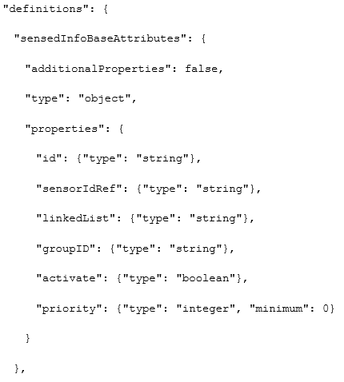
Corrected semantics for base sensor data

Slide 6
Corrected semantics for base sensor data
id | Uniquely identifies individual sensor data.
sensorIdRef | References the sensor that generated the information contained in this particular sensor data.
linkedlist | Describes a multi-sensor structure organized into sensor groups in such a way that each record contains a reference to the ID of the next sensor.
groupID | Identifies a group multi-sensor structure to which this specific sensor belongs.
activate | Describes whether the sensor is activated. A value of "true" means the sensor is active and "false" means the sensor is disabled. In binary representation, a value of "1" means the sensor is active, and "0" means the sensor is disabled.
priority | Describes the priority of sensor data with respect to other sensor data that share the same point in time when sensor data is adapted. A value of 1 represents the highest priority, and a larger value represents the lower priority. If there is more than one sensor data of the same priority, the order of processing can be determined by the adaptation engine itself. EXAMPLE The adaptation engine from the physical world to the cyber world processes individual sensor data in a group of sensors in descending order of priority due to their limited capabilities. This means that sensor data with low priority may be lost.

Slide 7
Thank You

