Slide 1
[Syntax and semantics of audio-video sensor data]
[Sang-Kyun Kim / Myongji University]

Slide 2
Compliance with
IEEE Standards Policies and Procedures
Subclause 5.2.1 of the IEEE-SA Standards Board Bylaws states, "While participating in IEEE standards development activities, all participants...shall act in accordance with all applicable laws (nation-based and international), the IEEE Code of Ethics, and with IEEE Standards policies and procedures."
The contributor acknowledges and accepts that this contribution is subject to
The IEEE Standards copyright policy as stated in the IEEE-SA Standards Board Bylaws, section 7, http://standards.ieee.org/develop/policies/bylaws/sect6-7.html#7, and the IEEE-SA Standards Board Operations Manual, section 6.1, http://standards.ieee.org/develop/policies/opman/sect6.html
The IEEE Standards patent policy as stated in the IEEE-SA Standards Board Bylaws, section 6, http://standards.ieee.org/guides/bylaws/sect6-7.html#6, and the IEEE-SA Standards Board Operations Manual, section 6.3, http://standards.ieee.org/develop/policies/opman/sect6.html

Slide 3
IEEE 2888
Interfacing Cyber and Physical World Working Group
Kyoungro Yoon, yoonk@konkuk.ac.kr
Syntax and semantics of audio-video sensor data
Date: 2020-07-22
Author(s):
Name | Affiliation | Phone | Email
Sang-Kyun Kim | Myongji University | +82 10 6406 8163 | goldmunt@gmail.com
Min-Hyuk Jeong | Myongji University | +82 10 3248 4909 | jmh8900@gmail.com
Kyoungro Yoon | Konkuk University | +82 10 5177 3768 | yoonk@konkuk.ac.kr
Sangkwon Peter Jeong | JoyFun | +82 10 8667 7329 | ceo@joyfun.kr
Dong Soo Choi | Dong-A University | +82 10 9318 4170 | soochoi@dau.ac.kr
HyeonWoo Nam | Dongduck Women’s Univ. | +82 10 5313 1197 | hwnam@dongduk.ac.kr
Jeonghwoan Choi | Skonec Entertainment Co., Ltd | +82 10 3042 8901 | jordhanchoi@skonec.com

Slide 4
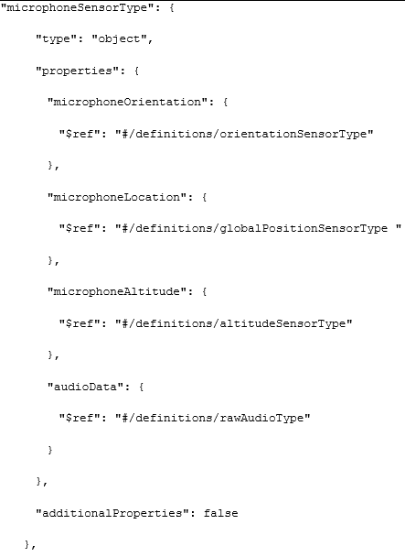
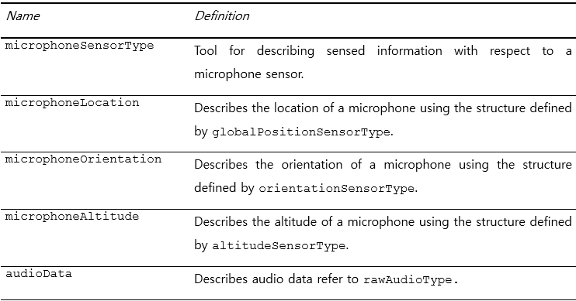
Microphone sensor

Slide 5
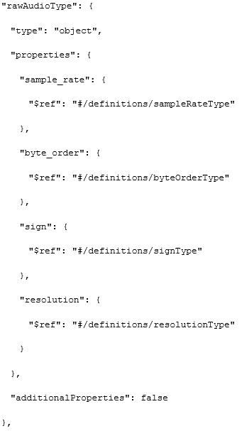
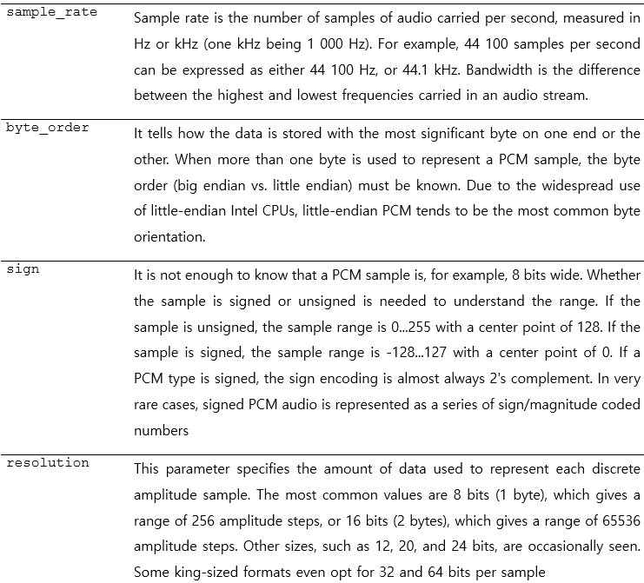
Microphone sensor

Slide 6
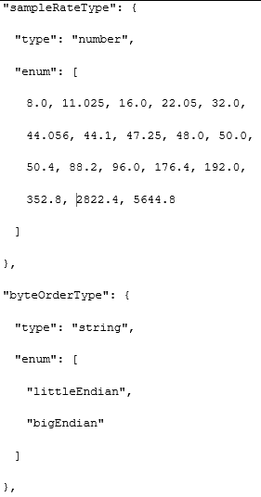
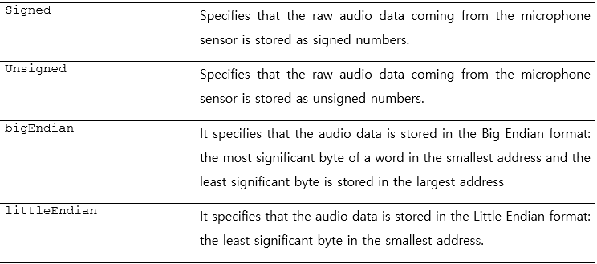
Microphone sensor

Slide 7
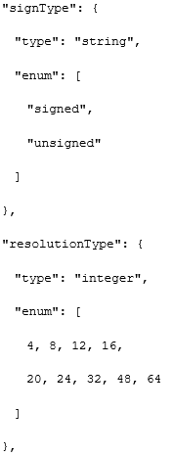
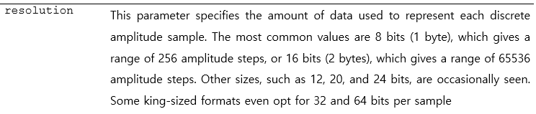
Microphone sensor

Slide 8
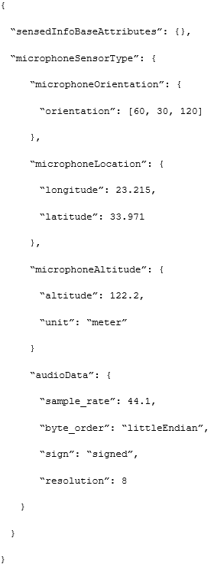
Microphone sensor instance example

Slide 9
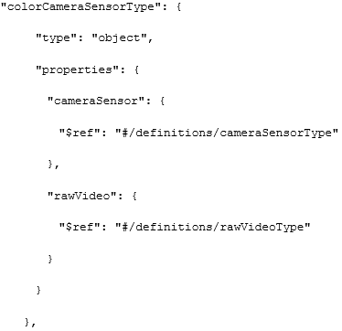
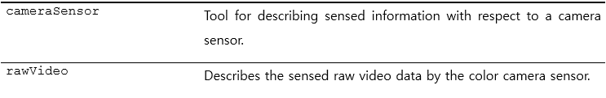
Color camera sensor

Slide 10
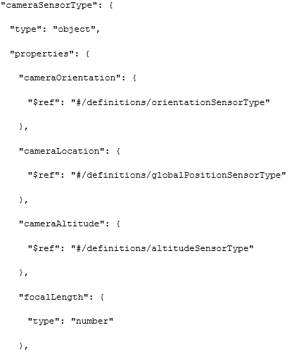
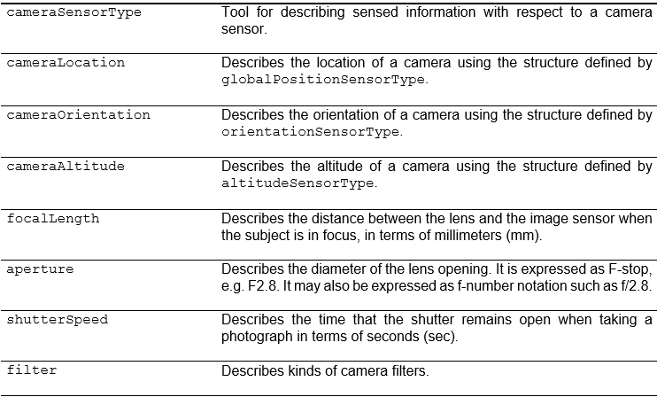
Camera sensor type

Slide 11
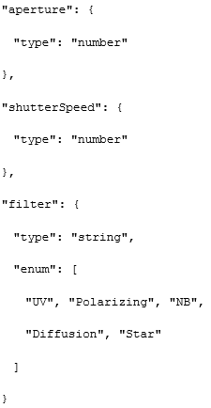
Camera sensor type

Slide 12
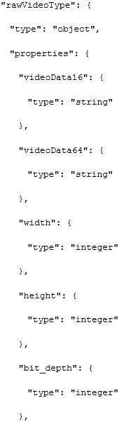
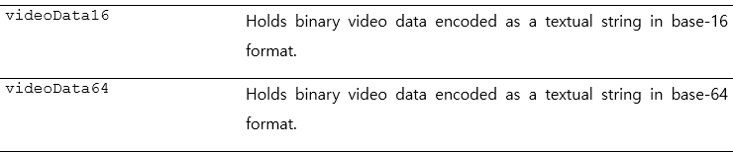
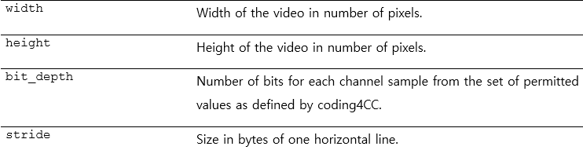
raw video type

Slide 13
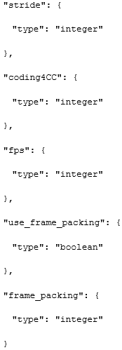
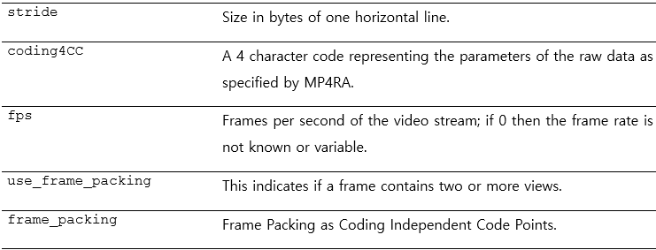
raw video type

Slide 14
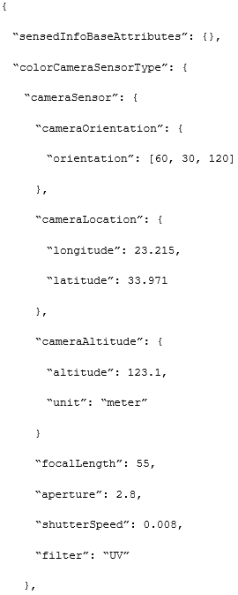
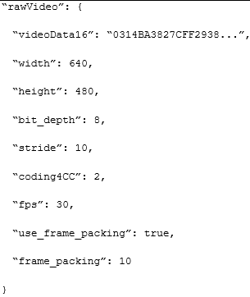
Color camera sensor instance example

Slide 15
Thank You

