Slide 1
[Large Space Virtual Reality Disaster Response Training System]
[Jeonghwoan Choi / Skonec Entertainment. Co., Ltd. ]
July 22, 2020

Slide 2
Compliance with IEEE Standards Policies and Procedures
Subclause 5.2.1 of the IEEE-SA Standards Board Bylaws states, "While participating in IEEE standards development activities, all participants...shall act in accordance with all applicable laws (nation-based and international), the IEEE Code of Ethics, and with IEEE Standards policies and procedures."
The contributor acknowledges and accepts that this contribution is subject to
The IEEE Standards copyright policy as stated in the IEEE-SA Standards Board Bylaws, section 7, http://standards.ieee.org/develop/policies/bylaws/sect6-7.html#7, and the IEEE-SA Standards Board Operations Manual, section 6.1, http://standards.ieee.org/develop/policies/opman/sect6.html
The IEEE Standards patent policy as stated in the IEEE-SA Standards Board Bylaws, section 6, http://standards.ieee.org/guides/bylaws/sect6-7.html#6, and the IEEE-SA Standards Board Operations Manual, section 6.3, http://standards.ieee.org/develop/policies/opman/sect6.html

Slide 3
IEEE 2888 Interfacing Cyber and Physical World Working Group Kyoungro Yoon, yoonk@konkuk.ac.kr
Large Space Virtual Reality Disaster Response Training System
Date: 2020-07-20
Author(s):
Name | Affiliation | Phone | Email
Jeonghwoan Choi | Skonec Entertainment Co., Ltd | +82 10 3042 8901 | jordhanchoi@skonec.com
Kyoungro Yoon | Konkuk University | +82 10 5177 3768 | yoonk@konkuk.ac.kr
Sang-Kyun Kim | Myongji University | +82 10 6406 8163 | goldmunt@gmail.com
Sangkwon Peter Jeong | JoyFun | +82 10 8667 7329 | ceo@joyfun.kr
Dong Soo Choi | Dong-A University | +82 10 9318 4170 | soochoi@dau.ac.kr
HyeonWoo Nam | Dongduck Women’s Univ. | +82 10 5313 1197 | hwnam@dongduk.ac.kr

Slide 4
Contents
Introduction
Use case
System setup
Conclusions

Slide 5
Introduction
Scope
This document proposes standardized guidelines that are needed for researchers and industry workers who want to implement a disaster response training system using virtual reality in large spaces that are difficult to reenact in the real world. The scope of this standard may include relevant techniques for building systems that provide effective disaster response training to users
Need
Cases of acquiring human/object location and movement data through sensors installed in large spaces and developing virtual reality training solutions based on them are increasing
A standard for securing accuracy and reliability in the stage of acquiring data of an object is required, and the 'object recognition module in large space for a disaster response training system' is a technology capable of presenting the corresponding standard

Slide 6
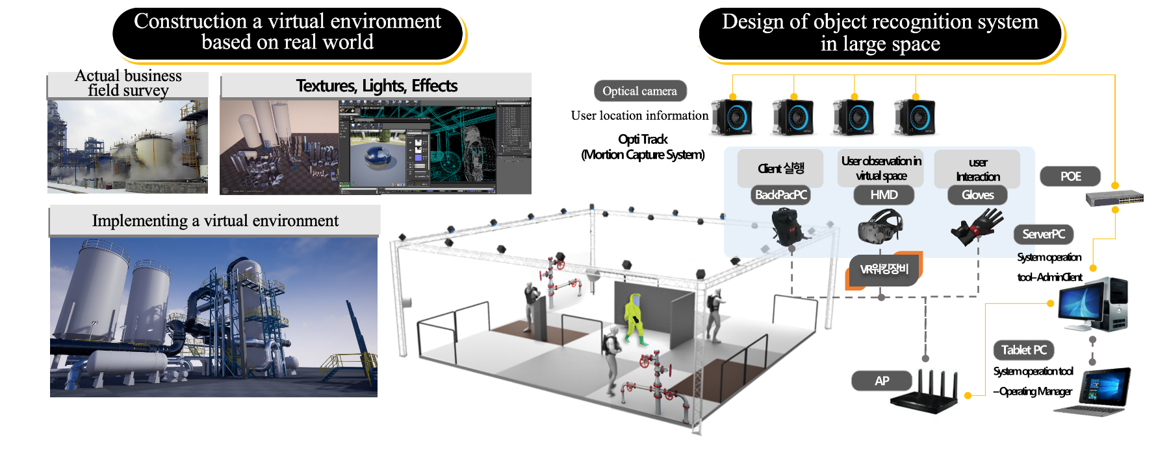
Use case
This standard can contribute to convergence research and development in industries that respond to field demands that require disaster response training and utilize object information in large spaces
Example of developing a virtual reality training program capable of responding to chemical accidents and terrorism
- Construct a large-scale virtual environment at the actual level based on actual chemical facilities
- Application of tangible VR technology based on real-time user location/motion tracking
- Development of a training scenario capable of collaborating with 4 to 5 people and design of multi-user tracking
- Establish training evaluation system using user's data in large space acquired during training

Slide 7
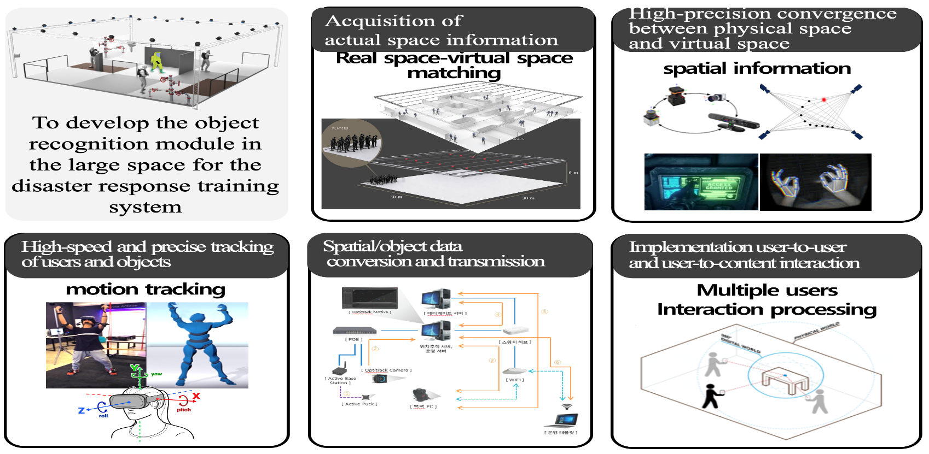
System setup
To develop the object recognition module in the large space for the disaster response training system, the following detailed development goals are derived
Acquisition of actual space information
Spatial/object data conversion and transmission
High-speed and precise tracking of users and objects
High-precision convergence between physical space and virtual space
Implementation user-to-user and user-to-content interaction

Slide 8
Conclusions
Applied to field where diaster response training system using virtual reality in large space
Diasater response and safety training
Providing disaster reponse and public safety training services
Used to improve accident response training and to educate experts
Purpose of solving safety problems in various situation and raising awareness about safety
Military training
Used in military training field such as terror response training
Realization of combat environment in large space and supporting for multi-person tactical training
Creating new services by utilizing object information in large space
Related industries (digital twin, IOT)
Expansion to industrial safety management field (application for medical, manufacturing, design, engineering, etc.)
Practical use as technology to raise awareness of accident prevention and minimize the risk of industrial accidents
Non-face-to-face culture and entertainment
Development of entertainment contents using large space
Creation of new services by convergence object recognition technology in large space with current culture
: Virtual exhibition, concert, virtual reality meeting, virtual reality education, virtual market, etc.
We propose starting a new PAR in IEEE 2888 for covering all the necessary requirements and specification for the proposed virtual reality training system in large space

Slide 9
Thank You

