Slide 1
[IEEE 2888 Session #2 WG Closing Plenary]
[Sangkwon Peter Jeong / JoyFun]

Slide 2
Compliance with
IEEE Standards Policies and Procedures
Subclause 5.2.1 of the IEEE-SA Standards Board Bylaws states, "While participating in IEEE standards development activities, all participants...shall act in accordance with all applicable laws (nation-based and international), the IEEE Code of Ethics, and with IEEE Standards policies and procedures."
The contributor acknowledges and accepts that this contribution is subject to
The IEEE Standards copyright policy as stated in the IEEE-SA Standards Board Bylaws, section 7, http://standards.ieee.org/develop/policies/bylaws/sect6-7.html#7, and the IEEE-SA Standards Board Operations Manual, section 6.1, http://standards.ieee.org/develop/policies/opman/sect6.html
The IEEE Standards patent policy as stated in the IEEE-SA Standards Board Bylaws, section 6, http://standards.ieee.org/guides/bylaws/sect6-7.html#6, and the IEEE-SA Standards Board Operations Manual, section 6.3, http://standards.ieee.org/develop/policies/opman/sect6.html

Slide 3
IEEE 2888
Interfacing Cyber and Physical World Working Group
Kyoungro Yoon, yoonk@konkuk.ac.kr
IEEE 2888 Session #2 WG Closing Plenary
Date: 2020-02-23
Author(s):
Name | Affiliation | Phone [optional] | Email [optional]
Jeong, Sangkwon Peter | JoyFun | +82 10 8667 7329 | ceo@joyfun.kr

Slide 4
Session Time and Location
 | Tuesday (February 25, 2020) | Wednesday (February 26, 2020) | Thursday (February 27, 2020)
AM1 9:00-10:30 AM |  | WG Meeting | WG Meeting
AM2 11:00-12:30 PM |  | WG Meeting | WG Closing Plenary
PM1 1:30-3:00 PM | Open Plenary Roll Call | WG Meeting
PM2 3:30-5:00 PM | WG Meeting | WG Meeting
※ Location
E-1904 Aoyama-Twin Tower Bldg. 1-1-1 Minami-aoyama Minato-ku, Tokyo 107-0062 Japan

Slide 5
WG Motions

Slide 6
WG Motion #1
Move to approve the ‘2888-20-0006-01-0000-Session-2-Agenda’
Move: Kyoungro Yoon
Second: Sang-Kyun Kim
For Agree: 03
Against: 00
Abstain: 00
Motion Passes

Slide 7
WG Motion #2
Move to approve the ‘2888-20-0004-01-0000-Session-1-WG-Meeting minutes’
Move: Sangkwon Peter Jeong
Second: Sang-Kyun Kim
For Agree: 03
Against: 00
Abstain: 00
Motion Passes

Slide 8
WG Motion #3
Move to approve the ‘2888-20-0001-01-0001-JSON_UAV’
Move: Kyoungro Yoon
Second: Sangkwon Peter Jeong
For Agree: 03
Against: 00
Abstain: 00
Motion Passes

Slide 9
WG Motion #4
Move to approve the ‘2888-20-0002-01-0001-JSONWaether’
Move: Sangkwon Peter Jeong
Second: Kyoungro Yoon
For Agree: 03
Against: 00
Abstain: 00
Motion Passes

Slide 10
WG Motion #5
Move to approve the ‘2888-20-0003-01-0001-JSONVehicle’
Move: Kyoungro Yoon
Second: Sangkwon Peter Jeong
For Agree: 03
Against: 00
Abstain: 00
Motion Passes

Slide 11
WG Motion #6
Move to approve the ‘2888-20-0008-01-0001-Sensor data format_root structure_JSON’
Move: Sang-Kyun Kim
Second: Sangkwon Peter Jeong
For Agree: 03
Against: 00
Abstain: 00
Motion Passes

Slide 12
WG Motion #7
Move to approve the ‘2888-20-0009-01-0001-Audio Video sensor data examples’
Move: Sang-Kyun Kim
Second: Sangkwon Peter Jeong
For Agree: 03
Against: 00
Abstain: 00
Motion Passes

Slide 13
WG Motion #8
Move to approve the ‘2888-20-0010-01-0001-Location-related sensor data formats’
Move: Sang-Kyun Kim
Second: Sangkwon Peter Jeong
For Agree: 03
Against: 00
Abstain: 00
Motion Passes

Slide 14
WG Motion #9
Move to approve the ‘2888-20-0011-01-0001-Environmental sensor data formats’
Move: Sang-Kyun Kim
Second: Sangkwon Peter Jeong
For Agree: 03
Against: 00
Abstain: 00
Motion Passes

Slide 15
WG Motion #10
Move to approve the ‘2888-20-0012-01-0001-Biosensor data formats’
Move: Sang-Kyun Kim
Second: Sangkwon Peter Jeong
For Agree: 03
Against: 00
Abstain: 00
Motion Passes

Slide 16
WG Motion #11
Move to approve the ‘2888-20-0013-01-0001-API examples for microphone and color camera sensor’
Move: Sangkwon Peter Jeong
Second: Sang-Kyun Kim
For Agree: 03
Against: 00
Abstain: 00
Motion Passes

Slide 17
WG Motion #12
Move to approve the ‘2888-20-0014-00-0000-IEEESTD-2888.1D1’
Move: Sangkwon Peter Jeong
Second: Sang-Kyun Kim
For Agree: 03
Against: 00
Abstain: 00
Motion Passes

Slide 18
Next Seoul Interim meeting
April 16, 4:00pm at Gangnam 2nd of ToZ.
May 21, 4:00pm at Gangnam 2nd of ToZ.

Slide 19
Next Singapore Meeting
When: July 21-23, 2020 (Upon availability of the meeting venue)
Where: IEEE-SA Office, 1 Fusionopolis Walk #04-07 South Tower, Solaris, Singapore, Singapore (To be confirmed)
Issues
  Writing for Draft document

Slide 20
Meeting Location
Location:
1 Fusionopolis Walk #04-07 South Tower, Solaris, (IEEE-SA Office), Singapore, Singapore
WG Documents: https://ieee-sa.imeetcentral.com/2888/
Food and Beverages:
  Lunch Time: 12:30PM –1:30PM
  Morning coffee breake: 10:00AM-10:30AM
  Afternoon coffee break: 3:30PM-4:00PM

Slide 21
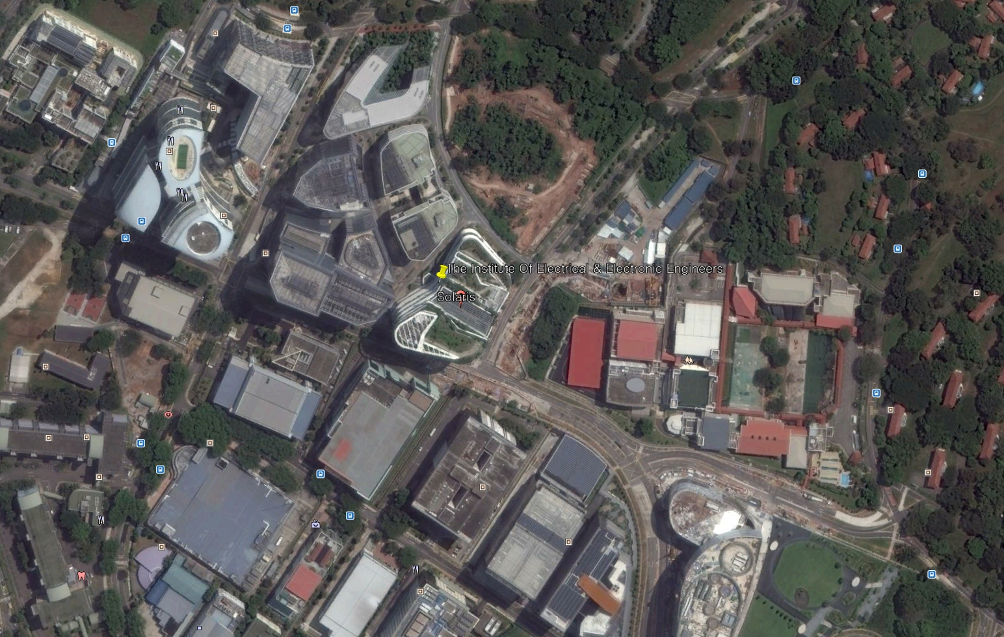
Information of Next Meeting Area

Slide 22
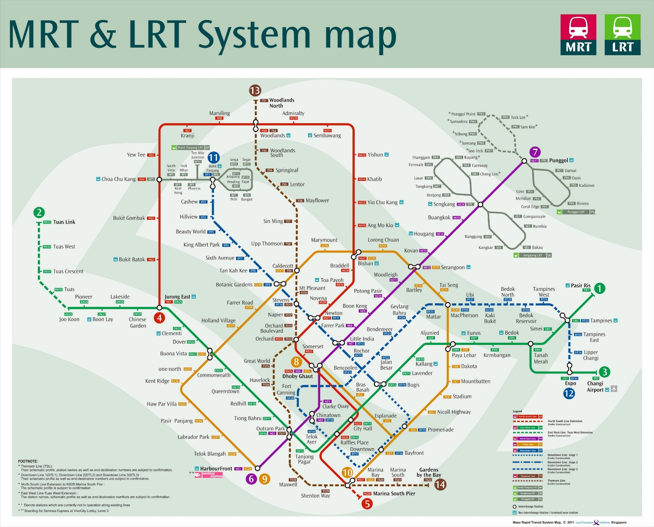
Information of Next Meeting Area
9호선 Circle Line
One-north 역
창이 공항

Slide 23
Attendees
Kyoungro Yoon | Konkuk University
Sangkyoon Kim | Myoungji University
Jeong, Sangkwon Peter | JoyFun Inc.,
Iwao Hyakutake | IEEE
Meiko Kajikawa | IEEE

Slide 24
Future Sessions – 2020
July 21-23, 1 Fusionopolis Walk #04-07 South Tower, Solaris, IEEE-SA Office, Singapore, Singapore (TBD by End of March)
November 24-26, Meeting room A, 9th Floor, TTA Building, 47, Bundang-ro, Seongnam-shi, Gyeonggi-do, Korea

Slide 25
Future Sessions – 2021
February 16 - 18, Altara Suits by Ri-Yaz, Danang, Vietnam
June 28 - July 2, IEEE-SA Office, 10662 Los Vaqueros Cir,
Los Alamitos, California, USA
October 20-22, Seoul, Korea (TBD)

Slide 26
Thank You

