Slide 1
[IEEE 2888 Session #2 WG Opening Plenary]
[Sangkwon Peter Jeong / JoyFun]

Slide 2
Compliance with IEEE Standards Policies and Procedures
Subclause 5.2.1 of the IEEE-SA Standards Board Bylaws states, "While participating in IEEE standards development activities, all participants...shall act in accordance with all applicable laws (nation-based and international), the IEEE Code of Ethics, and with IEEE Standards policies and procedures."
The contributor acknowledges and accepts that this contribution is subject to
The IEEE Standards copyright policy as stated in the IEEE-SA Standards Board Bylaws, section 7, http://standards.ieee.org/develop/policies/bylaws/sect6-7.html#7, and the IEEE-SA Standards Board Operations Manual, section 6.1, http://standards.ieee.org/develop/policies/opman/sect6.html
The IEEE Standards patent policy as stated in the IEEE-SA Standards Board Bylaws, section 6, http://standards.ieee.org/guides/bylaws/sect6-7.html#6, and the IEEE-SA Standards Board Operations Manual, section 6.3, http://standards.ieee.org/develop/policies/opman/sect6.html

Slide 3
IEEE 2888 Interfacing Cyber and Physical World Working Group Kyoungro Yoon, yoonk@konkuk.ac.kr
Session #2 WG Opening Plenary
Date: 2020-02-22
Author(s): Sangkwon Peter Jeong
Name | Affiliation | Phone | Email
Jeong, Sangkwon Peter | JoyFun | +82 10 8667 7329 | ceo@joyfun.kr

Slide 4
Session Time and Location
 | Tuesday (February 25, 2020) | Wednesday (February 26, 2020) | Thursday (February 27, 2020)
AM1 9:00-10:30 AM |  | WG Meeting | WG Meeting
AM2 11:00-12:30 PM |  | WG Meeting | WG Closing Plenary
PM1 1:30-3:00 PM | Open Plenary Roll Call | WG Meeting
PM2 3:30-5:00 PM | WG Meeting | WG Meeting
※ Location
E-1904 Aoyama-Twin Tower Bldg. 1-1-1 Minami-aoyama Minato-ku, Tokyo 107-0062 Japan

Slide 5
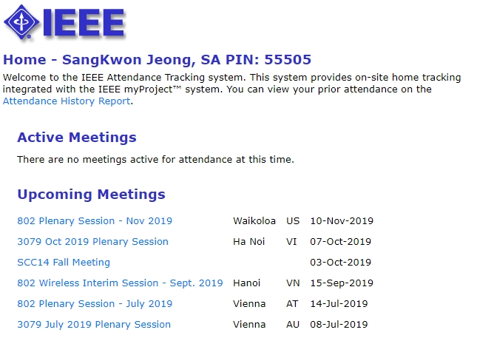
Attendance
Electronic Attendance ONLY
Electronic Attendance
IMAT System
https://imat.ieee.org/2888/
Mark attendance during every session

Slide 6
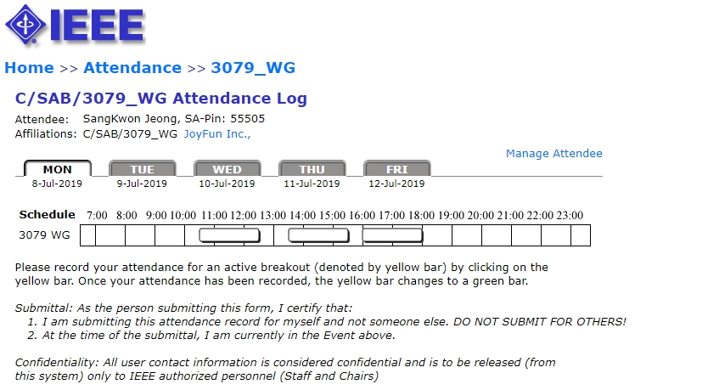
Attendance
Total number of IEEE 2888 WG timeslots: 8
04 timeslots for 50% attendance to be counted towards WG voting membership
All attendance records are reported on the meeting minutes
Please check the attendance records for any errors

Slide 7
Voting Membership
2888 Voting Membership described in
DCN#: 2888-19-0000-00-0000
Maintenance of Voting Membership
Missing two consecutive plenary sessions may result in loss of voting rights
WG Letter Ballots
WG members are expected to vote on WG LBs
Failure to vote on 2 out of last 3 WG LBs could result in loss of voting rights

Slide 8
Miscellaneous Meeting Logistics
WG Documents: https://ieee-sa.imeetcentral.com/2888/
Food and Beverages:
Lunch Time: 12:30PM –1:30PM
Morning Coffee break: 10:30AM-11:00AM
Afternoon Coffee break: 3:00PM-3:30PM

Slide 9
Registration and Media Recording
Each Attendee must provide contact information and pay conference fee
Conference fee has to be paid through the registration desk
Failure to pay conference fee results in loss of credit for voting rights
Photography not permitted unless approved by WG Chair
Audio taping of IEEE 2888 meetings is NOT allowed
Media – Press and Analyst briefings
Only the 2888 WG Chair is allowed to give verbal statements/interviews to the media on behalf of the IEEE 2888 working group

Slide 10
Membership & Anti-Trust
Individual membership
In all IEEE standards meetings, membership is by individual, hence you do not represent a company or organization.
Anti-Trust laws
The Anti-Trust laws forbid the discussion of prices within our meetings.

Slide 11
The IEEE-SA strongly recommends that at each WG meeting the chair or a designee:
Show slides #8 through #11 of this presentation
Advise the WG attendees that:
The IEEE’s patent policy is consistent with the ANSI patent policy and is described in Clause 6 of the IEEE-SA Standards Board Bylaws;
Early identification of patent claims which may be essential for the use of standards under development is strongly encouraged;
There may be Essential Patent Claims of which the IEEE is not aware. Additionally, neither the IEEE, the WG, nor the WG chair can ensure the accuracy or completeness of any assurance or whether any such assurance is, in fact, of a Patent Claim that is essential for the use of the standard under development.
Instruct the WG Secretary to record in the minutes of the relevant WG meeting:
That the foregoing information was provided and that slides 1 through 4 (and this slide 0, if applicable) were shown;
That the chair or designee provided an opportunity for participants to identify patent claim(s)/patent application claim(s) and/or the holder of patent claim(s)/patent application claim(s) of which the participant is personally aware and that may be essential for the use of that standard
Any responses that were given, specifically the patent claim(s)/patent application claim(s) and/or the holder of the patent claim(s)/patent application claim(s) that were identified (if any) and by whom.
The WG Chair shall ensure that a request is made to any identified holders of potential essential patent claim(s) to complete and submit a Letter of Assurance.
It is recommended that the WG chair review the guidance in IEEE-SA Standards Board Operations Manual 6.3.5 and in FAQs 12 and 12a on inclusion of potential Essential Patent Claims by incorporation or by reference.
Note: WG includes Working Groups, Task Groups, and other standards-developing committees with a PAR approved by the IEEE-SA Standards Board.

Slide 12
Participants, Patents, and Duty to Inform
All participants in this meeting have certain obligations under the IEEE-SA Patent Policy. Participants:
“Shall inform the IEEE (or cause the IEEE to be informed)” of the identity of each “holder of any potential Essential Patent Claims of which they are personally aware” if the claims are owned or controlled by the participant or the entity the participant is from, employed by, or otherwise represents
“Personal awareness” means that the participant “is personally aware that the holder may have a potential Essential Patent Claim,” even if the participant is not personally aware of the specific patents or patent claims
“Should inform the IEEE (or cause the IEEE to be informed)” of the identity of “any other holders of such potential Essential Patent Claims” (that is, third parties that are not affiliated with the participant, with the participant’s employer, or with anyone else that the participant is from or otherwise represents)
The above does not apply if the patent claim is already the subject of an Accepted Letter of Assurance that applies to the proposed standard(s) under consideration by this group
Quoted text excerpted from IEEE-SA Standards Board Bylaws subclause 6.2
Early identification of holders of potential Essential Patent Claims is strongly encouraged
No duty to perform a patent search

Slide 13
Call for Potentially Essential Patents
If anyone in this meeting is personally aware of the holder of any patent claims that are potentially essential to implementation of the proposed standard(s) under consideration by this group and that are not already the subject of an Accepted Letter of Assurance:
Either speak up now or
Provide the chair of this group with the identity of the holder(s) of any and all such claims as soon as possible or
Cause an LOA to be submitted

Slide 14
Participation in IEEE 2888 Meetings
All participation in IEEE 2888 Working Group meetings is on an individual basis
• Participants in the IEEE standards development individual process shall act based on their qualifications and experience. (https://standards.ieee.org/develop/policies/bylaws/sb_bylaws.pdfsection 5.2.1)
• IEEE 2888 Working Group membership is by individual; “Working Group members shall participate in the consensus process in a manner consistent with their professional expert opinion as individuals, and not as organizational representatives”. (subclause 4.2.1 “Establishment”, of the IEEE 2888 Working Group Policies and Procedures)
Participants have an obligation to act and vote as an individual and not under the direction of any other individual or group. A Participant’s obligation to act and vote as an individual applies in all cases, regardless of any external commitments, agreements, contracts, or orders.
Participants shall not direct the actions or votes of any other member of an IEEE 2888 Working Group or retaliate against any other member for their actions or votes within IEEE 2888 Working Group meetings, see https://standards.ieee.org/develop/policies/bylaws/sb_bylaws.pdf section 5.2.1.3 and the IEEE 2888 Working Group Policies and Procedures, subclause 3.4.1 “Chair”, list item x.
By participating in IEEE 2888 meetings, you accept these requirements. If you do not agree to these policies then you shall not participate.

Slide 15
Other Guidelines for IEEE WG Meetings
All IEEE-SA standards meetings shall be conducted in compliance with all applicable laws, including antitrust and competition laws.
Don’t discuss the interpretation, validity, or essentiality of patents/patent claims.
Don’t discuss specific license rates, terms, or conditions.
Relative costs, including licensing costs of essential patent claims, of different technical approaches may be discussed in standards development meetings.
Technical considerations remain primary focus
Don’t discuss or engage in the fixing of product prices, allocation of customers, or division of sales markets.
Don’t discuss the status or substance of ongoing or threatened litigation.
Don’t be silent if inappropriate topics are discussed … do formally object.
---------------------------------------------------------------
See IEEE-SA Standards Board Operations Manual, clause 5.3.10 and “Promoting Competition and Innovation: What You Need to Know about the IEEE Standards Association's Antitrust and Competition Policy” for more details.

Slide 16
Copyright
Under the current US copyright law — the author of information is deemed to own the copyright from the moment of creation
The IEEE Bylaws require copyright of all material to be held by the IEEE
Must consult with IEEE for re-use of copyright material
The IEEE Standards accomplishes transfer of copyright ownership through the Project Authorization Request (PAR) process

Slide 17
Work Status
Working Group Status
Decision of the Scope for P2888.1 Draft Document
Decision of the Context for P2888.1 Draft Document
Discussion on the P2888.1 Terms and Definitions

Slide 18
Objectives for the February Meeting
Work and Discuss
Discuss and decide the future Face-to-Face meeting schedule for 2020 and 2021
Discuss the next action plan

Slide 19
Development Timeline
PAR approved: 09/2019
Working Group 1st Letter Ballot: 06/2021 (20 days) - Before July meeting
Working Group 2nd Letter Ballot: 09/2021 (20 days) - Before October meeting
Open Sponsor Ballot Invitation: 10/2021 (30 days)
Start Sponsor Ballot: 11/2021 (30 days)
Start Recirculation 1st Ballot: 02/2022 (10 days)
Start Recirculation 2nd Ballot: 05/2022 (10 days)
Submit to RevCom: 07/2022
Publishing: 01/2023
Open Sponsor Ballot Invitation
Mandatory Editorial Coordination submission
WG 2nd
letter Ballot
WG Meeting to address comments
Ballot Resolution Telecon 1
Sent comments to the WG
Sent comment to the WG
Ballot Resolution Telecon1
PAR
Approve
WG 1st
letter Ballot
Start Sponsor
Ballot
Start Recirculation
1st Ballot
Start Recirculation
2nd Ballot
RevCom comment review
Submit to RevCom
SASB Approval
Publishing
09/2019
06/2021
09/2021
11/2021
01/2022
03/2022
05/2022
07/2022
09/2022
01/2023
10/2021
12/2021
02/2022
04/2022
06/2022
08/2022

Slide 20
Future Sessions – 2020
July 13-17, 1 Fusionopolis Walk #04-07 South Tower, Solaris, IEEE-SA Office, Singapore, Singapore
November 26-28, Meeting room A, 9th Floor, TTA Building, 47, Bundang-ro, Seongnam-shi, Gyeonggi-do, Korea

Slide 21
Future Sessions – 2021
February 15 - 19, IEEE-SA Office, 10662 Los Vaqueros Cir, Los Alamitos, California, USA
June 28 - July 2, East Asia (TBD) Vladivostok
October 20-22, Korea (TBD)

Slide 22
Thank You

