Slide 1
IEEE 1900.5 Contribution
Author’s Name | Affiliation | Address | Phone | email
Tony Rennier | Foundry Inc. | Severn, MD | 301.485.9679 | trennier@foundryinc.com
Document Title: Agenda, Admin and Chair’s Notes for IEEE 1900.5 WG Meeting on 30 March – 1 April 2021
Document Date: 30 March - 1 April 2021
Document No: 5-21-0005-00-agen
Notice: This document has been prepared to assist IEEE DySPAN-SC and its Working Groups. It is offered as a basis for discussion and is not binding on the contributing individual(s) or organization(s). The material in this document is subject to change in form and content after further study. The contributor(s) reserve(s) the right to add, amend or withdraw material contained herein.
Release: The contributor grants a free, irrevocable license to the IEEE to incorporate material contained in this contribution, and any modifications thereof, in the creation of an IEEE Standards publication; to copyright in the IEEE’s name any IEEE Standards publication even though it may include portions of this contribution; and at the IEEE’s sole discretion to permit others to reproduce in whole or in part the resulting IEEE Standards publication. The contributor also acknowledges and accepts that this contribution may be made public by IEEE DySPAN-SC.
Patent Policy and Procedures: The contributor is familiar with the IEEE Patent Policy and Procedures including the statement "IEEE standards may include the known use of patent(s), including patent applications, provided the IEEE receives assurance from the patent holder or applicant with respect to patents essential for compliance with both mandatory and optional portions of the standard." Early disclosure to IEEE DySPAN-SC and its Working Groups of patent information that might be relevant to the standard is essential to reduce the possibility for delays in the development process and increase the likelihood thatthe draft publication will be approved for publication. Please notify the Chair <trennier@foundryinc.com> as early as possible, in written or electronic form, if patented technology (or technology under patent application) might be incorporated into a draft standard being developed within the IEEE DySPAN-SC Committee. If you have questions, contact the IEEE Patent Committee Administrator at < patcom@ieee.org >.

Slide 2
Electronic Meeting Details
IEEE 1900.5 Meetings
https://ieeesa.webex.com/meet/trennier | 1736136765
Join by phone
+1-646-992-2010 United States Toll (New York City)
+1-213-306-3065 United States Toll (Los Angeles)
Access code: 173 613 6765
Notes:
September 22, 2008
2

Slide 3
Rules
IEEE DySPAN-SC rules
https://ieee.app.box.com/v/PandP-DySPAN-SC
IEEE 1900.5 WG rules
http://grouper.ieee.org/groups/dyspan/files/individual-WG-PnPs.pdf
Roberts Rules (latest edition) as needed…

Slide 4
Current Membership
Quorum 3/30? - No
Quorum 4/1? - Yes
3/30/21-4/1/21 | WG Status | First Name | Last Name | Affiliation
xy | Member | Julia | Andrusenko | JHU/APL
xy | Member | Carlos | Caicedo | Syracuse University (Secretary)
xy | Member | David | Chester | L3Harris
 | Participant | Jameson | Dempsey | Google
 | Participant | Wesley | Eddy | Google
 | Member | Lynn | Grande | Southern Cloud
 | Participant | Corrigan | Johnson | Chesapeake Technology International
 | Member | Mitch | Kokar | VIStology & Northeastern University
xy | Member | Alex | Lackpour | Drexel University (Vice Chair)
xy | Member | Eric | Lindahl | CDS2
 | Member | Jakub | Moskal | Vistology
 | Participant | V | Prasad | Wireless and Mobile Communication, TU Delft
 | Member | Becca | Rousseau | MITRE
xy | Member | Reinhard | Schrage | SchrageConsult
 | Member | Kael | Stilp | MITRE
xy | Member | John | Stine | MITRE
x | Member | Timothy | Woods | ANDRO Computational Solutions, LLC
 | Participant | Sean | Furman | ANDRO Computational Solutions, LLC
xy | Participant | Brent | Josefiak | L3Harris
xy | Member | Daniel | Zahirniak | Joint Electronic Warfare Center (JEWC)
xy | Member | Tony | Rennier | Foundry Inc (Chair)
Quorum > ½ membership (9 members)
2 meetings to get in, 2 meetings to get out

Slide 5
Draft Agenda
3/30/21 9:00-10:30 all times EDT
Administrivia
Roll Call / Quorum Check
Approve Agenda
Copyright Slides
Patent Slides
Approval of recent minutes
Status on 1900.5a
Status on 1900.5.1
Status on 1900.5.2a
Review of other 1900 activities (1900.1, Leadership meeting etc.)
1900.5 Marketing Opportunities
1900.5 meeting planning and review
AoB
Any modifications? No
Notes:
September 22, 2008
5

Slide 6
Draft Agenda
4/1/21 9:00-10:30 all times EDT
Administrivia
Roll Call / Quorum Check
Approve Agenda
Copyright Slides
Patent Slides
Approval of recent minutes
Approval of Motion for Chair to Ballot 1900.5.2a Draft
Status on 1900.5a
Status on 1900.5.1
Status on 1900.5.2a
Review of other 1900 activities (1900.1, Leadership meeting etc.)
1900.5 Marketing Opportunities
1900.5 meeting planning and review
AoB
Any modifications?
Notes:
September 22, 2008
6

Slide 7
Approval of Agenda
Motion to approve Agenda contained in Doc #: 5-21-0005-00-agen
Mover: Alex
Second: Carlos
Vote: UC

Slide 8
Instructions for Chairs of standards development activities
At the beginning of each standards development meeting the chair or a designee is to:
Show the following slides (or provide them beforehand)
Advise the standards development group participants that:
IEEE SA’s copyright policy is described in Clause 7 of the IEEE SA Standards Board Bylaws and Clause 6.1 of the IEEE SA Standards Board Operations Manual;
Any material submitted during standards development, whether verbal, recorded, or in written form, is a Contribution and shall comply with the IEEE SA Copyright Policy;
Instruct the Secretary to record in the minutes of the relevant meeting:
That the foregoing information was provided and that the copyright slides were shown (or provided beforehand).

Slide 9
IEEE SA Copyright Policy
By participating in this activity, you agree to comply with the IEEE Code of Ethics, all applicable laws, and all IEEE policies and procedures including, but not limited to, the IEEE SA Copyright Policy.
Previously Published material (copyright assertion indicated) shall not be presented/submitted to the Working Group nor incorporated into a Working Group draft unless permission is granted.
Prior to presentation or submission, you shall notify the Working Group Chair of previously Published material and should assist the Chair in obtaining copyright permission acceptable to IEEE SA.
For material that is not previously Published, IEEE is automatically granted a license to use any material that is presented or submitted.

Slide 10
IEEE SA Copyright Policy
The IEEE SA Copyright Policy is described in the IEEE SA Standards Board Bylaws and IEEE SA Standards Board Operations Manual
IEEE SA Copyright Policy, see Clause 7 of the IEEE SA Standards Board Bylaws https://standards.ieee.org/about/policies/bylaws/sect6-7.html#7 Clause 6.1 of the IEEE SA Standards Board Operations Manual https://standards.ieee.org/about/policies/opman/sect6.html
IEEE SA Copyright Permission
https://standards.ieee.org/content/dam/ieee-standards/standards/web/documents/other/permissionltrs.zip
IEEE SA Copyright FAQs
http://standards.ieee.org/faqs/copyrights.html/
IEEE SA Best Practices for IEEE Standards Development
http://standards.ieee.org/develop/policies/best_practices_for_ieee_standards_development_051215.pdf
Distribution of Draft Standards (see 6.1.3 of the SASB Operations Manual)
https://standards.ieee.org/about/policies/opman/sect6.html

Slide 11
Instructions for the WG Chair
The IEEE-SA strongly recommends that at each WG meeting the chair or a designee:
Show slides #1 through #4 of this presentation
Advise the WG attendees that:
IEEE’s patent policy is described in Clause 6 of the IEEE-SA Standards Board Bylaws;
Early identification of patent claims which may be essential for the use of standards under development is strongly encouraged;
There may be Essential Patent Claims of which IEEE is not aware. Additionally, neither IEEE, the WG, nor the WG Chair can ensure the accuracy or completeness of any assurance or whether any such assurance is, in fact, of a Patent Claim that is essential for the use of the standard under development.
Instruct the WG Secretary to record in the minutes of the relevant WG meeting:
That the foregoing information was provided and that slides 1 through 4 (and this slide 0, if applicable) were shown;
That the chair or designee provided an opportunity for participants to identify patent claim(s)/patent application claim(s) and/or the holder of patent claim(s)/patent application claim(s) of which the participant is personally aware and that may be essential for the use of that standard
Any responses that were given, specifically the patent claim(s)/patent application claim(s) and/or the holder of the patent claim(s)/patent application claim(s) that were identified (if any) and by whom.
The WG Chair shall ensure that a request is made to any identified holders of potential essential patent claim(s) to complete and submit a Letter of Assurance.
It is recommended that the WG Chair review the guidance in IEEE-SA Standards Board Operations Manual 6.3.5 and in FAQs 14 and 15 on inclusion of potential Essential Patent Claims by incorporation or by reference.
Note: WG includes Working Groups, Task Groups, and other standards-developing committees with a PAR approved by the IEEE-SA Standards Board.

Slide 12
Participants have a duty to inform the IEEE
Participants shall inform the IEEE (or cause the IEEE to be informed) of the identity of each holder of any potential Essential Patent Claims of which they are personally aware if the claims are owned or controlled by the participant or the entity the participant is from, employed by, or otherwise represents
Participants should inform the IEEE (or cause the IEEE to be informed) of the identity of any other holders of potential Essential Patent Claims
Early identification of holders of potential Essential Patent Claims is encouraged

Slide 13
Ways to inform IEEE
Cause an LOA to be submitted to the IEEE-SA (patcom@ieee.org); or
Provide the chair of this group with the identity of the holder(s) of any and all such claims as soon as possible; or
Speak up now and respond to this Call for Potentially Essential Patents
If anyone in this meeting is personally aware of the holder of any patent claims that are potentially essential to implementation of the proposed standard(s) under consideration by this group and that are not already the subject of an Accepted Letter of Assurance, please respond at this time by providing relevant information to the WG Chair

Slide 14
Other guidelines for IEEE WG meetings
All IEEE-SA standards meetings shall be conducted in compliance with all applicable laws, including antitrust and competition laws.
Don’t discuss the interpretation, validity, or essentiality of patents/patent claims.
Don’t discuss specific license rates, terms, or conditions.
Relative costs of different technical approaches that include relative costs of patent licensing terms may be discussed in standards development meetings.
Technical considerations remain the primary focus
Don’t discuss or engage in the fixing of product prices, allocation of customers, or division of sales markets.
Don’t discuss the status or substance of ongoing or threatened litigation.
Don’t be silent if inappropriate topics are discussed … do formally object.
---------------------------------------------------------------
For more details, see IEEE-SA Standards Board Operations Manual, clause 5.3.10 and Antitrust and Competition Policy: What You Need to Know at http://standards.ieee.org/develop/policies/antitrust.pdf

Slide 15
Patent-related information
The patent policy and the procedures used to execute that policy are documented in the:
IEEE-SA Standards Board Bylaws (http://standards.ieee.org/develop/policies/bylaws/sect6-7.html#6)
IEEE-SA Standards Board Operations Manual (http://standards.ieee.org/develop/policies/opman/sect6.html#6.3)
Material about the patent policy is available at
http://standards.ieee.org/about/sasb/patcom/materials.html
If you have questions, contact the IEEE-SA Standards Board Patent Committee Administrator at patcom@ieee.org

Slide 16
Motion for approval
Motion to invite IEEE liaison to brief the 1900.5 WG on WG members responsibilities with regard to existing or pending patents.
Mover:
Second:
Discussion: Amended for interested WG members to do further research prior to inviting the IEEE liaison to brief
Vote:

Slide 17
Minutes for approval
Motion to approve 3/5/21 WG minutes contained in Doc #: 5-21-0006-00-mins
Mover: Alex
Second: Reinhard
Vote: UC

Slide 18
Motion
Approval for WG Chair to ballot with editorial changes as necessary the document 5-19-0032-15 for acceptance as the 1900.5.2a WG Draft. Ballot shall be no less than minimum required calendar days.
Mover: John
Second: Reinhard
Vote:
8 Approve
0 Disapprove
0 Abstain

Slide 19
Current Status for 1900.5a
3/5/21
Contribution from Mitch, the MLM Use case from SDRF 11 year ago, London bombing
Next meeting 3/19
Planning a discussion on requirements for the standard
Taking on a complex task with the goal making a not to complex standard
Considering multiple architectures? Including the idea of a Meta architecture
3/30/21
Ad-hoc at 2pm today
Revisiting P1900.5-2011 pros and cons
Working on requirements and black box description
4/1/21
Had ad-hoc 3/30/21
Discuss properties of policy management and delivery
Including lifecycle of a policy
Hierarchical nature
Generation of mission policy, likely machine generated
Eric planning a reference implementation
Planning toward informational items for the standard
Addressing
Digital signature
Policy decomposability

Slide 20
Current Status for 1900.5.1
2/12/21
Issues with reference implementation discovered
Working toward an ad-hoc on the UI
IEEE publications/editorials reviewed the approved draft 1900.5.1
All issues agreed
Will distribute final document to WG
3/5/21
Final document published P1900.5.1-2020
Planning a Hands-on at the Plenary 3/31/21
3/30/21
Published 2/26/21
Ad-hoc 4/8/21 at 1100 ET
Focusing now on the practical aspects of a policy language

Slide 21
Current Status for 1900.5.2a
2/12/21
Ad-hoc yesterday
Final changes will be posted this weekend
Many presentations well received in US DoD
3/5/21
John posted latest revision on Mentor yesterday
Awaiting comments - 3/22/21 deadline
Planning 3/31/21 ad-hoc to support comment resolution
3/30/21
Posted latest version 2 weeks ago
Dave Chester reviewed - discussed hybrid (FH and DS) systems
Others are still reviewing
Will make an agenda item for 4/1/21 to promote the draft to WG ballot
Canceling the ad-hoc on 3/31/21
4/1/21
Motion to promote draft to WG ballot passed

Slide 22
Other DySPAN-SC Activities
3/8/21 Leadership meeting
Chair update:
New Projects
1900.1 PAR
Francesco resolved a couple of minor comments from NesCom.
1900.8 PAR
Alex resolved a couple of minor comments from NesCom. Now approved!
DARPA SC2 Language standardization
Possible standardization effort?
National Spectrum Consortium
No updates
Recommend that we have an ad hoc meeting on potential impact of DySPAN-SC on IMT2020 and other 5G standards
Discussion on IEEE web/email tools
Discussion about DySPAN-SC email distribution list
Jennifer recommends removing emails from the SC list, as well as the WG list, if a person has not attended a meeting for one year or otherwise not responded to communication.
Alex to develop a basic WordPress website for DySPAN-SC prior to Spring Plenary meeting.

Slide 23
Other DySPAN-SC Activities
WG Status Reports
1900.1 WG (Francesco reports)
Waiting for PAR approval in late March.
1900.2 WG (Stephen reports)
Working on draft revision – plan to share with the WG soon
1900.6 WG (Oliver reports)
1900.6b
Continuing to finalize comment resolutions.
1900.8 WG (Alex reports)
Planning to hold an informal meeting during the Spring plenary session.
Next Leadership meeting:
Next leadership meeting: April 26th, 2021 @ 4PM UTC (Noon EDT)

Slide 24
1900.5 Marketing Inputs
3/5/21
Carlos working with a few other Universities on a Spectrum Innovation Initiative proposal
Created a Demo on using SCMs to control SDRs
3/30/21
NITA and WINNFORUM meeting mentioned by 1900.5.2
4/1/21
NSC obliquely referencing P1900.5 standard efforts
Alex attending NSC WG meetings on standardization
3 WGs related to standards
Military Civilian sharing
Military Military
5G sharing
Regulatory issues and topics

Slide 25
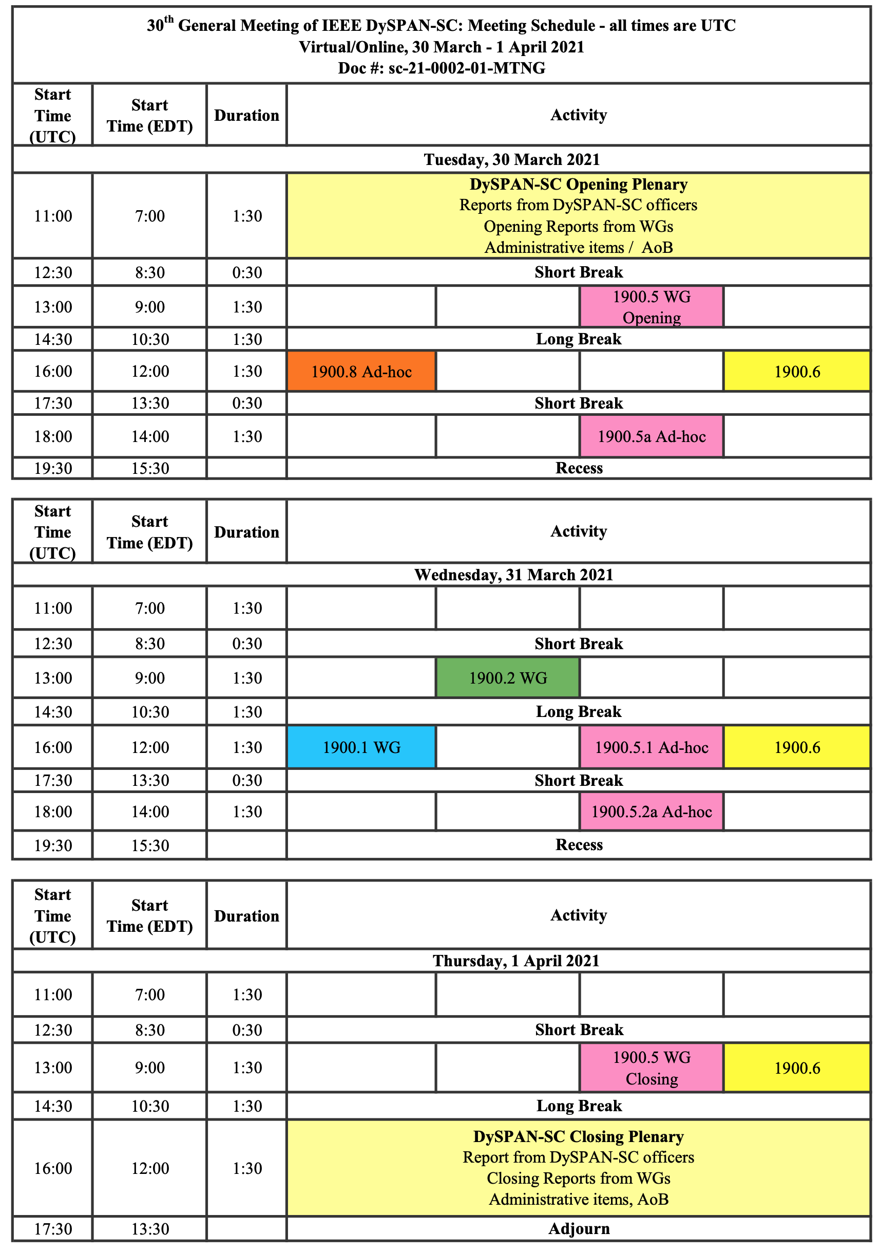
1900.5 Meeting Planning and Review
WG meetings
This week
4/8/21 1100 P1900.5.1
4/16/21 1300 P1900.5a Ad-hoc
5/7/21 0800 P1900.5 WG
5/14/21 1300 P1900.5a Ad-hoc

Slide 26
1900.5 Adjourn

