Slide 1
IEEE 1900.5 Contribution
Author’s Name | Affiliation | Address | Phone | email
Tony Rennier | Foundry Inc. | Severn, MD | 301.485.9679 | trennier@foundryinc.com
Document Title: Agenda, Admin and Chair’s Notes for IEEE 1900.5 WG Meeting on 05-07 March 2019
Document Date: 05-07 March 2019
Document No: 5-19-0011-00-agen
Notice: This document has been prepared to assist IEEE DySPAN-SC and its Working Groups. It is offered as a basis for discussion and is not binding on the contributing individual(s) or organization(s). The material in this document is subject to change in form and content after further study. The contributor(s) reserve(s) the right to add, amend or withdraw material contained herein.
Release: The contributor grants a free, irrevocable license to the IEEE to incorporate material contained in this contribution, and any modifications thereof, in the creation of an IEEE Standards publication; to copyright in the IEEE’s name any IEEE Standards publication even though it may include portions of this contribution; and at the IEEE’s sole discretion to permit others to reproduce in whole or in part the resulting IEEE Standards publication. The contributor also acknowledges and accepts that this contribution may be made public by IEEE DySPAN-SC.
Patent Policy and Procedures: The contributor is familiar with the IEEE Patent Policy and Procedures including the statement "IEEE standards may include the known use of patent(s), including patent applications, provided the IEEE receives assurance from the patent holder or applicant with respect to patents essential for compliance with both mandatory and optional portions of the standard." Early disclosure to IEEE DySPAN-SC and its Working Groups of patent information that might be relevant to the standard is essential to reduce the possibility for delays in the development process and increase the likelihood thatthe draft publication will be approved for publication. Please notify the Chair <trennier@foundryinc.com> as early as possible, in written or electronic form, if patented technology (or technology under patent application) might be incorporated into a draft standard being developed within the IEEE DySPAN-SC Committee. If you have questions, contact the IEEE Patent Committee Administrator at < patcom@ieee.org >.

Slide 2
Electronic Meeting Details
IEEE 1900.5 Meetings
Hosted by Tony Rennier
Wednesday 12:00 am | 24 hours | (UTC-05:00) Eastern Time (US & Canada)
Occurs every day effective 2/27/2019 from 12:00 AM to 12:00 AM, (UTC-05:00) Eastern Time (US & Canada)
Meeting number: 624 724 824
Password: nfKJw7Jg
https://foundryinc.my.webex.com/foundryinc.my/j.php?MTID=m692e0f8e641247be995567a1addab5a4
Join by video system
Dial 624724824@foundryinc.my.webex.com
You can also dial 173.243.2.68 and enter your meeting number.
Join by phone
+1-510-338-9438 USA Toll
Access code: 624 724 824
Notes:
September 22, 2008
2

Slide 3
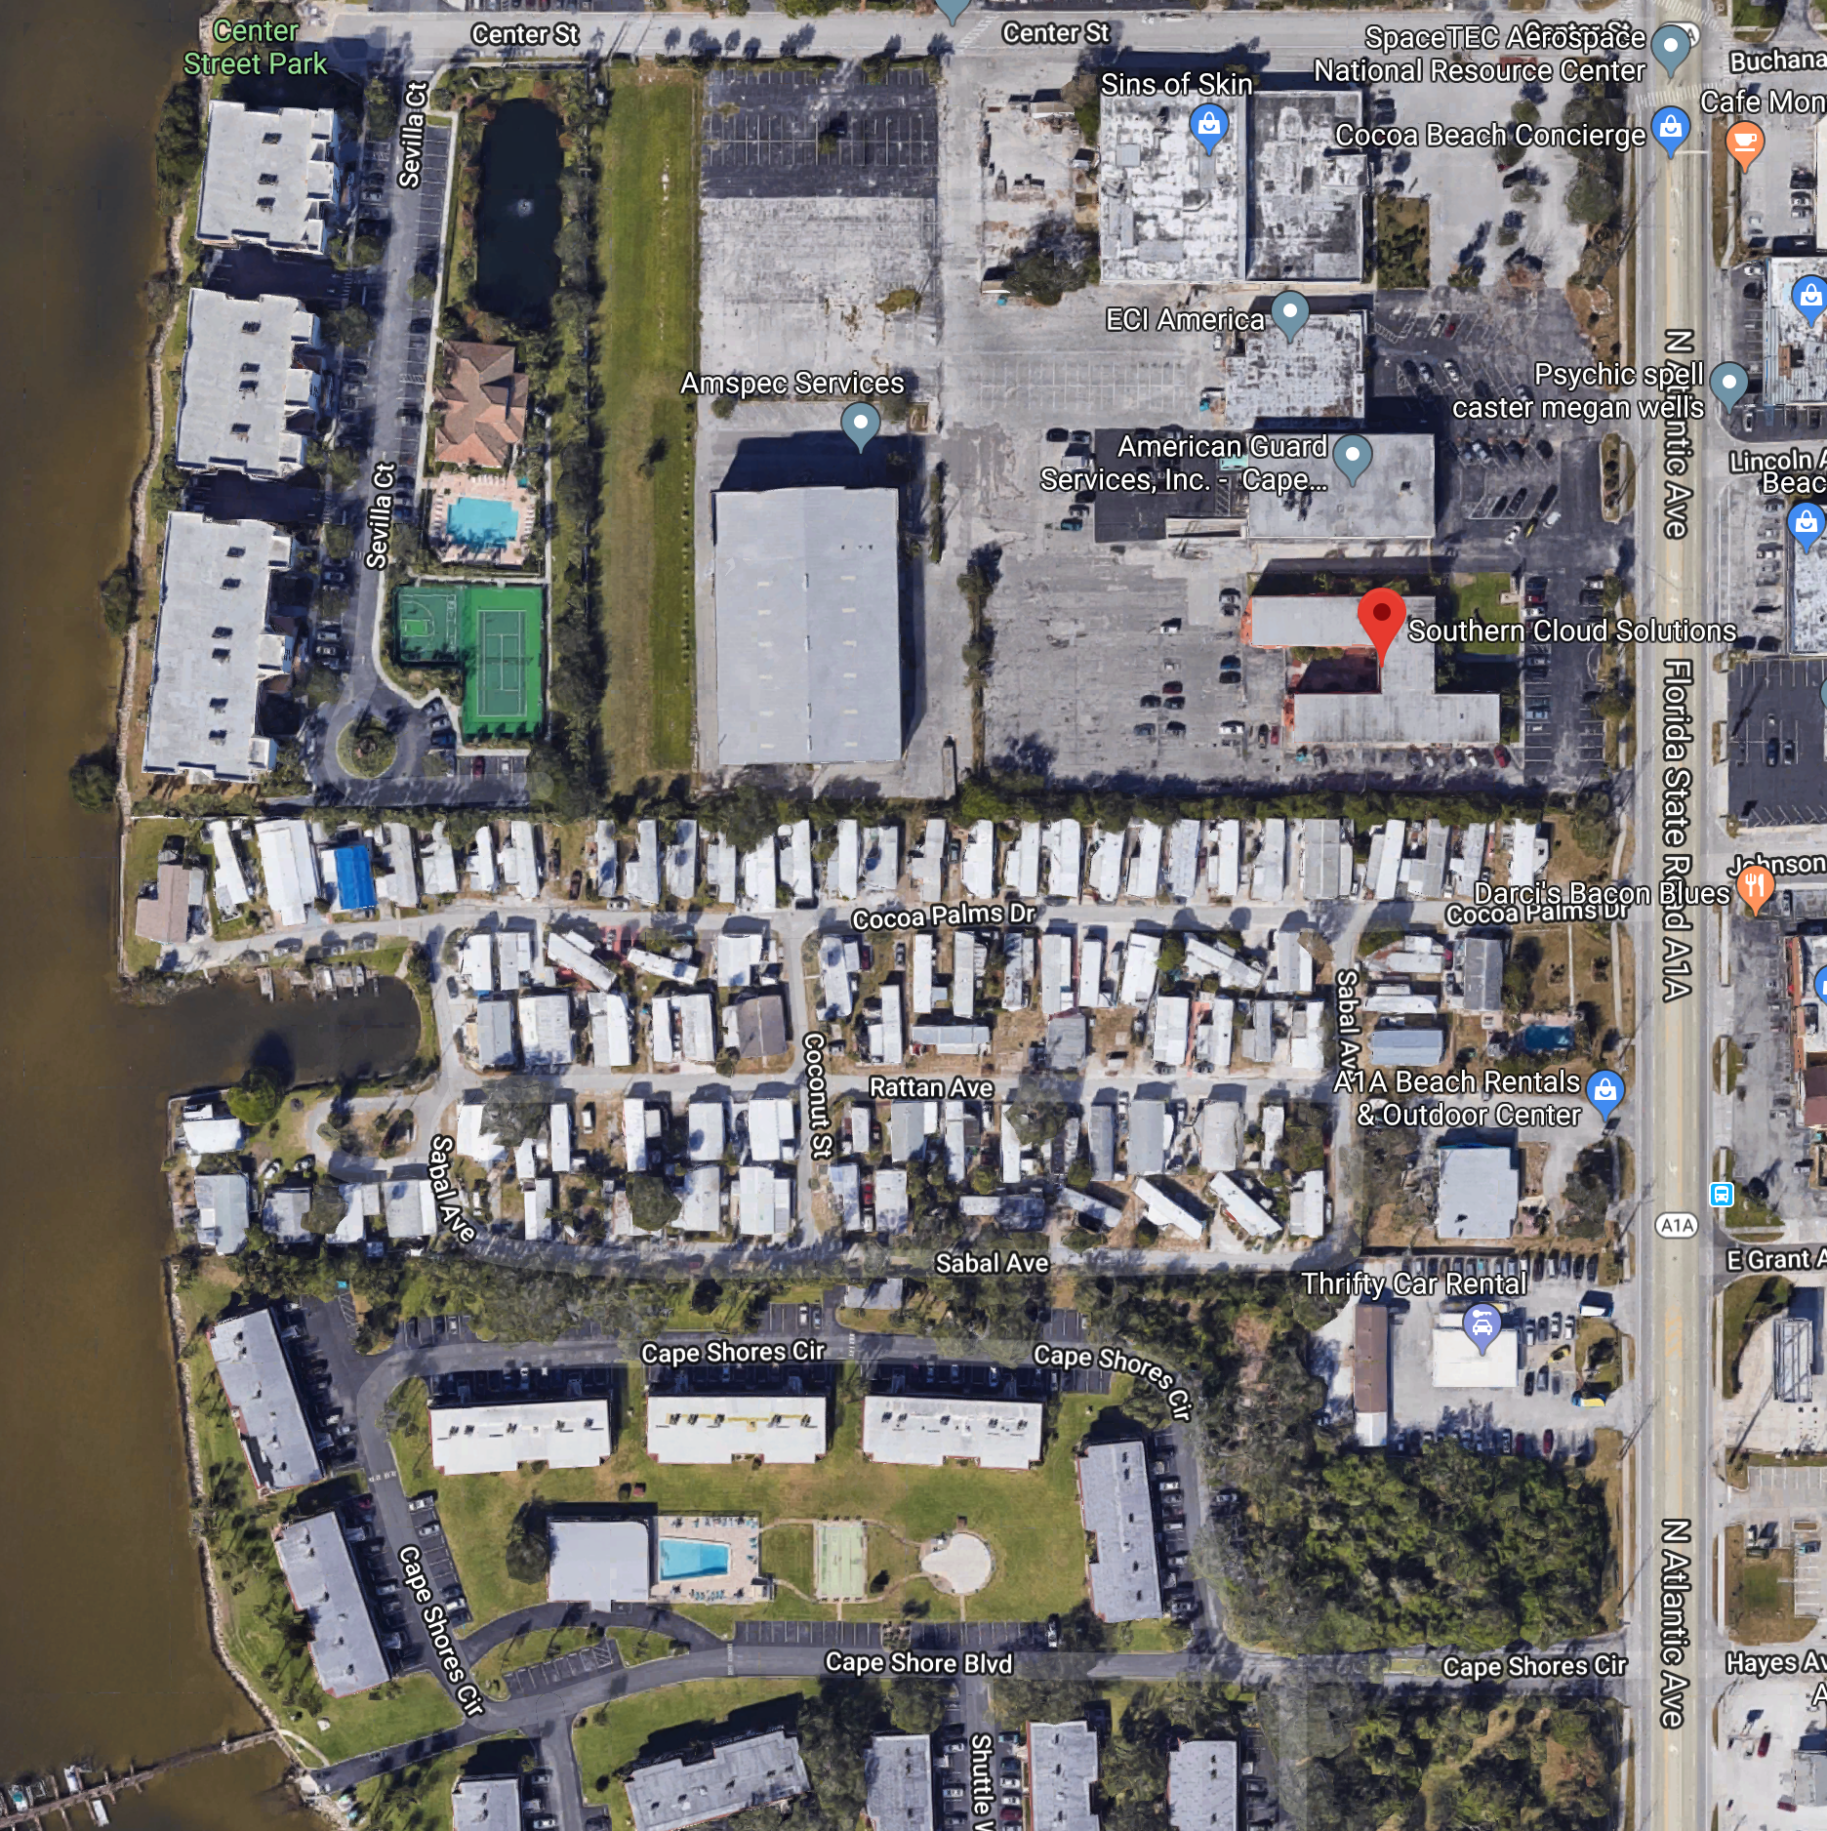
Face to Face Details
Address:
Southern Cloud Solutions
7001 N Atlantic Ave. Suite 200
Cape Canaveral, FL 32920
Phone: (508) 341-3258
Notes:
Meeting is room on 2nd floor at the Southern Cloud offices.
Small groups are easy to plan on the fly for the food, etc.
We will have some breakfast items available each morning.
Southern Cloud

Slide 4
Rules
IEEE DySPAN-SC rules
  http://standards.ieee.org/about/sasb/audcom/pnp/DySPAN_SC.pdf
IEEE 1900.5 WG rules
  http://grouper.ieee.org/groups/dyspan/files/individual-WG-PnPs.pdf
Roberts Rules (latest edition) as needed…
Note – Rules changed approved effective 1/1/19
  https://mentor.ieee.org/1900.5/dcn/18/5-18-0037-00-polp-draft-policies-and-procedures-for-ieee-dyspan-sc-working-groups.doc

Slide 5
Current Membership
3/5/19 | 3/7/19 | WG Status | First Name | Last Name | Affiliation
 |  | 15 | Total
 |  | Member | Thor | Berglie | SSC
 |  | Member | Carlos | Caicedo | Syracuse University (Secretary)
 |  | Member | David | Chester | Harris
 |  | Member | Lynn | Grande | Self
 |  | Member | Colby | Harper | Pathfinder Wireless Corp
 |  | Member | Mitch | Kokar | VIStology & Northeastern University
 |  | Member | Alex | Lackpour | Lockheed
 |  | Member | Li | Li | Communications Research Centre Canada
 |  | Member | Jakub | Moskal | Vistology
 |  | Member | V | Prasad | Wireless and Mobile Communication, TU Delft
 |  | Member | Tony | Rennier | Foundry Inc (Chair)
 |  | Memer | Reinhard | Schrage | SchrageConsult
 |  | Member | Mat | Sherman | BAE Systems (Former Chair)
 |  | Member | John | Stine | MITRE
 |  | Member | Darcy | Swain-Walsh | MITRE (Vice Chair)
 |  | Participant | Stephen | Berger | TEM Consulting
 |  | Participant | Mark | Birchler | Roberson & Associates
 |  | Participant | Nick | Buris | Nebens
 |  | Participant | Jesse | Caufield | Keybridge
 |  | Participant | Yang Yi | Chen | Northeastern University
 |  | Participant | Andy | Clegg | Google
 |  | Participant | Paul | Falvell | CGI Group Inc.
 |  | Participant | Tim | Fulford | Airbus Defence & Space
 |  | Participant | Omar | Granados | SWRI
 |  | Participant | Dustan | Hellwig | Chesapeake Technology International
 |  | Participant | Mark | Johnson | Aerospace Corp.
 |  | Participant | Shawn | Kern | SRI International
 |  | Participant | Nilesh | Khamberkar | Univ. of Buffalo
 |  | Participant | Catherine | King | MITRE
 |  | Participant | Andy | Lee | Google
 |  | Participant | Mike | Lynch | IEEE SA Liason to ITU-R
 |  | Participant | Mark | McHenry | Shared Spectrum Company
 |  | Participant | Joe | Messner | BAE Systems
 |  | Participant | Paul | Nikolich | Self
 |  | Participant | Karthikeyan | Ovuraj | Twilight Ventures
 |  | Participant | Luzango | Pangani | CSIR Institute
 |  | Participant | Saeedeh | Parsaeefard | ITRC
 |  | Participant | Yuriy | Posherstnik | US Army RDECOM CERDEC
 |  | Participant | Lee | Pucker | Wireless Innovation Forum
 |  | Participant | Ranga | Reddy | BAE Systems
 |  | Participant | Sam | Schmitz | Mitre
 |  | Participant | Charles | Sheehe | NASA
 |  | Participant | Nicholas | Sherman | BAE Systems
 |  | Participant | Kael | Stilp | MITRE
 |  | Participant | Spenser | Vogel | SWRI
 |  | Participant | Harris | Zebrowitz | DISA/DSO - MITRE
Quorum 3/5?
Quorum 3/7?
Quorum > ½ membership (8 members)
2 meetings to get in, 2 meetings to get out

Slide 6
Draft Agenda
3/5/19 11:00-12:30 all tine EST (UTC-5)
Administrivia
  Roll Call / Quorum Check
  Approve Agenda
  Patent slides / Notes on status
  Approval of recent minutes
Status on 1900.5.1
Status on 1900.5.2a
Status on Architecture / 1900.5 Revision
Review of other 1900 activities (1900.1, Leadership meeting etc.)
1900.5 marketing inputs
1900.5 meeting planning and review
AoB
Adjourn
Ad Hoc sessions (Review and planning for subgroup activities as needed)
  1900.5.2a - 3/5 2:00 pm and 4:00 pm
  1900.5 Architecture – 3/6 9:00 am, 3/7 9:00 am
  1900.5.1 – 3/6 11:00 am and 2:00 pm
Any modifications?
Notes:
September 22, 2008
6

Slide 7
Approval of Agenda
Motion to approve Agenda contained in Doc #:5-19-0011-00-agen
Mover:
Second:
Vote:

Slide 8
Instructions for the WG Chair
The IEEE-SA strongly recommends that at each WG meeting the chair or a designee:
  Show slides #1 through #4 of this presentation
  Advise the WG attendees that:
    IEEE’s patent policy is described in Clause 6 of the IEEE-SA Standards Board Bylaws;
    Early identification of patent claims which may be essential for the use of standards under development is strongly encouraged;
    There may be Essential Patent Claims of which IEEE is not aware. Additionally, neither IEEE, the WG, nor the WG Chair can ensure the accuracy or completeness of any assurance or whether any such assurance is, in fact, of a Patent Claim that is essential for the use of the standard under development.
  Instruct the WG Secretary to record in the minutes of the relevant WG meeting:
    That the foregoing information was provided and that slides 1 through 4 (and this slide 0, if applicable) were shown;
    That the chair or designee provided an opportunity for participants to identify patent claim(s)/patent application claim(s) and/or the holder of patent claim(s)/patent application claim(s) of which the participant is personally aware and that may be essential for the use of that standard
    Any responses that were given, specifically the patent claim(s)/patent application claim(s) and/or the holder of the patent claim(s)/patent application claim(s) that were identified (if any) and by whom.
  The WG Chair shall ensure that a request is made to any identified holders of potential essential patent claim(s) to complete and submit a Letter of Assurance.
  It is recommended that the WG Chair review the guidance in IEEE-SA Standards Board Operations Manual 6.3.5 and in FAQs 14 and 15 on inclusion of potential Essential Patent Claims by incorporation or by reference.
  Note: WG includes Working Groups, Task Groups, and other standards-developing committees with a PAR approved by the IEEE-SA Standards Board.
(Optional to be shown)

Slide 9
Participants have a duty to inform the IEEE
  Participants shall inform the IEEE (or cause the IEEE to be informed) of the identity of each holder of any potential Essential Patent Claims of which they are personally aware if the claims are owned or controlled by the participant or the entity the participant is from, employed by, or otherwise represents
  Participants should inform the IEEE (or cause the IEEE to be informed) of the identity of any other holders of potential Essential Patent Claims
  Early identification of holders of potential Essential Patent Claims is encouraged
Slide #1

Slide 10
Ways to inform IEEE
Cause an LOA to be submitted to the IEEE-SA (patcom@ieee.org); or
Provide the chair of this group with the identity of the holder(s) of any and all such claims as soon as possible; or
Speak up now and respond to this Call for Potentially Essential Patents
If anyone in this meeting is personally aware of the holder of any patent claims that are potentially essential to implementation of the proposed standard(s) under consideration by this group and that are not already the subject of an Accepted Letter of Assurance, please respond at this time by providing relevant information to the WG Chair
Slide #2

Slide 11
Other guidelines for IEEE WG meetings
All IEEE-SA standards meetings shall be conducted in compliance with all applicable laws, including antitrust and competition laws.
  Don’t discuss the interpretation, validity, or essentiality of patents/patent claims.
  Don’t discuss specific license rates, terms, or conditions.
    Relative costs of different technical approaches that include relative costs of patent licensing terms may be discussed in standards development meetings.
      Technical considerations remain the primary focus
  Don’t discuss or engage in the fixing of product prices, allocation of customers, or division of sales markets.
  Don’t discuss the status or substance of ongoing or threatened litigation.
  Don’t be silent if inappropriate topics are discussed … do formally object.
---------------------------------------------------------------
For more details, see IEEE-SA Standards Board Operations Manual, clause 5.3.10 and
Antitrust and Competition Policy: What You Need to Know at http://standards.ieee.org/develop/policies/antitrust.pdf
Slide #3

Slide 12
Patent-related information
  The patent policy and the procedures used to execute that policy are documented in the:
    IEEE-SA Standards Board Bylaws (http://standards.ieee.org/develop/policies/bylaws/sect6-7.html#6)
    IEEE-SA Standards Board Operations Manual (http://standards.ieee.org/develop/policies/opman/sect6.html#6.3)
  Material about the patent policy is available at
  http://standards.ieee.org/about/sasb/patcom/materials.html
  If you have questions, contact the IEEE-SA Standards Board Patent Committee Administrator at patcom@ieee.org
Slide #4

Slide 13
Minutes for approval
Motion to approve 2/1/19 WG minutes contained in Doc #:??
Mover:
Second (shaker):
Vote:

Slide 14
Current Status for 1900.5.1
1900.5.1 status
  1/18/19
    SHACL Review
      Possible issue combining RIF with OWL; can’t import Turtle
    Assessing examples from John
      More coming from John by the next meeting...
    Active ballot due 2/15/19
  2/1/19
    Used John’s Dec example to make RIF examples
    Having ad-hoc today

Slide 15
Working Schedule for 1900.5.1
Full review of drafting 3/17 √
First WG Ballot 2/19 (2/15/19 deadline)
WG Recirc 4/19
Sponsor Ballot 6/19 (Prior to PAR Extension)
Sponsor Recirc 9/19
Sponsor Recirc 2 12/19
Submit to REVCOM 3/20
Proposed Update
Requires PAR Extension 6/19

Slide 16
Current Status for 1900.5.2a
1900.5.2a status
  1/18/19
    MITRE team working on schemas, JAVA conversion to JSON first then XML
      Planning to have some early release prior to next monthly
    Still looking at correctness of current schema
      Noted some small tweaks between JSON and XML schema
  2/1/19
    John submitted draft document
      Uses Java to define structure and the rules
      Is addressing some concerns (constructs and naming)
    Carlos working with XML and matching 1900.5.2
      Some corrections need to be made
    Looking toward a mutual verification at March meeting

Slide 17
Current Architecture Status
Architecture Status
  1/18/19
    PAR submitted by Mat
    Ad-hoc planned for 1/23/19 9-11 am
  2/1/19
    Ad-hoc held 1/25/19 1-3pm EST
    Add
      Identify business process (and definition) as a higher org than use case.
      Use of Evidence that is not Policy i.e. Spectrum Sensor outputs
      Machine Learning
    Next ad-hoc is planned for 2/22/19 1-2:30pm EST

Slide 18
Other DySPAN-SC Activities
Leadership meetings
  2/1/19
    Discussion for March meeting (1900.5 +1)
    .1 Definitions going to hibernation
    .2 NTR (most popular)
    .4 Hibernation
    .5 Awesome
    .6 Kicking along
    .7 Hibernation
    Finances good
Machine Learning Study Group
  1/18/19
    Focus: Should we change anything to facilitate the advances in ML into cognitive radio/network design/operations
    May go inactive…
  2/1/19
    Mat – combine with 1900.5 architecture?

Slide 19
1900.5 Marketing Inputs
1/18/19
  NSC opportunities
    Some progress on .2
    More difficult with .1
2/1/19
  NTR

Slide 20
1900.5 Meeting Planning and Review
Face to Face in March for DySPAN-SC
  Cape Canaveral, FL
  3/5-7/19
Next WG electronic only meeting
  2:30 PM EDT (UTC-4) on 4/5/2019

Slide 21
AoB
  1/18/19
    Need to close the 1900.5.1 ballot 1 week prior to the F2F 2/25/19
  2/1/19
    None

Slide 22
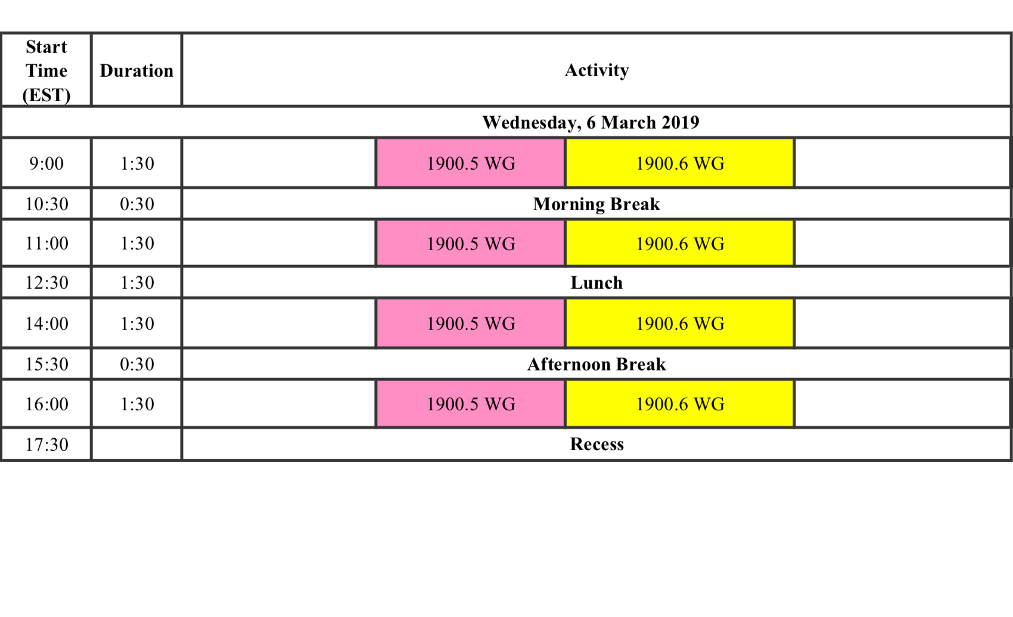
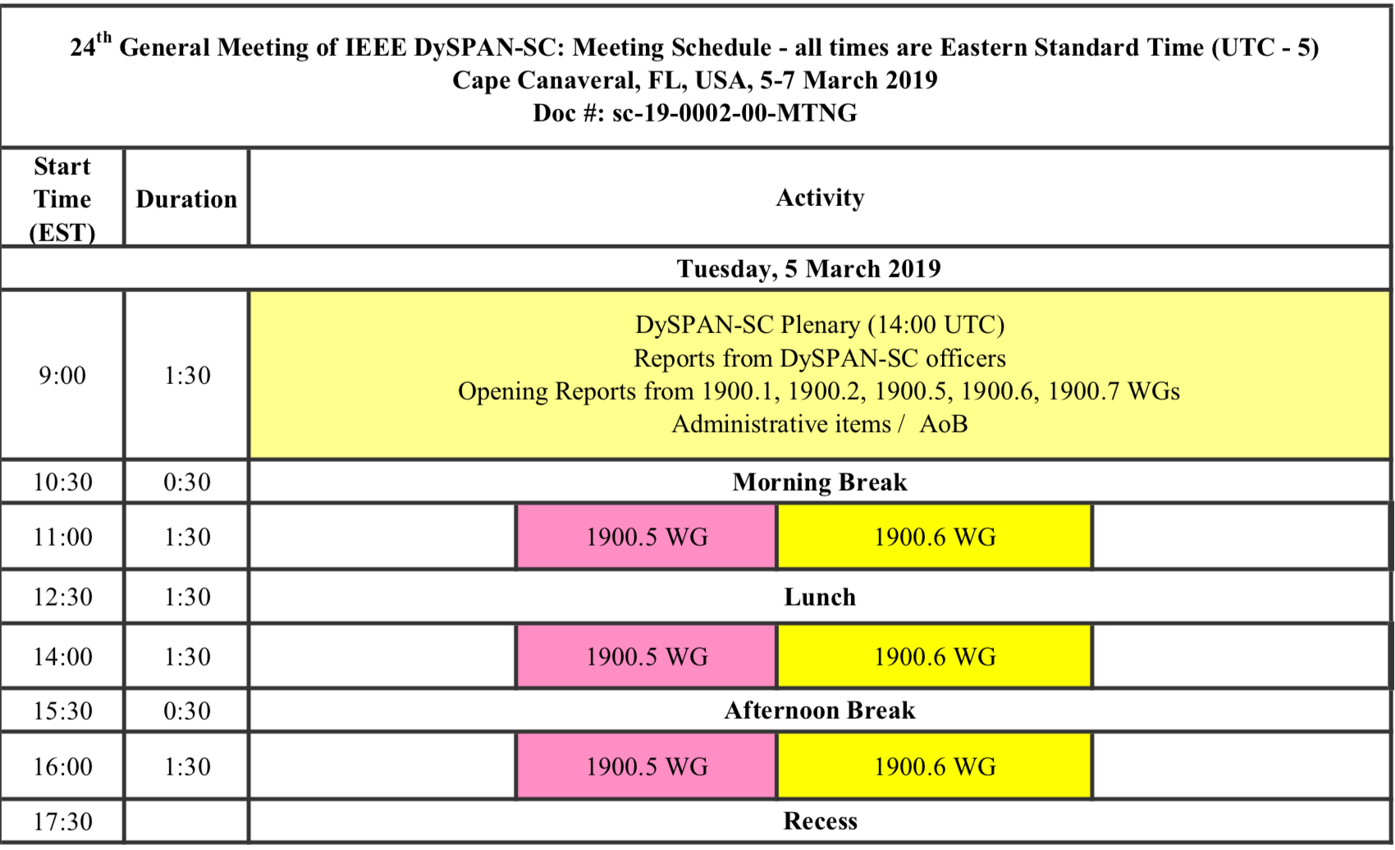
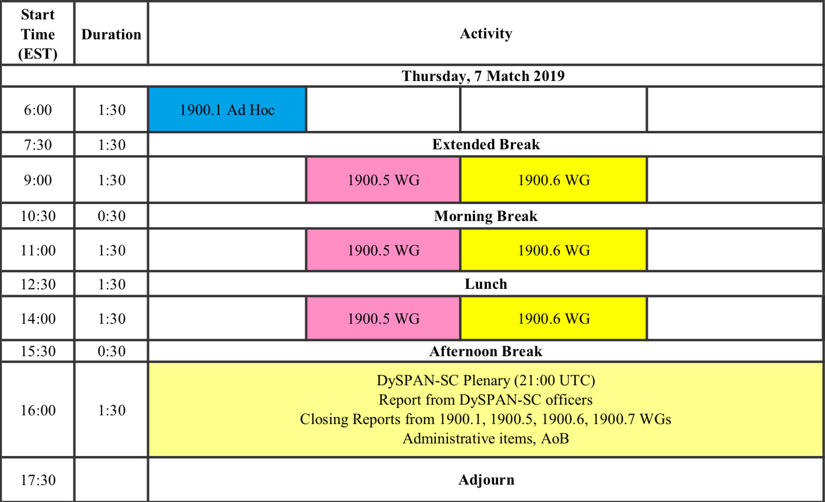
Ad Hoc Sessions
1900.5 Arch
1900.5.1
1900.5.1
1900.5.2a
1900.5.2a
1900.5 Arch

