Slide 1
Region 5 PACE Program
By Diane Bowen Collier

Slide 2
What is PACE?
PACE stands for Professional Activities Committee for Engineers.
Professional activities are aimed at elevating the professional status of technical professionals.
  These activities focus on building the knowledge and skills of members of your Section and its Chapters, Student Branches, and Affinity Groups in the non-technical, or professional domain.
  Professional activities also promote the profession to the public and youth.
PACE was an IEEE-USA committee. In prior years IEEE-USA provided funding to Regions 1-6 to support PACE activities.
In this first year IEEE-USA is not contributing PACE fund to the Regions. Region 5 is continuing the program and has budgeted funds to support it.

Slide 3
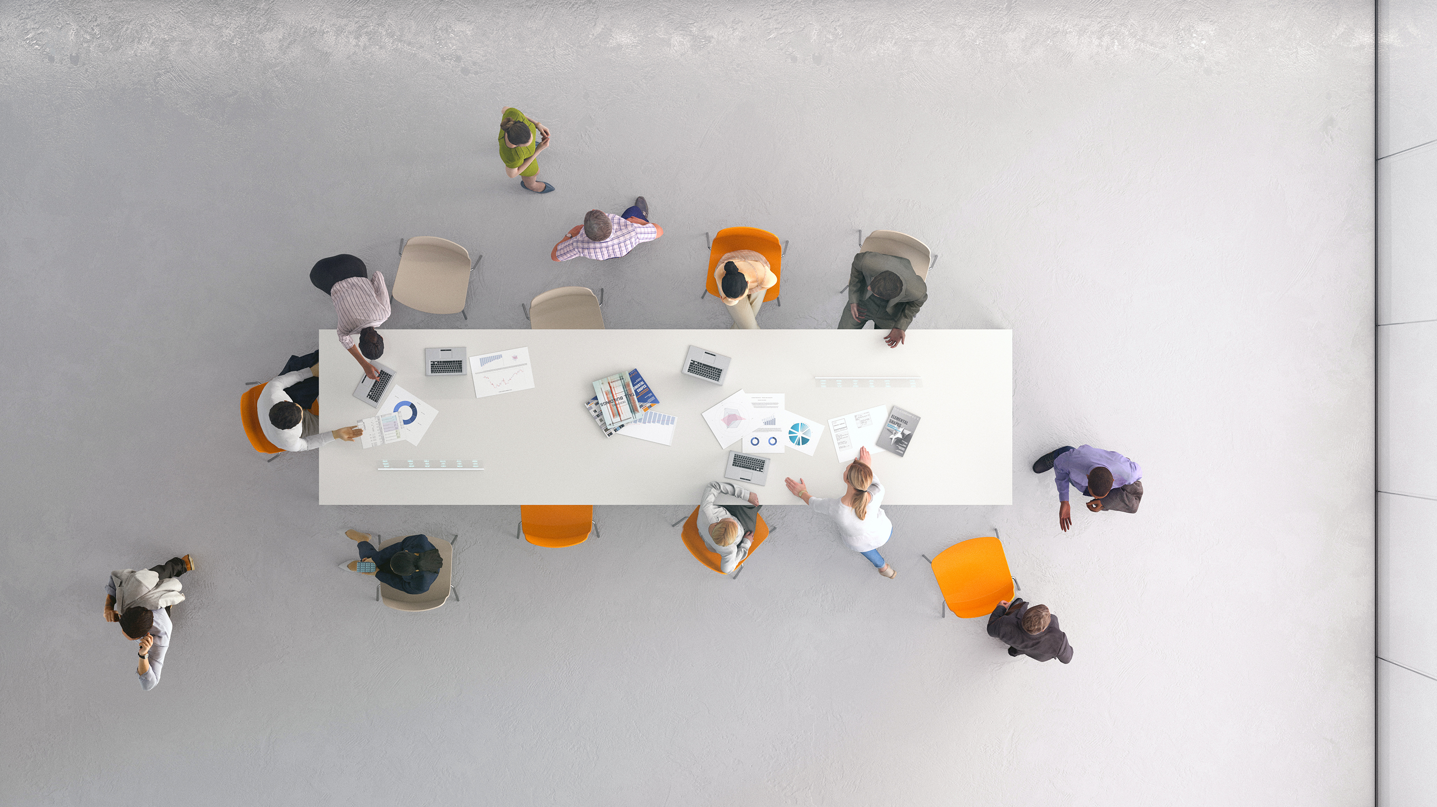
Types of programs
Careers and Jobs – Workshops
  Resume, Interviewing
Business Skills non-technical
Soft skills
Networking
Humanitarian
SPAx
K-12 STEM/STEAM
Public Outreach

Slide 4





Resources – Youth
STEM or STEAM
https://www.firstinspires.org/robotics/frc
https://www.tryengineering.org
https://ieeeusa.org/volunteers/youth-resources/
https://discovere.org/volunteer/
https://www.photonicssociety.org/education-careers/pre-university-outreach-resources
https://www.mathcounts.org/

Slide 5
Resources Member and Student Members/Networking
Start an Employment Network https://ieeeusa.org/careers/employment/networks/
Teacher-in-Service Training (TISP)
https://tryengineering.org/engineering-lesson-plan-toolkit/
IEEE Humanitarian Activities Committee (project funding available)
https://hac.ieee.org/
SPAx – Student Professional Awareness
https://students.ieee.org/spax/spax-events/

Slide 6

Member and Student Members/Networking
Ideas
Making Social Networks work for you
Ethics presentation – supports PE registration
Meet the Fellows networking event
IEEE-USA salary survey overview
Partner with PMI (Project Management Institute)
Financial Planning Seminar

Slide 7
Family Programs
Include your family in your IEEE family
Hold a “Bring the Kids to IEEE Event”
Tours – Science Museum, Industry,
IEEE PES RES for kids https://cmte.ieee.org/pes-csac/pes-res-for-kids/
Environmental Projects – Area Cleanup - example Fort Worth PES Trinity River Cleanup Day

Slide 8
How to request PACE funds
Cha ching
Submit PACE form requesting up to $1000
OU submitting request must have contributed twice as much as requested
PACE request form will be added to R5 website
Notify me of planned event to reserve funds
Provide completed request (includes vTools meeting report) to
dbcollier@ymail.com

