Slide 1
Product Safety Requirements in the US
by Charles D. Goertz

Slide 2
Agenda
Introduction
The history of safety agencies in the US
Work place safety laws
National recognized testing laboratories (NRTL)
Application of the National Electric Code (NEC)
The use of standards

Slide 3
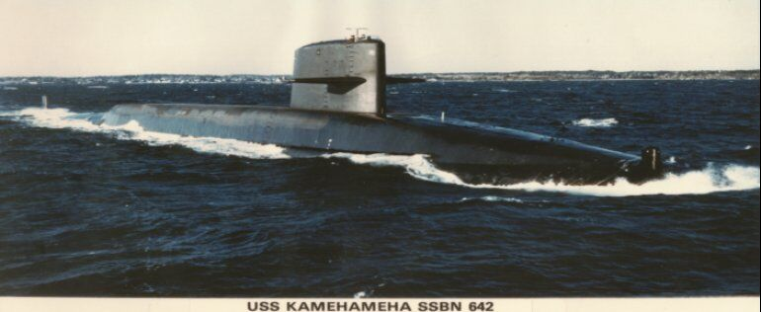
Introduction

Slide 4
Oldest safety agency in U.S. - UL
How did UL start
Fire Prevention
Insurance companies in Chicago had to pay for more fire related loses when electric lighting was being introduced.
In 1894, a fire inspector from Boston was hired to investigate the fires, William Henry Merill
What he found was PAPER was being used as the insulation material in the fixtures
Mr. Merill performed flammability testing on other insulation material
If you bought light fixtures with the material that passed his testing, you got a break on your insurance.
The name underwriters Laboratory (UL) because the financing was done through insurance companies, underwriters.

Slide 5
Oldest safety agency in U.S. - UL
Terms used by UL
What term did UL use for their approved products?
Listed
Factory inspections
Unannounced factory inspections
Marks on power cords

Slide 6
History of OSHA
Before OSHA
Before the 1970s, there was very little legislation on safety in the workplace
In 1970 there were over 14,000 recorded fatalities due to work related accident and injuries.
President Lyndon Johnson proposed legislation for work place safety

Slide 7
History of OSHA
After 1970
President Richard Nixon signed the Occupational Safety and Health Act in December of 1970. The law officially went into effect in April of 1971.
Big business and Congress were adversaries since the regulations could hurt economic activity
President Jimmy Carter assigned DR. Bingham as the Assistant Secretary of Labor. She discarded trivial laws and clarified necessary standards to manage serious health and safety situation.
In 2009, there were less than 5,000 fatalities recorded in the workplace.

Slide 8
Responsibility of OSHA
OSHA is Responsible for work place safety
OSHA has the authority to visit and inspect any workplace
Will OSHA visit an office work place
Almost never
Will OSHA visit a manufacturing work place
There is a chance
Will OSHA visit a construction site
It is almost assured that OSHA will visit.

Slide 9
National Recognized Testing Laboratories (NRTL)
History of NRTLs
In 1973, DOL promulgated regulation pursuant to the Occupational Safety and Health Act intended to establish procedures for the certification of NRTLs.
The regulations were never implemented.
DOL did issue general standards governing the testing of equipment and in those standards suggested that such work could only be done by UL and FM.
MET filed suit in 1982 alleging violation of its equal protection, due process, and statutory rights and seeking to force DOL to implement workable NRTL accreditation procedures and to eliminate the provisions suggesting that UL and FM were uniquely qualified as NRTLs. The parties reached a settlement in which DOL agreed to delete references to UL and FM and to establish procedures by which other laboratories could obtain recognition as NRTLs.
DOL did not establish such procedures.

Slide 10
National Recognized Testing Laboratories (NRTL)
MET filed suit again in 1987 seeking to enforce the terms of the settlement.
DOL was allowed to keep in their regulations “UL and FM” as allowable agencies until 1993 so that there would be recognized NRTLs in their regulations.
MET labs had to petition for a summary judgement to force the agreement.
In 1995, one article of the summary judgement was:
“That Defendant Department of Labor is Ordered to remove all references to UL and FM from regulations or standards, expedite review of UL and FM's application for certification, and deny temporary certification to any new procedures or facilities of UL or FM”
Met labs was awarded as being the first NRTL

Slide 11
National Recognized Testing Laboratories (NRTL)
OSHA standards for safety
AAMI ES60601-1:2005/(R)2012 | Medical Electrical Equipment - Part 1: General Requirements for Basic Safety and Essential Performance (with amendments)
ANSI C37.44 | Distribution Oil Cutouts and Fuse Links
ANSI FM 3265 | Spark Detection and Extinguishing Systems
ANSI Z8.1 | Commercial Laundry and Drycleaning Equipment and Operations - Safety Requirements
ANSI Z21.89 | Outdoor Cooking Specialty Gas Appliances
ANSI Z83.26 | Gas-Fired Outdoor Infrared Patio Heaters
ASME A17.5 | Elevators and Escalator Electrical Equipment
BHMA A156.3 | Exit Devices
CGA G-2.1 / ANSI K61.1 | Storage and Handling of Anhydrous Ammonia (CGA G-2.1)
CPLSO-14-2016 | Crane Insulators
CSA/AM Z21.1 | Household Cooking Gas Appliances
CSA/AM Z21.5.1 | Gas Clothes Dryers-Type 1

Slide 12
National Recognized Testing Laboratories (NRTL)
OSHA standards for safety
CSA/AM Z21.5.2 | Gas Clothes Dryers-Type 2
CSA/AM Z21.10.1 | Gas Water Heaters-Automatic Storage Type Water Heaters with Inputs of 70,000 Btu Per Hour or Less
CSA/AM Z21.10.3 | Water Heaters-Circulating Tank, Instantaneous and Large Automatic Storage Type Water Heaters
CSA/AM Z21.11.2 | Gas-Fired Room Heaters-Unvented Room Heaters
CSA/AM Z21.12 | Draft Hoods
CSA/AM Z21.13 | Gas-Fired Low-Pressure Steam and Hot Water Heating Boilers
CSA/AM Z21.15 | Manually Operated Gas Valves
CSA/AM Z21.17 | Domestic Gas Conversion Burners
CSA/AM Z21.18 | Gas Appliance Pressure Regulators
CSA/AM Z21.19 | Refrigerators Using Gas Fuel
CSA/AM Z21.20 | Automatic Gas Ignition Systems and Components
CSA/AM Z21.21 | Automatic Valves for Gas Appliances
CSA/AM Z21.22 | Relief Valves and Automatic Gas Shutoff Devices for Hot Water Supply System
CSA/AM Z21.23 | Gas Appliance Thermostats
CSA/AM Z21.24 | Metal Connectors for Gas Appliances

Slide 13
National Recognized Testing Laboratories (NRTL)
OSHA standards for safety
There are 921 standards listed.
The entire list can be viewed at
https://www.osha.gov/nationally-recognized-testing-laboratory-program/list-standards

Slide 14
National Recognized Testing Laboratories (NRTL)
Authors of the standards
AAMI
ANSI
BHMA
CGA
CPLSO
CSA/AM
FM
IEEE
ISA
NEMA
NFPA
TIA
UL

Slide 15
National Recognized Testing Laboratory (NRTL)
How to become a NRTL
An application needs to be submitted to OSHA.
1.) It will include your expertise.
2.) A list of standards that you will want to use
3.) The test equipment that you have to test to the standards.
4.) Time to wait

Slide 16
National Recognized Testing Laboratory (NRTL)
List of NRTLs as of 2022
Applied Research Laboratories of South Florida, LLC, Miami, FL
Bay Area Compliance Laboratories, Sunnyvale, CA
Bureau Veritas Consumer Products Services, Inc. (BVCPS), Buffalo, NY
CSA Group Testing and Certification Inc., Ontario Canada
DEKRA Certification, Inc. Sterling VA
Eurofins Electrical and Electronic Testing NA, Inc. Baltimore MD
FM Approvals (FM), Norwood, MA
International Association of Plu0mbing and mechanical Officials EGS (IAPMO), Ontario, CA
Intertek Testing Services NA, Inc. (ITSNA), Arlington Heights, IL
LabTest Certification Inc., British Columbia, Canada
Nemko North America, Inc. (NNA), Carlsbad CA
NSF International (NSF), An Arbor, MI
QAI Laboratories, LTD (QAI), British Columbia, Canada
QPS Evaluation Services Inc., Toronto, Canada
SGS North America Inc. Suwanee, GA
Solar PTL, LLC, Tempe AZ
Southwest Research Institute, San Antonio, TX
TUV Rheinland of North America, Inc., Newtown CT
TUV SUD America Inc., Wakefield IL
TUV SUD Product Services GmBH , Munich Germany
Underwriter Laboratory Inc. Northbrook IL

Slide 17
National Recognized Testing Laboratory (NRTL)
Southwest Research Institute
Standard Number | Standard Title
UL 10A | Tin-Clad Fire Doors
UL 10B | Fire Tests of Door Assemblies
UL 155 | Tests of Fire Resistance of Vault and File Room Doors
UL 162 | Foam Equipment and Liquid Concentrates
UL 525 | Flame Arresters
UL 555 | Fire Dampers
UL 711 | Rating and Fire Testing of Fire Extinguishers
UL 1887 | Fire Test of Plastic Sprinkler Pipe for Flame and Smoke Characteristics
UL 2085 | Insulated Aboveground Tanks for Flammable and Combustible Liquids
UL 60950-1 | Information Technology Equipment - Safety - Part 1: General Requirements

Slide 18
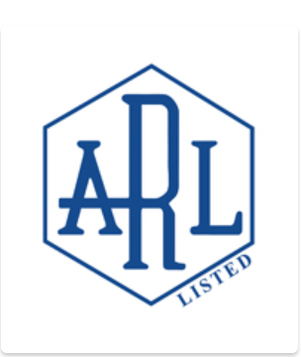
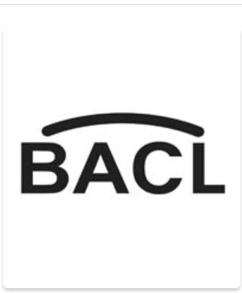

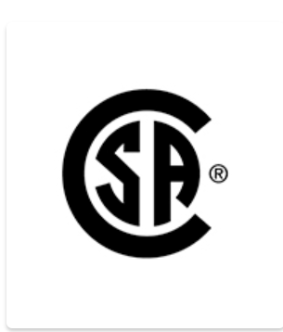
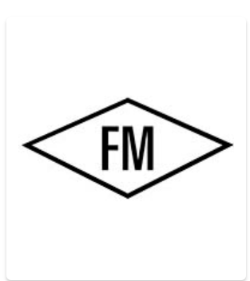
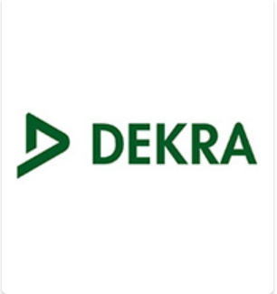
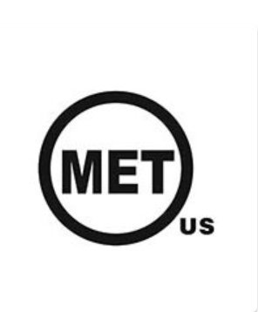

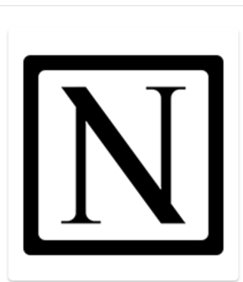
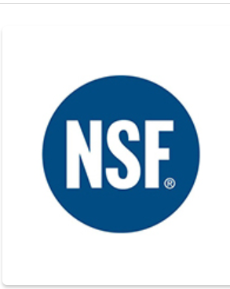
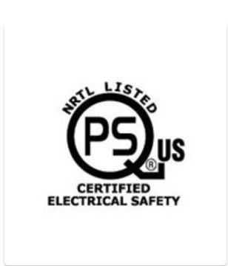
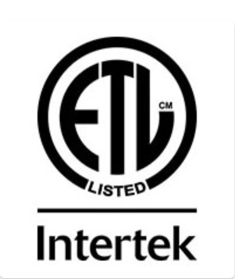



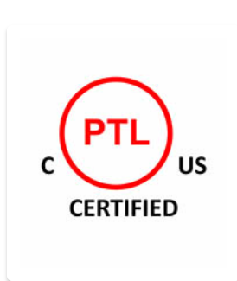
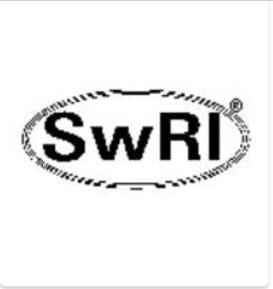


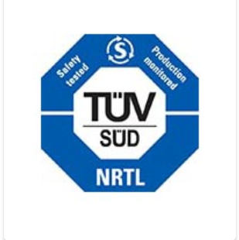
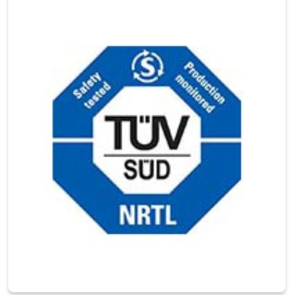
National Recognized Testing Laboratory (NRTL)
Registered Marks of the NRTLs

Slide 19




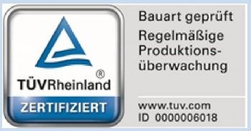
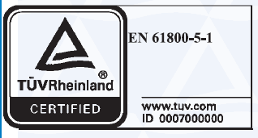
Test Marks
Test Marks of TUV Rheinland

Slide 20
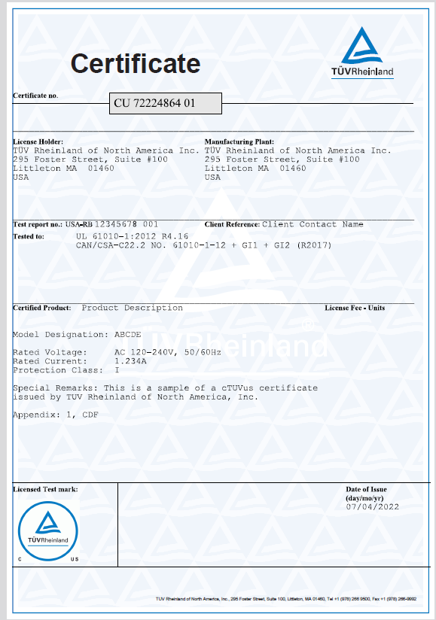
Test Marks – TUV license

Slide 21

Test marks

Slide 22
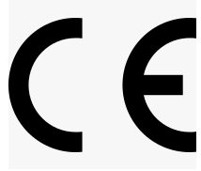
Test Marks
This is not a test mark

Slide 23
Approvals
OSHA requirements
Code of federal regulations
1910.303A
Approval. The conductors and equipment required or permitted by this subpart shall be acceptable only if approved, as defined in §1910.399.

Slide 24
National Electric Code
Approvals
90.7 Examination of Equipment for Safety. For specific items of equipment and materials referred to in this Code, examinations for safety made under standard conditions provide a basis for approval where the record is made generally available through promulgation by organizations properly equipped and qualified for experimental testing, inspections of the run of goods at factories, and service-value determination through field inspections. This avoids the necessity for repetition of examinations by different examiners, frequently with inadequate facilities for such work, and the confusion that would result from conflicting reports on the suitability of devices and materials examined for a given purpose.
It is the intent of this Code that factory-installed internal wiring or the construction of equipment need not be inspected at the time of installation of the equipment, except to detect alterations or damage, if the equipment has been listed by a qualified electrical testing laboratory that is recognized as having the facilities described in the preceding paragraph and that requires suitability for installation in accordance with this Code. Suitability shall be determined by application of requirements that are compatible with this Code.
110.2 Approval. The conductors and equipment required or
permitted by this Code shall be acceptable only if approved.

Slide 25
National Electric Code
Definitions
Approved. Acceptable to the authority having jurisdiction.
Authority Having Jurisdiction (AHJ). An organization, office, or individual responsible for enforcing
the requirements of a code or standard, or for approving equipment, materials, an installation, or a procedure.
Labeled. Equipment or materials to which has been attached a label, symbol, or other identifying mark
of an organization that is acceptable to the authority having jurisdiction and concerned with product evaluation,
that maintains periodic inspection of production of labeled equipment or materials, and by whose labeling
the manufacturer indicates compliance with appropriate standards or performance in a specified manner.

Slide 26
National Electric Code
Authority Having Jurisdiction
Four Cities
Fort Worth, Texas
Waco, Texas
Austin, Texas
Round Top, Texas

Slide 27
Standards
Scope
IEC 60335-1 HOUSEHOLD AND SIMILAR ELECTRICAL APPLIANCES –SAFETY
Part 1: General requirements
1 Scope
This International Standard deals with the safety of electrical appliances for household and similar purposes, their rated voltage being not more than 250 V for single-phase appliances and 480 V for other appliances.
NOTE 1 Battery-operated appliances and other d.c. supplied appliances are within the scope of this standard.
Appliances not intended for normal household use but which nevertheless may be a source of danger to the public, such as appliances intended to be used by laymen in shops, in light industry and on farms, are within the scope of this standard.
NOTE 2 Examples of such appliances are catering equipment, cleaning appliances for commercial use, and appliances for hairdressers.
As far as is practicable, this standard deals with the common hazards presented by appliances that are encountered by all persons in and around the home. However, in general, it does not take into account – persons (including children) whose
• physical, sensory or mental capabilities; or
• lack of experience and knowledge prevents them from using the appliance safely without supervision or instruction;
– children playing with the appliance.

Slide 28
Standards
Computers & Business Equipment Standards
UL 478 - standard for information-processing and business equipment.
IEC 380 - Safety of electrically energized office machines & IEC 435 Safety of Data Processing Equipment
IEC 950 - standard for information technology equipment including electrical business equipment
EN 60950 - standard for information technology equipment including electrical business equipment
UL 1950 - standard for information technology equipment including electrical business equipment

Slide 29
Standards
IEC 1010-1 Safety Requirements for Electrical Equipment for
Measurement, Control, and Laboratory Use - Part 1: General Requirements
UL 3101-1 Standard for Safety for Electrical Equipment for Laboratory Use
UL 3111-1 Standard for Safety for Electrical Measuring and Test Equipment
UL 3121-1 Standard for Safety for Process Control Equipment

Slide 30
Standards
IEC 1010-1 Safety requirements for electrical equipment for
measurement, control, and laboratory use - Part 1: General requirements
UL 61010A-1 UL Standard for Safety Electrical Equipment for Laboratory Use; Part 1: General Requirements
UL 61010B-1 UL Standard for Safety Electrical Measuring and Test Equipment; Part 1: General Requirements
UL 61010C-1 UL Standard for Safety Process Control Equipment

Slide 31
Standards
North America
CAN/CSA-C22.2 NO. 60950-1-07 ¨ UL 60950-1
CAN/CSA-C22.2 NO. 61010-1-12 ¨ ANSI/ISA-61010-1 (82.02.01) ¨ UL 61010-1
NMX-J-564/106-ANCE ♦ CSA C22.2 No. 253:20 ♦ UL 347

