Slide 1
A Brief History of Motorola with a Focus on
Semiconductors in the ‘70s, ‘80s & ‘90s
August 18, 2022
By
Michael G. Collins
Especially prepared for the
IEEE CTS CTCN and LM
Notes:
NETFLIX – Inventing Anna

Slide 2
Agenda
Early days – Galvin Manufacturing
Motorola Semiconductor
  Birth of Semiconductors
  Product Line
  Applications
  The split up

Slide 3
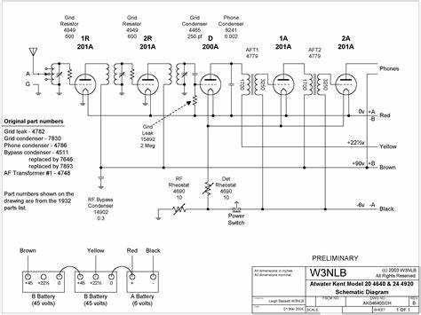
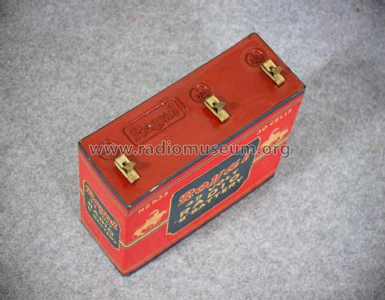
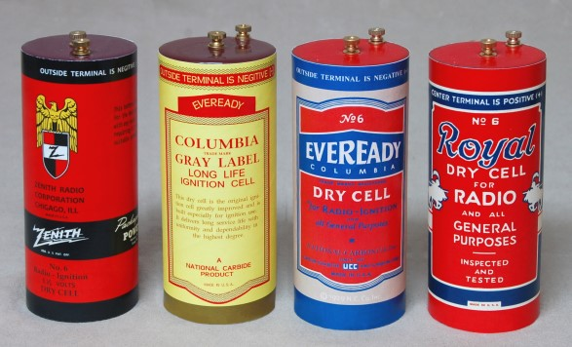
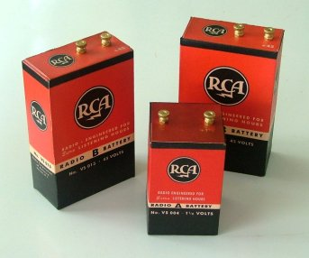
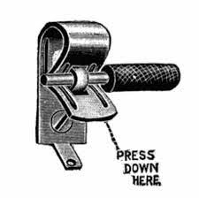
All early radios were battery powered
A Battery – 6 Volt
B Battery – 45V
Batteries were consumable. Needed to be replaced
Fahnestock clip

Slide 4
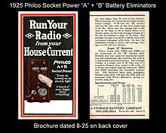
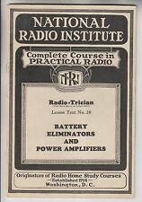
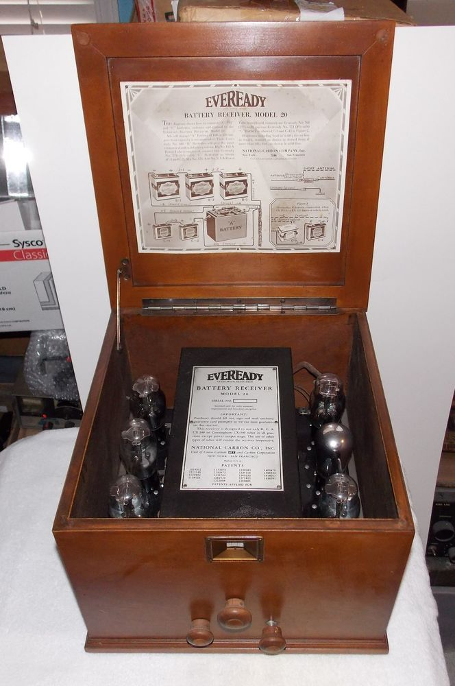
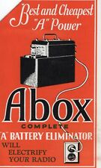
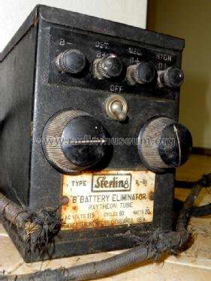
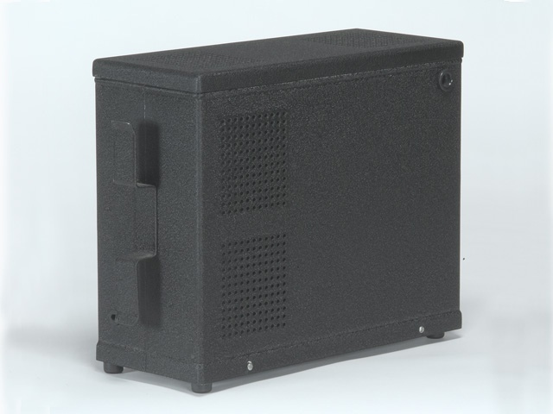
Battery Eliminators – No need to buy batteries
1920s ~ 35% of US households had electricity
As more US households had electricity, Battery Eliminators Became Popular
Battery Eliminators = Power Supply

Slide 5
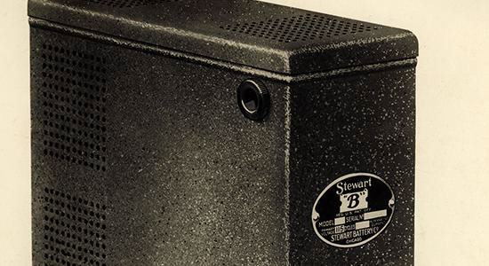
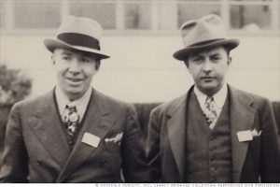
MOTOROLA – The Beginning
1928 Motorola started in Chicago, Illinois, as Galvin Manufacturing Corporation by building battery eliminators.
Brothers, Paul V. and Joseph E. Galvin, purchased the bankrupt Stewart Battery Company's battery-eliminator plans and manufacturing equipment at auction for $750.
Galvin Manufacturing started making Battery Eliminators
Radio manufacturers started to integrate power supplies into their radios and the market for Battery Eliminators soon became obsolete.
Galvin Manufacturing needed other products

Slide 6
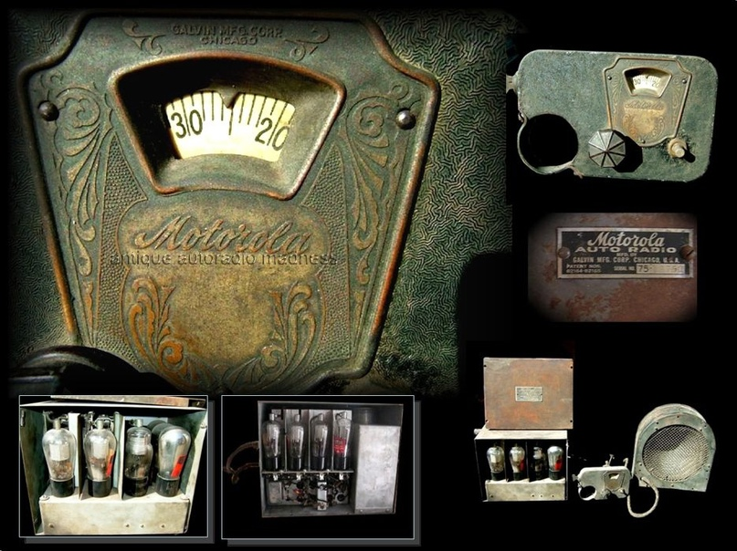
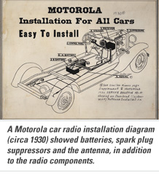

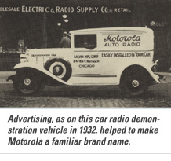
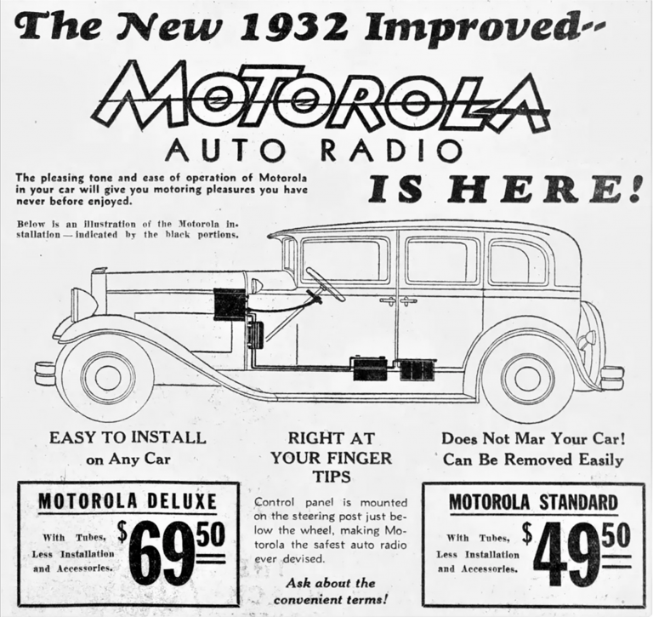
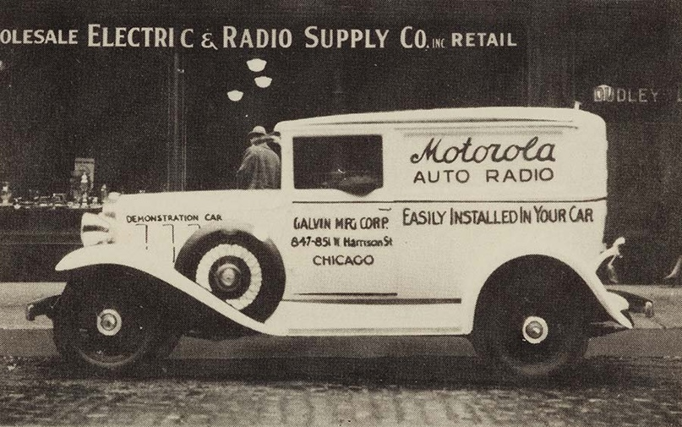
Paul Galvin learned that some radio technicians were installing sets in cars.
Challenged his engineers to design an inexpensive car radio that could be installed in most vehicles.
Galvin demonstrated a working model of the radio at the June 1930 Radio Manufacturers Association convention in Atlantic City, New Jersey.
Brought home enough orders to keep the company in business.
“Motorola” was created by linking "motor" (for motorcar) with "ola" (from Victrola)
“Motorola” was created by linking "motor" (for motorcar) with "ola" (from Victrola)
Motorola went public in 1943,
became Motorola, Inc. in 1947

Slide 7
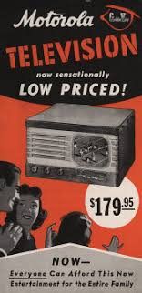
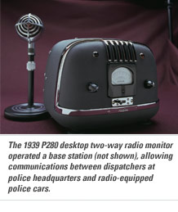
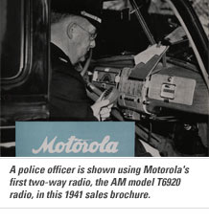
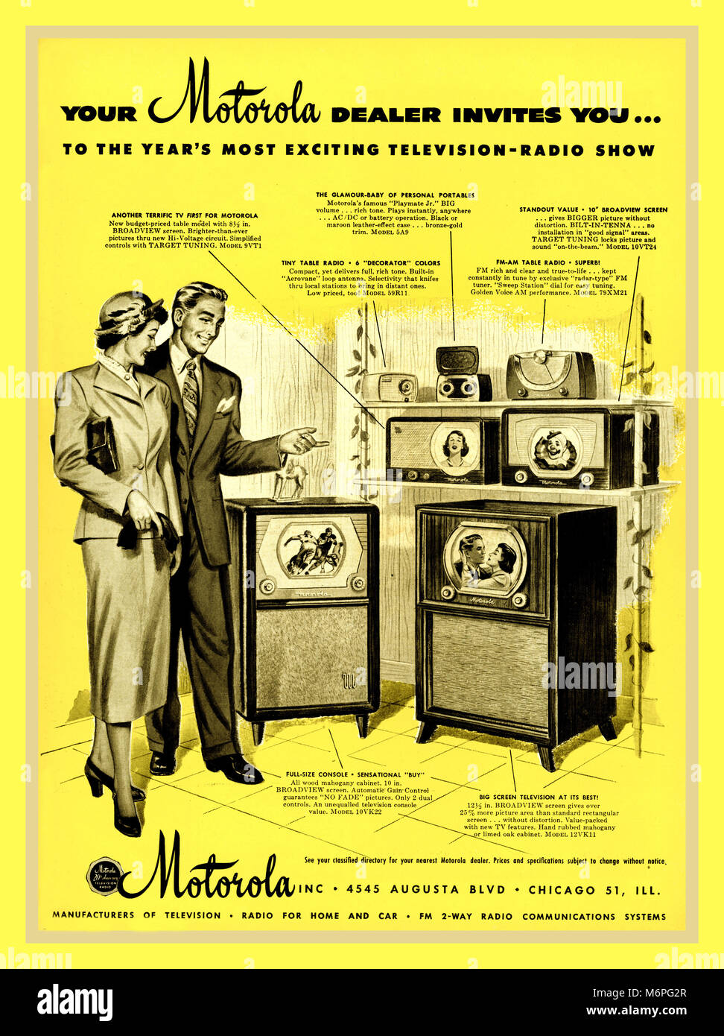
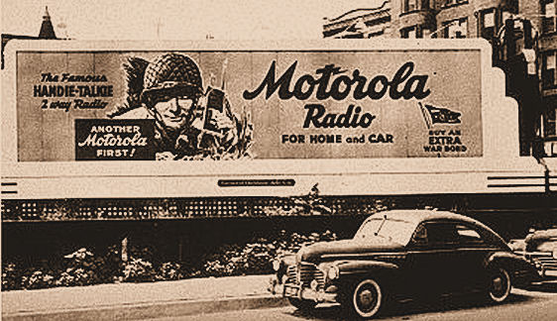
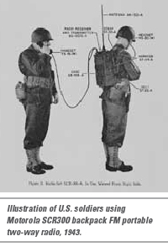
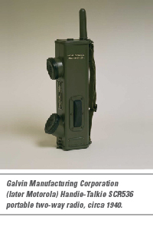
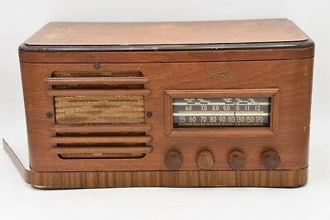
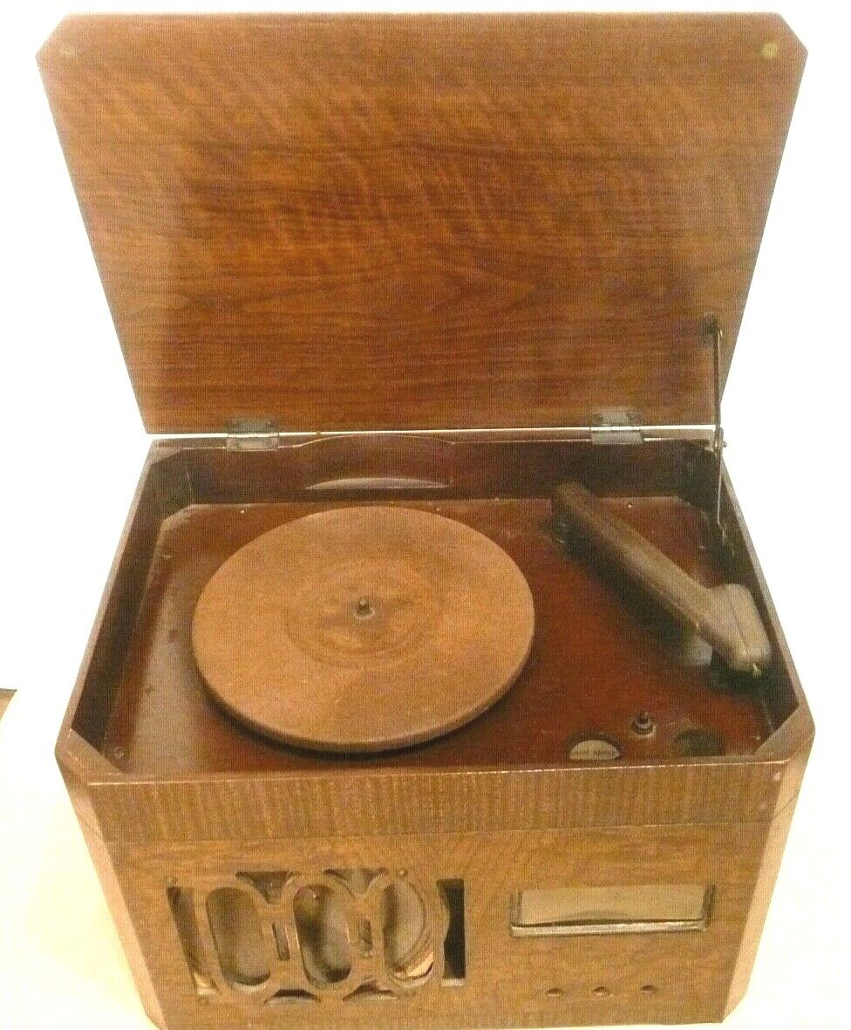

Slide 8
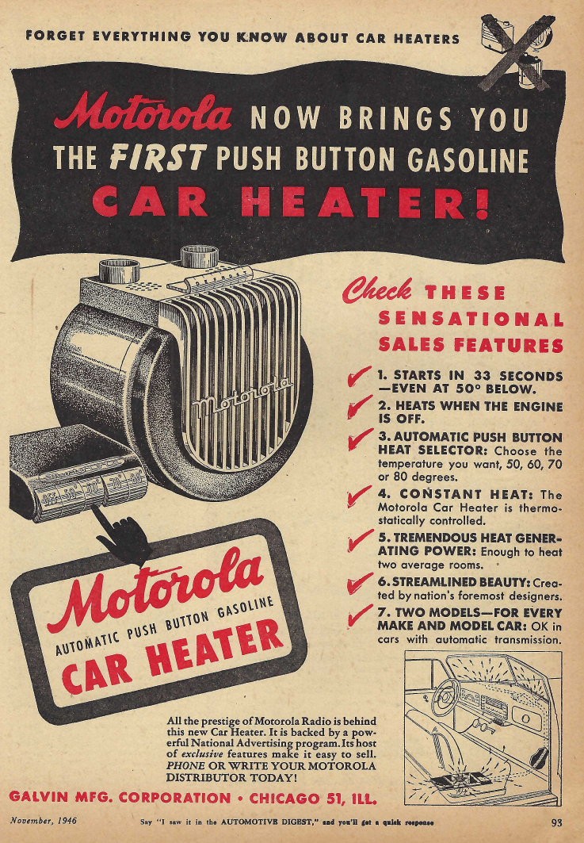
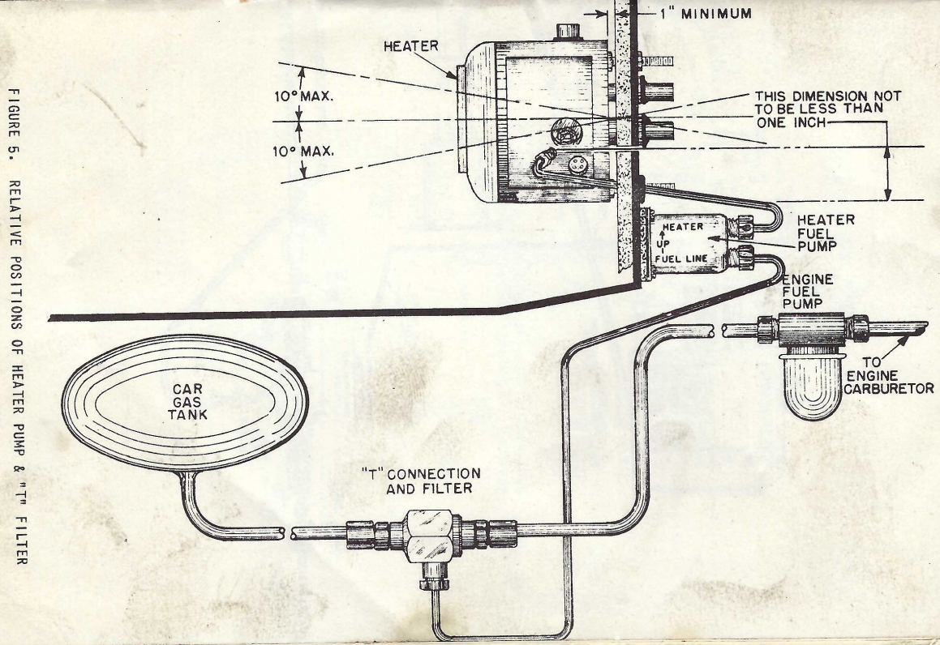
Motorola tried other automotive products
. . . not all were successful.

Slide 9
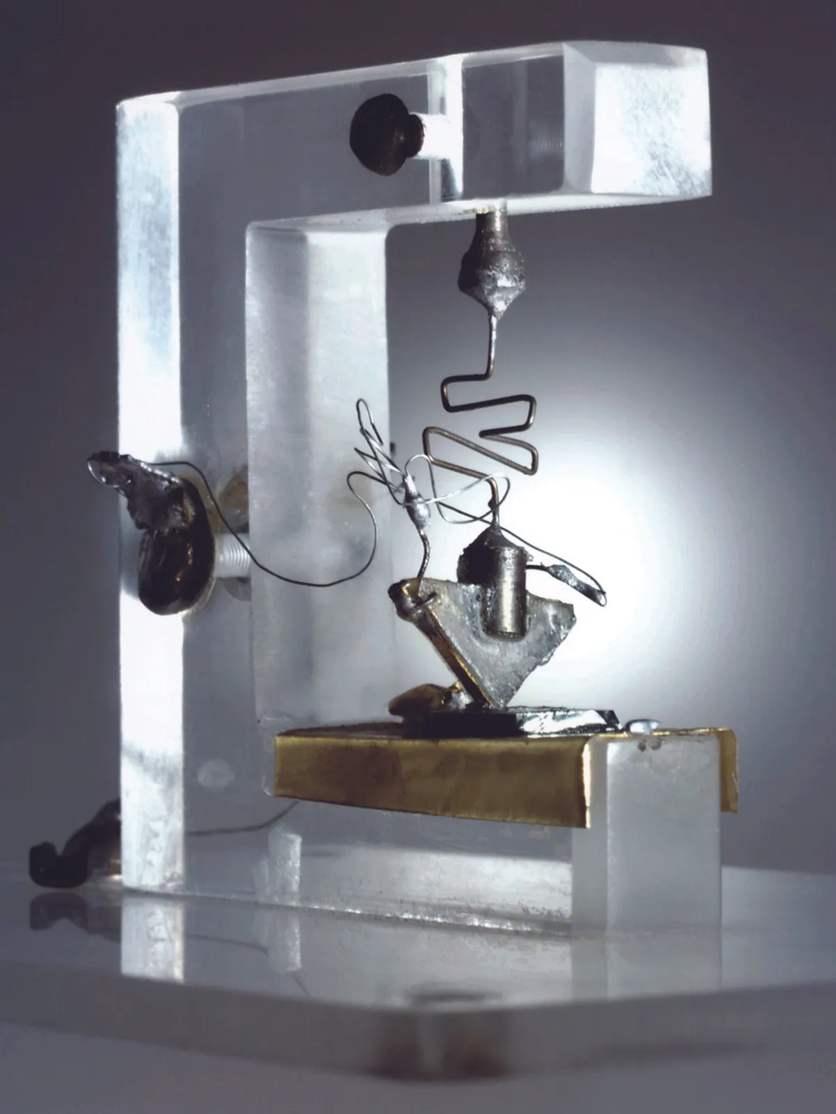
A Brief History of Semiconductors from Conception to the first Transistor
Earliest Semiconductor application – Crystal Radio Cat Whisker, point contact rectifier
1909 - Physicist William Eccles discovered the crystal diode oscillator.
1926 - Physicist Julius Edgar Lilienfeld proposed and patented the concept of a field-effect transistor.
1947 - American physicists William Shockley, John Bardeen and
Walter Brattain demonstrate point contact transistor at Bell Labs.
1949 - Motorola started a research and development laboratory in
Phoenix, Arizona, to research new solid-state technology. (Dan Noble)
1952 April - Over 100 representatives from 40 companies that had paid a $25,000 patent-licensing fee came for a nine-day Transistor Technology Symposium, including a visit to Western Electric's ultramodern transistor manufacturing plant in Allentown, PA.
  There were participants from such electronics titans as GE and RCA, as well as from then-small firms like Texas Instruments and Sony.
1952 – Motorola licenses transistor technology from Bell Labs.
  Early Applications:
    Power Supplies
    Amplifier output stage
    Automotive Alternators
1962 – Motorola Semiconductor had more than 4,000 components in the market.

Slide 10
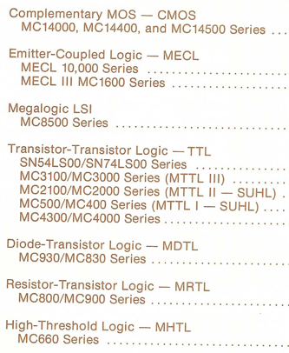
Logic

Slide 11
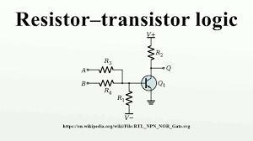
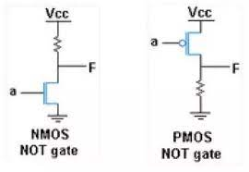
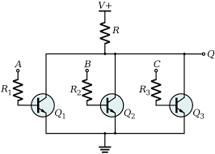
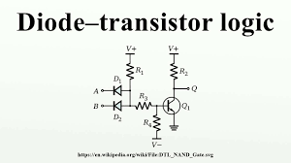
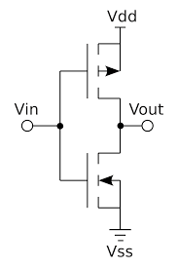
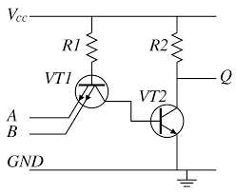
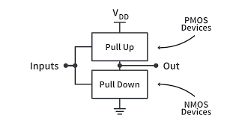
Logic Family Examples
Metal Oxide Semiconductor Field Effect (MOSFET) Logic
Emitter Coupled Logic
(Current Mode)
1962 - Motorola introduced MECL I. Their first digital monolithic integrated circuit line.
1966 - MECL II
1968 - MECL III 1-nanosecond gate propagation time and 300 MHz flip-flop toggle rates.
1971 - 10,000 series (lower power consumption and controlled edge speeds)
1981 - The MECL 10H family.
Complementary MOS(FET) Logic
Transistor Transistor Logic

Slide 12
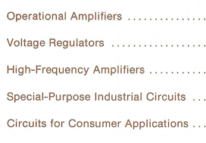
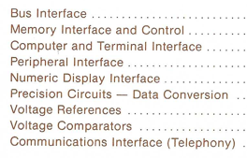
Linear & Interface

Slide 13
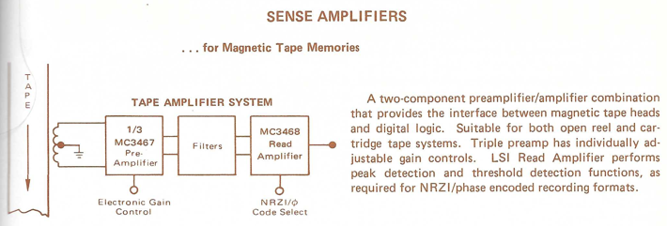
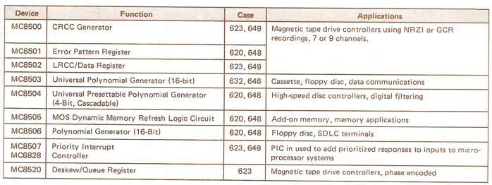
Driven by Mainframe Technology

Slide 14
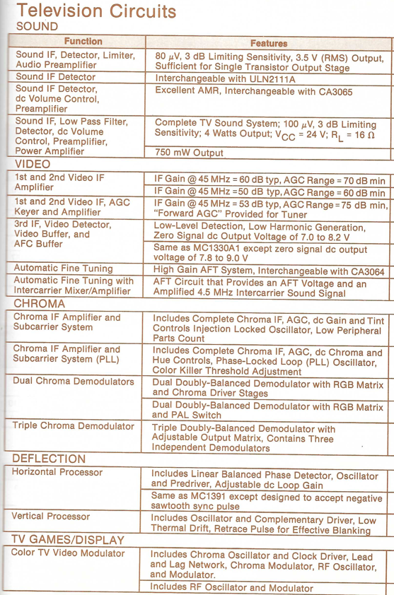
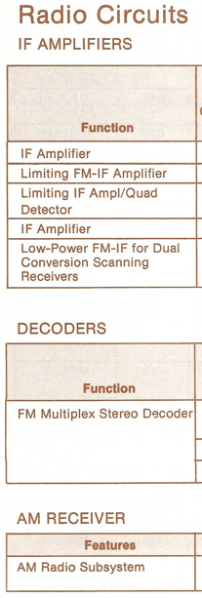
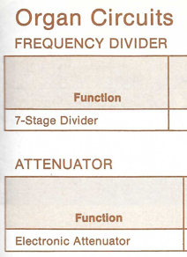
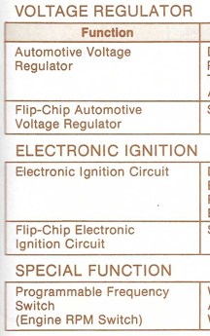
Consumer

Slide 15
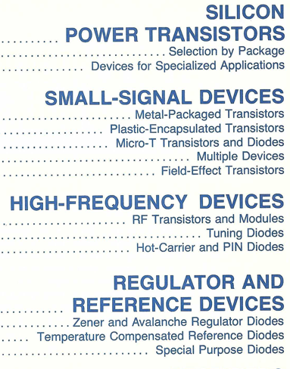
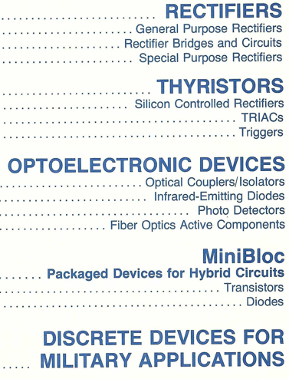
Discrete

Slide 16
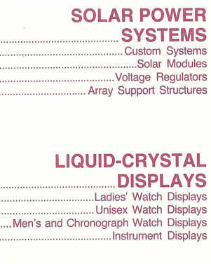
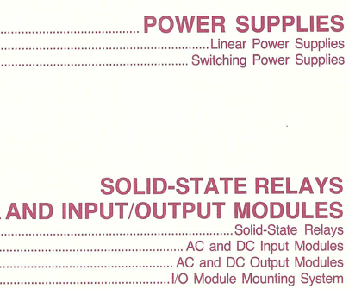
Specialty
Vertical
Integration

Slide 17






Solar Power Systems

Slide 18





Liquid-Crystal Displays

Slide 19




Memories
Bubble Memories

Slide 20



Memory System 3000
Year 1981
2MB Memory Card
12” x 18”
Cost $9,210
16 cards/19in Chassis
32MB/Chassis
Notes:
Jeff Nutt – Marketing Manger
Things were different in the 1980s

Slide 21












Packages – Speed Ranges – Temp Ranges
Temperature Ranges
Commercial: 0 to 70 °C
Industrial: −40 to 85 °C
Military: −55 to 125 °C
One Die could be a dozen parts
Motorola SPS was a broad line supplier with
OVER 25,000 unique products!
Notes:
As an FAE, this is what I had to support.
All products over all applications over thousands of customers.
No way I could do this
I was a Paid Professional Data Sheet Reader.

Slide 22
Processors & Peripherals
4 Bit
141000
CMOS (TI)
2900
TTL - AMD
10800
ECL
MC14500
1-Bit
6809
Intel
8051
8 Bit
6800
6801
6805
146805
CMOS
16/32 Bit & Peripherals
68000
32-64 Bit
Industrial Control
88000
RISC
PowerPC
AIM
Other
DSP96000
96 Bit
DSP56000
24 Bit
VeCOMP701
Vector
LonWorks
Neuron
DSP56100
16 Bit
Notes:
Too many processors to list
Intel Processor was 8051. Used in Engine Control for Motorola Seguin.
Who knows about Motorola Seguin? Show of Hands.
Car Radios
Microwave Front Panels
Engine Controls
LonWorks – Neuron Chip
http://147.32.193.59/semi/motorola/books/sg73/pdf/2_7lon_msg.pdf
Highlight the MC14500 – The processor that thought he could.

Slide 23







MC14500B 1-bit Processor (1977)
Notes:
Customer called and asked if there was a floating point package for this chip?
I had to decline

Slide 24




MC14500 1-bit Processor Derivatives
Vacuum Tube Implementation

Slide 25






APPLICATIONS
PELLERIN MILNOR
New Orleans
Industrial Washers
& Dryers
DISTRIBUTORS
Hall-Mark
Hamilton/Avnet
Schweber
Sterling
DATAPOINT
San Antonio
Terminals
Networking
Created 8008
OEHLER Research
Austin
Ballistic Testing
NASA
Houston
INTERMEDICS
Freeport
Pacemakers
National Instruments
Austin
IEEE488 GPIB
Texas Instruments
IBM
Austin
Notes:
OEHLER – Microprocessor for Machine Gun
Pellerin Milnor – BIG Washing machines. TUNNEL - Converting Relay Logic to Microprocessor
TEXAS INSTRUMENTS – Watch – Mot made LCD, CMOS Clock chip, Crystal They added battery and plastic
IBM – 5.6V Zener diode all 5000 BAD
National Instruments – KC Brown delivered MC68400 GPIB chip to Dr James Truchard on Bee Caves. Now many buildings on MoPac near Domain
NASA – Flew shuttle simulator to reentry – Crashed it
Datapoint – TTY silent replacement, Created 8008 architecture, First NETWORK. ARCNET. Infrared building to building optical connection
Intermedics – Used RCA CMOS processor. Mot would not support life critical applications. Pacemaker programmer 6809 - LAZARUS selection
POSTER – Sears Die Hard

Slide 26
Digital Signal Processing
Wrote DSP Training Courses - 1987
MTTA5 – Cassette
MTT31 – Instructor led course <- Looking for this
DSP Marketing Manager - 1988
16-Bit - Cellular
24-Bit – Audio Industry Standard
32/96 Bit Floating point
VeComp701 – Vector Computer - 1995
Created largest patent - > 450 citations
Notes:
DSP
Bryant Wilder
Paul Marino
Kevin Kloker
Garth Hillman
Keith Essency
Eric Cheval
VeComp
Terry Lawell
Steve Marsh
Bob Seaton
Jason & Terrance Spielman

Slide 27





Sony Customer at Home
Mirrored Closet Doors
https://www.slideserve.com/bailey/video-conferencing-unit

Slide 28


4G LTE Prototype Development & Demo Platform
“Off the shelf” RF, FPGA based baseband
  2 downlink paths, 1 uplink path
Provides an FPGA platform to test RF, DSP and MAC protocol
Provides a test environment to simulate a base station, host processor and RF channel
Provides early demonstrations for checking interoperability
Application Server
Base station emulation
RF Rx Channel 1
Elektrobit C8 Fading Simulator
RF Rx Channel 2
RF Tx
Rohde Schwarz CRTU
Protocol Tester
RF Transceiver
Host Processor
Traffic Data
SPI
BB Tx
BB RX Chan 1,2
RF Interface Board
USB 2.0
FPGA Board
Test Controller &
Instrumentation Display
FPGA A
MAC Protocol
Processor
FPGA B
PHY Engine
(MODEM)
FPGA C
Decoder/
Encoder
JTAG
PCIX
Notes:
135 engineers in 6 design locations
Austin, Toulouse France, Boca Raton Florida, Chicago, Phoenix, San Diego
Feb 2008 - Demoed 4K Video over 4GLTE in Barcelona Spain – World Mobile congress.
We were the only company with such a demo.
Motorola SPS had a great RF team. Sold to Fujitsu.

Slide 29



Notes:
2008 – Great Recession
March 2009 – 1,800 riffed.

Slide 30




Motorola Semiconductor Products Sector Split
Power
Analog
Logic
Discrete
LED
1999
Automotive
Networking
Processors
Broadband
RF
Sensors
2006
2015

Slide 31
THANK YOU
For your time

Slide 32
Links
Fahnestock Clip
https://en.wikipedia.org/wiki/Fahnestock_clip
LonWorks
https://www.csimn.com/CSI_pages/LonWorks101.html
Motorola Wikipedia
https://en.wikipedia.org/wiki/Motorola
Semiconductors
https://www.britannica.com/science/semiconductor
History of Auto Radio
https://blog.consumerguide.com/a-brief-history-of-car-radio/
Motorola Timeline
https://www.landley.net/history/mirror/6800_MotDoc.pdf
Motorola History
https://www.britannica.com/topic/Motorola-Inc
https://www.company-histories.com/Motorola-Inc-Company-History.html
Transistor History
https://en.wikipedia.org/wiki/Transistor
1952 Bell Labs License symposium
https://www.computerhistory.org/siliconengine/bell-labs-licenses-transistor-technology/
1 bit processor
Datasheet
http://ww.bitsavers.org/components/motorola/14500/MC14500B_Rev3.pdf
Handbook
http://www.bitsavers.org/components/motorola/14500/MC14500B_Industrial_Control_Unit_Handbook_1977.pdf
Discreet version
https://www.youtube.com/watch?v=BJSHJkaYqaE
Motorola Video Conferencing
https://www.slideserve.com/bailey/video-conferencing-unit

Slide 33

Notes:
ARPANET - Advanced Research Projects Agency Network (the World's first operational packet switching network)
Department of Defense
Approx 150 systems online
PENTAGON – MILITARY – UNIVERSITY
NOTE – Mystery TEXAS node
MORE NODES IN THIS BUILDING THAN THE ENTIRE INTERNET BACK THEN

Slide 34



Interface Message Processor
LINK:
https://en.wikipedia.org/wiki/ARPANET
Notes:
ARPA awarded the contract to build the network to Bolt Beranek & Newman who developed the first protocol for the network
Required Interface Message Processor (GIANT BOX) to connect.
TIMELINE
1969 – First Connect
1971 – Declared operational
I HAD NOTHING TO DO WITH THIS.
Just an interesting fact.

