Slide 1
Fusion Energy: Clean and Inexhaustible
Presentation to the IEEE Life Members in Central Texas Section
May 16, 2024
Raymond L. Orbach
Professor
The University of Texas at Austin
orbach@utexas.edu

Slide 2
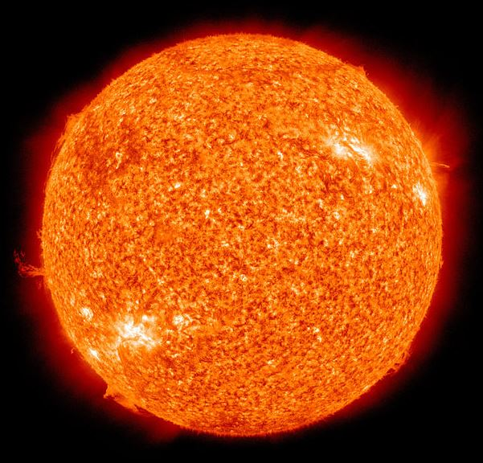
Our Sun

Slide 3
Some Facts About Our Sun
The Sun formed about 4.567 billion years ago from the gravitational collapse of a region within a large molecular cloud.
Most of the matter gathered in the center, while the rest flattened into an orbiting disk that would become the Solar System.
The central mass became increasingly hot and dense, eventually initiating thermonuclear fusion in its core.

Slide 4
What Is Fusion and What Does It Do?
The sun generates its energy by nuclear fusion of hydrogen nuclei into helium.
In its core, the Sun fuses about 620 million metric tons of hydrogen each second.
The process of fusion in the Sun is known as the proton-proton chain. The Sun starts with protons, and though a series of steps, turns them into helium.
Because the total mass of helium is less than the mass of the protons that went into it, this fusion releases energy [E=Mc²].

Slide 5
How Does the Sun Do It?
Two pairs of protons fuse, forming two deuterons [A deuteron has one proton and one neutron, and is an isotope of hydrogen].
Each deuteron fuses with an additional proton to form helium-3 [helium-3, or He³, has two protons and one neutron].
Two He³ nuclei fuse to create beryllium-6 [beryllium-6, or Be⁶, has four protons and two neutrons]
Be⁶ is unstable and disintegrates into two protons and a helium-4 [helium-4, or He⁴, has two protons and two neutrons. It is helium as we know it, and is very stable.]
The reaction also releases two neutrinos, two positrons and gamma rays.

Slide 6
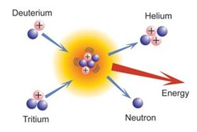
What’s the Problem? Why Can’t We Do it?
Note the positive charge on the hydrogen isotopes. Like charges repel (coulomb repulsion) requiring nuclei to move so rapidly for fusion that they overcome the coulomb repulsion. This translates to temperatures
greater than 200,000,000ºC.
The simplest and least energetic fusion process involved a deuterium and tritium, both isotopes of hydrogen:

Slide 7
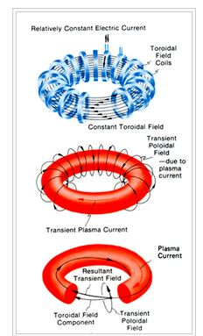
How to Contain the Furnace: Magnetic fields via the “Tokamak”

Slide 8
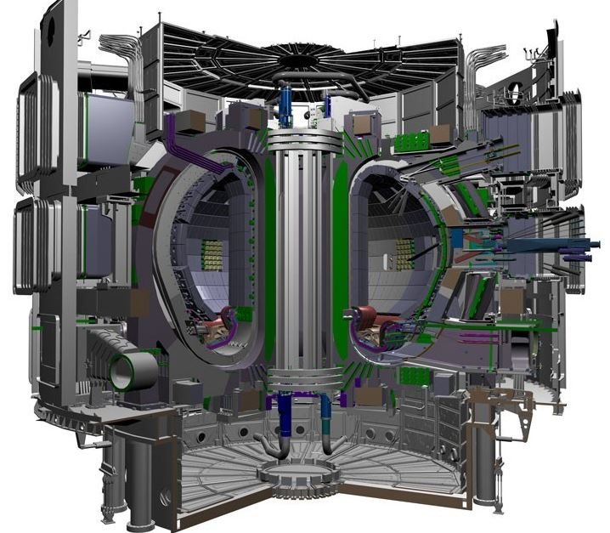
International Thermonuclear Experimental Reactor: aka ITER (“the way” in latin)

Slide 9
Fusion is Not Fission
There is no extrinsic radioactive material
  The neutron released in the fusion process strikes Li in the “blanket” inside the tokomak, creating tritium and helium. The tritium fuses with the deuterium in the burning plasma, providing helium and a neutron that strikes Li in the blanket inside the tokomak, creation tritium and ….
  The produced energy heats a liquid to vapor to drive a turbine generator to produce electricity
  The stuff out the “tailpipe” is helium (and that escapes from the earth’s gravity) and electricity
If there is a problem, you just turn the machine off (like turning off your stove) and the process stops
There is enough deuterium in a body of water the size of lake Erie to provide all of the energy the earth requires for 10,000 years

Slide 10
How Did ITER Start?
• After Geneva Superpower Summit 1985, President Reagan stated:
“As a potential way of dealing with the energy needs of the world of the future, we have…advocated international cooperation to explore the feasibility of developing fusion energy.”
• After the standoff over nuclear disarmament at the Reykjavik Summit 1986, the concept of a fusion experimental research facility was agreed upon.
• 1988, start of the ITER Conceptual Design Activity
• 1998, U.S. finishes commitment, leaves ITER

Slide 11
What Happened Next?
The House of Representatives passes “Securing America’s Future Energy Act of 2001, requiring DOE’s Office of Science to take a number of actions exploring a burning plasma experiment.
As Director of the Office of Science, I commissioned a study and workshop in Snowmass, Colorado, in 2002 for the purpose of “…examination of the proposed burning plasma experimental designs.” I then asked the Fusion Energy Sciences Advisory Committee and the National Academy of Sciences to evaluate the Snowmass workshop report.
September, 2002: the Fusion Energy Sciences Advisory Committee supports the entry of the U.S. into the ITER negotiations
December, 2002: the National Research Council of the National Academy of Sciences endorses the ITER effort “…as a necessary next step in the U.S. fusion energy research program.”

Slide 12
President George W. Bush:
January 30, 2003: “The results of ITER will advance the effort to produce clean, safe, renewable, and commercially available energy by the middle of this century. Commercialization of fusion has the potential to dramatically improve America’s energy security while significantly reducing air pollution and emissions of greenhouse gases…We welcome the opportunity to work with our [ITER] partners to make fusion energy a reality.”

Slide 13
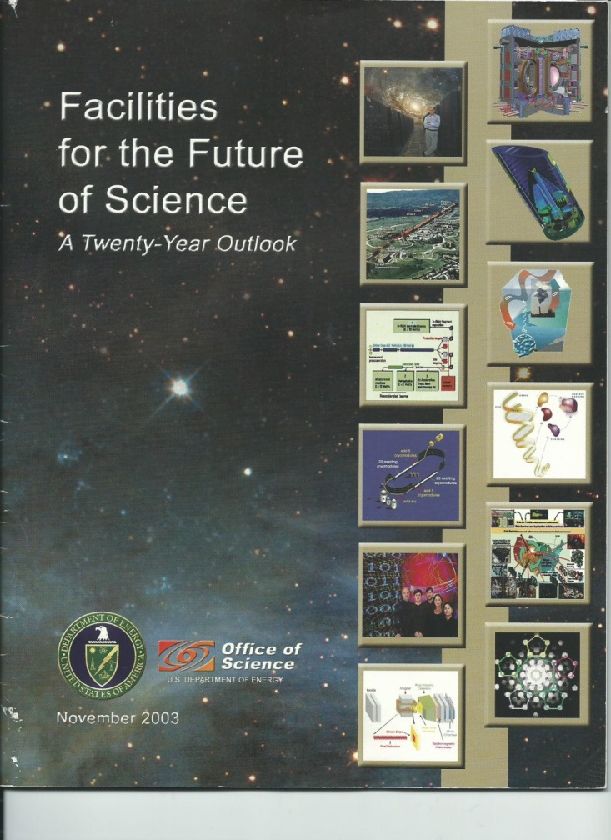
And at the Office of Science, working with its Advisory Committees, I prioritized 28 large scale scientific facilities across disciplinary lines to produce:

Slide 14
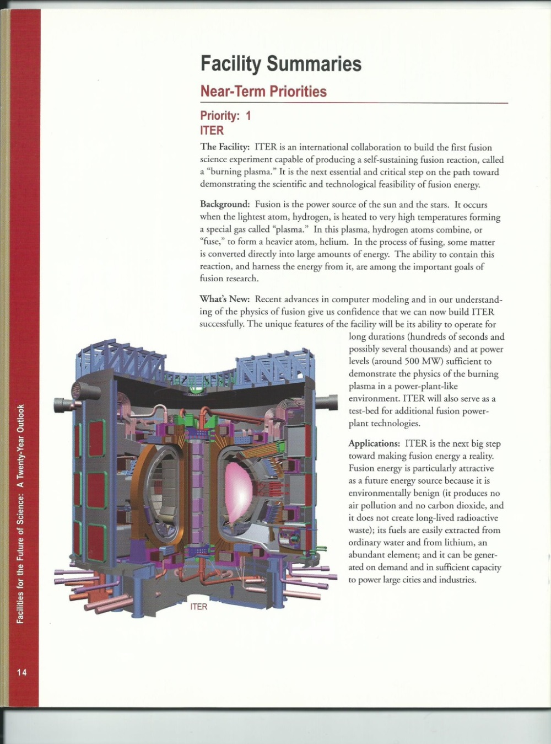
And the First Priority Among the 28:

Slide 15
So the U.S. rejoined ITER in 2003
As soon as the U.S. joined the E.U., Russian Federation and Japan, China and South Korea submitted applications to join, followed by India in subsequent years.
I was chosen to head the U.S. negotiating team, assisted by my deputy, Mr. Todd Harding, and a top State Department attorney familiar with international law, Ms. Melanie Khanna.
Together we presented the U.S. perspective on all of the ITER issues (and there were many!)

Slide 16
The First Stumbling Block:
Where Would ITER Be Built?
From the U.S. point of view, there were four sites, ordered by my preference as follows:
  The Darlington site (Canada, on Lake Ontario)
    Nuclear licensed site, where commercial tritium is produced
  The Spanish site (near Barcelona, on the coast)
    Nuclear licensed site, with shut-down de-activated nuclear reactor
  The Japanese site (in Rokkasho-mura, northern Honshu, on the coast)
    Unused port with direct access to sea
  The French site (Cadarache, in Provence)
    Nuclear licensed site, 100 km from a port, over Provence roads

Slide 17
Where would ITER Be Built?
The Decision
From the U.S. point of view, there were four sites, ordered by my preference as follows:
  The Darlington site (Canada, on Lake Ontario)
    The Canadians refused to put any money on the table
  The Spanish site (near Barcelona, on the coast)
    The E.U. chose the French site
  The Japanese site (in Rokkasho-mura, northern Honshu, on the coast)
    The E.U. and Japan negotiated the “Broader Agreement” making cost concessions to Japan
  The French site (Cadarache, in Provence)
    The largest coils had to be made on-site, requiring construction of a factory. The roads had to be widened to get the other construction components to the site. The tritium to start the process had to be flown to a French military base close by the site.

Slide 18
Now the “Hard Part”: Negotiations over the first truly international large scale scientific facility
There was no agreement on legal and policy structures that would be appropriate for creating and sustaining a major (expensive) international facility and experiment.
The partners had diverse political and legal systems:
  The European Union
  Japan
  The Russian Federation
  The United States
  China
  South Korea
  India

Slide 19
Innovative Solutions
The ITER agreement was initialed by the heads of delegation in Brussels on May 24, 2006
The final signing by all seven parties took place in the Élysée Palace in Paris on November 21, 2006
President Bush signed the Executive Order on November 19, 2007 designating the ITER International Fusion Energy Organization as a Public International Organization
For the United States:
  The ability to conclude the agreement consistent with U.S. law (including the IOIA) without entering into any open-ended, uncertain financial or other liabilities
  Conclusion of the ITER Agreement as a congressional-executive agreement is an important precedent for similar future international scientific (and other) projects

Slide 20
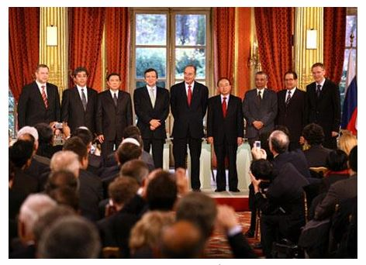
The Signing

Slide 21
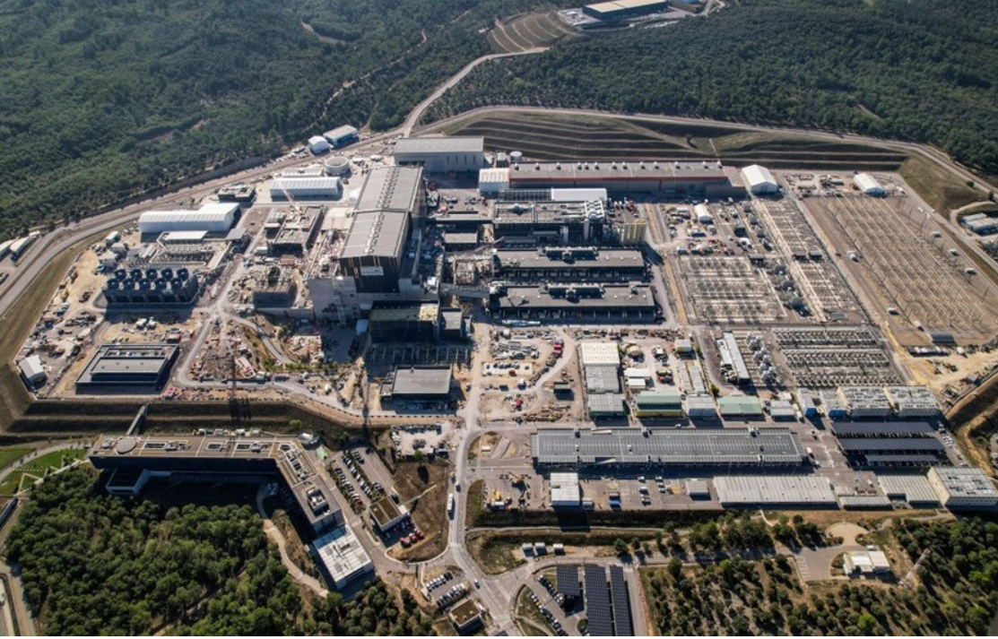
ITER Today

Slide 22
What will ITER do?
Achieve a deuterium-tritium plasma in which the fusion conditions are sustained mostly by internal fusion heating.
Reach an internal temperature of 150 million ºC
Generate 500 MW of fusion power in its plasma from 50 MW of total input heating power (“plug power”), Q = 10.
First Plasma in 2025 and on to Deuterium-Tritium Operation in 2035
Pave the way for a demonstration power plant, “Demo” with Q = 20 (prototype by 2045?, power in the grid by 2050?).

