Slide 1
2023 Crystal Ball Market Outlook
Katrina Radenberg CFA, Chief Investment Officer |
Jeff Krumpelman CFA, Chief Investment Strategist & Head of Equities

Slide 2
2022 Year in Review
Global Equities | Jan. thru Oct. 12 | 2022 Full Year
MSCI ACWI (U.S. & Int’l combined) | -25.7% | -18.0%
S&P 500 Index (Large Cap) | -24.0% | -18.1%
Russell 2000 Index (Small Cap) | -24.1% | -20.4%
MSCI EAFE (International) | -27.4% | -14.0%
MSCI Emerging Market Index (Int’l) | -27.7% | -19.7%
Russell 1000 Value Index | -17.2% | -7.5%
Russell 1000 Growth Index | -31.3% | -29.1%
Fixed Income | 2022 Full Year
Bloomberg U.S. Aggregate Bond Index | -13.0%
Balanced Portfolios | 2022 Full Year
S&P Target Risk Moderate Index | -14.4%
The S&P 500 experienced one of its worst years since 2008, declining19.4%. While painful, let’s put this in perspective. On a calendar-year basis, this doesn’t even meet the criteria of the minimum 20% threshold decline to be considered a bear market. Further, the comparison to 2008 is not apples to apples given that the S&P 500 fell 37% that year. International equity markets also declined by double-digit levels in 2022, so there was virtually no place to hide in stocks last year.
Clearly this is a result of major wall of worry items that included elevated inflation, a major shift in Federal Reserve policy to address rising price levels, a slowing economy, war in Ukraine and other significant tension on the geopolitical front with key trading partners.
The market was dealing with a number of transitions that still aren’t resolved. That said, we anticipated a correction this year of around 20%, and the market generally experiences a sell-off like this in a midterm election year. In fact, in 2022, the market declined by roughly the average figure we’ve seen in advance of previous recessions despite the fact we haven’t experienced one yet! This is encouraging to us regarding 2023. The market anticipates where the economy is headed and is forward-looking. 2022 was a year of strong earnings yet a weak stock market, because stock investors expected a slowdown in the economy and earnings in advance of it occurring in 2023. Similarly, it should recover handsomely once it anticipates recovery and a re-acceleration in these metrics as we move through the second half of next year and into 2024. In other words, 2023 could be the reverse of 2022—a year of weaker earnings but healthy stock market returns.
We maintain our domestic bias as the U.S. economy continues to exhibit superior strength and stability relative to foreign countries. The employment picture in the U.S. continues to be solid as does spending on services. Should a recession develop, we believe it will be mild in nature, and U.S. stocks have already declined in anticipation of that. We continue to urge investors to hold their ground and long-term equity allocation target and look to add equity exposure once it becomes clearer that inflation is calming, and the Fed can pause from these significant fed funds rate hikes.
Index returns sourced from FactSet
Indexes are unmanaged and cannot be directly invested into. Past performance does not guarantee future results. Investing involves risk and the potential to lose principal.

Slide 3
2022 Forecast and Results
What we got right:
What we missed:
Expected a correction of 20%
Recommended reducing any overweight in equities back to long-term target
Did not suggest buying on the dips
Large-cap over Small-cap
Blend of defensive and risk-on equities
Duration of the correction
Inflation was stickier than we anticipated

Slide 4
2023 Base Case
Expected Environment
GDP growth is in a range of -1% to +1.5%.
Federal Reserve continues to raise short term rates up to a range of 4.75%-5.25%. Longer-term rates settle in a range of 3%-4%.
Market Scenarios | Probability | S&P Level | Price Return | Total Return
Optimistic case | 10% | 4875 | 27% | 29%
Base case | 60% | 4500 | 17% | 19%
Disappointing case | 20% | 3520 | -8% | -6%
Pessimistic case | 10% | 3140 | -18% | -16%
Optimistic Case: Based on a P/E of 19.5x on a consensus 2024 earnings of $250.
Base Case: Based on a P/E of 18x on a consensus 2024 earnings of $250.
Disappointing Case: Based on a P/E of 17x on a disappointing 10% hit to 2023 consensus earnings ($230) to $207.
Pessimistic Case: Based on a lower 16x P/E on a 10% decline from 2022 earnings of $218 down to $196.
IMPORTANT: The target return expectations regarding the likelihood of various investment outcomes are hypothetical in nature, do not reflect actual investment results, and are not guarantees of future results.
These target return expectations are for the next 12 months through December 2023. For the scenarios outlined above, the price return is determined using a starting level of 3,839, the closing price for the S&P 500 on Dec. 30, 2022, and the total return is incorporating the impact of dividends; we are using a flat 2% expected dividend, and the actual dividend yield will vary. Consensus earnings projections are based on information obtained from FactSet. The environment set forth above is an estimate based upon research and formulation of estimates. There is no guarantee that any claims made will come to pass. Individuals cannot invest directly in an index. Index returns do not include the impact of trading costs or advisory and other fees. Scenarios are subject to change at the firm’s discretion with no notice to you.
Source: Mariner Equity Team

Slide 5
Fundamentals, Valuation and Technicals
Overall, our indicators are neutral/positive. Despite negative market action,
the data is still constructive.
 | Rating
Fundamentals: Data that impacts revenues and earnings | Neutral
Economic Trends | O
Earnings Trends | O/–
Federal Reserve Policy | O
Interest Rate Trends | O
Real Rates | +
M&A/IPO activity | O
Credit Spreads | +
Valuation: How expensive stocks are | Neutral
Price Earnings | O
Dividend Yields vs. Interest Rates | O
Price to Sales | O
Earnings Yield to Bond Yield | O
Technical Price Trends: Quality of trend in market | Neutral
Advance/Decline | O
Stocks above 200-day MA | O
Sentiment | +
Long-Term Trend | O
Sector/Individual Stock Trends | O
+ | Positive
O | Neutral
– | Negative
Metrics are ranked positive, neutral or negative based solely on the firm’s interpretation of market data, are subject to change at the firm’s discretion with no notice to you and are not a guarantee of future results. They are presented for information purposes only and do not take into account any individual personal, financial or tax considerations, nor are they intended to be personal legal or investment advice or a solicitation to buy or sell any security or engage in a particular investment strategy or market sector.

Slide 6
Current Wall of Worry Items
Current risk factors:
What we focus on:
Inflation
Federal Reserve Policy Mistake
Weakening Economic Data
Geopolitical Tension
Debt Ceiling Debates
China-Economy and Covid-19 Policy
Economic growth
Employment
Earnings
Interest rates
Credit spreads

Slide 7
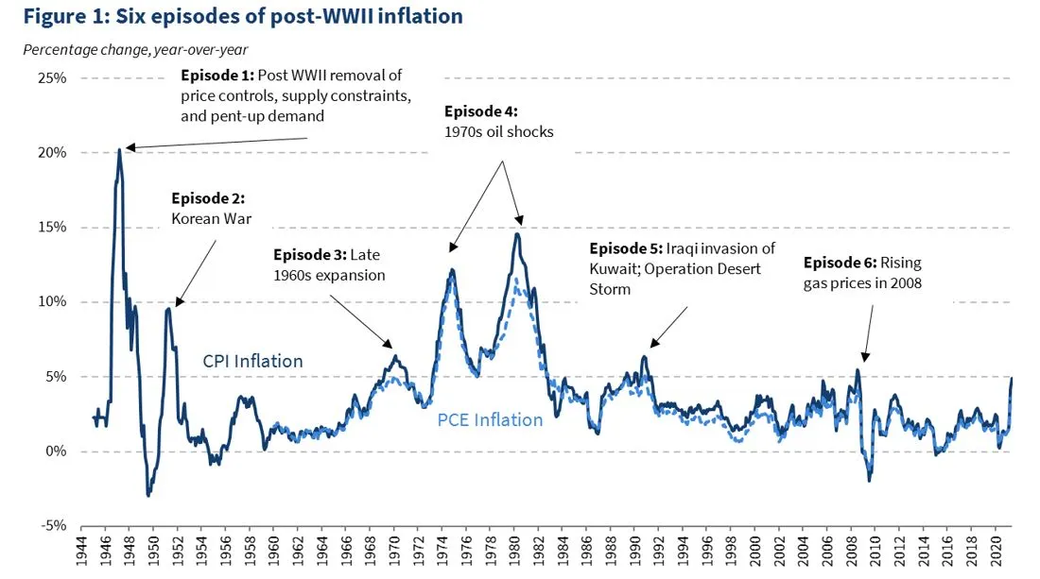
Inflation
There are several parallels that can be drawn between the current environment and that of the early 1950s.
Source: Federal Reserve Economic Data (FRED), Haver Analytics, CEA Calculations; whitehouse.gov

Slide 8
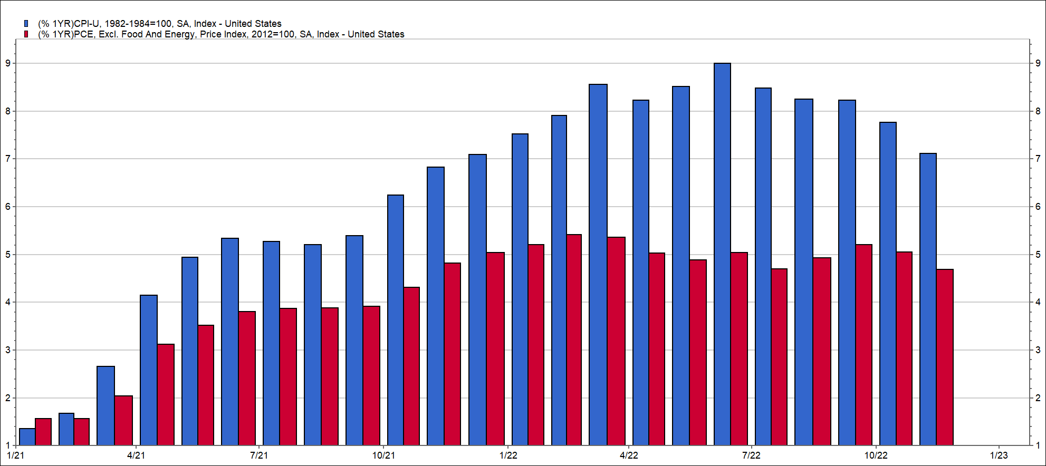
CPI Versus PCE
The public tends to focus on headline CPI year-over-year growth, while the Fed’s preferred inflation measure is Core PCE.
Source: FactSet

Slide 9
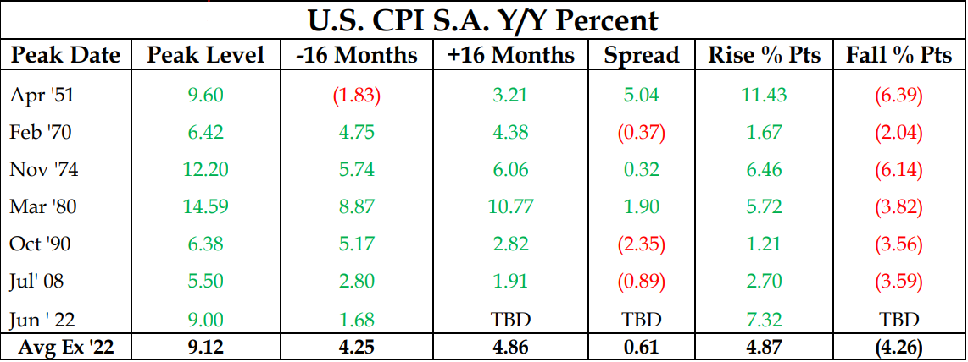
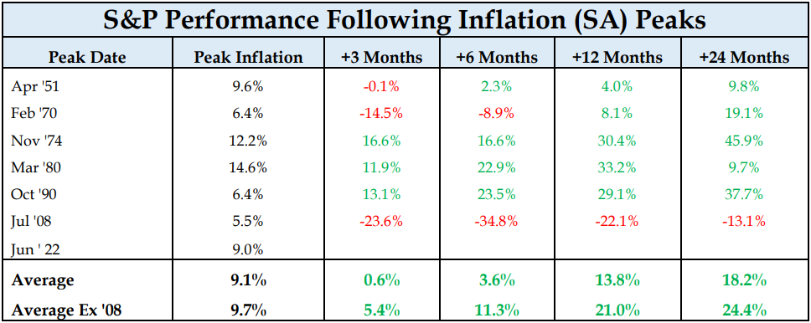
Inflation Can Calm Quickly
Historically, inflation has calmed rather quickly after peaking. The market also tends to perform well the 12-months after inflation peaks.
Source: Strategas – The S&P 500 Index is unmanaged and cannot be directly invested into. Past performance does not guarantee future results. Investing involves risk and the potential to lose principal.

Slide 10
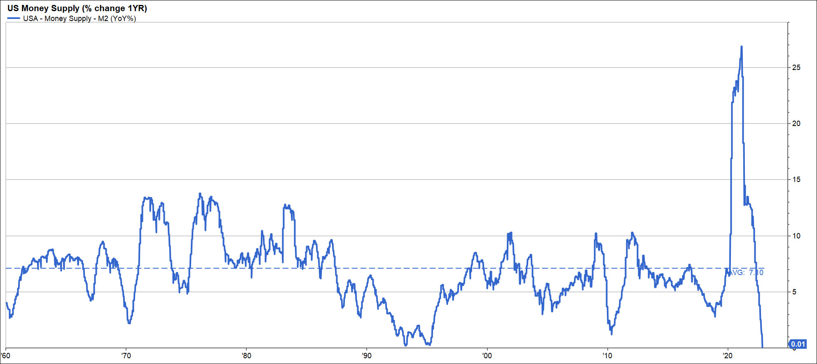
Spike in the Money Supply
Unprecedented fiscal and monetary stimulus during the pandemic saw a sharp increase in the money supply that has since slowed considerably. When M2 slows, inflation slows with a lag.
Source: FactSet

Slide 11
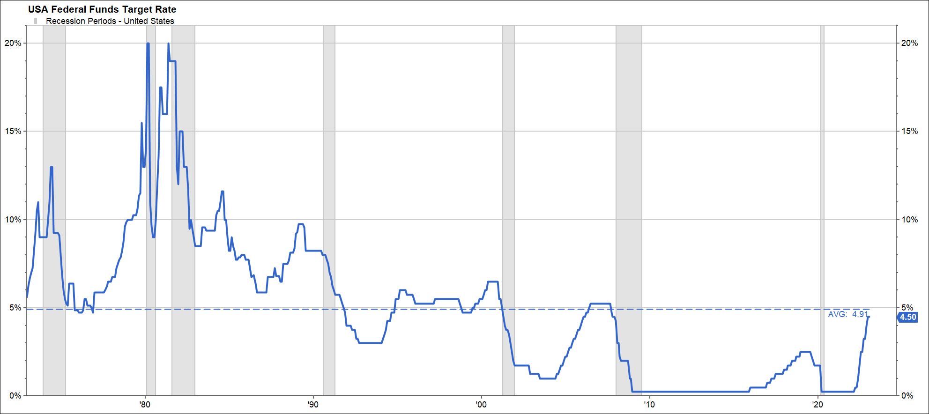
Putting Restrictive Monetary Policy in Perspective
The Fed’s stated terminal target fed funds rate is just over 5%. Even if the Fed goes that high, let’s put that in historical perspective. We’ve seen some extreme tightening periods. The roughly 50-year average is around 5%.
Volcker became Fed Chair in 1979 and continued to hike rates up to 20%.
Source: FactSet

Slide 12
Fed Funds Futures Curve
The market is not believing the Fed. Investors in interest rate derivatives and bond investors believe the Fed will taper hikes.
Source: Data was sourced from FactSet as of 12/30/2022

Slide 13
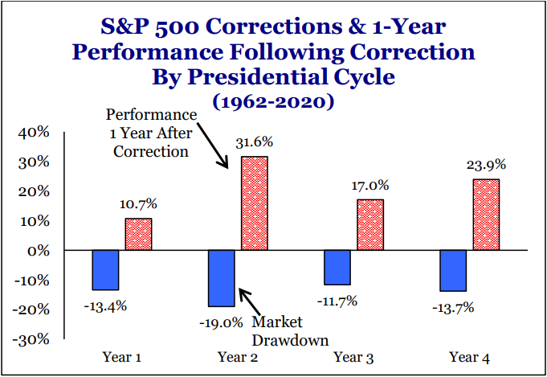
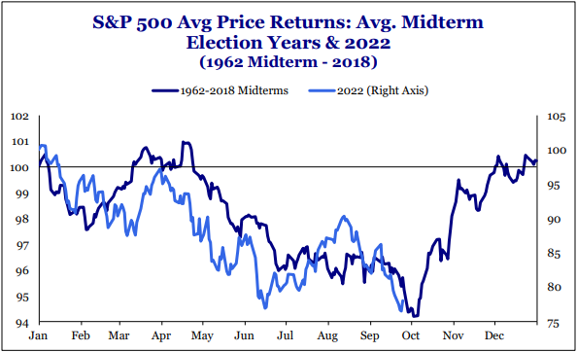
Midterm Elections
The current market downturn is typical in midterm election years. The market performance in the 12-months following the correction has been strong, and October has historically been an inflection point.
Source: Strategas - The S&P 500 Index is unmanaged and cannot be directly invested into. Past performance does not guarantee future results. Investing involves risk and the potential to lose principal.

Slide 14
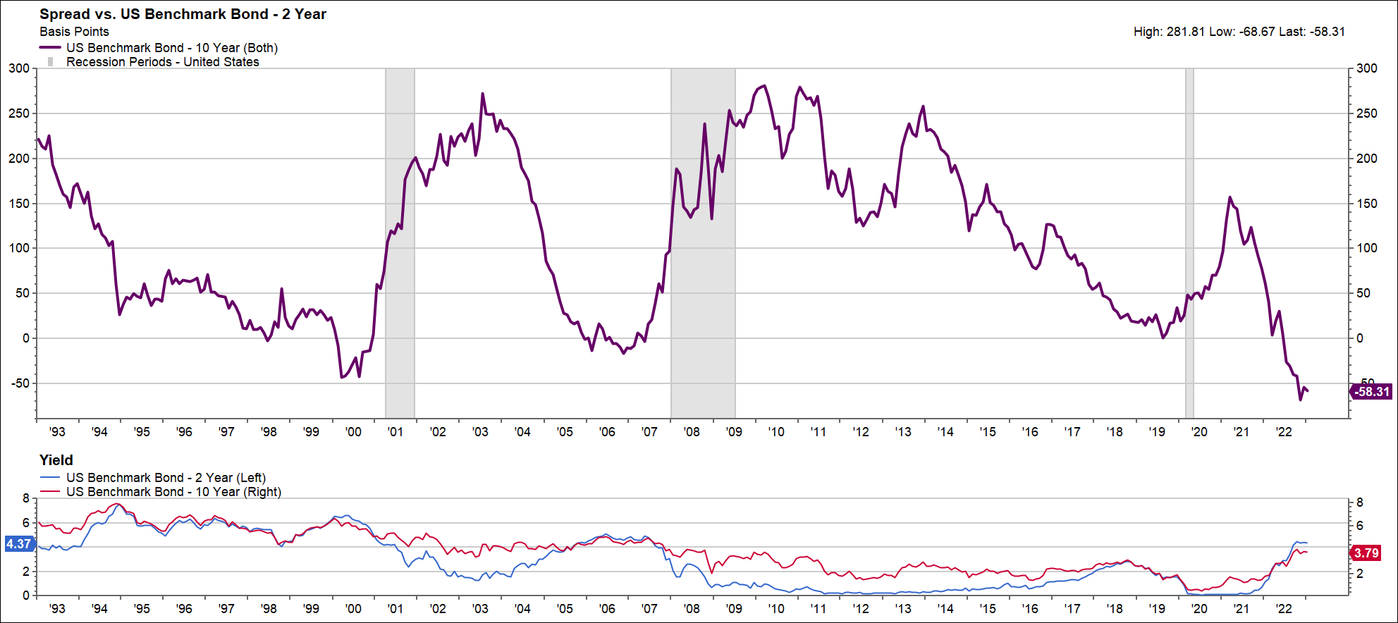
The Yield Curve Inverted! The Yield Curve Inverted!
Potentially the bond market signaling its expectation for inflation rather than its productivity expectation. Normally, credit spreads are widening sharply at these levels of inversion. Not so today. That’s different.
Source: FactSet

Slide 15
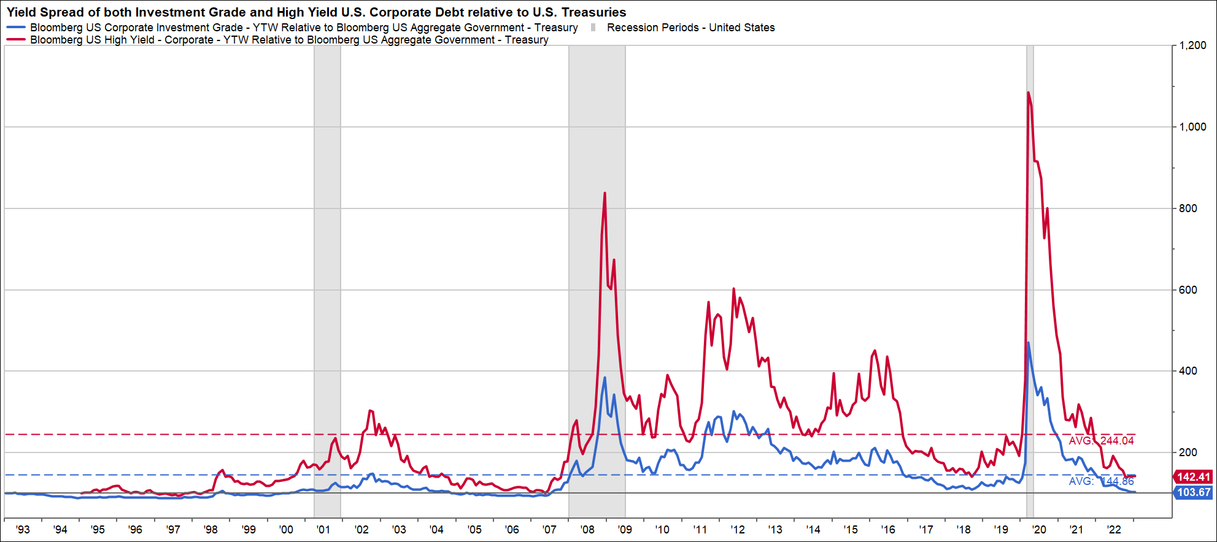
Credit Markets are Healthy
Typically, when signaling recession, the yield curve is accompanied by a deterioration in the credit markets and credit spreads remain relatively tight.
Source: FactSet

Slide 16
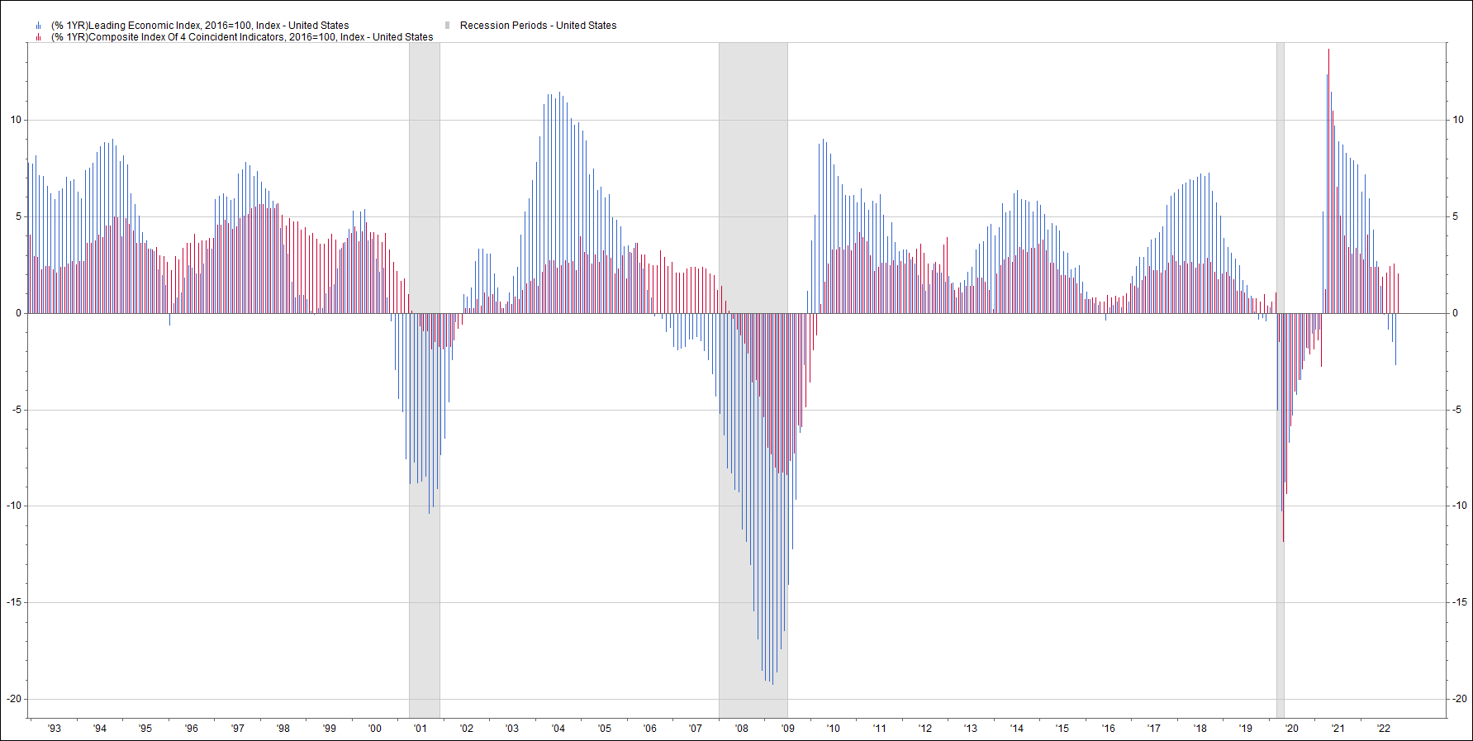
Leading and Coincidental Economic Indicators
Normally, coincident indicators weaken shortly after leading ones do as a signal of recession. This time coincident indicators are rising. That’s different.
Source: FactSet

Slide 17
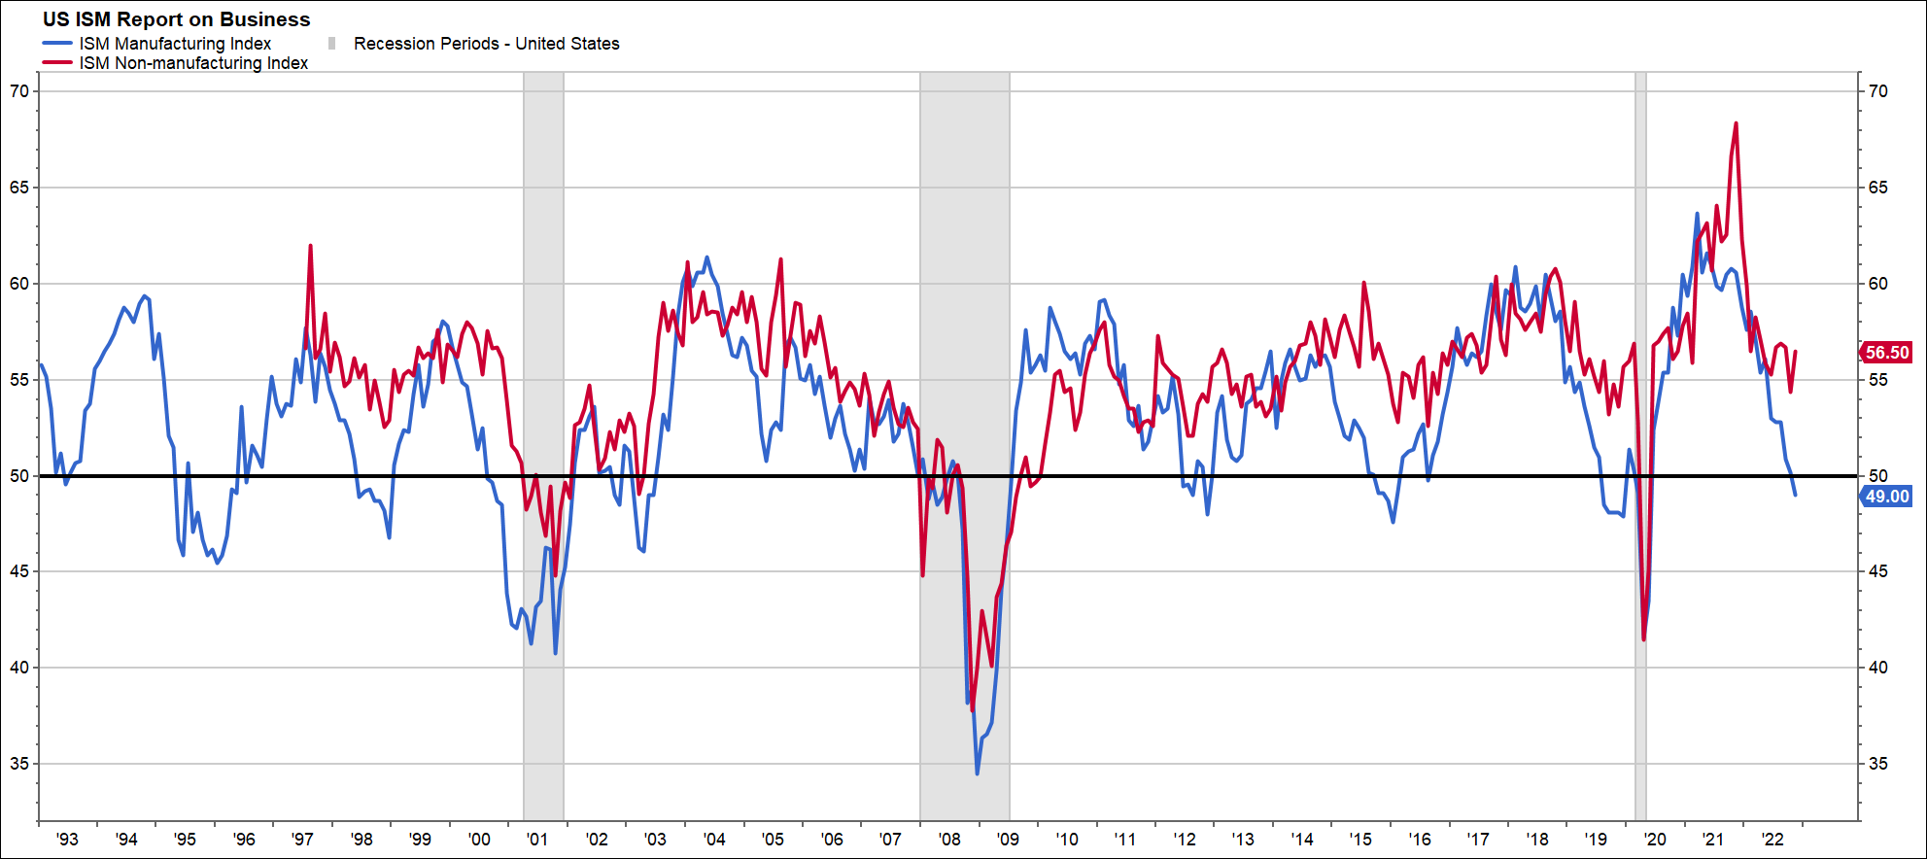
Institute for Supply Management’s PMIs
Need both to dip below 50 to be a strong signal. The shift in consumer behavior is reflected in the services or non-manufacturing PMI ticking up while goods/manufacturing declines. Both must decline to be considered a true signal of recession.
Source: FactSet

Slide 18
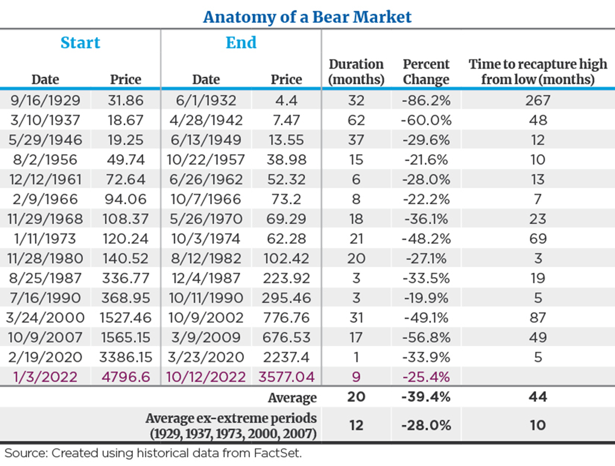
Anatomy of a Bear Market
Not all bear markets are built the same. If you exclude past economic collapses, the average drawdown in a mild recession is less severe, shorter in duration and quicker to recover. Almost half the time, returns are positive amid a recession.
Stock Performance Around Recessions
Time Period | Average Return | % of Positive Periods
During | -1% | 45%
6M Before | -2% | 45%
12M Before | -3% | 45%
6M After | 7% | 82%
12M After | 16% | 91%
2Y After | 20% | 82%
Source: Ycharts
Data based on the S&P 500 Index
The S&P 500 Index is unmanaged and cannot be directly invested into. Past performance does not guarantee future results. Investing involves risk and the potential to lose principal.

Slide 19
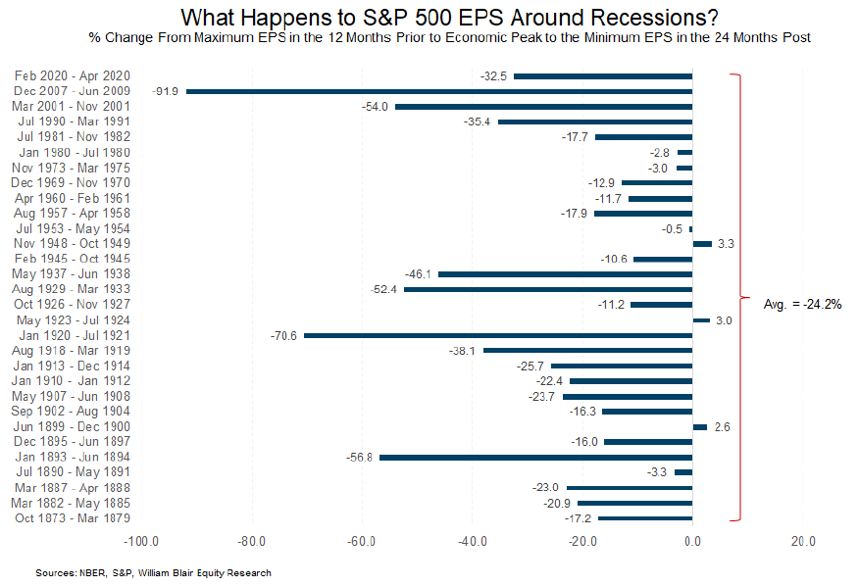
S&P 500 Earnings Around Recessions
The bears say the next shoe to drop is sharp negative revisions to earnings if recession occurs. Actually this is not a given. It is not unusual for earnings to be resilient in prior mild/normal recessions
Source: NBER, S&P, William Blair Equity Research - Past performance does not guarantee future results.

Slide 20
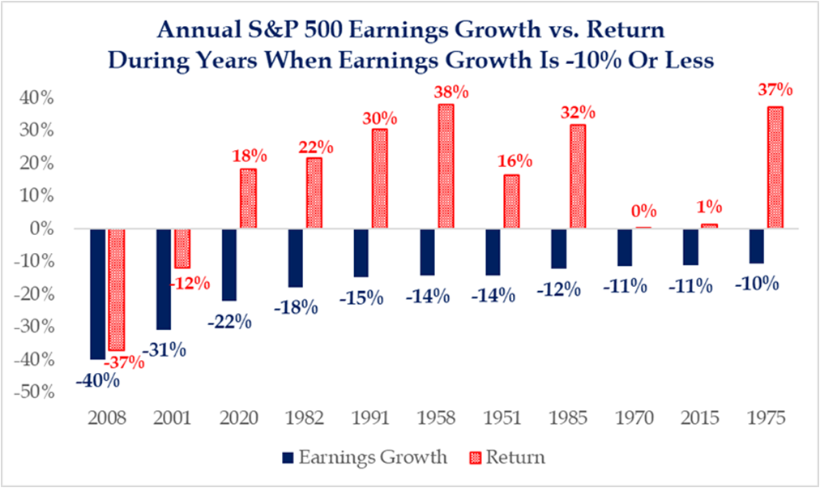
Market Returns in Years of Earnings Declines
Again, the bears say it’s all about earnings. History says not so. The market is driven by three things…P/E’s, inflation/rates and earnings. There are plenty of examples where trends in the first two swamp trends in earnings regarding market impact.
Source: Strategas - The S&P 500 Index is unmanaged and cannot be directly invested into. Past performance does not guarantee future results. Investing involves risk and the potential to lose principal.

Slide 21
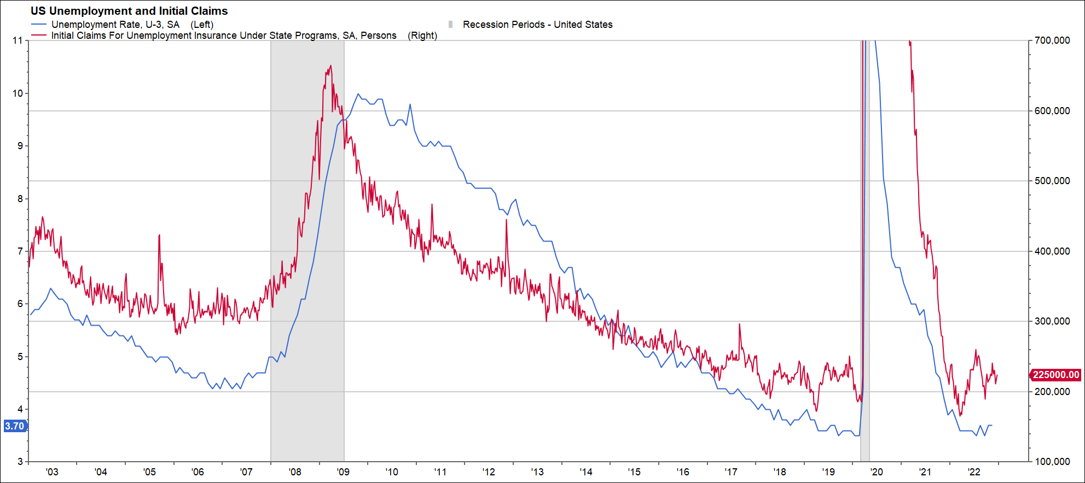
Labor Market is Healthy
The Fed expects unemployment to peak at about 4.5% in a slowdown…that sure isn’t the
10%-20% levels we’ve seen in prior hard landing recessions
Source: FactSet

Slide 22
Earnings Expectations
S&P 500 forward earnings expectations continue to decline, but earnings are still expected to grow about 7% per year through 2025. Hardly cause to sound the recession alarm bells.
Source: FactSet - The earnings expectations are based on various assumptions and there is no guarantee that expectations will be realized. Forecasts are subject to change at any time.

Slide 23
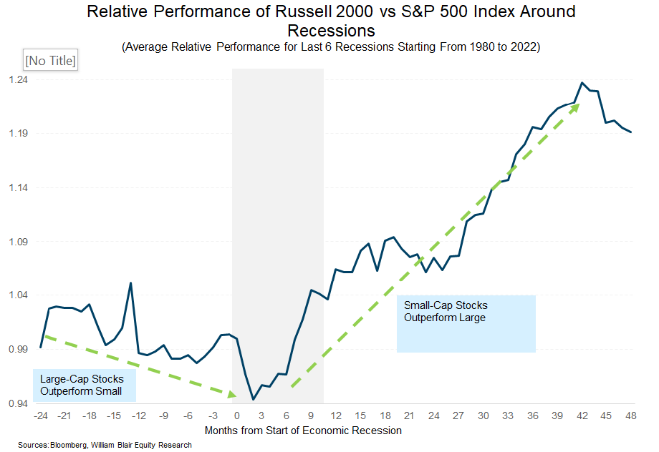
Small-Cap Cycle Begins Early
Small caps historically outperform as recovery unfolds and the Fed ceases restrictive policy.
Sources: Bloomberg, William Blair Equity Research - Indexes are unmanaged and cannot be directly invested into. Past performance does not guarantee future results. Investing involves risk and the potential to lose principal.

Slide 24
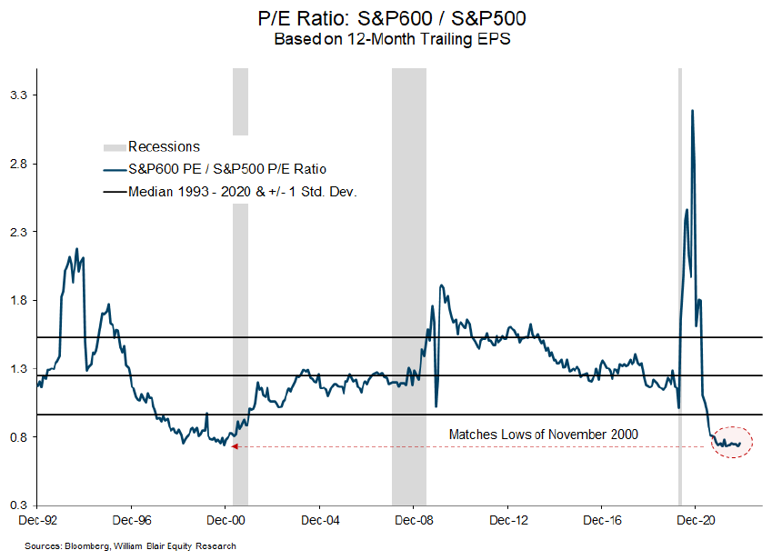
Small-Cap Relative Valuations
Small-cap relative valuation are cheap compared to large-cap.
Sources: Bloomberg, William Blair Equity Research - Indexes are unmanaged and cannot be directly invested into. Past performance does not guarantee future results. Investing involves risk and the potential to lose principal.

Slide 25
What To Do
Don’t predict the predictors
Patience is a virtue
Continue to hold your ground
Be poised to increase equity exposure when rates calm
Maintain a blend of growth and value in equity portfolios
  Long duration is not dead
Active management can add value in this environment
Bonds have become more attractive
Small caps could be a good opportunity

Slide 26
Disclosures
This presentation is intended for educational and informational purposes only. The presentation is limited to disseminating general information on Mariner Wealth Advisors’ investment advisory services and general economic market conditions. The views expressed are for commentary purposes only and do not take into account any individual personal, financial, or tax considerations. As such, the information contained herein is not intended to be personal legal, investment or tax advice or a solicitation to buy or sell any security or engage in a particular investment strategy. Nothing herein should be relied upon as such, and there is no guarantee that any claims made will come to pass. Any opinions and forecasts contained herein are based on information and sources of information deemed to be reliable, but Mariner Wealth Advisors does not warrant the accuracy of the information that this opinion and forecast is based upon. You should note that the materials are provided "as is" without any express or implied warranties. Opinions expressed are subject to change without notice and are not intended as investment advice or to predict future performance. Consult your financial professional before making any investment decision.
Individuals cannot invest directly in an index. Index returns do not include fees and expenses. Investing in securities involves risk of loss, including loss of principal, that clients should be prepared to bear. Past performance is not indicative of future results.
Mariner Wealth Advisors (“MWA”) is an SEC registered investment adviser with its principal place of business in the State of Kansas. Registration of an investment adviser does not imply a certain level of skill or training. MWA is in compliance with the current notice filing requirements imposed upon registered investment advisers by those states in which MWA maintains clients. MWA may only transact business in those states in which it is notice filed or qualifies for an exemption or exclusion from notice filing requirements. Any subsequent, direct communication by MWA with a prospective client shall be conducted by a representative that is either registered or qualifies for an exemption or exclusion from registration in the state where the prospective client resides. For additional information about MWA, including fees and services, please contact MWA or refer to the Investment Adviser Public Disclosure website (www.adviserinfo.sec.gov). Please read the disclosure statement carefully before you invest or send money.
Equity Risks: The value of equity securities is sensitive to stock market volatility. Equity securities may fluctuate in response to news on companies, industries, market conditions, and the general economic environment. The share prices of small and mid-cap companies may exhibit greater volatility than the share prices of larger capitalization companies. In addition, shares of small and mid-cap companies are often less liquid than larger capitalization companies. International investing entails greater risk, as well as greater potential rewards compared to U.S. investing. These risks include political and economic uncertainties of foreign countries as well as the risk of currency fluctuations. These risks are magnified in countries with emerging markets since these countries may have relatively unstable governments and less established markets and economies.
Fixed Income Risks: Investing in any bond market is subject to risks, including market, interest rate, issuer, credit, inflation risk, and liquidity risk. The value of most bonds and bond strategies are impacted by changes in interest rates. Bonds and bond strategies with longer durations tend to be more sensitive and volatile than those with shorter durations; bond prices generally fall as interest rates rise, and the current low-interest rate environment increases this risk. Current reductions in bond counterparty capacity may contribute to decreased market liquidity and increased price volatility. Bond investments may be worth more or less than the original cost if sold prior to maturity. Amortization/accretion of cost basis for a bond held to maturity will not result in a loss to the client based on the yield locked in at the time of purchase.
Index Definitions: S&P 500 Index is a market-value weighted index provided by Standard & Poor’s and is comprised of 500 companies chosen for market size and industry group representation. S&P 500 Value Index represents value stocks measured by three factors: book value ratios, earnings, and sales to price. S&P 500 Growth Index represents the fastest-growing companies in the S&P 500. The index identifies growth stocks using three factors: sales growth, the ratio of earnings change to price, and momentum. S&P Target Risk Moderate Index is designed to measure the performance of moderate stock-bond allocations to fixed income while seeking to increase opportunities for higher returns through equities. MSCI ACWI Index captures large and mid cap representation across 23 Developed Markets (DM) and 24 Emerging Markets (EM) countries*. With 2,885 constituents, the index covers approximately 85% of the global investable equity opportunity set. MSCI EAFE Index is an equity index that captures large and mid-cap representation across 21 Developed Markets countries around the world, excluding the US and Canada. With 796 constituents, the index covers approximately 85% of each country's free float-adjusted market capitalization. MSCI Emerging Markets Index captures large and mid-cap representation across 24 Emerging Markets (EM) countries. With 1,377 constituents, the index covers approximately 85% of each country's free float-adjusted market capitalization. Russell 1000 Value Index measures the performance of those Russell 1000 Index companies with lower price-to-book ratios and lower forecasted growth values. Russell 1000 Growth Index measures the performance of those Russell 1000 Index companies with higher price-to-book ratios and higher forecasted growth values. Russell 2000 Index is an index measuring the performance of approximately 2,000 smallest-cap American companies in the Russell 3000 Index, which is made up of 3,000 of the largest U.S. stocks. It is a market-cap-weighted index. Bloomberg U.S. Aggregate Bond Index provides a measure of the performance of the U.S. dollar-denominated investment-grade bond market, which includes investment-grade government bonds, investment-grade corporate bonds, mortgage pass-through securities, commercial mortgage-backed securities, and asset-backed securities that are publicly for sale in the United States. Bloomberg USD High-Yield Corporate Bond Index is a rules-based, market-value-weighted index engineered to measure publicly issued non-investment grade USD fixed-rate, taxable and corporate bonds. Bloomberg U.S. Corporate Index is a broad-based benchmark that measures the investment grade, fixed-rate, taxable corporate bond market.

