Slide 1
Collabratec
Dave Green d.green@ieee.org

Slide 2
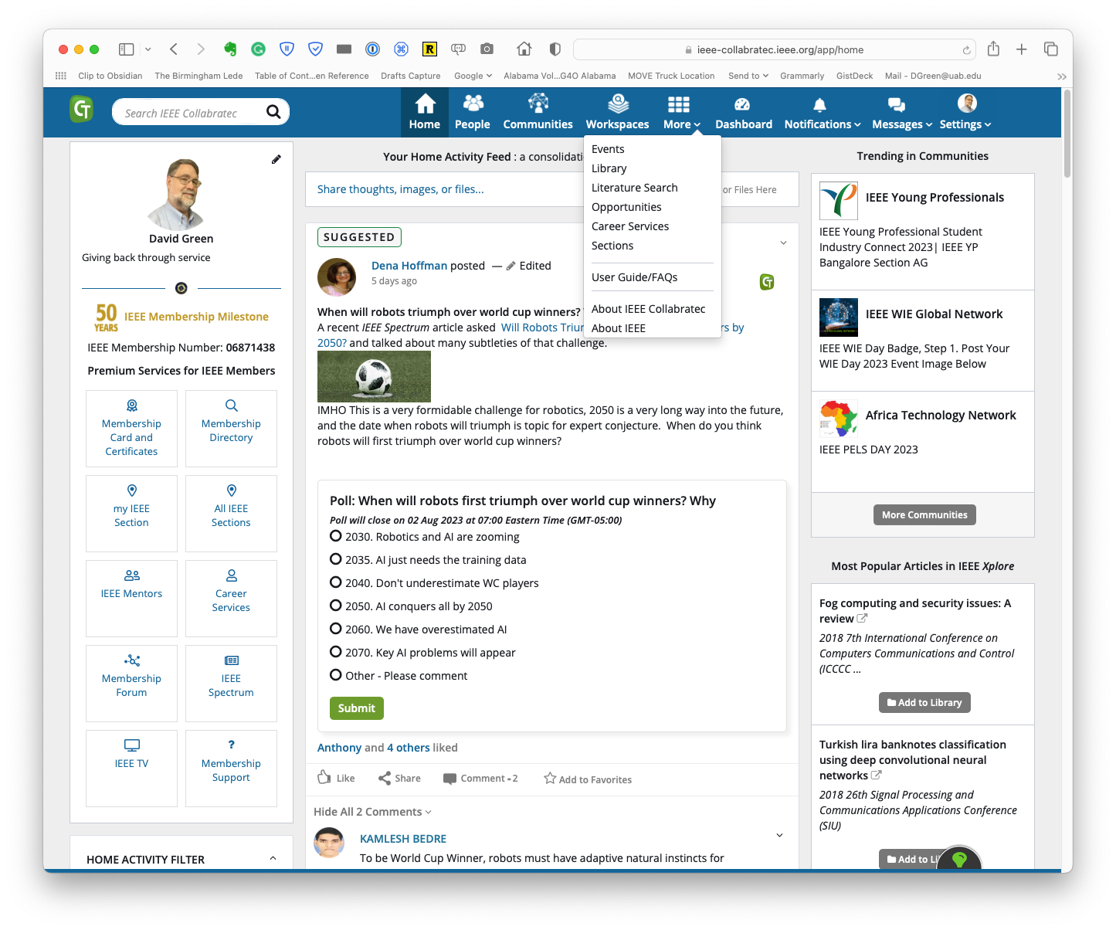
IEEE Collabratec
IEEE Collabratec is an integrated online community platform where technology professionals, especially engineers, can discover, connect and collaborate --- all in one central hub.
IEEE developed & operated
Mobile Friendly Web Site
IEEE Web Account credentials
No company/country blocks due to third parties
Project began in 2013, announced at SC2014.
Incremental Improvements
https://collabratec.ieee.org

Slide 3
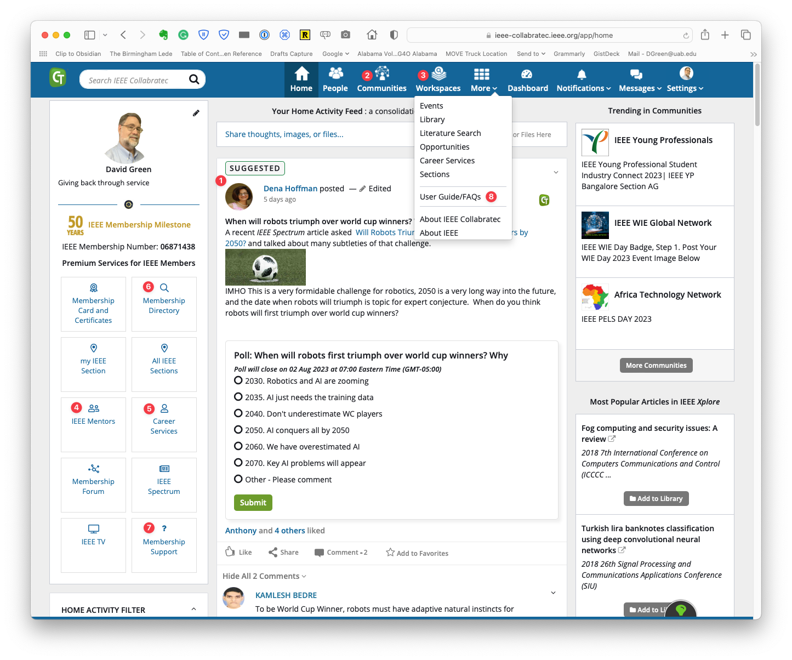
Major Modes
Stream with Network
Communities
Workspaces (Individual & Group)
Mentoring
Opportunities
Member Directory
Linkage to Other IEEE Services
User Guide

Slide 4
Sample Communities
Artificial Intelligence
Cyberethics
IEEE Entrepreneurship Exchange
5G
Smart Cities
MOVE Community Outreach Inside Scoop
IEEE AuthorLab
IEEE Collabratec Users Forum
Women in Leadership
IEEE Puzzlers
Climate Change
Cloud Computing
IEEE Foundation
IEEE Membership Forum
IEEE Membership Development
IEEE Sustainability
IEEE Internet of Things
vTools User Community
Eta Kappa Nu
Proceedings of the IEEE

Slide 5
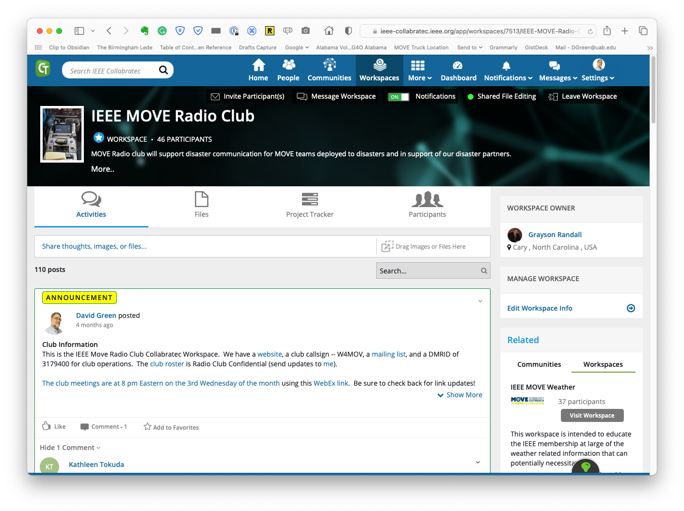
Focus on Workspaces
Individuals or
Groups
Sections
Chapters
Committees
Working Groups
Article Publication
Various Invite Models
Soft Limits
Special version for formal OUs that will auto-populate some members
https://sites.google.com/ieee.org/ieee-collabratec-info-pages/workspaces?authuser=0

Slide 6
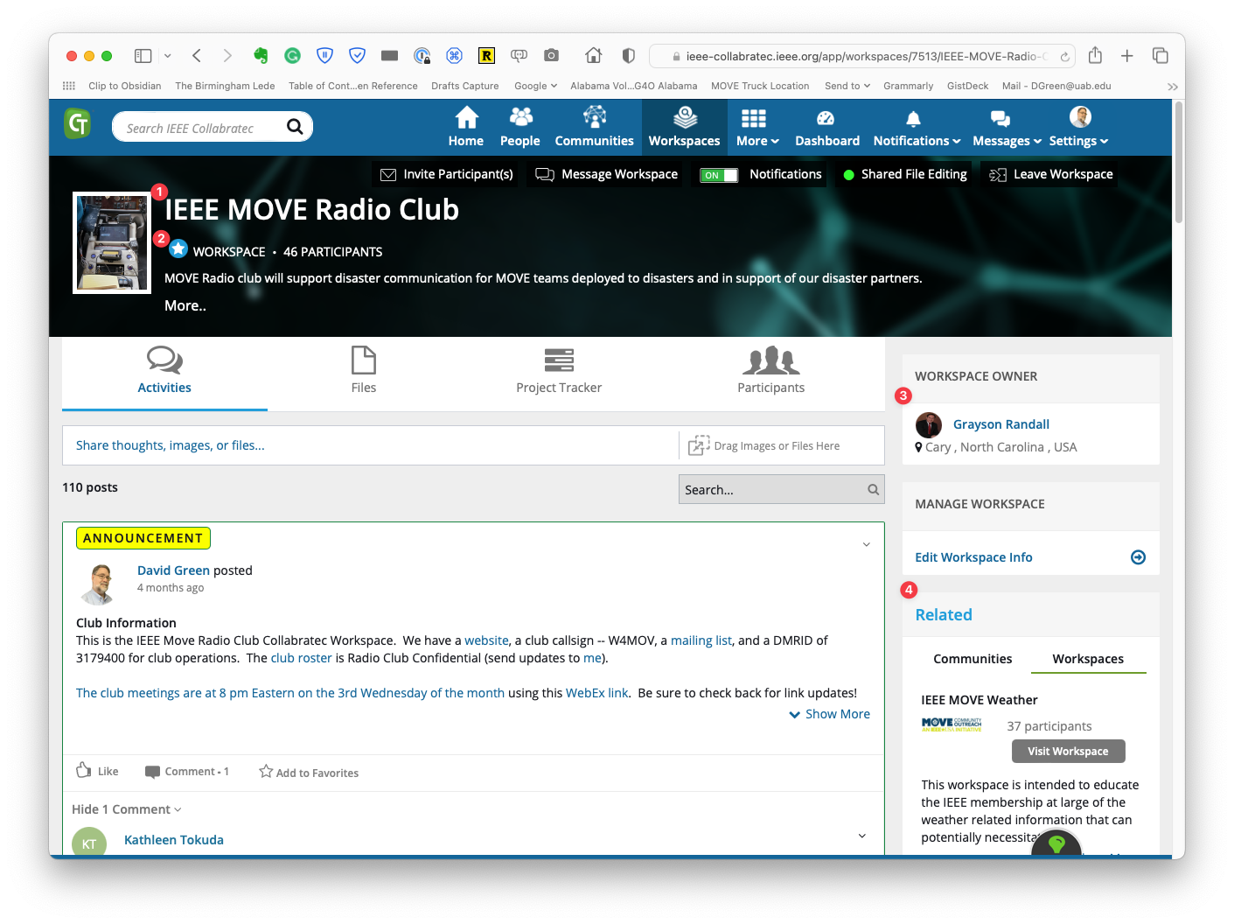
Defining a Workspace
Name & Graphic
Can be a personal favorite
Owned by a user
Can be linked to related Communities and Workspaces

Slide 7
Workspace Control
Invite participants (by name, email, URL). E-mail/URL invites can be to non-Collabratec users
Send messages (in CT)
Get notifications for this Workspace
Shared file editing (if set up for Google)

Slide 8
Manage Workspace
Edit Workspace Info

Slide 9
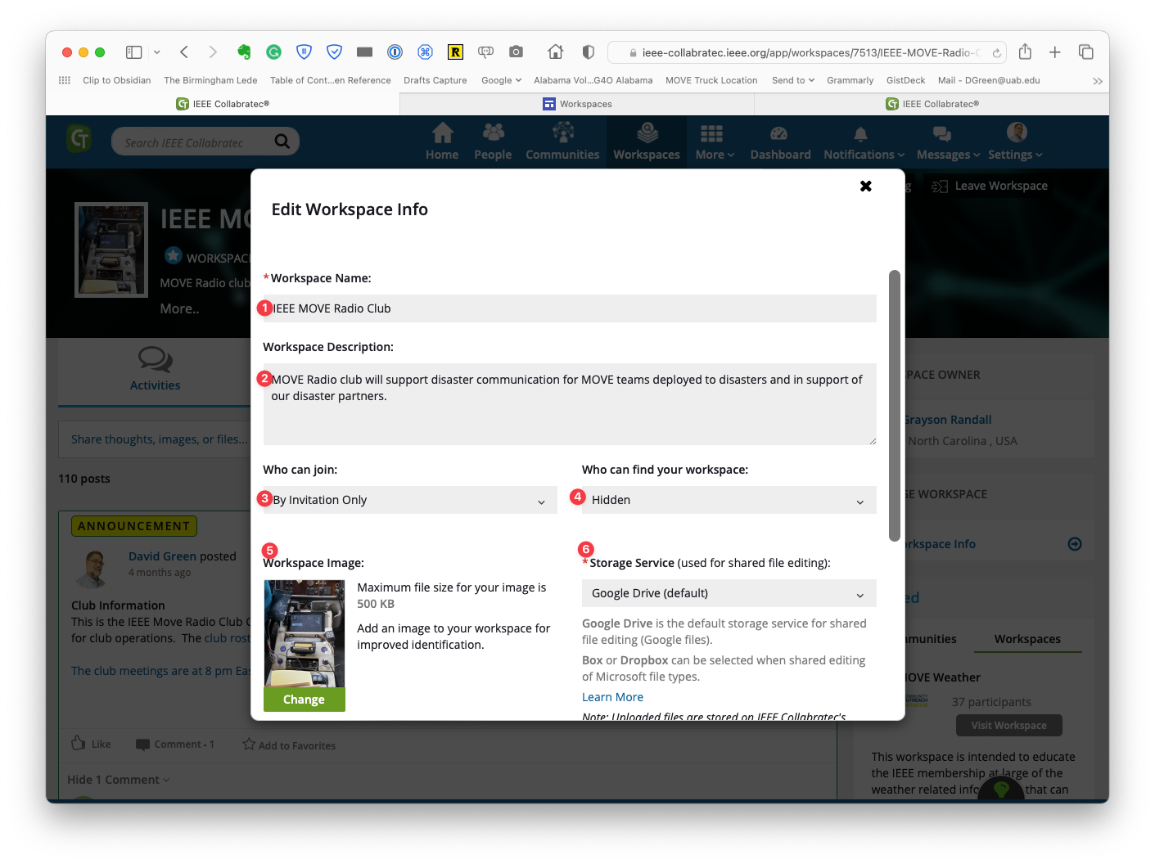
Manage Workspace
Change
Name
Description
Join Model
Visibility
Workspace Image
Storage (stay with Google!)

Slide 10
Activities
Stream
Posts and replies
Joins
File operations (optionally)
Use Announcement & Post Promotion to put things at top of the stream

Slide 11
Files
Storage

Slide 12
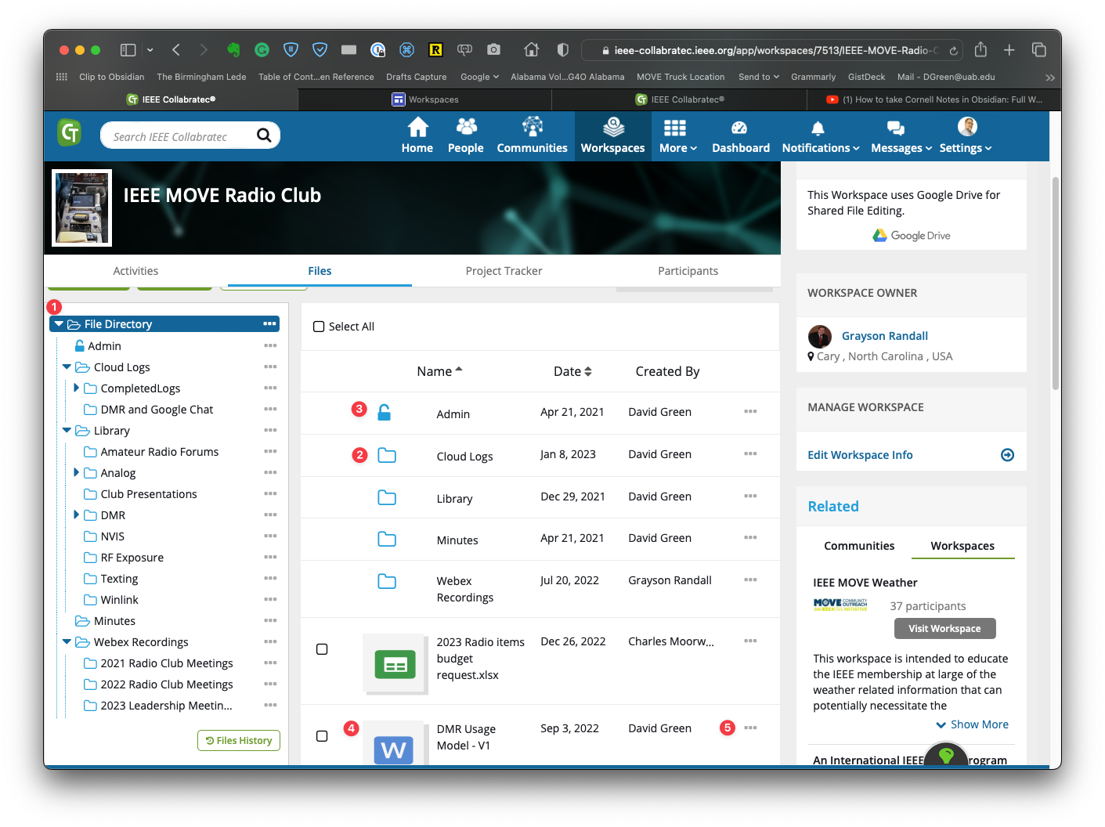
Files
Tree Structure
Folder selected directory
Limited Access Folder
File
Actions

Slide 13
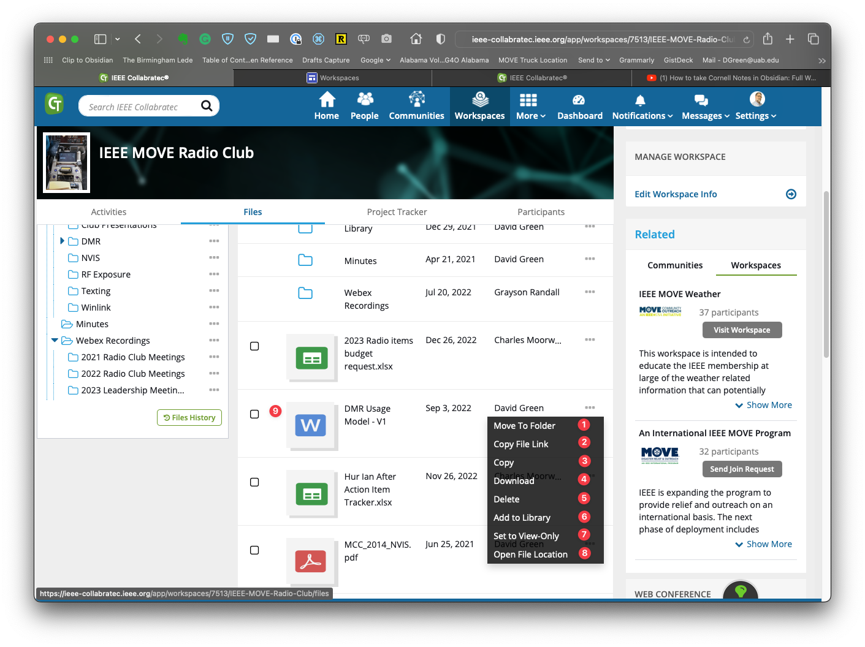
File Actions
Move to another folder
Get URL to file
Duplicate the file
Download the file
Delete the file
Add file to personal library
Set to Read-Only
Show directory for file
Open File by clicking

Slide 14
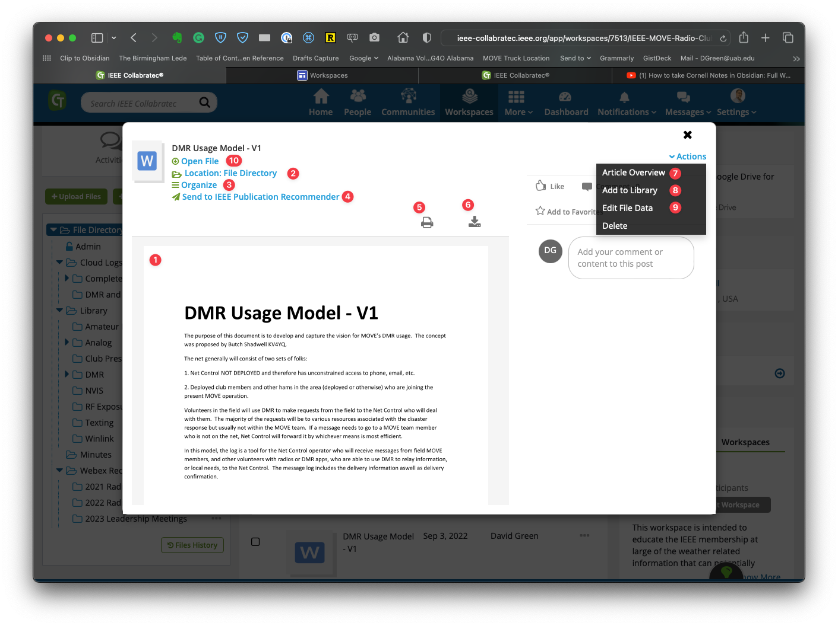
File Open (clicked)
Read only rendering of file
Show folder for directory
Add note, tags
Pubs action
Print
Download
Article info (authors, etc.)
Add to personal library
Edit file data (including file name)
(really) Open the file

Slide 15
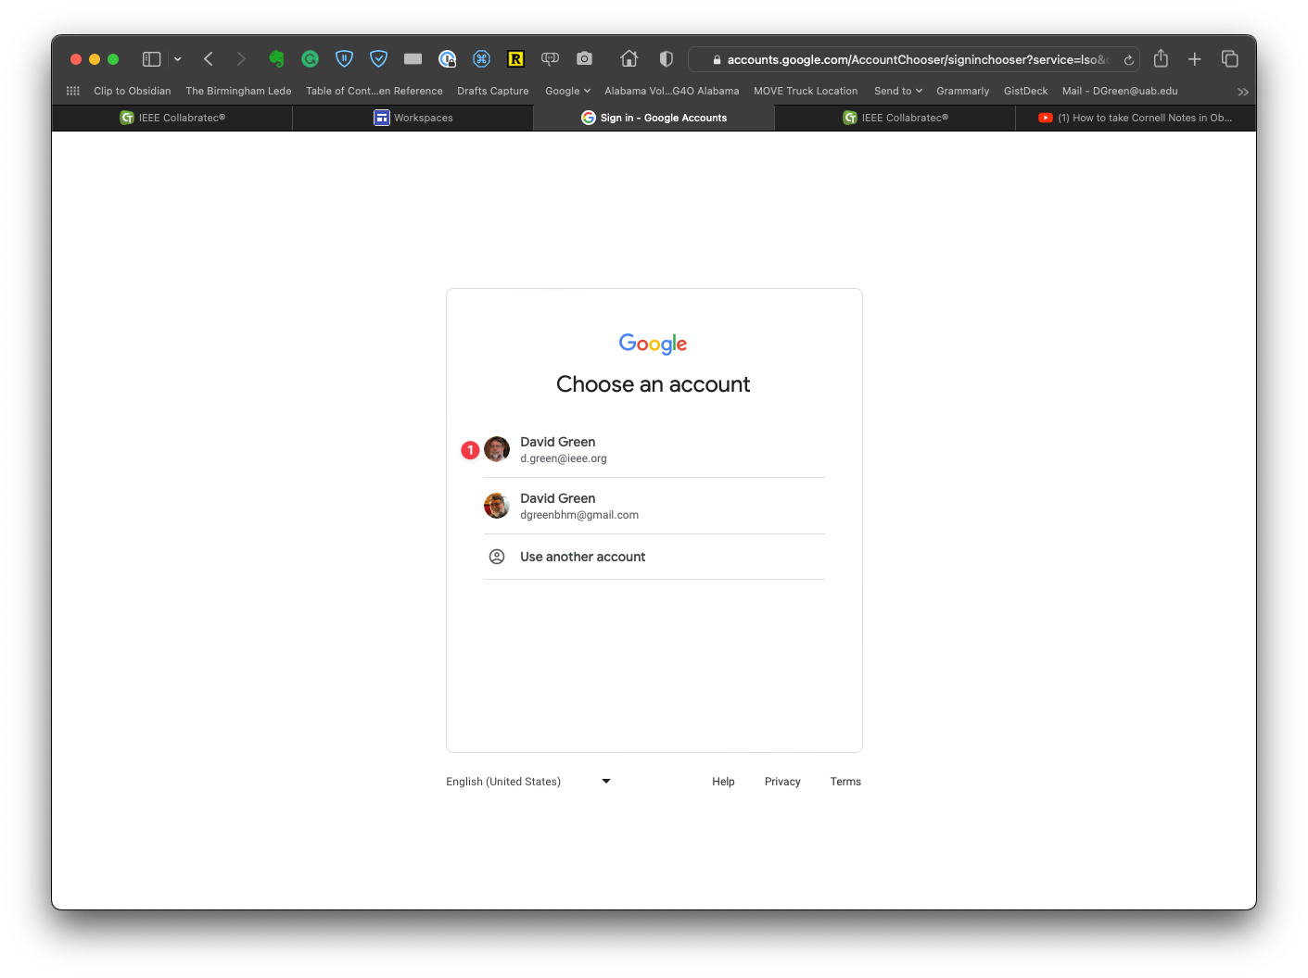
File open - Account
If more than one Google account known, select the right one

Slide 16
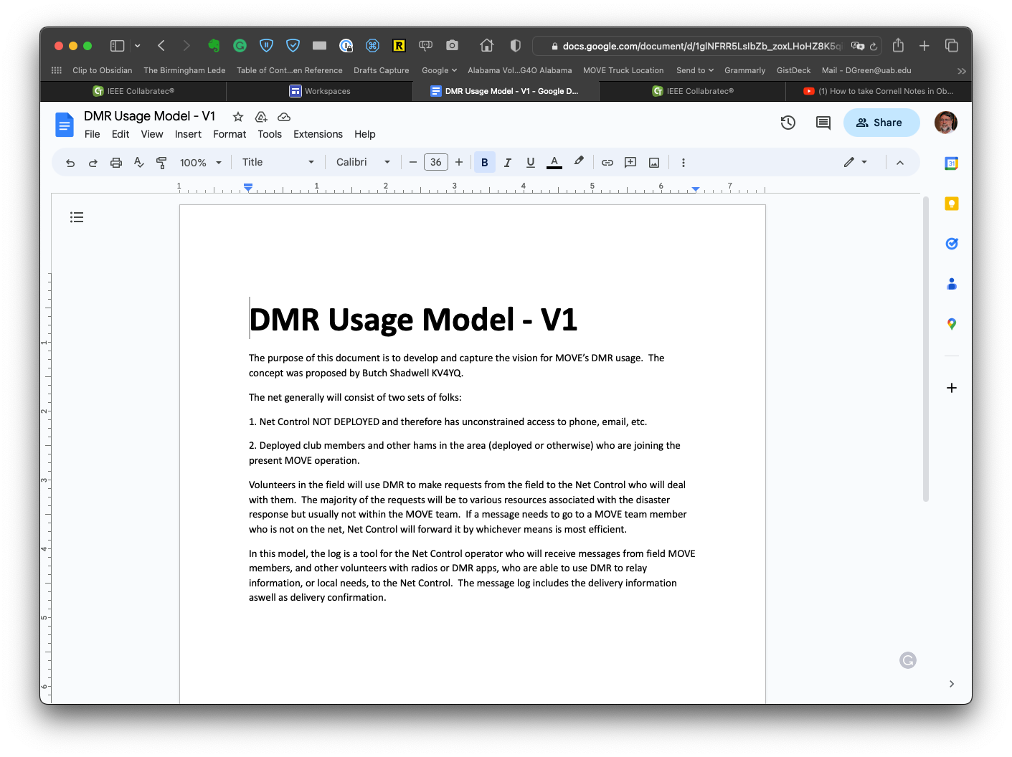
File open for edit
Collaborative file editing using Google Docs, Sheets, and Slides.

Slide 17
Participants

Slide 18
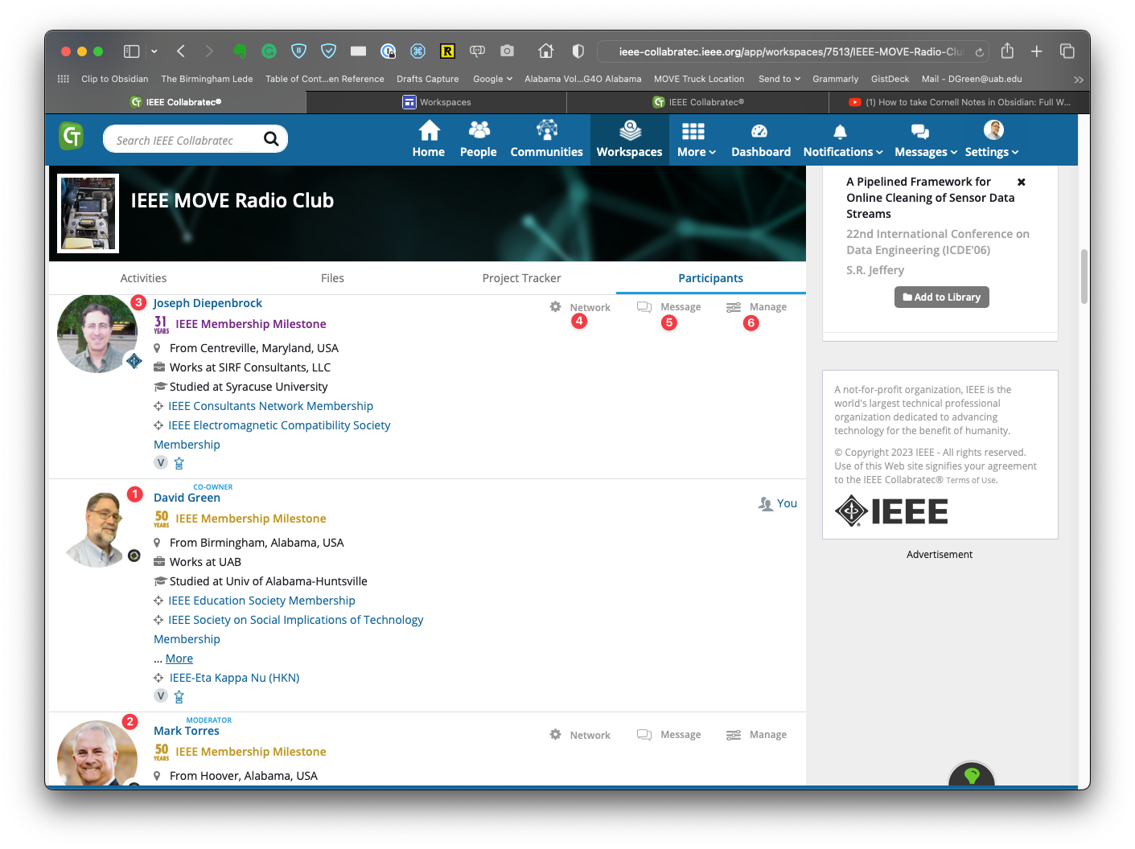
Participants
A Co-owner
A Moderator
A member
Add/remove to your personal network
Send a message
Adjust role (if owner or co-owner)

Slide 19
Some of the New Collabratec Features in 2023
Help finding directory of a file that you have the link for
New access control: Restricted in addition to Read Only ((check))
OU Workspaces – includes archival life cycle support
Default store – Google
Coming
UI Refresh

Slide 20
Mobile Friendly Web App
Add to Home Page
Move it where you want in your structure (like an IEEE collection)
Find it, start it and go from there.
Select the favorites
Choose your workspace (IEEE MOVE Radio Club)
Look at the stream
Look at the files

Slide 21
For more information
Ignite Session: IEEE Collabratec - Uniting the IEEE Community Globally
Speaker Name : Cybele Ghanem
Saturday | 12:00 - 12:50 | Ignite Stage Exhibit Hall
Help Site:
https://sites.google.com/ieee.org/ieee-collabratec-info-pages/ieee-collabratec-main?authuser=0

