Slide 1
Region 3 Meeting | 10 AUG
Ottawa, Canada | 11–13 AUG
vTools Engage
Vera Sharoff and Aubrey Walter
IEEE MGA Information Management

Slide 2
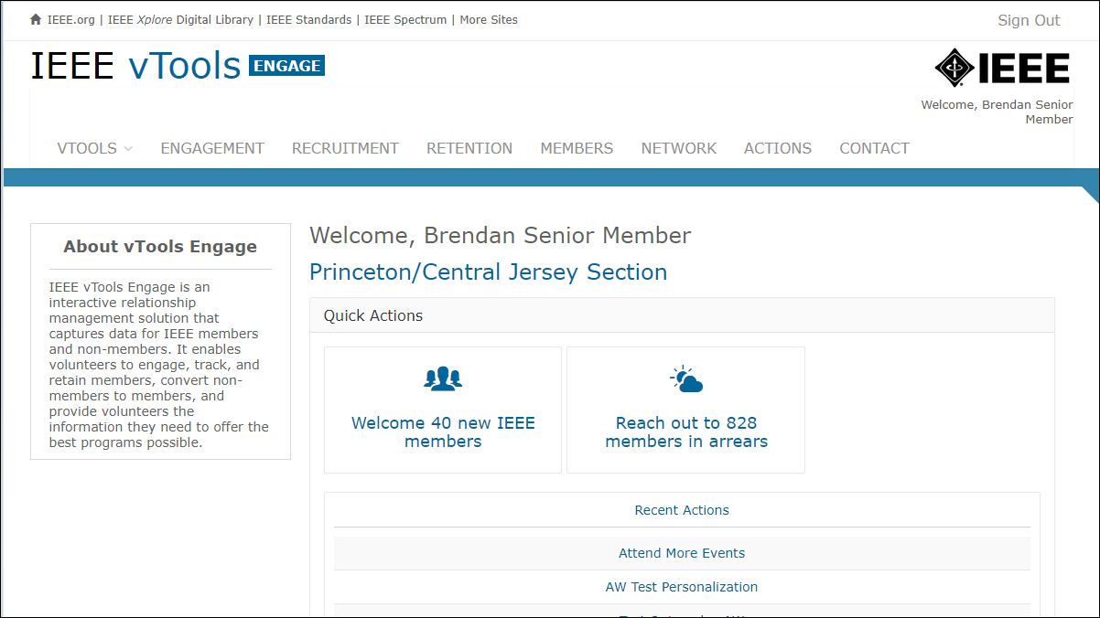
vTools ENGAGE
vTools Customer Relationship Management (CRM) system
https://engage.vtools.ieee.org/
Launched in December 2022
vTools Engage is an interactive relationship management solution that captures data for IEEE members and non-members.
Supports Regions and Sections
It enables volunteers to engage, track, and retain members, convert non-members to members, and provide volunteers the information they need to offer the best programs possible.

Slide 3
vTools ENGAGE
New Features as of 27 July 2023
Engagement Scores are now visible next to people’s names.
Click on the “eye” icon to view lists and see the corresponding engagement scores.
Customization in emails, like eNotice, is now available.
E.g., being able to pull in <First Name><Last Name>.
Add a CC to the OU Chair (or other ExCom) on emails sent from the platform.
When viewing lists, there is now a search box at the top of the screen that will allow you to search on any value on the page (name, status, engagement score, etc.).
Email stats, like in eNotice, are now visible, e.g., who opened, clicked, etc.

Slide 4
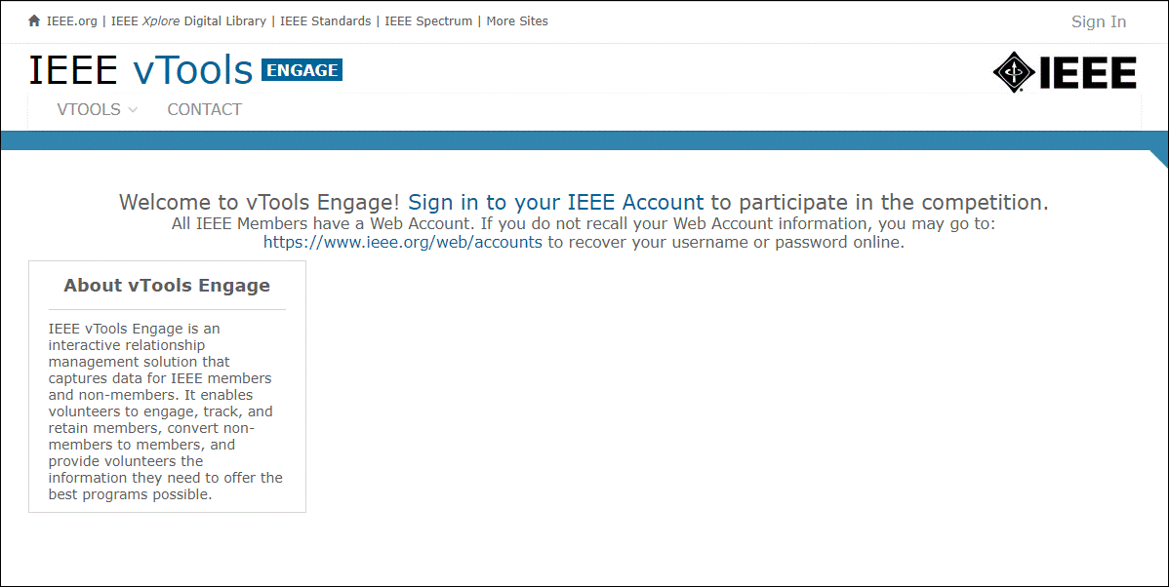

Slide 5
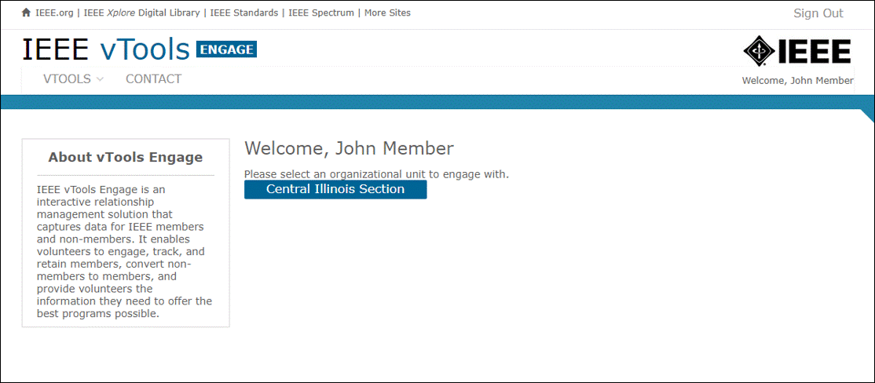

Slide 6
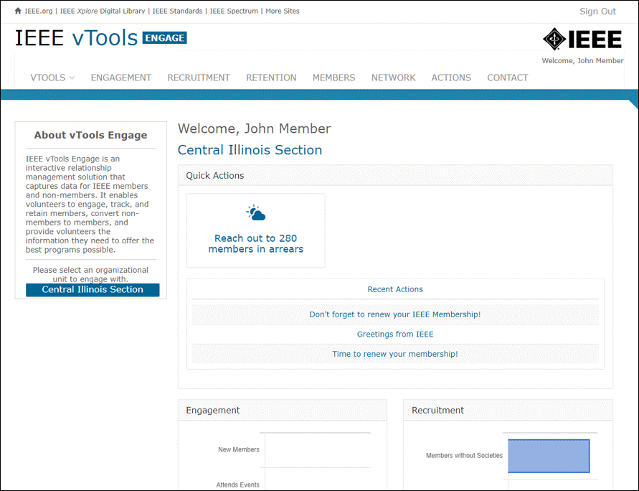
Quick Actions/Home Page
This is the “home” page for Engage. Here, you will be able to take the following quick actions:
Welcome ## New Members
Remind ## to Renew
Reach out to ## Members in Arrears
Note: If the count for any of these categories is ‘0’ (zero), then the quick action will not show.

Slide 7
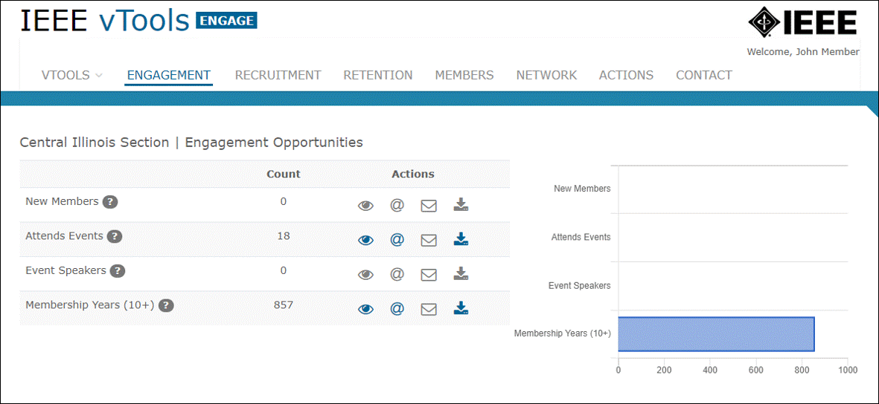
Engagement

Slide 8
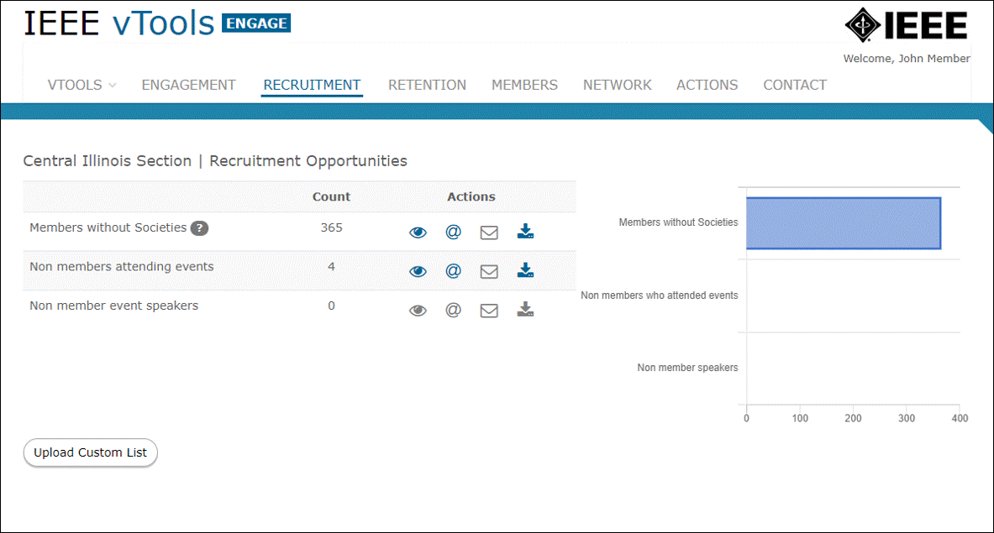
Recruitment

Slide 9
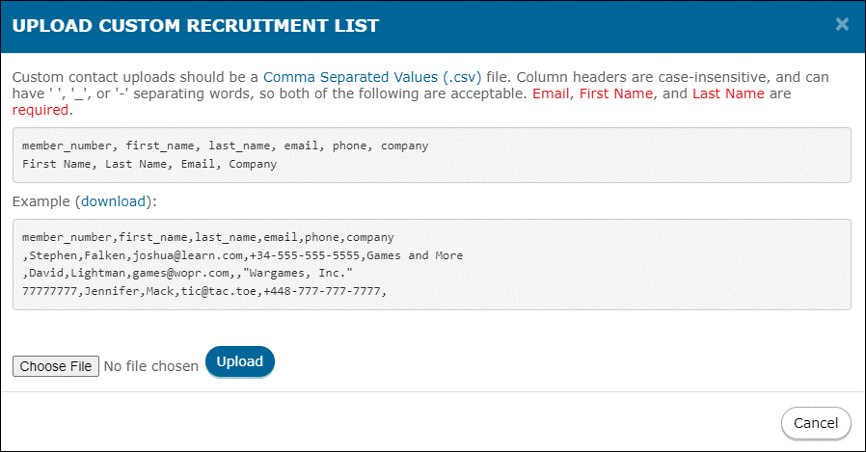
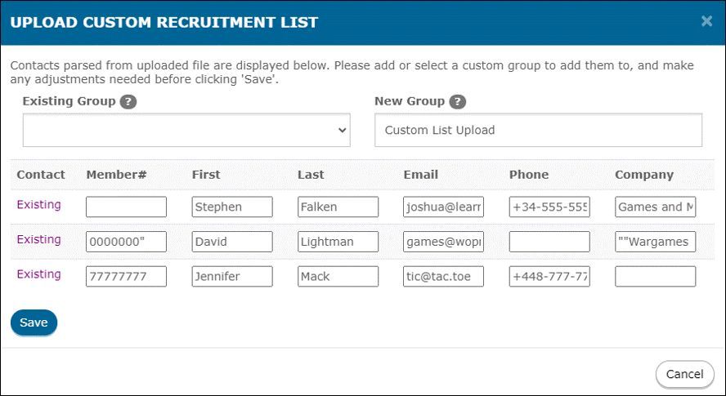
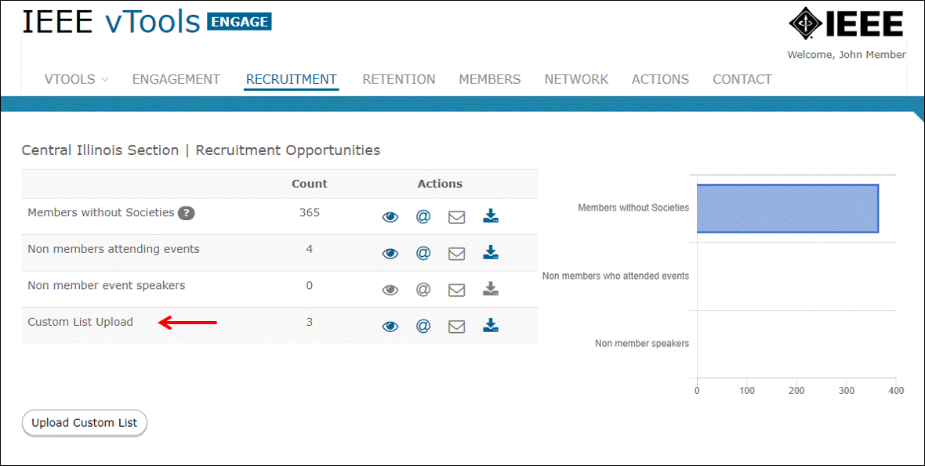

Slide 10
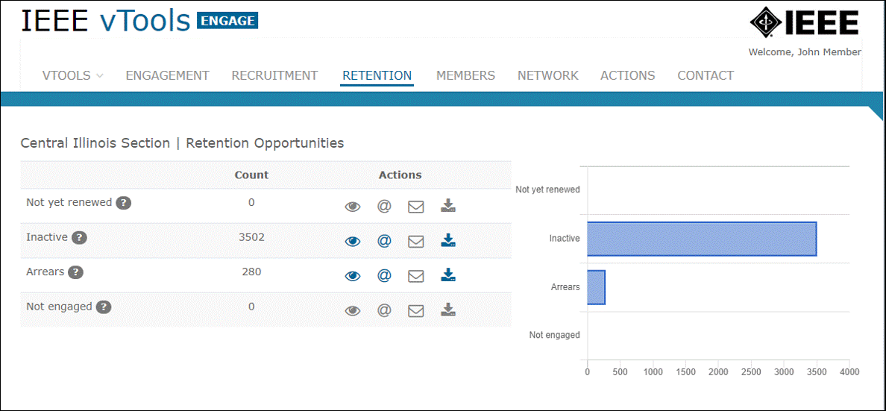
Retention

Slide 11
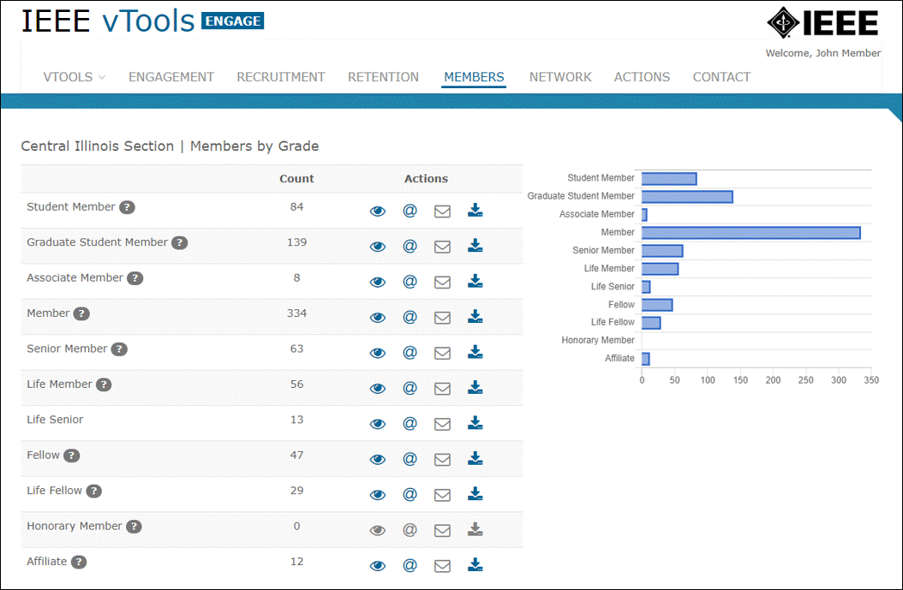
Members

Slide 12
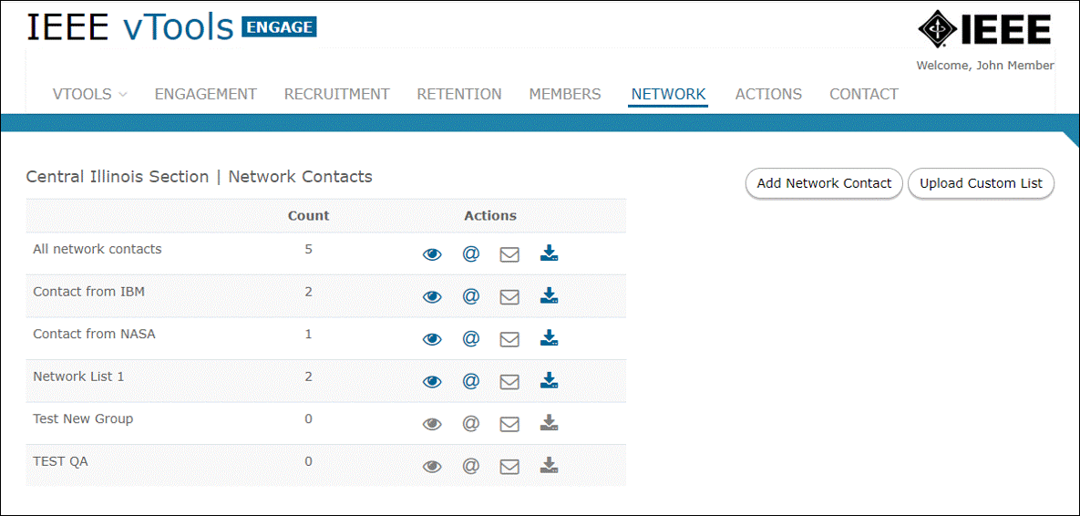
Network

Slide 13
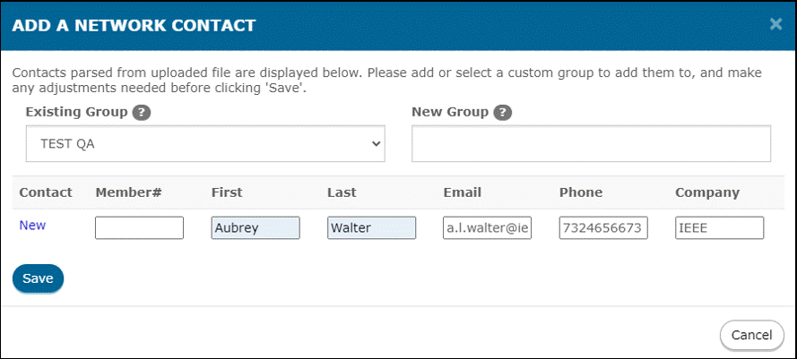
Add a Network Contact

Slide 14
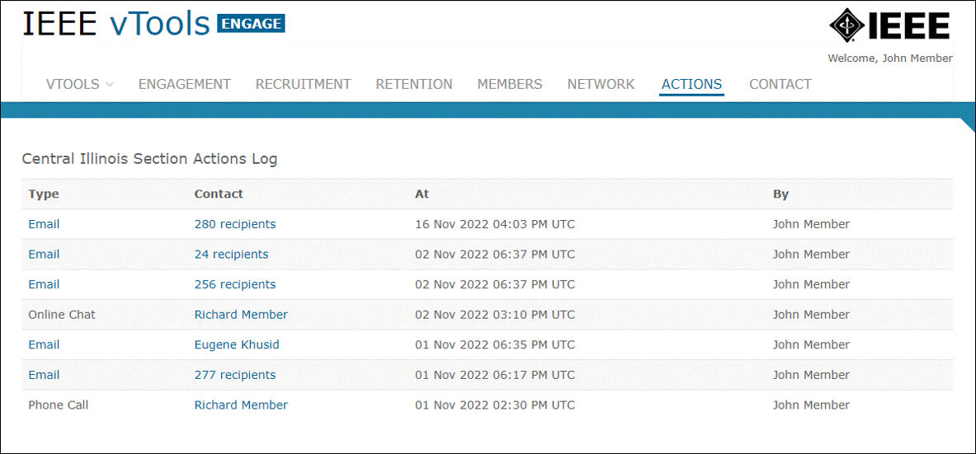
Actions

Slide 15
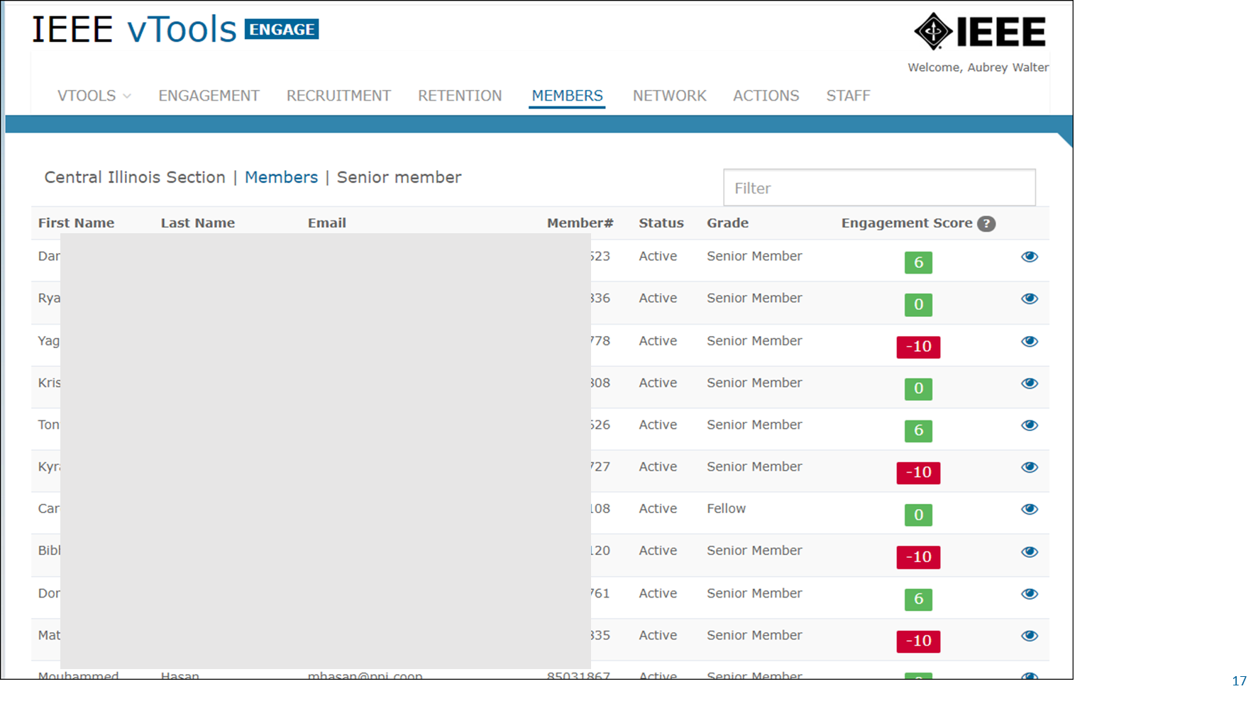

Slide 16
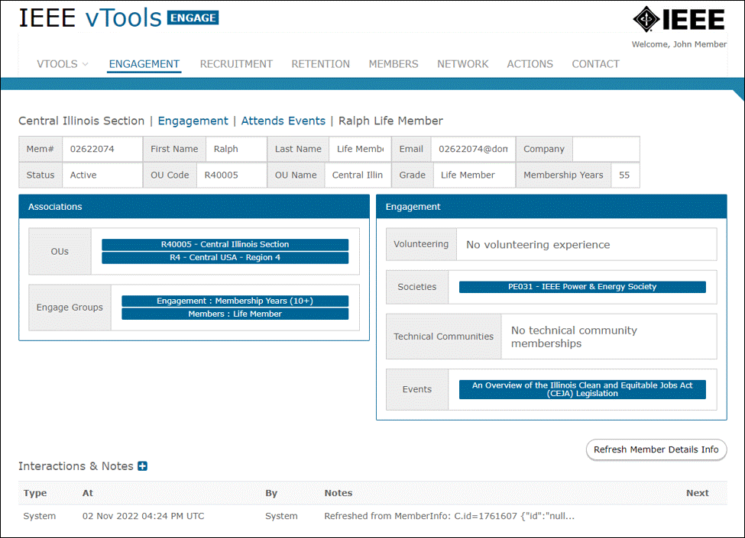
Viewing an Individual Member

Slide 17
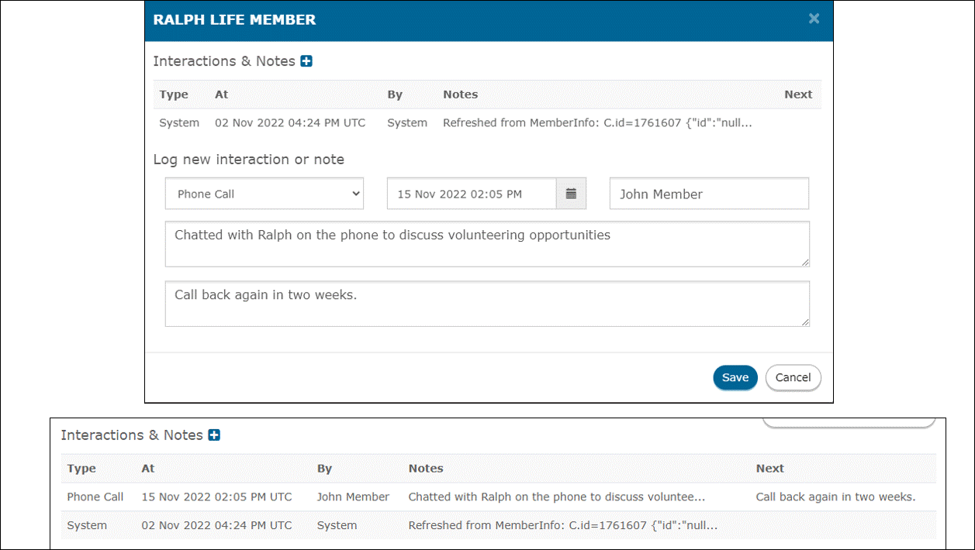
Log an Interaction/Note

Slide 18
Questions?

Slide 19
vTools Contacts
Vera Sharoff - v.sharoff@ieee.org
vTools - Aubrey Walter – a.l.walter@ieee.org
eNotice – Terence Martinez Jr. – martinez.t.c@ieee.org

