Slide 1
Region 3 Meeting | 10 AUG
Ottawa, Canada | 11–13 AUG

Slide 2
vTools Elections
Section (Officer) Elections
vTools Nominations (*new*)
vTools Elections

Slide 3
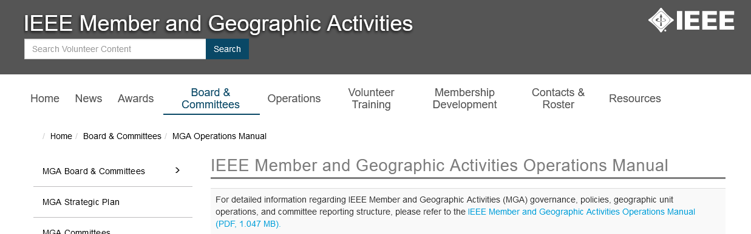
Section Elections
Must conform to MGA Operations Manual https://mga.ieee.org/board-committees/operations-manual
Key Elements:
- Section Officers (Section 9.5.F) – terms and eligibility - Section Nominating Committee (Section 9.5.G) - Section Election Process (Section 9.5.H)

Slide 4
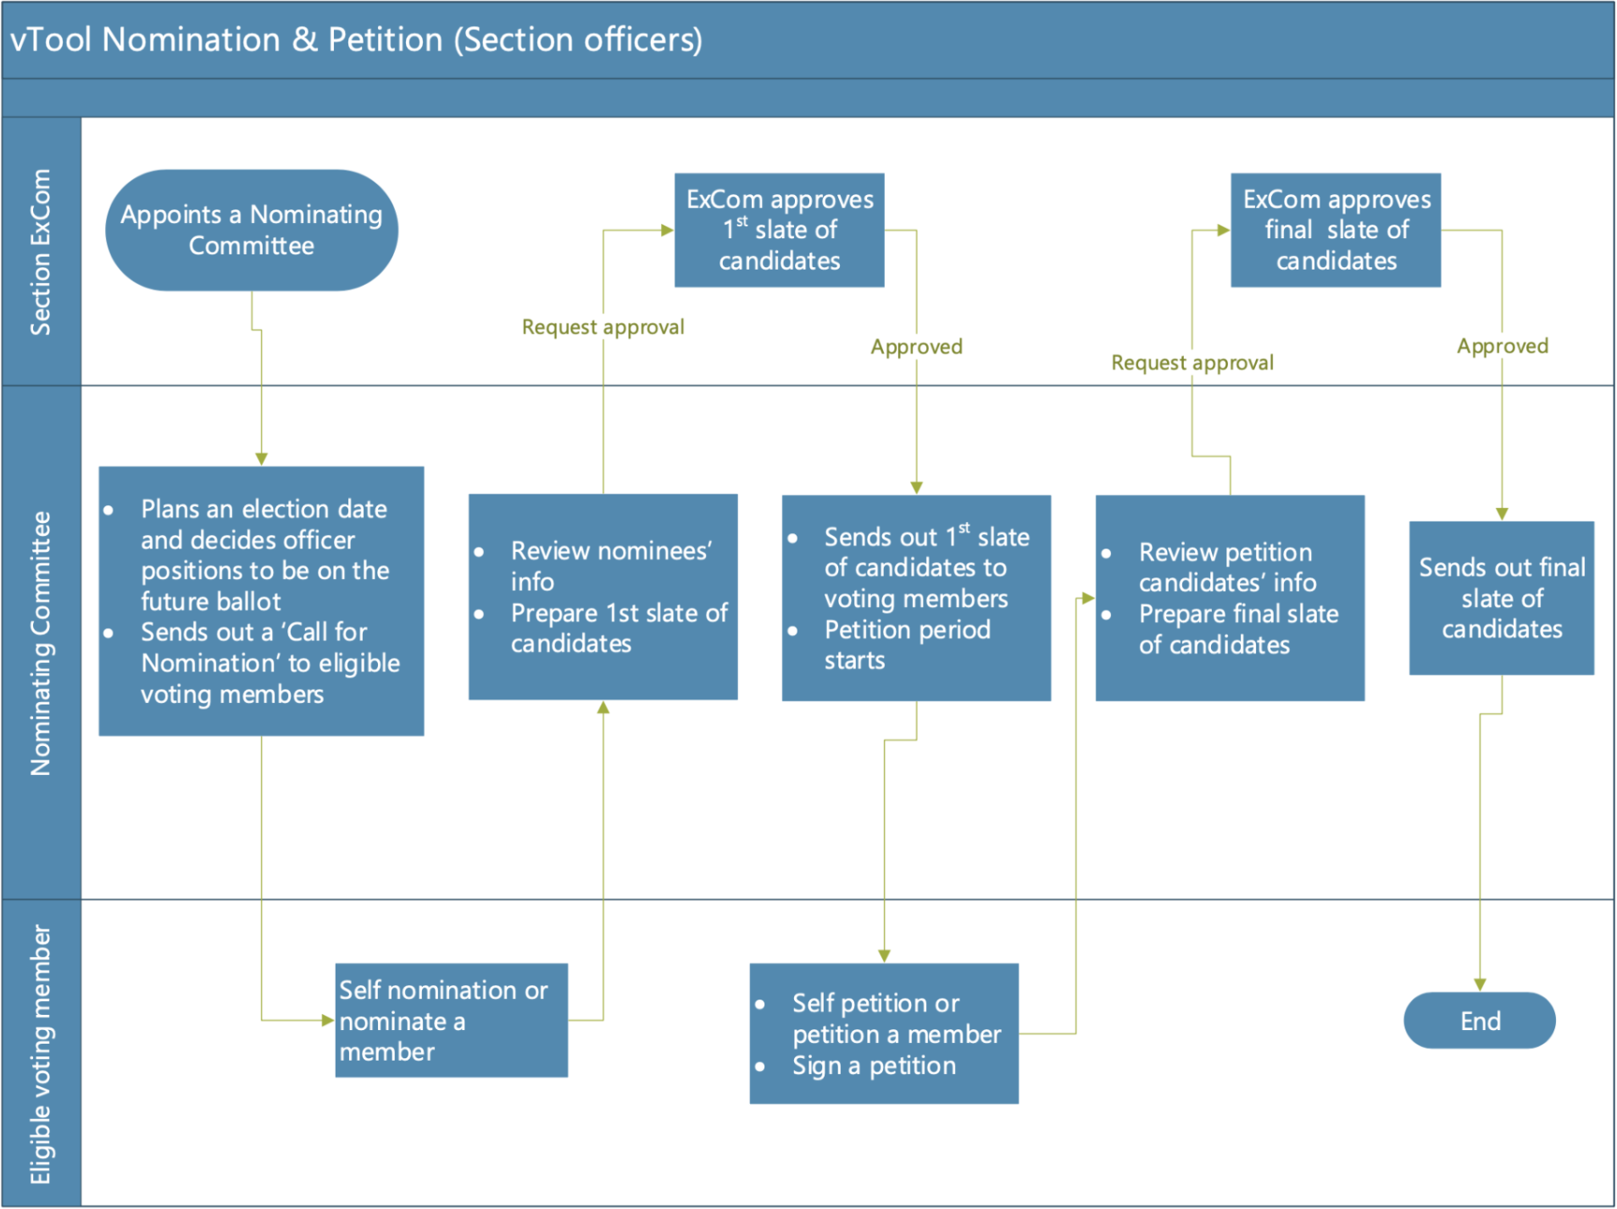
MGA Manual Timeline
Per MGA Operations Manual (29 June 2023)
2~3 for each position
@ >6 weeks before election date
@ >2 weeks before election date
@6 months before election date
Tellers Committee reports results to Section Chair
Section Chair informs each candidate of results
E-Notice of results to Section
Secretary reports to EEE (vTools)
Election begins
Duration: 1 month
Duration: 1 month
Signatures from 2% of eligible voters (<30k voters), or 600+1% marginal rate.
ends >28 days before election date

Slide 5
Shortened Timeline
Shortened Timeline Pilot for remainder of 2023
(requires Section to actively participate in Pilot)
https://mga.ieee.org/resources-operations/geographic-unit/geographic-unit-election-pilot
2~3 for each position
@ > ~8 weeks before election date
@ >1 week before election date
@ ~3 months before election date
Tellers Committee reports results to Section Chair
Section Chair informs each candidate of results
E-Notice of results to Section
Secretary reports to EEE (vTools)
Election begins
Duration: 1 month
Duration: 1 week
Signatures from 2% of eligible voters (<30k voters), or 600+1% marginal rate.
Ends @ > ~6 weeks before election date

Slide 6
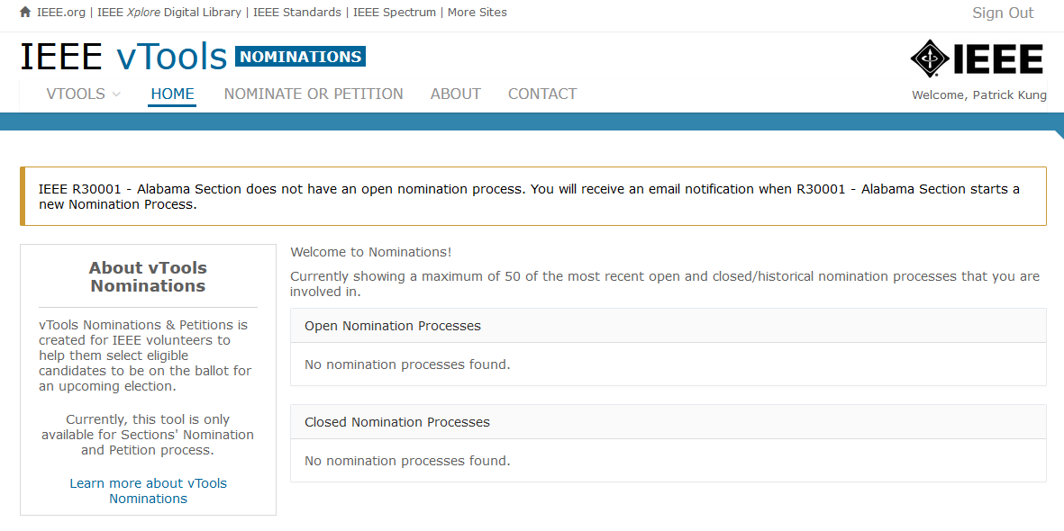
vTools Nominations
http://nominations.vtools.ieee.org/
(sign-in required)

Slide 7
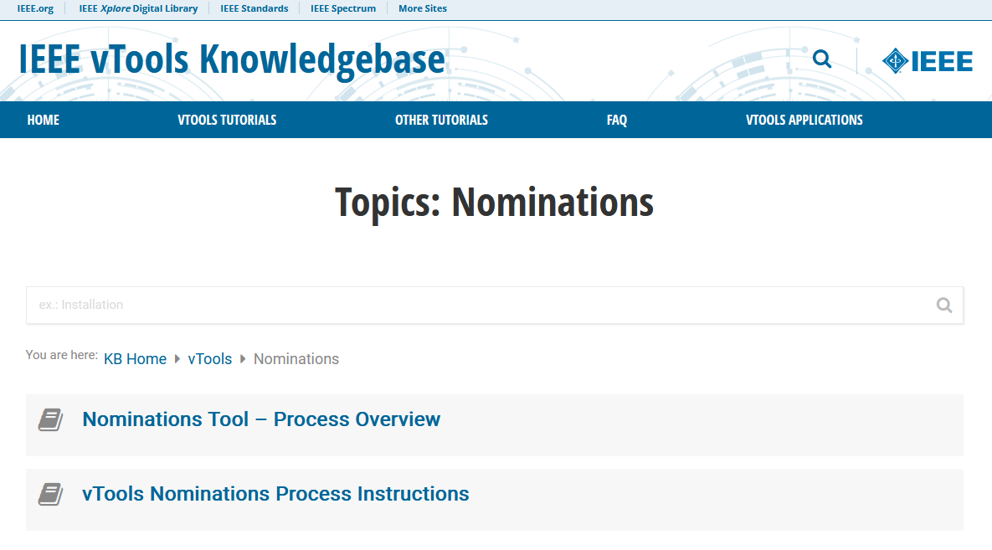
vTools Nominations
Currently: https://kb.ieee.org/vtools/blog/kbtopic/nominations/
or contact MGA staff

Slide 8
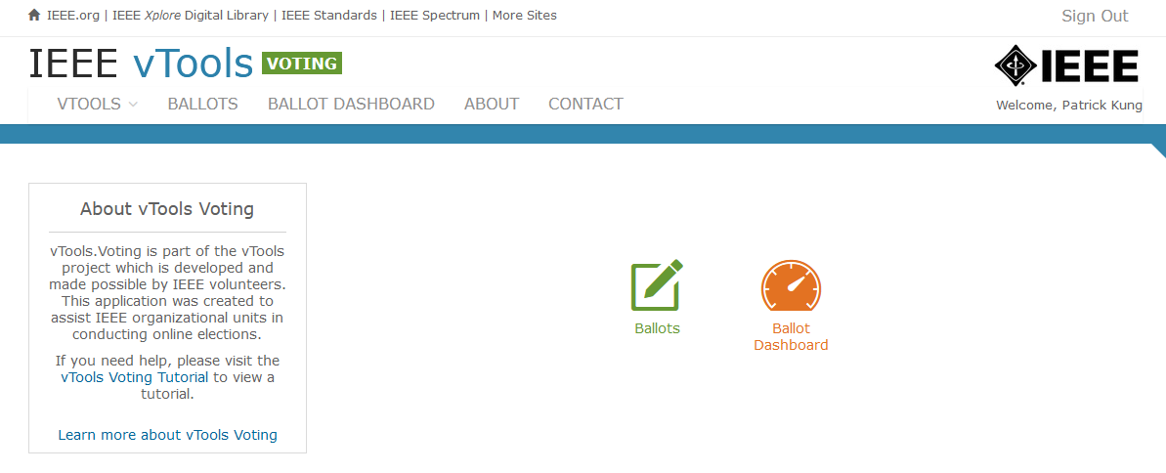
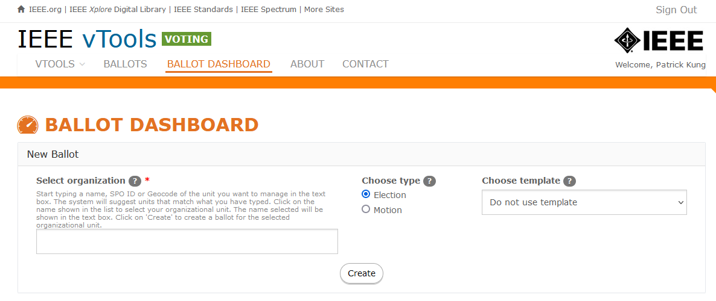
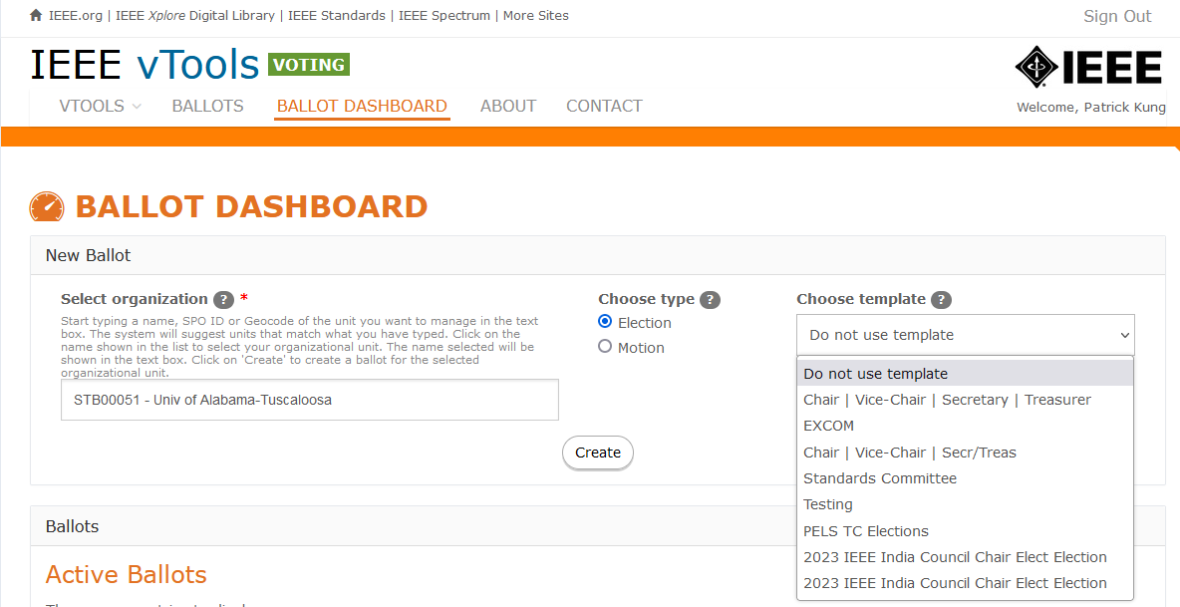
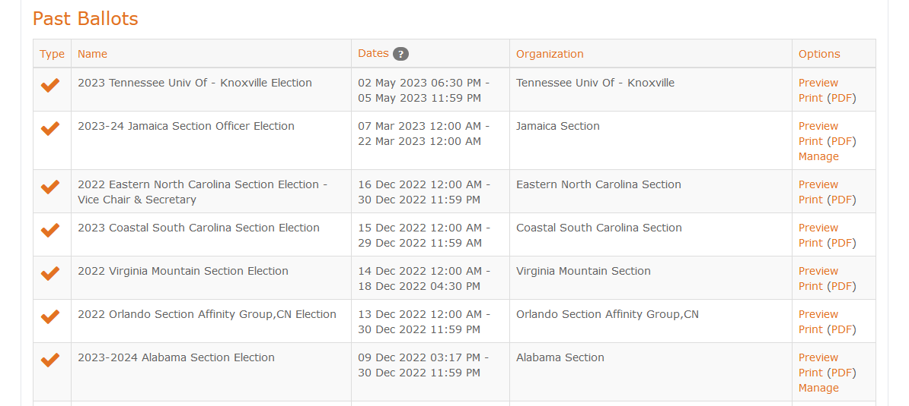
vTools Elections - Dashboard
http://voting.vtools.ieee.org/
(sign-in required)

Slide 9
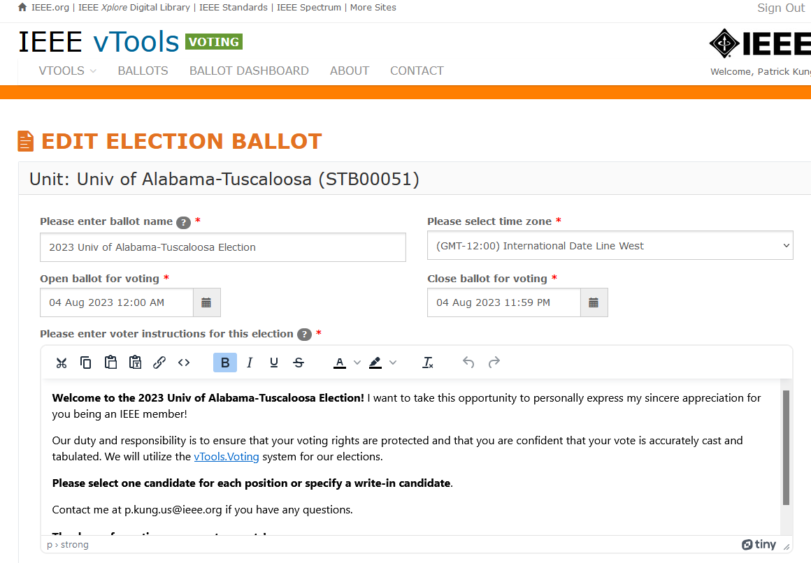
vTools Elections - Ballot

Slide 10
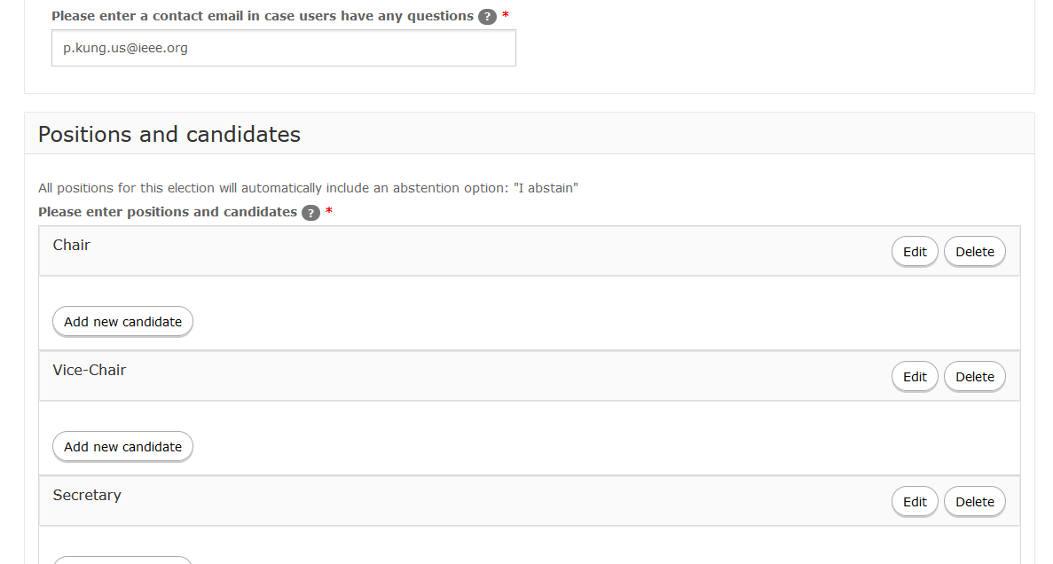
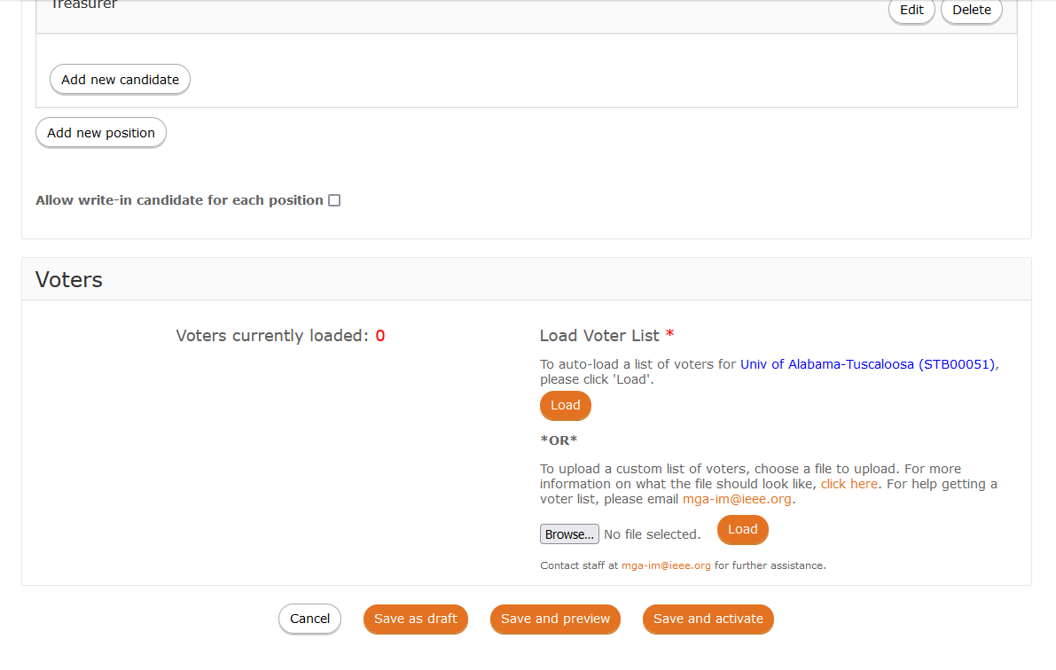
vTools Elections - Ballot
Bio, statement, photo

Slide 11
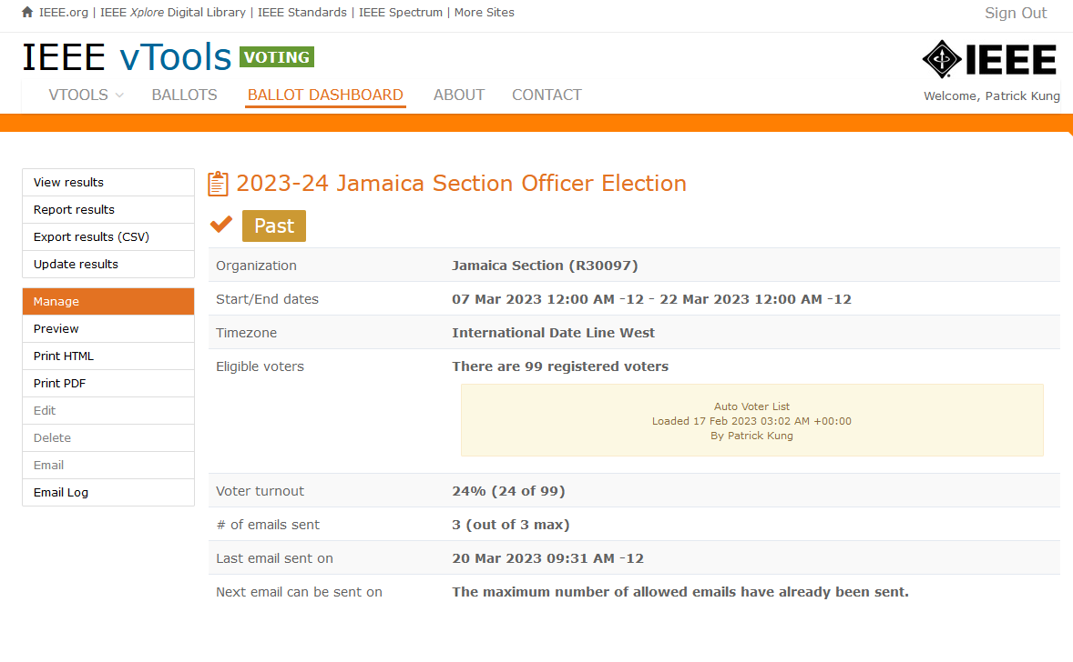
vTools Elections - Management

Slide 12
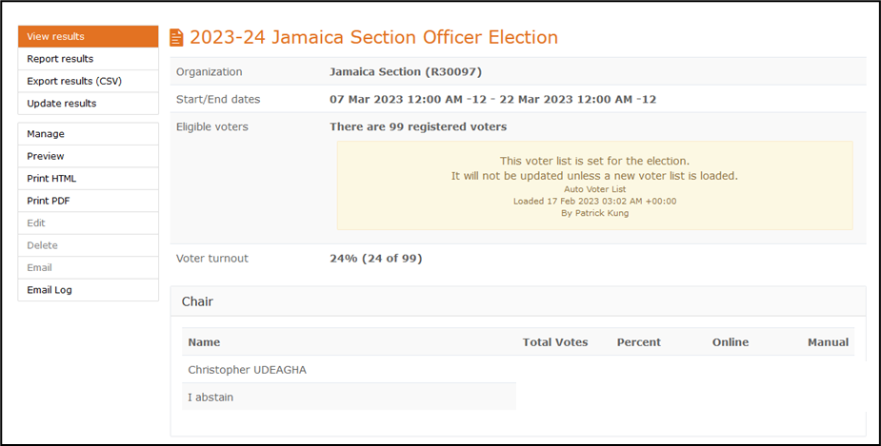
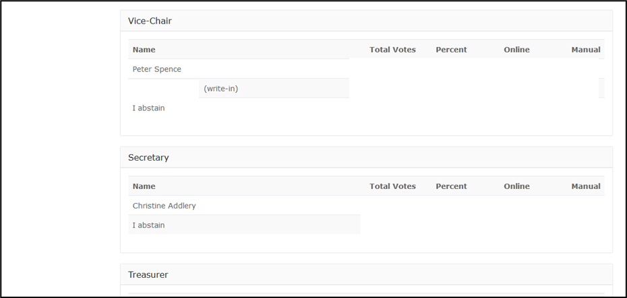
vTools Elections - Results

Slide 13
Success
Tellers Committee reports results to Section Chair
Section Chair informs each candidate of results
E-Notice of results to Section
Secretary reports to EEE (vTools)
Election begins

Slide 14
Additional Resources
vTools Elections: https://kb.ieee.org/vtools/blog/kbtopic/voting/
vTools Nominations: https://kb.ieee.org/vtools/blog/kbtopic/nominations/
MGA Operations Manual: https://mga.ieee.org/board-committees/operations-manual
Contact info: p.kung.us@ieee.org

